Slide 1
Any
Used with comparison operators to compare a value to any value in a list or subquery
Returns true if the condition applies to at least one value in the list.
SELECT EmployeeID, FirstName, Salary
FROM Employees
WHERE Salary > ANY (SELECT Salary FROM Interns);

Slide 2
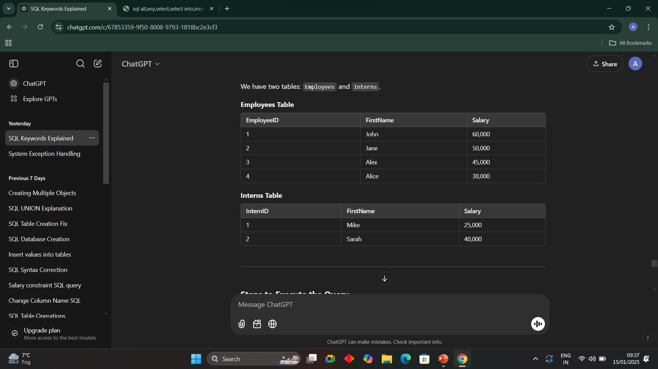
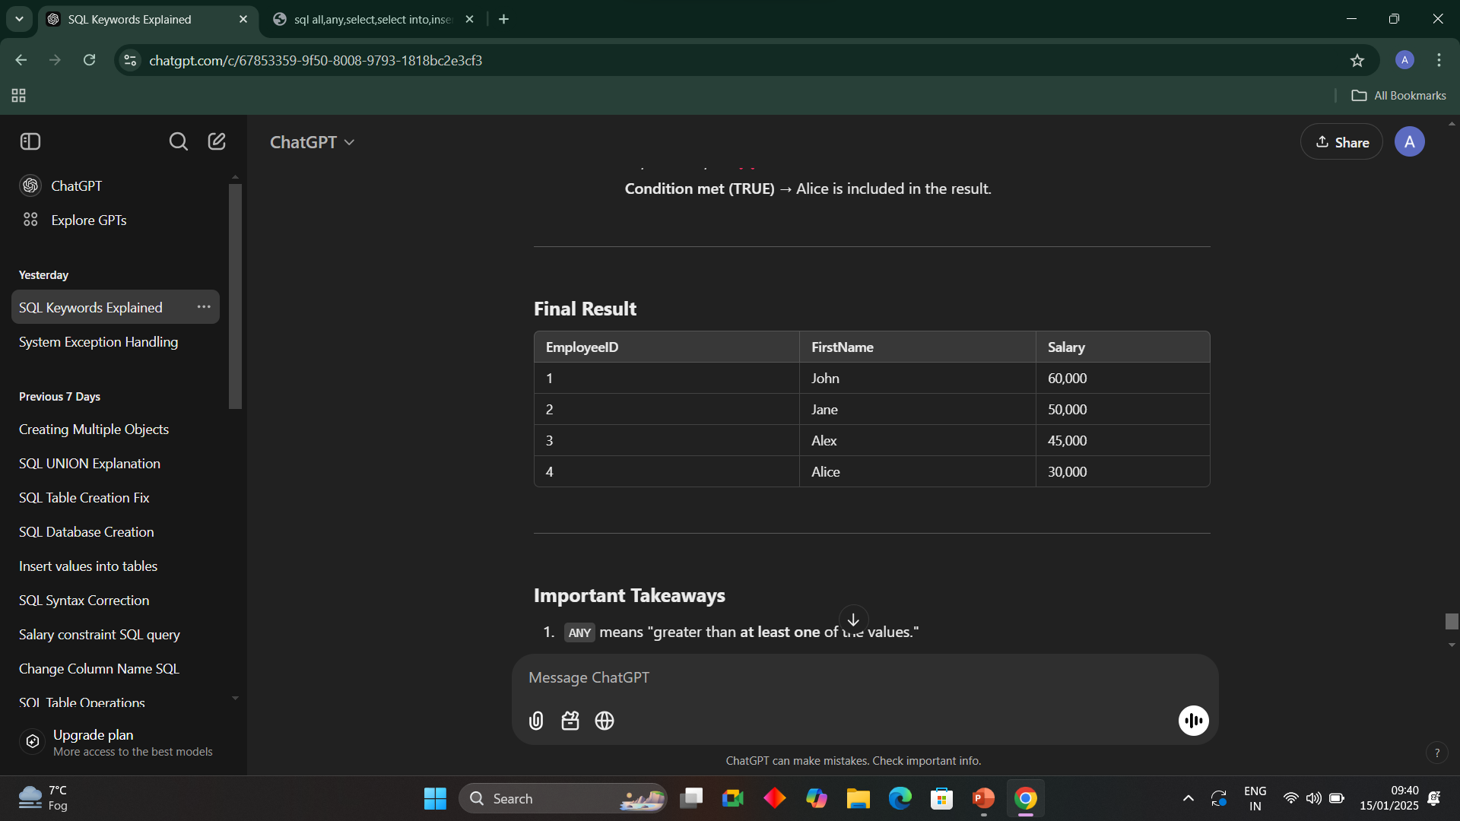

Slide 3
All
Used with comparison operators to compare a value
SELECT *
FROM Employees
WHERE Salary > ALL (SELECT Salary FROM Interns);
This query selects all employees whose salary is greater than the salaries of all interns.

Slide 4
Select into
Creates a new table and inserts data into it as part of the query
You cannot specify column names for the target table because the table is created dynamically.
SELECT * INTO BackupEmployees
FROM Employees
WHERE Department = 'HR’;
This creates a new table called BackupEmployees and copies all HR employees into it.

Slide 5
Insert into select
The INSERT INTO SELECT statement in SQL is used to copy data from one table (or query) into another table. It allows you to insert rows into a table based on the result of a SELECT query.
Requires the target table to exist before running the query
INSERT INTO target_table (column1, column2, ...)
SELECT column1, column2, ...
FROM source_table
WHERE condition; -- (Optional)

Slide 6
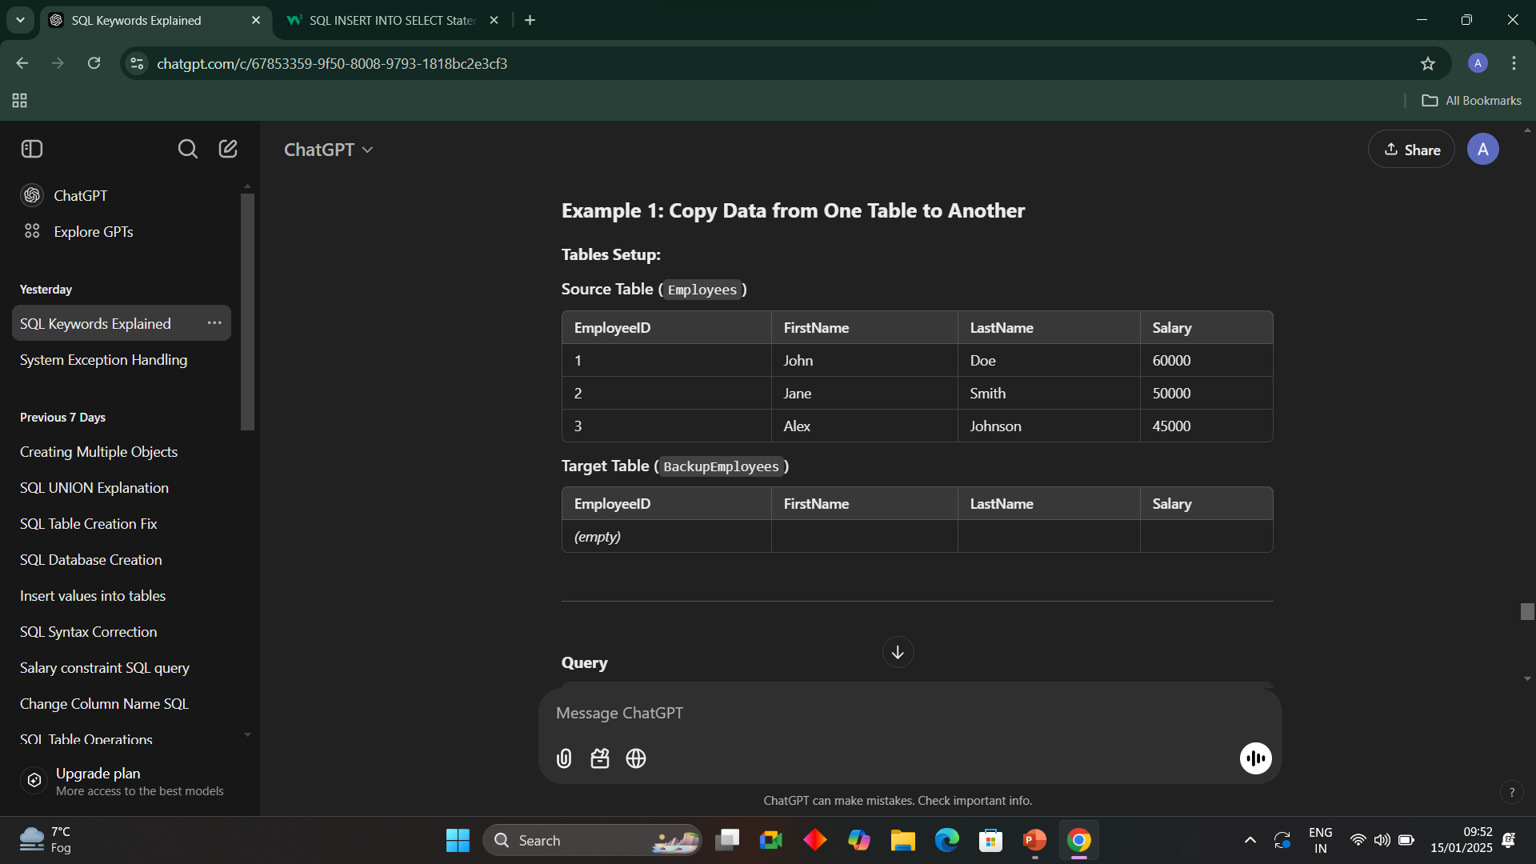
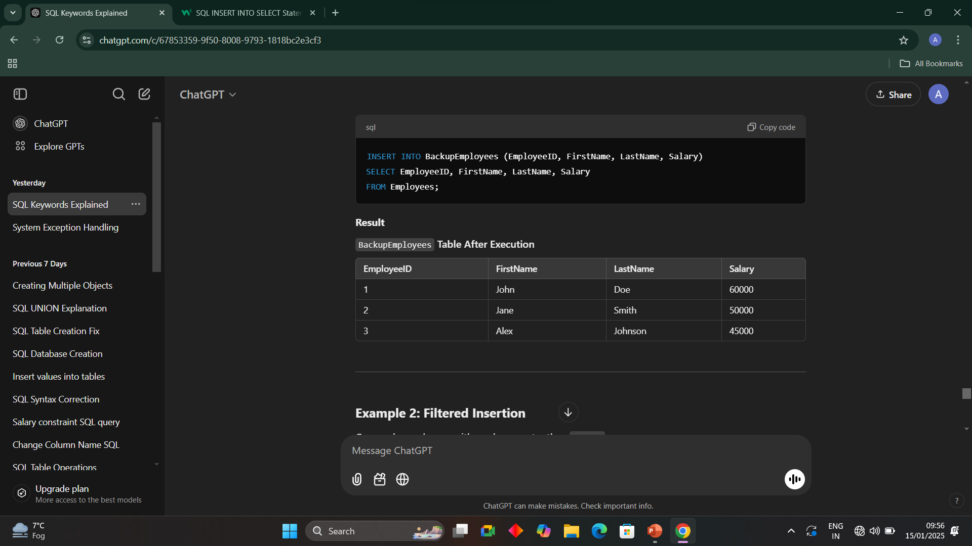
INSERT INTO BackupEmployees (EmployeeID, FirstName, LastName, Salary)
SELECT EmployeeID, FirstName, LastName, Salary
FROM Employees;

Slide 7
Case
The CASE expression goes through conditions and returns a value when the first condition is met (like an if-then-else statement). So, once a condition is true, it will stop reading and return the result. If no conditions are true, it returns the value in the ELSE clause.

Slide 8
SELECT
EmployeeID,
FirstName,
LastName,
CASE
WHEN Department = 'HR' THEN 'Human Resources'
WHEN Department = 'IT' THEN 'Information Technology' .
ELSE 'Other' -- For all other values of Department, return 'Other'.
END AS DepartmentName -- The transformed result is given the alias 'DepartmentName'.
FROM Employees;

Slide 9
