Slide 1

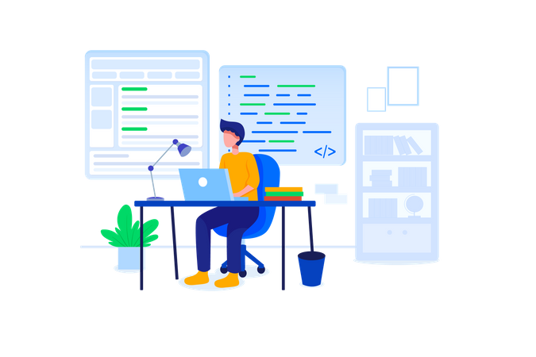

WORKSHOP
IN
MEAN STACK

Slide 2

What Is MEAN
MongoDB: A NoSQL database that stores data in a flexible,
Express.js: A web application framework for Node.js.
Angular: A JavaScript framework for building dynamic, single-page web applications
Node.js: A JavaScript runtime environment that allows developers to run JavaScript code server-side.

Slide 3

Objectives of MEAN
Used to create modern, real time, full-stack web applications using JavaScript
This unified technology stack promotes code reusability, simplifies development workflows
Can be deployed easily and are suitable for building highly scalable application

Slide 4
We are introducing
HTML
TYPESCRIPT
CSS
NODE JS
JAVASCRIPT
EXPRESS
BOOTSTRAP
MONGO DB
ANGULAR
DOCKER

Slide 5
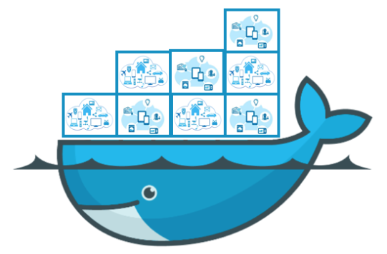
Docker
A platform used by developers to build, package, and deploy applications.
Simplifies the development process by enabling easy sharing and deployment of applications
Creates lightweight, self-contained containers that ensure consistency across different environments
Notes:
Containerization is the packaging of software code with just the operating system (OS) libraries and dependencies required to run the code to create a single lightweight executable—called a container—that runs consistently on any infrastructure

Slide 6

Expense Page
Add Expense:
Similar form-based interface for adding expense details.
Fields for title, amount, date, category, and description.
View Expense:
Display of all expense transactions with relevant details.
Option to delete transactions if needed

Slide 7
Income page
Add Income
Form-based interface for adding income details.
Fields for title, amount, date, category, and description
View Income
Display of all income transactions with relevant details.
Option to delete transactions if needed.

Slide 8
Dashboard page
Visual Representation:
Utilizes charts for a clear overview of transactions.
Charts dynamically updated based on user data.
Statistics:
Displays total income, total expense, and overall balance.
Real-time calculations ensure accurate information

Slide 9

User case diagram
Chart generation
Add income
View income
View total
income
Income
Delete income
View Balance
Expense
Add expense
View expense
View total expense
Delete expense
user

Slide 10
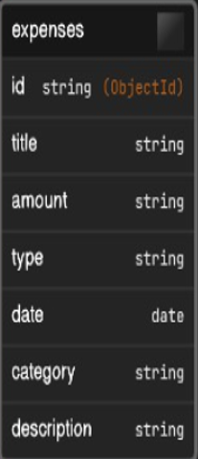
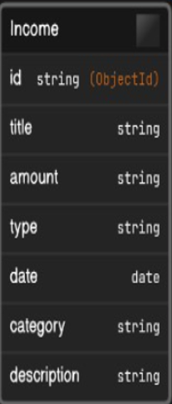
Domain Model

Slide 11
Components of Personal finance manager

Slide 12
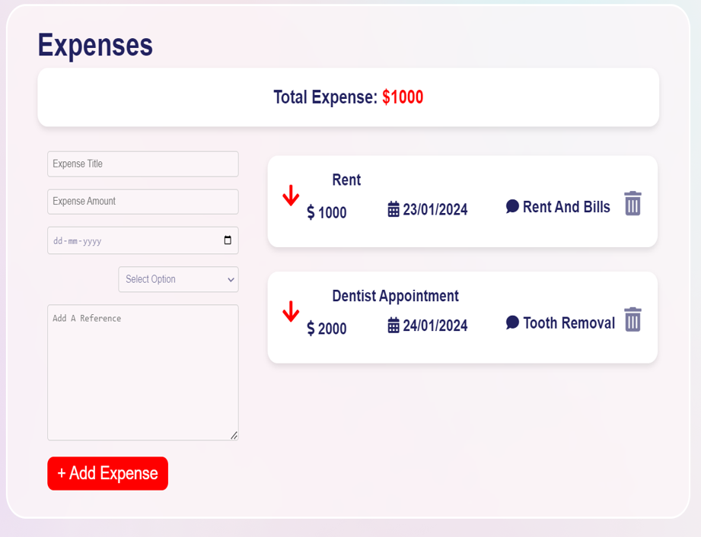
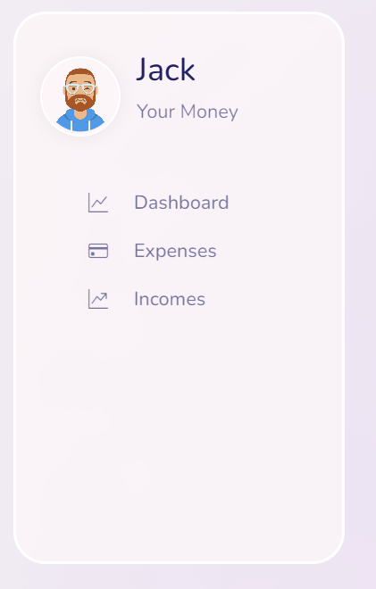
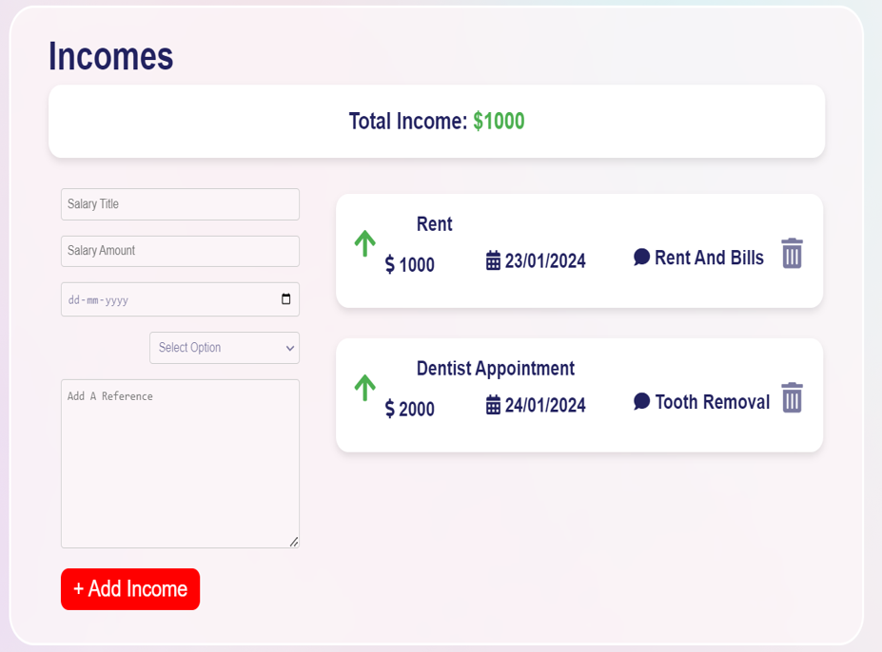
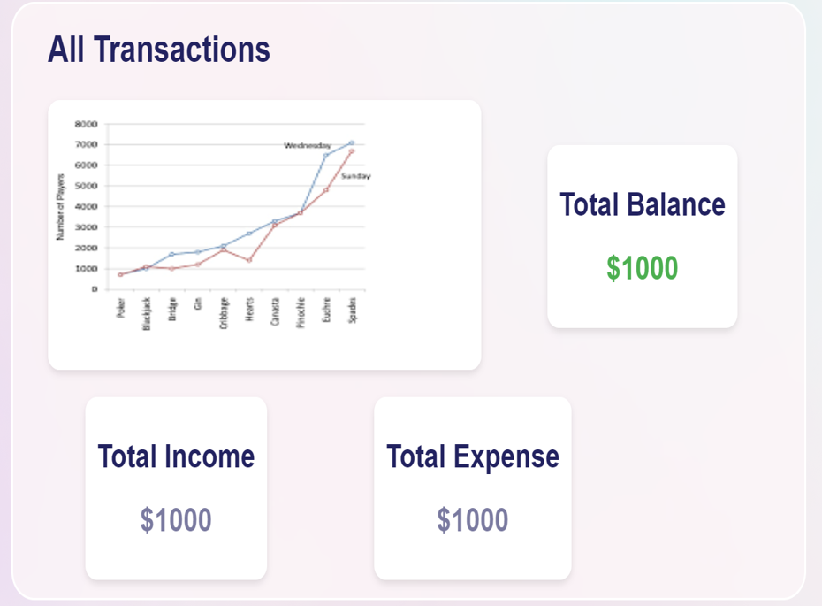
Personal Finance Manager

Slide 13
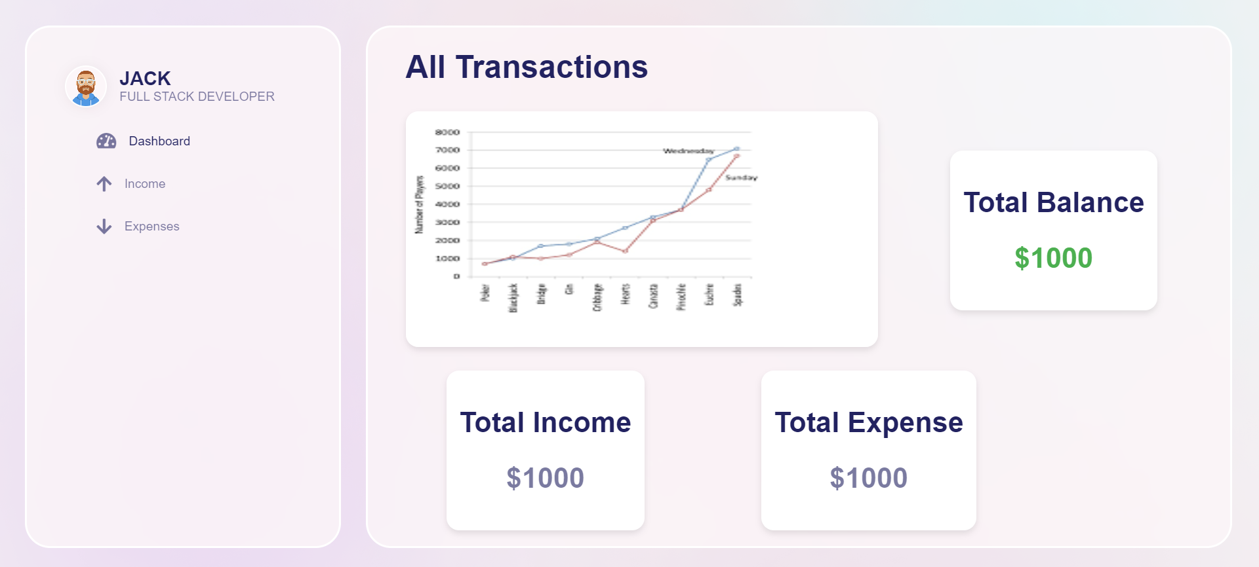
Dashboard page

Slide 14
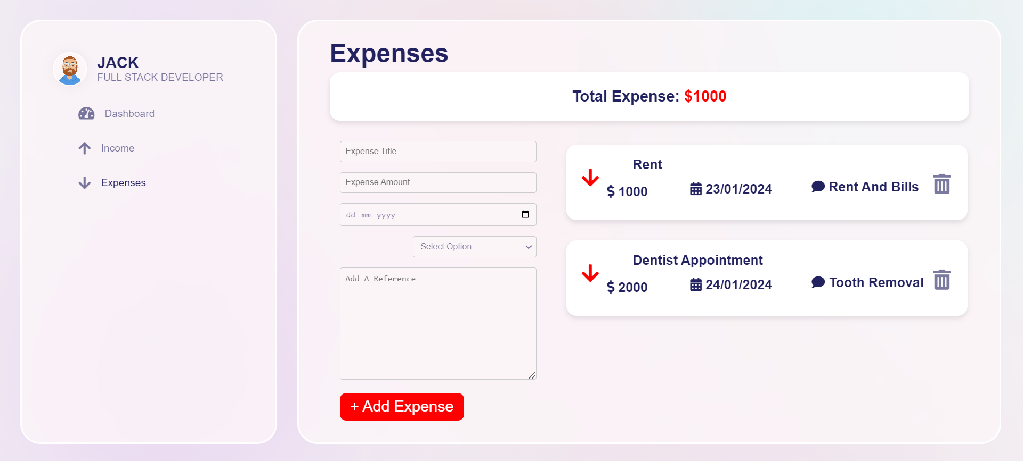
Expense page

Slide 15
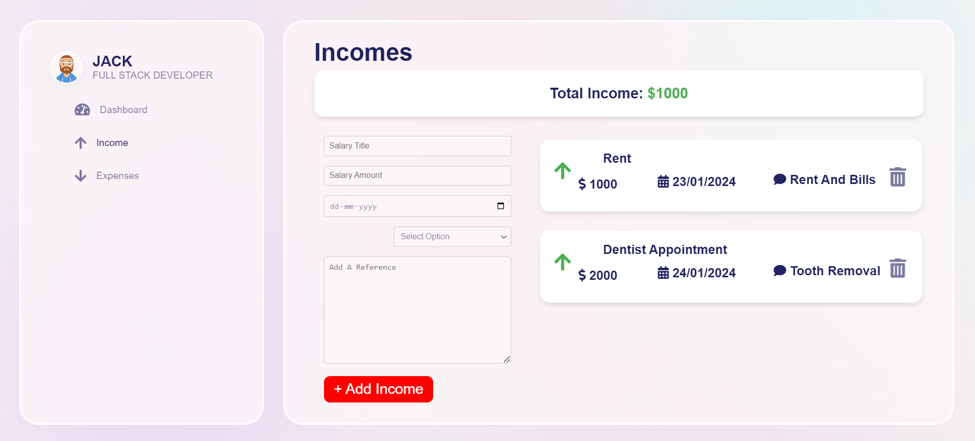
Income page

Slide 16
Thanks!!

