Slide 1

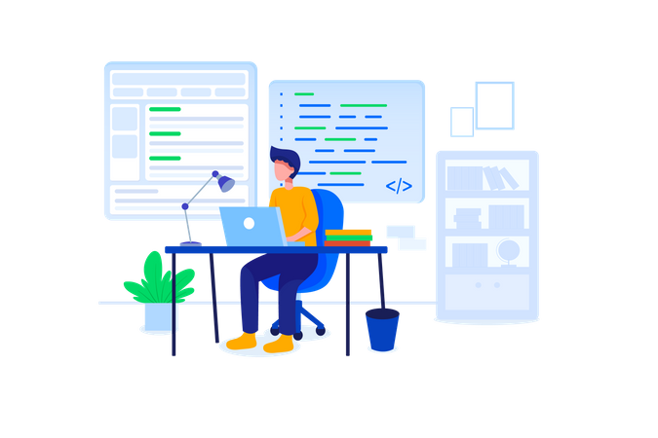

WORKSHOP
IN
MEAN STACK

Slide 3

We introduced
HTML
CSS
JAVASCRIPT
BOOTSTRAP
MEAN
CONTAINERIZATION

Slide 4


What is MEAN ?
M- MongoDB
E- Express.js
A- Angular
N- Node.js

Slide 5

CONTAINERIZATION
Containerization packages software code along with necessary operating system libraries and dependencies to form a light weight executable known as a container.
These containers ensure consistent execution of the code across any infrastructure
Notes:
Containerization is the packaging of software code with just the operating system (OS) libraries and dependencies required to run the code to create a single lightweight executable—called a container—that runs consistently on any infrastructure

Slide 6

Personal Finance Manager
All Transactions
Visual Representation:
Utilizes charts for a clear overview of transactions.
Charts dynamically updated based on user data.
Statistics:
Displays total income, total expense, and overall balance.
Real-time calculations ensure accurate information.

Slide 7
Income Management
Add Income
Form-based interface for adding income details.
Fields for title, amount, date, category, and description
View Income
Display of all income transactions with relevant details.
Option to delete transactions if needed.

Slide 8
Expense Management
Add Expense:
Similar form-based interface for adding expense details.
Fields for title, amount, date, category, and description.
View Expense:
Display of all expense transactions with relevant details.
Option to delete transactions if needed.

Slide 9

User case diagram
Chart generation
Add income
View income
View total
income
Income
Delete income
View Balance
Expense
Add expense
View expense
View total expense
Delete expense
user

Slide 10
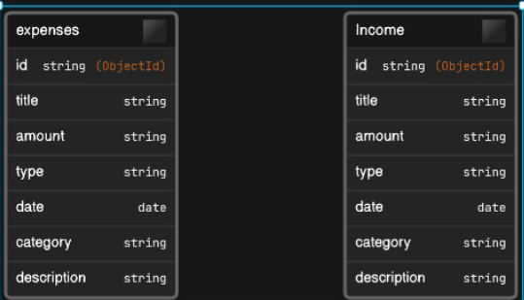
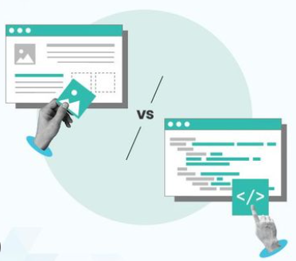
Domain Model

Slide 11
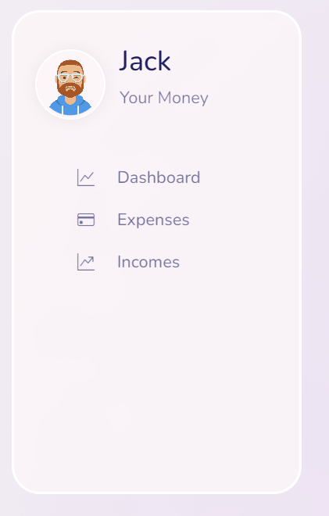
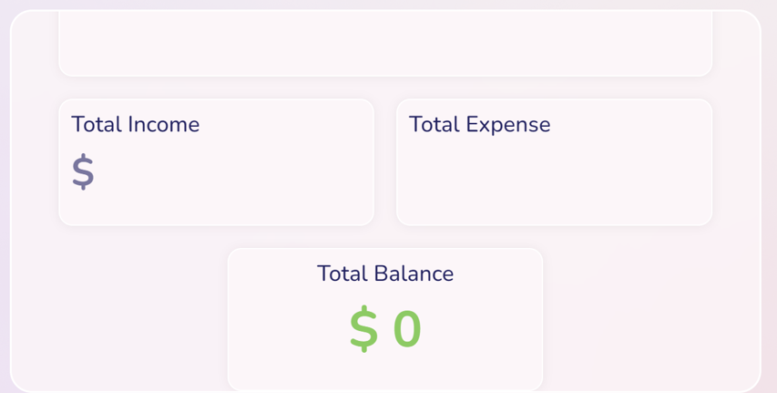
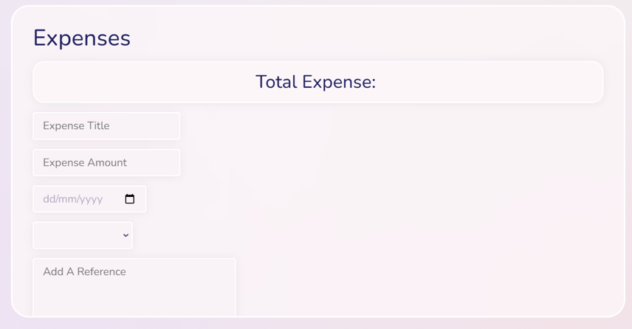
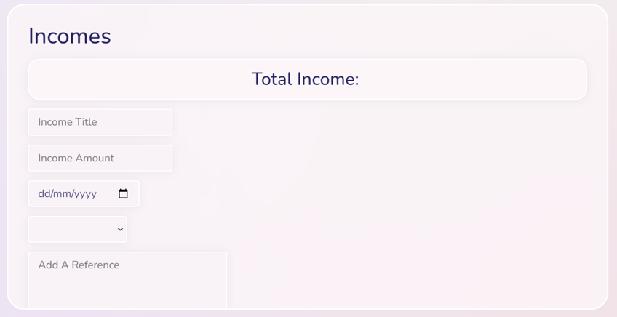
Personal Finance Manager

Slide 12
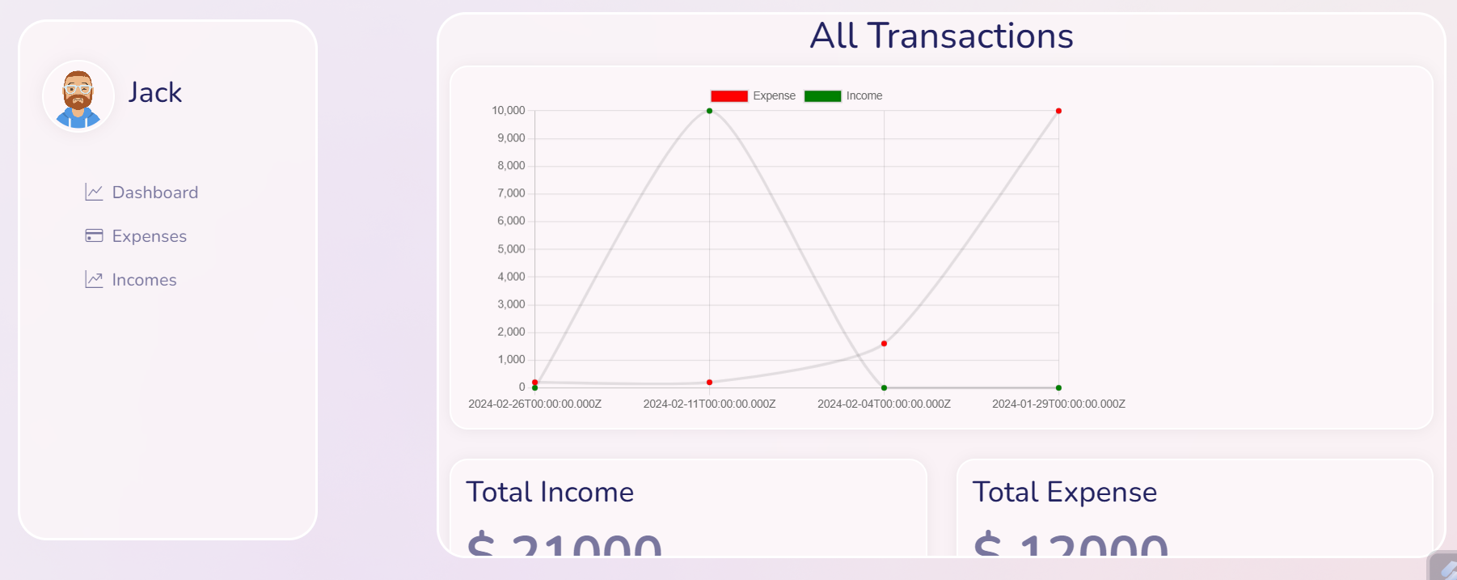
Dashboard

Slide 13
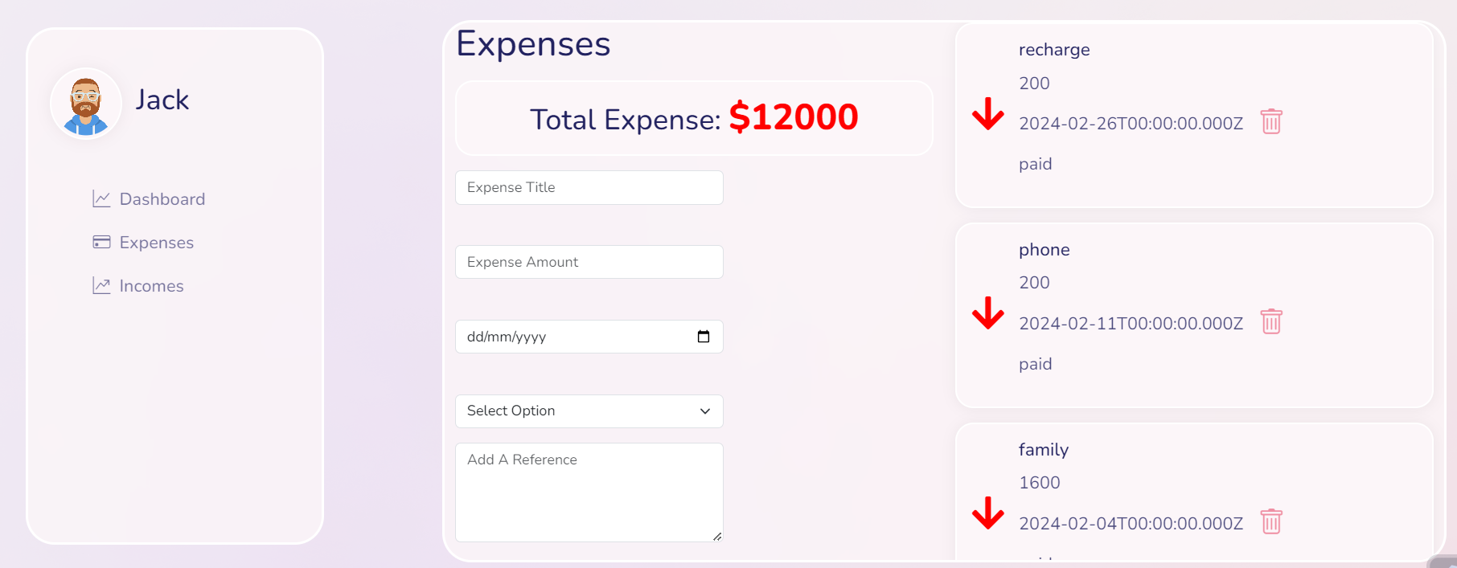
Expense

Slide 14
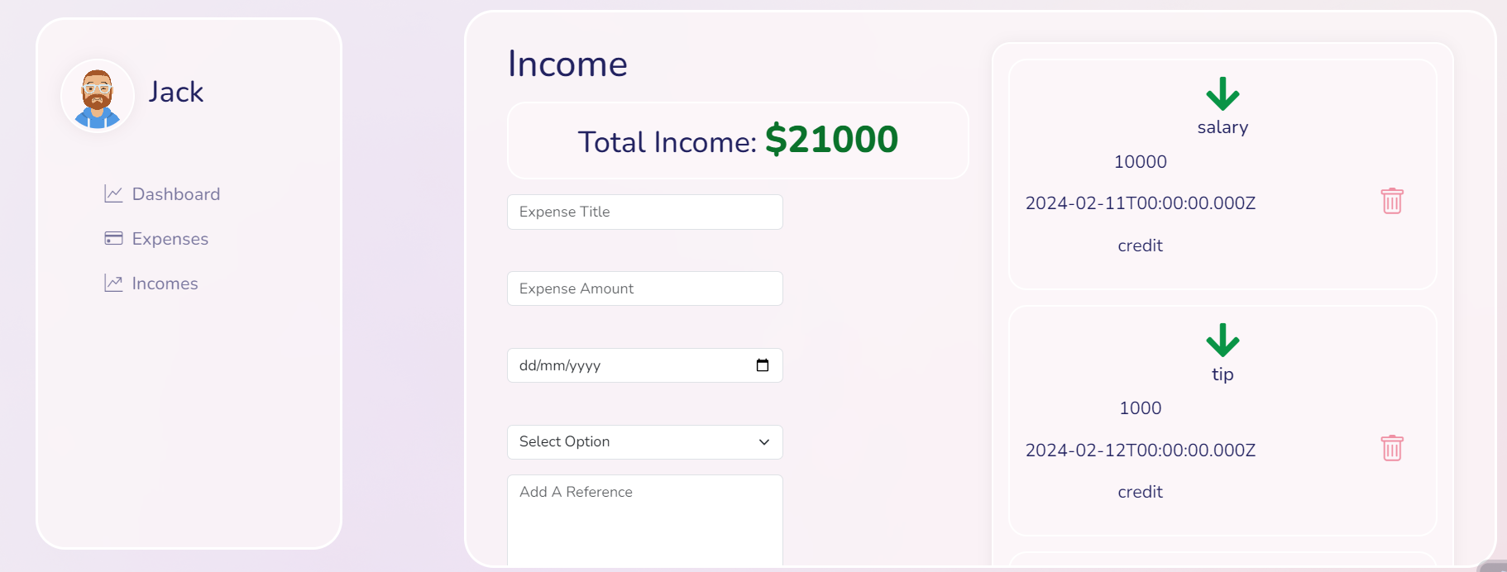
Income page

Slide 15
Thanks!!

