Slide 1



WORKSHOP
IN
MEAN STACK

Slide 2

Introduction to MEAN Stack
MongoDB: A NoSQL database that stores data in a flexible,
Express.js: A web application framework for Node.js.
Angular: A JavaScript framework for building dynamic, single-page web applications
Node.js: A JavaScript runtime environment that allows developers to run JavaScript code server-side.

Slide 3

Objectives of MEAN
Used to create modern, real time, full-stack web applications using JavaScript
This unified technology stack promotes code reusability, simplifies development workflows
Can be deployed easily and are suitable for building highly scalable application

Slide 4

Workshop Objectives
Familiarization Objective
Hands-On Experience
Understanding Ecosystem
Containerization Overview
Practical Exposure
No In-Depth Learning
Preparation for Further Learning
Notes:
Familiarisation Objective: Introduce participants to the basic concepts of the MEAN stack and Docker.
Hands-On Experience: Provide opportunities for hands-on exploration and experimentation.
Understanding Ecosystem: Gain familiarity with the components and interactions within the MEAN stack.
Containerization Overview: Offer an overview of Docker and its role in modern web development.
Practical Exposure: Focus on practical exercises to give participants a feel for working with MEAN and Docker.
No In-Depth Learning: Clarify that the workshop is not designed for in-depth learning but rather for getting acquainted with the technologies.
Preparation for Further Learning: Lay the groundwork for participants to pursue further learning on their own after the workshop.

Slide 5
Workshop Agenda
HTML
TYPESCRIPT
CSS
NODE JS
JAVASCRIPT
EXPRESS
BOOTSTRAP
MONGO DB
ANGULAR
DOCKER

Slide 6

Personal Finance Manager
Product Introduction

Slide 7

Expense Page
Add Expense:
Similar form-based interface for adding expense details.
Fields for title, amount, date, category, and description.
View Expense:
Display of all expense transactions with relevant details.
Option to delete transactions if needed

Slide 8
Income page
Add Income
Form-based interface for adding income details.
Fields for title, amount, date, category, and description
View Income
Display of all income transactions with relevant details.
Option to delete transactions if needed.

Slide 9
Dashboard page
Visual Representation:
Utilizes charts for a clear overview of transactions.
Charts dynamically updated based on user data.
Statistics:
Displays total income, total expense, and overall balance.
Real-time calculations ensure accurate information

Slide 10
Personal Finance Manager
Architecture and Design

Slide 11
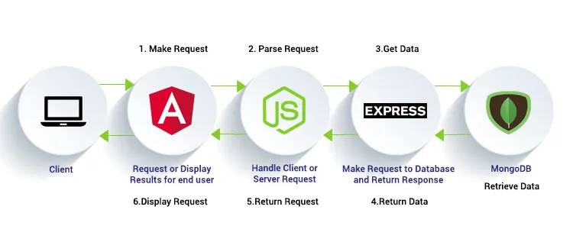
MEAN Stack Architecture

Slide 12

User case diagram
Chart generation
Add income
View income
View total
income
Income
Delete income
View Balance
Expense
Add expense
View expense
View total expense
Delete expense
user

Slide 13
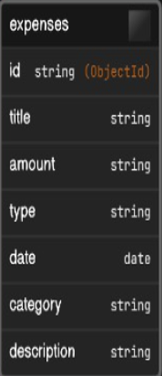
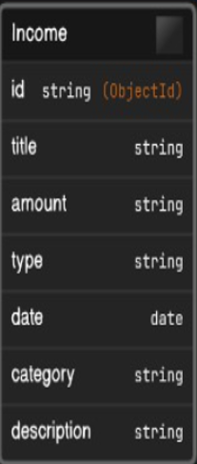
Domain Model

Slide 14
Components of Personal Finance Manager

Slide 15
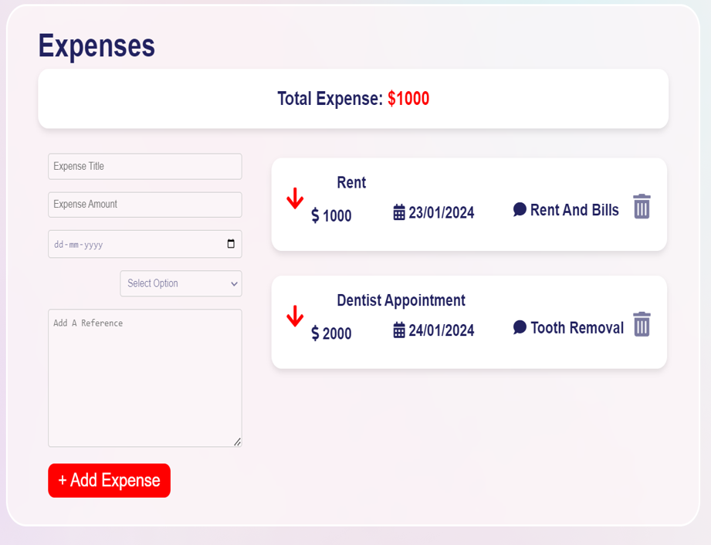
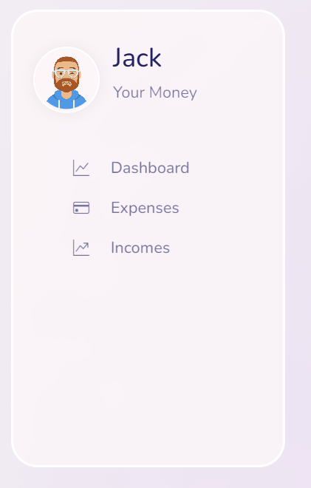
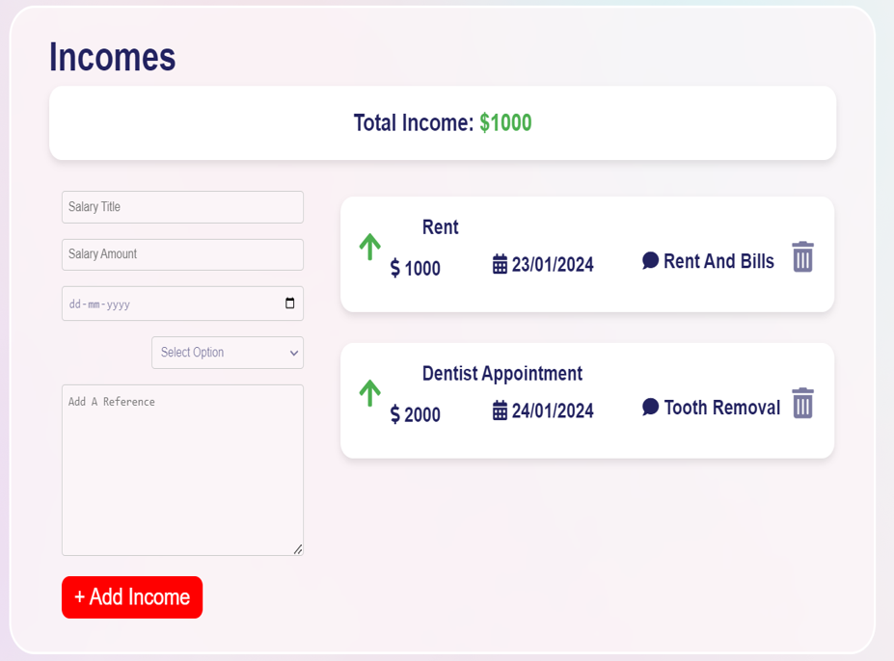
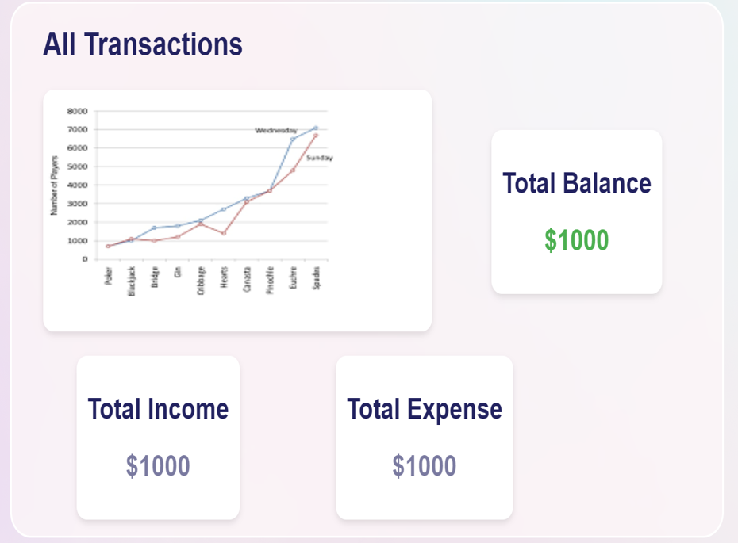
Personal Finance Manager

Slide 16
Thanks!!

