Slide 1




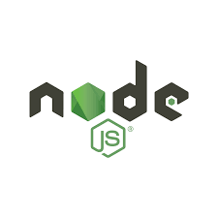
Introduction to Node JS

Slide 2
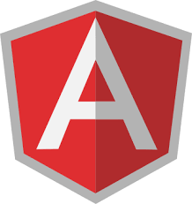


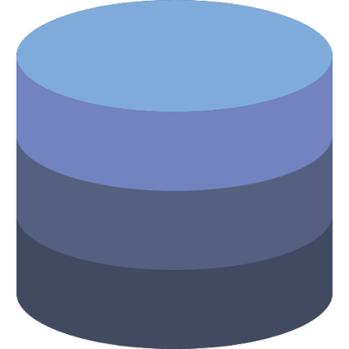


What is Node JS ?
Client
Server
Database
Notes:
In the world of web development, we often encounter the concept of a client-server architecture, where the client sends requests to the server, and the server responds with the requested information. Additionally, data is often stored in a database that the server accesses to fulfill the client's requests.
When it comes to building web applications, developers often use different technologies for the front-end and the back-end. On the front-end side, we have popular frameworks like React and Angular that allow developers to build dynamic and interactive user interfaces. On the other hand, on the back-end side, we have Node.js, a powerful and versatile JavaScript runtime that allows developers to run JavaScript on the server-side.
In this presentation, we will explore the benefits of using Node.js for building server-side applications, its architecture, and the many packages available through the Node Package Manager. We will also look at some examples of how Node.js is used in the real world and highlight some of the popular companies that use Node.js.

Slide 3
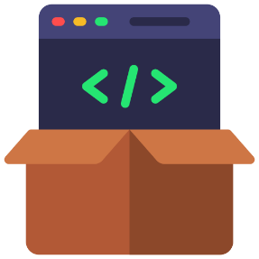
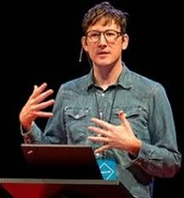

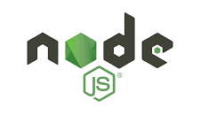
Created by Ryan Dahl in 2009
Provides a non-blocking I/O model and event-driven architecture, making it ideal for building real-time, data-intensive applications
Simplifies the development process by using a single language (JavaScript) for both client-side and server-side development
Used by many large companies, including Netflix, LinkedIn, and PayPal, to build scalable and high-performance applications
Open Source
What is Node JS ?
Cross Platform
V8 Engine
Notes:
An open-source, cross-platform JavaScript runtime built on the V8 engine
Created by Ryan Dahl in 2009
Provides a non-blocking I/O model and event-driven architecture, making it ideal for building real-time, data-intensive applications
Simplifies the development process by using a single language (JavaScript) for both client-side and server-side development
Can be used to build a wide range of applications, including web applications, desktop apps, command-line tools, and more
Used by many large companies, including Netflix, LinkedIn, and PayPal, to build scalable and high-performance applications

Slide 4
Node Js
Express js

Slide 5

What is express
Express is a Node.js framework designed for building APIs, web applications and cross platform mobile apps
Express is high performance, fast, unopinionated, and lightweight
It is used as a server-side scripting language

Slide 6
Features of express
Fast server side development
With the help of the node js features express can save a lot of time
Middleware
It is a request handler , which have the access to the applications request-response cycle
Routing
Refers to how an applications endpoints (URIs) respond to client requests.

Slide 7

Templating
Creates a html template file with less code and render HTML pages
Debugging
Express makes it easier as it identifiers the exact part where bugs are

Slide 8

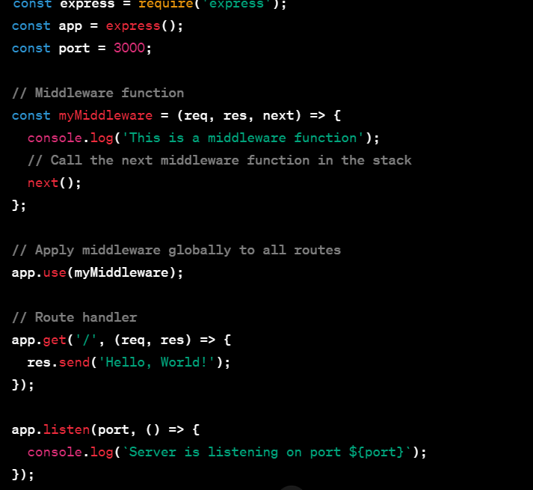


Slide 9
Thanks!!

