Slide 1
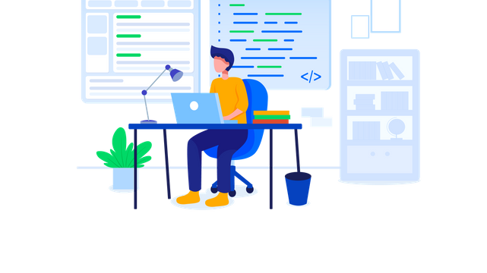

MEAN STACK
Workshop Introduction

Slide 2

Workshop Objectives
Familiarization Objective
Hands-On Experience
Understanding Ecosystem
Containerization Overview
Practical Exposure
No In-Depth Learning
Preparation for Further Learning
Notes:
Familiarisation Objective: Introduce participants to the basic concepts of the MEAN stack and Docker.
Hands-On Experience: Provide opportunities for hands-on exploration and experimentation.
Understanding Ecosystem: Gain familiarity with the components and interactions within the MEAN stack.
Containerization Overview: Offer an overview of Docker and its role in modern web development.
Practical Exposure: Focus on practical exercises to give participants a feel for working with MEAN and Docker.
No In-Depth Learning: Clarify that the workshop is not designed for in-depth learning but rather for getting acquainted with the technologies.
Preparation for Further Learning: Lay the groundwork for participants to pursue further learning on their own after the workshop.

Slide 3
Getting to Know
UI / UX
Bootstrap
Use case diagram
Angular
Domain Model
TypeScript
Mean stack architecture
Node JS
HTML
Express
CSS
MONGO DB
JavaScript
DOCKER

Slide 4

Personal Finance Manager
Product Introduction

Slide 5

Expense Page
Add Expense:
Similar form-based interface for adding expense details.
Fields for title, amount, date, category, and description.
View Expense:
Display of all expense transactions with relevant details.
Option to delete transactions if needed

Slide 6
Income page
Add Income
Form-based interface for adding income details.
Fields for title, amount, date, category, and description
View Income
Display of all income transactions with relevant details.
Option to delete transactions if needed.

Slide 7
Dashboard page
Visual Representation:
Utilizes charts for a clear overview of transactions.
Charts dynamically updated based on user data.
Statistics:
Displays total income, total expense, and overall balance.
Real-time calculations ensure accurate information

Slide 8
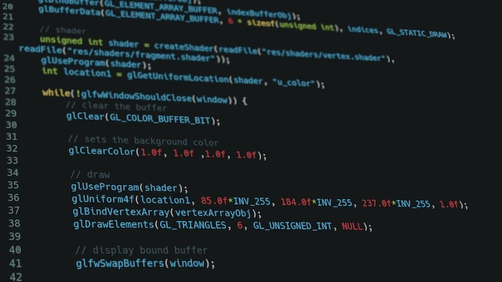
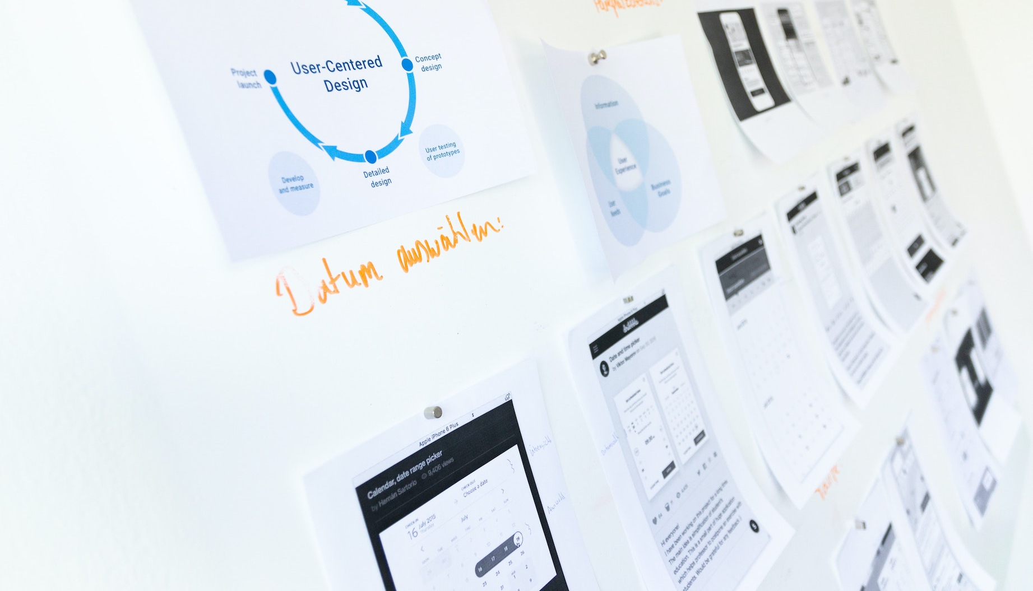

How to solve this problem?
UI/UX Designing
Front-end development – Client-side Technologies
Backend development - Server side Technologies
Web API Design
Deployment & Cloud Infrastructre (Azure)
Software Engineering Practices – All of SDLC, DDD, Architecture & System Design
Software Engineering Tools (Git, Github, VS Code, UML, Figma,..)

Slide 9

Introduction to MEAN Stack
MongoDB: A NoSQL database that stores data in a flexible,
Express.js: A web application framework for Node.js.
Angular: A JavaScript framework for building dynamic, single-page web applications
Node.js: A JavaScript runtime environment that allows developers to run JavaScript code server-side.

Slide 10

Objectives of MEAN
Used to create modern, real time, full-stack web applications using JavaScript
This unified technology stack promotes code reusability, simplifies development workflows
Can be deployed easily and are suitable for building highly scalable application

Slide 11

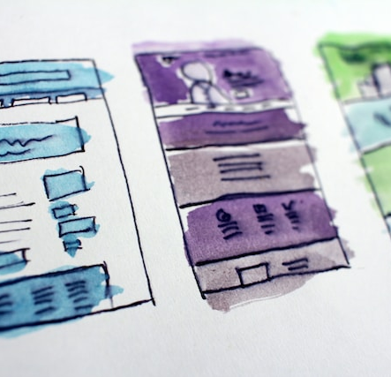
UI/UX Designing
Creating low-fidelity wireframes using Figma
Creating high-fidelity mockups using Figma

Slide 12

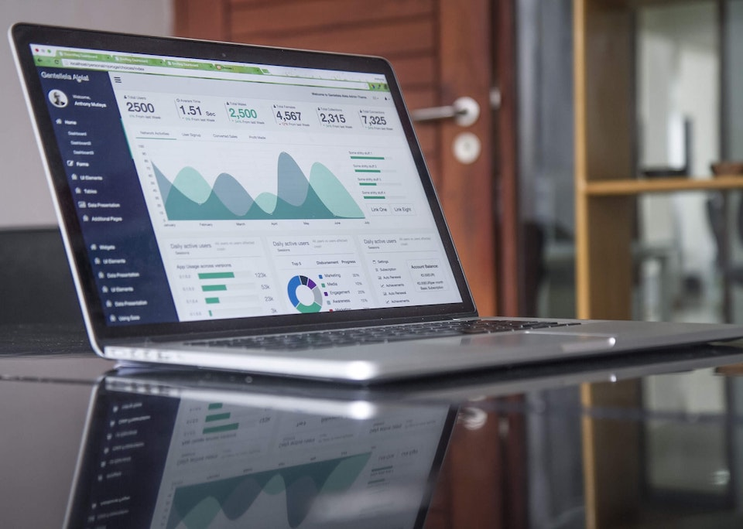
Front-end Web Development
Building professional grade web applications using HTML, CSS and JavaScript.
Developing responsive and mobile-first front-end applications using Bootstrap.
Developing scalable, high performance Single Page Applications (SPA) using Angular and TypeScript.

Slide 13

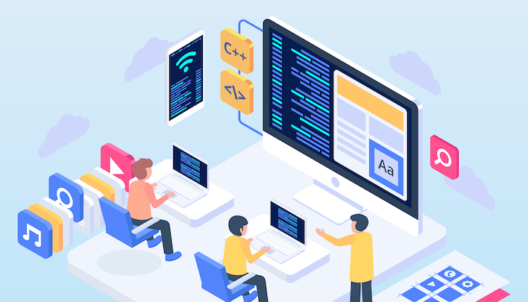
Back-end Development using NodeJS
Explore the principles of event-driven, non-blocking I/O programming with Node.js.
Functional Programming using NodeJS Programming Language.
Building modern, high-performance, cloud native, Internet-connected apps using NodeJS.
Building enterprise Web APIs based on microservice architecture using NodeJS.
Build flexible Node.js web application framework that provides a robust set of features for web and mobile applications using Express

Slide 14
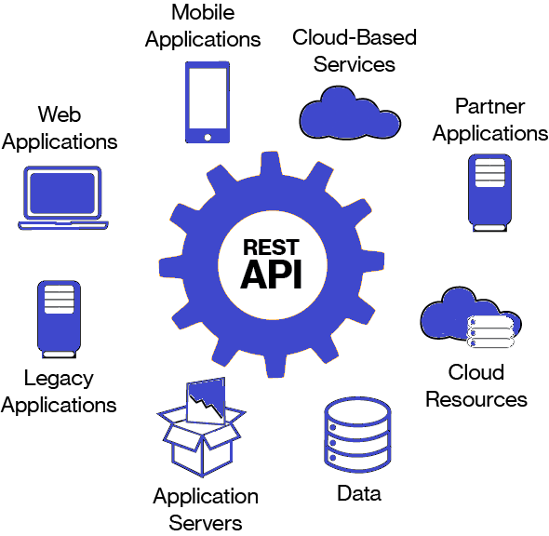

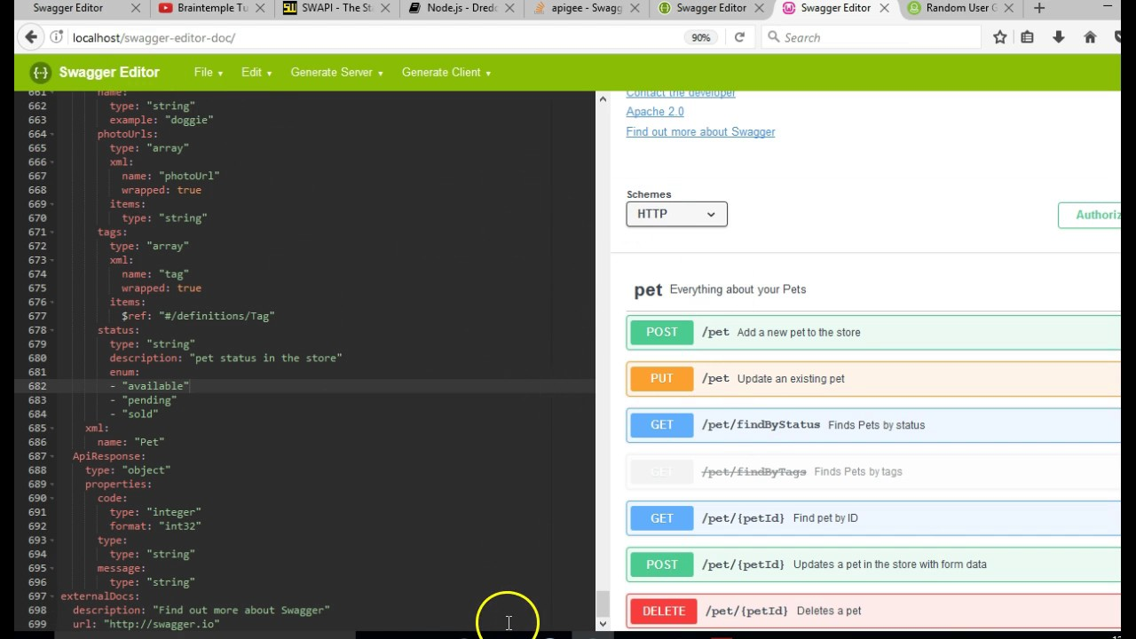
Web API Designing using Open API & Swagger
Designing API Schema using Swagger & Open API
Data contract between the front-end and back-end teams
Facilitates Front-end development even before the backend development
API Testing using Postman and Swagger Inspector

Slide 15
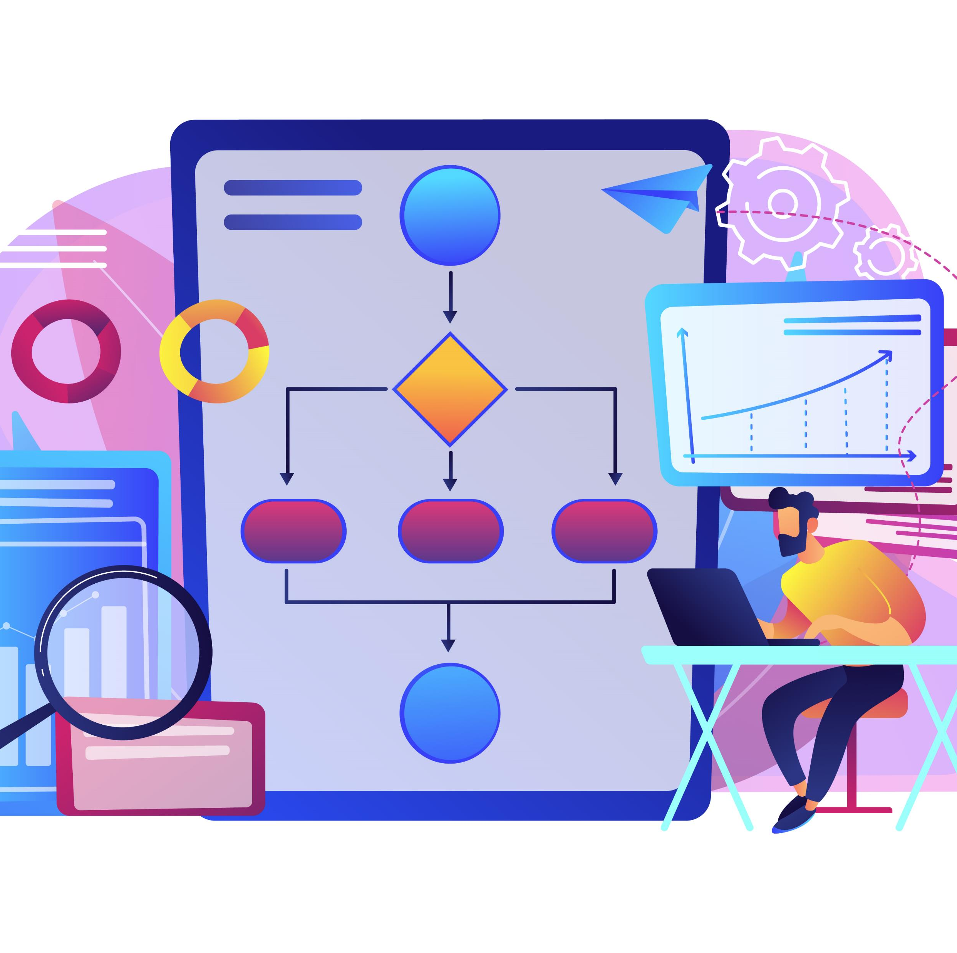
Personal Finance Manager
Architecture and Design

Slide 16
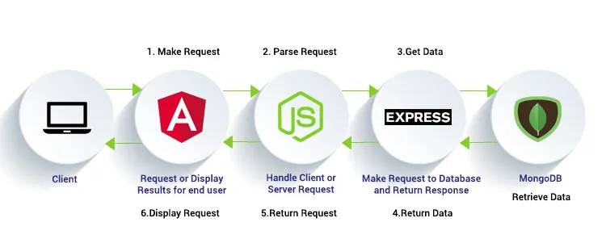
MEAN Stack Architecture

Slide 17

User case diagram
Chart generation
Add income
View income
View total
income
Income
Delete income
View Balance
Expense
Add expense
View expense
View total expense
Delete expense

Slide 18
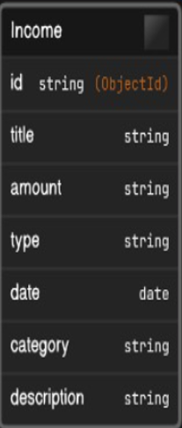
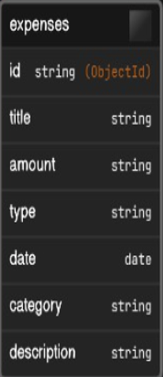
Domain Model

Slide 19
Components of Personal Finance Manager

Slide 20
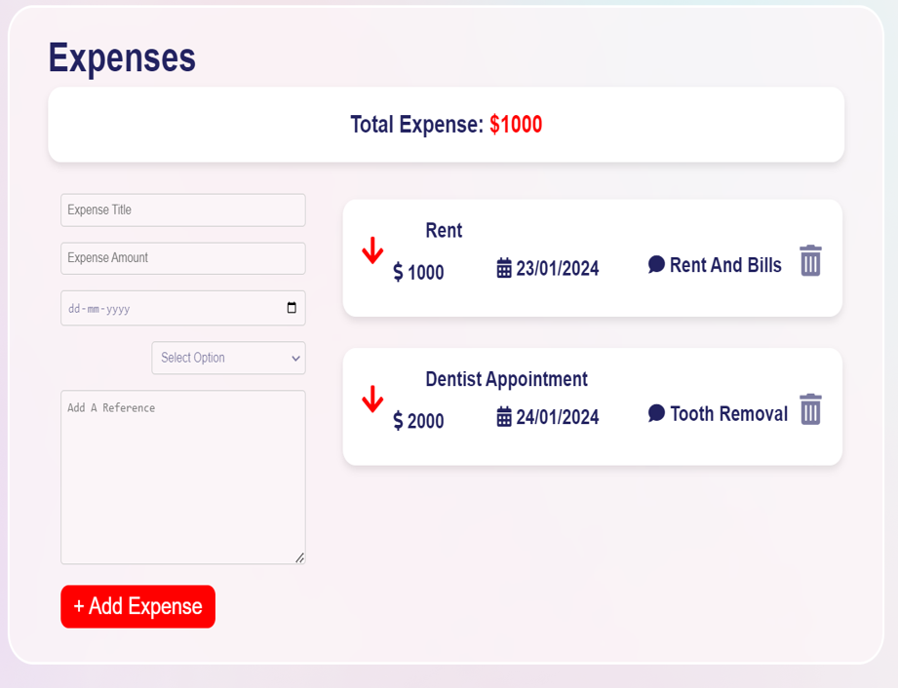
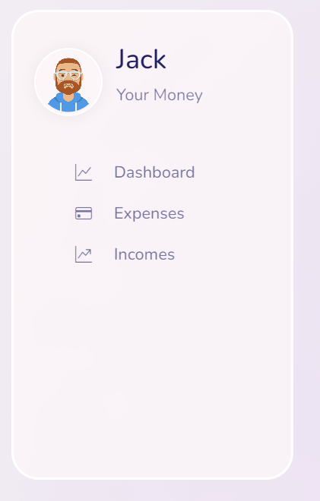
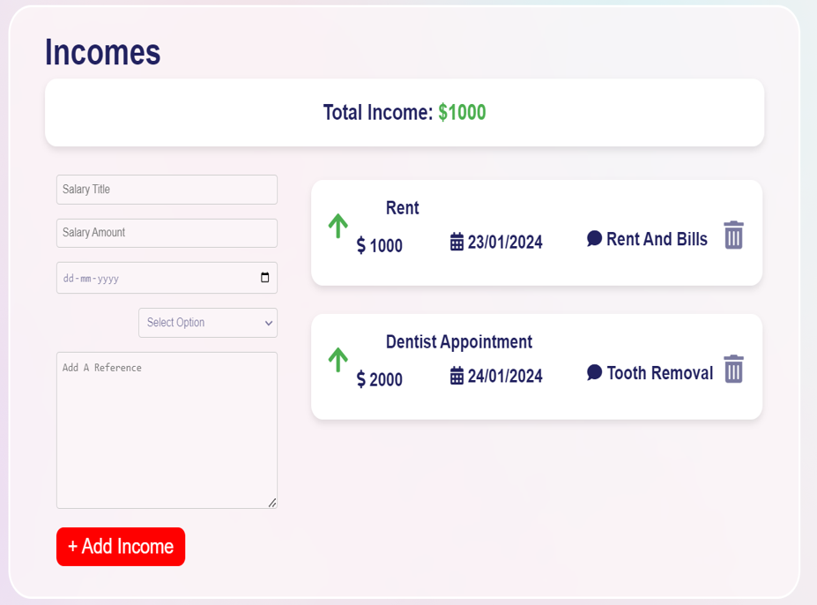
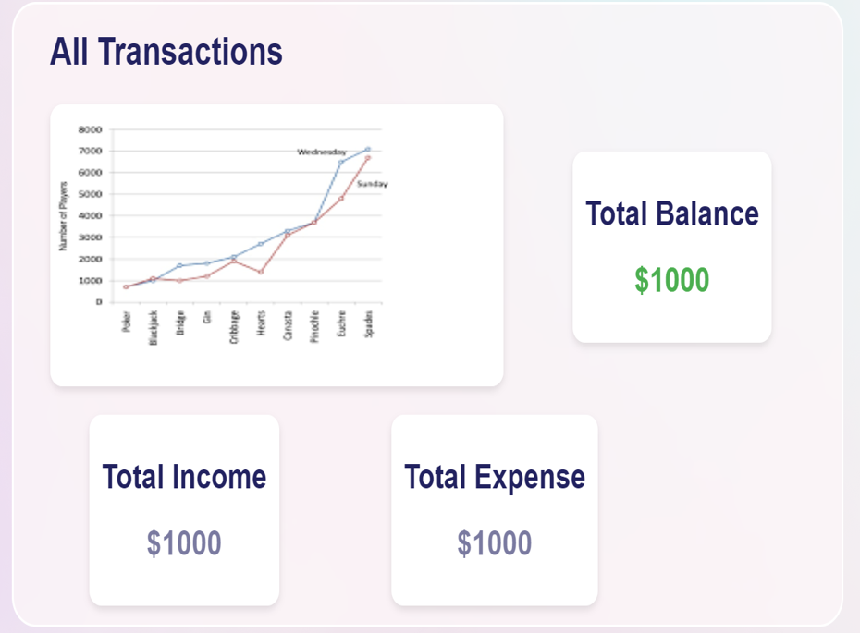
Personal Finance Manager

Slide 21
Thanks!!

