Slide 1
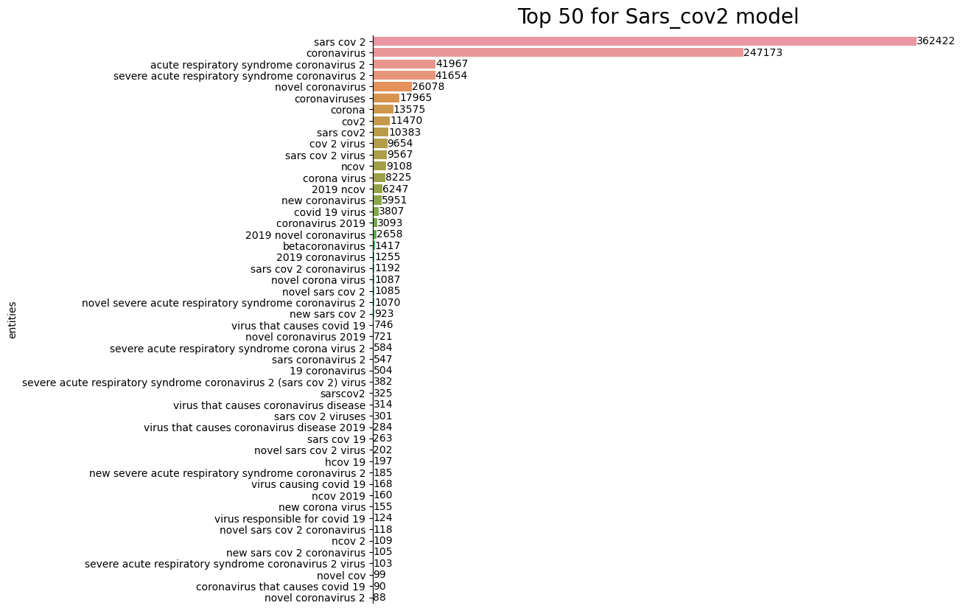
A
B

Slide 2
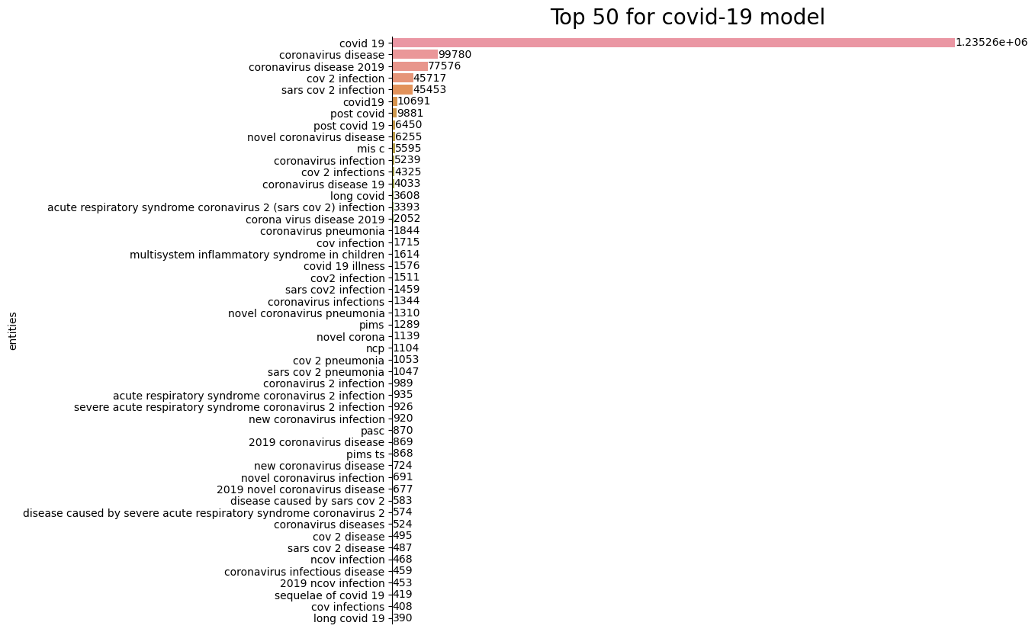
B
Figure 1 -Most frequent terms from the SARS-CoV-2 virus and COVID-19 disease dictionaries in abstracts from the CORD-19 dataset. All text was changed to lowercase and hyphens were removed prior to detecting terms using EasyNER, resulting in grouping of all terms that differ only in these aspects. A) Counts for 50 most frequent virus terms. B) Counts for disease terms. Full results, including all terms with total and per document counts.

Slide 3
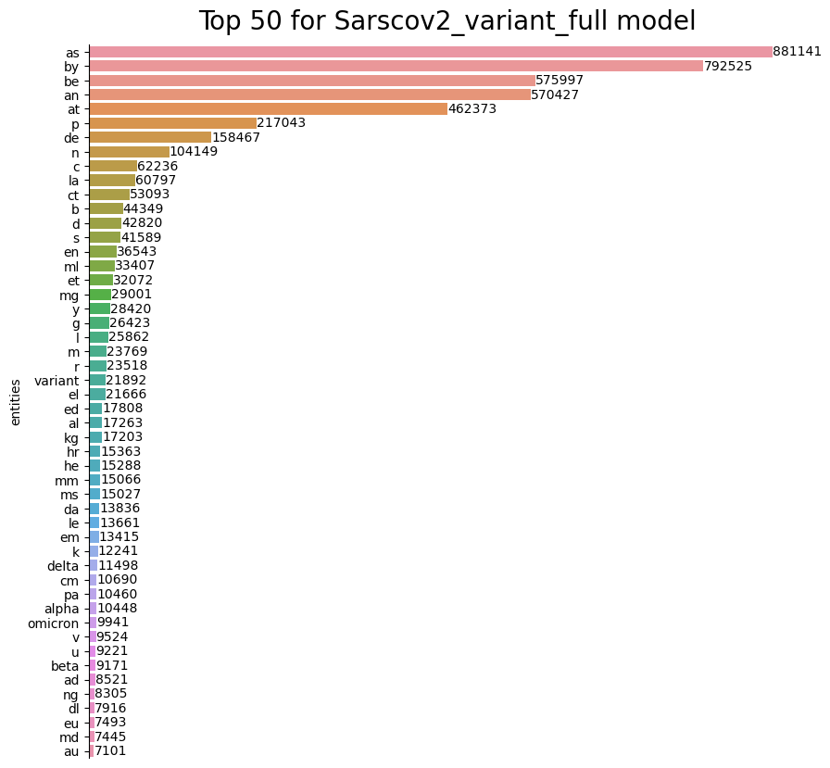
A

Slide 4
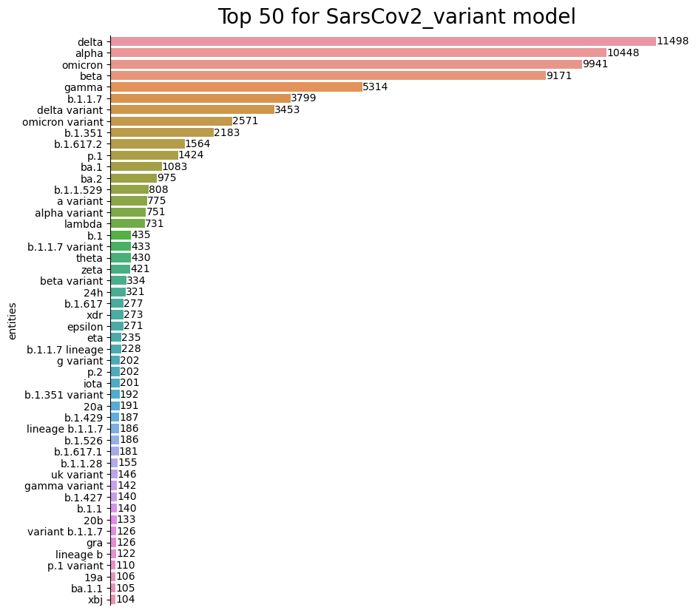
B
Figure 2- Most frequent terms from the SARS-CoV-2 variant dictionary in abstracts from the CORD-19 dataset. All text was changed to lowercase and hyphens were removed prior to detecting terms using EasyNER, resulting in grouping of all terms that differ only in these aspects. A) Counts for the full dictionary. B) Counts after removal of terms with less than 3 characters. Full results, including all terms with total and per document counts.

Slide 5
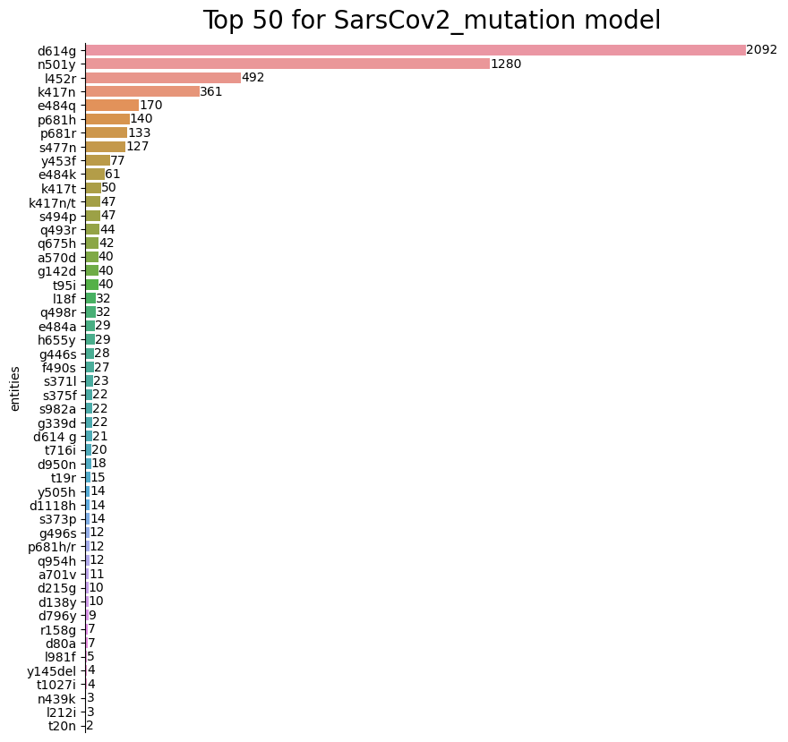
Figure 3. Most frequent terms from the SARS-CoV-2 mutation dictionary in abstracts from the CORD-19 dataset. All text was changed to lowercase and hyphens were removed prior to detecting terms using EasyNER, resulting in grouping of all terms that differ only in these aspects. Full results, including all terms with total and per document counts, in Supplemental file 10

