Slide 1
RapidReview
An easy customizable webtool for finding COVID-19 scientific evidence
for
health care staff, policy makers, scientists and everybody else

Slide 2


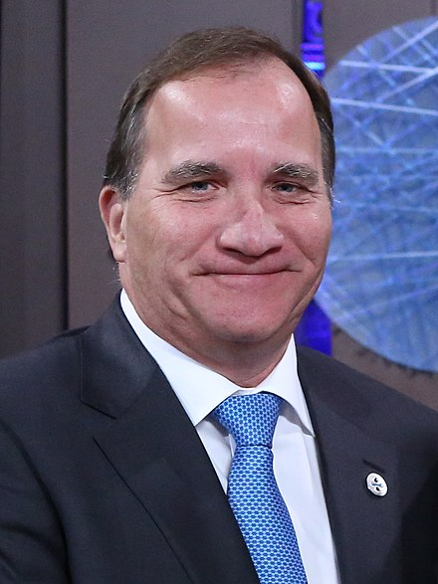
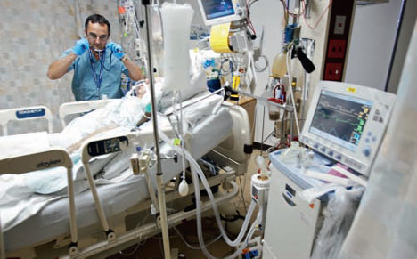
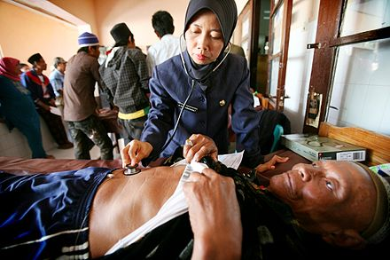
Many people are in need of scientific evidence to inform their essential work

Slide 3
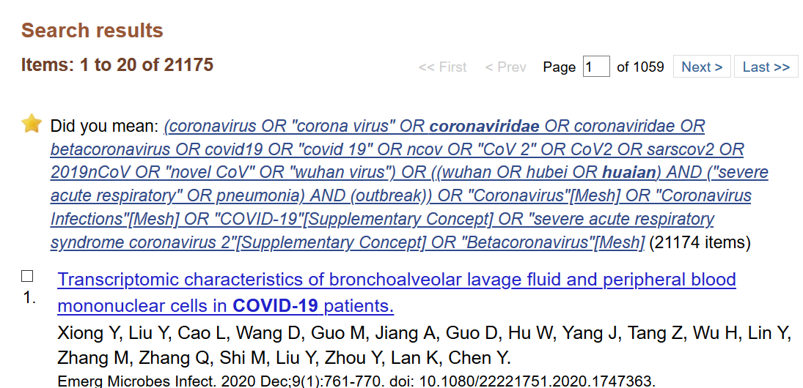
We already know much about coronaviruses but it is buried in mountains of scientific literature
And more every day

Slide 4
Manual review and summarization by experts is too slow!
Scientists and non-experts need to find information in
scientific literature themselves
(but correct search queries are difficult)
RapidReview automatically finds and displays key scientific findings
for different target audiences
(and is easy to use)

Slide 5
RapidReview finds and annotates scientific evidence related to COVID-19
Scientific literature from several sources (CORD-19, Pubmed, etc)
Premade or
custom dictionaries
Dictionary
annotation pipeline
Rule
annotation pipeline
Scispacy
annotation pipeline
BioBERT
annotation pipeline
Pubtator
annotations
RapidReview
Merged annotations (in PubAnnotation format)
Webtool with custom filtering of annotations

Slide 6
Entry page (concept)
Welcome to RapidReviewer!
Choose your profile
Or upload a list of keywords that you want to annotate in addition to our baseline tools.
epidemiologist
clinician
nurse
drug developer
Vaccine developer
Journalist
Structural biologist
Policy maker
RapidReviewer is brought to you by the Cell Death, Lysosomes and Artificial Intelligence Group at Lund University

Slide 7
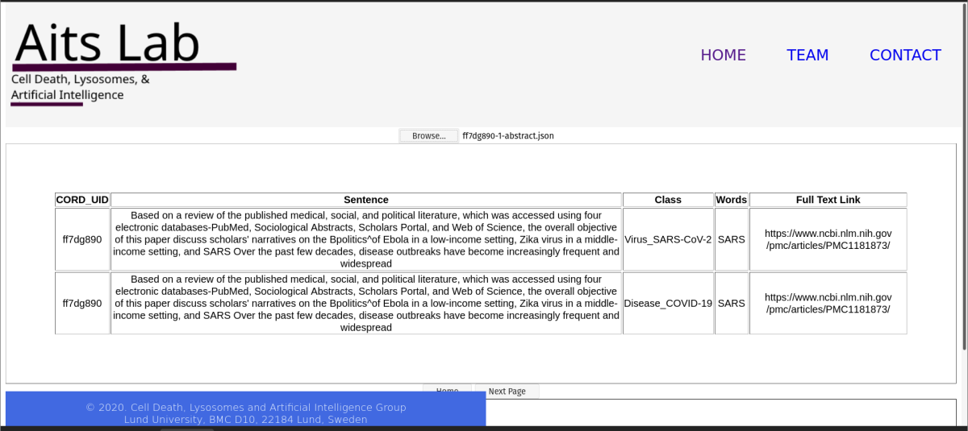
Results view
Annotated words
RapidReview
Article ID
Annotation class
(customizable)
www.aitslab.org

Slide 8
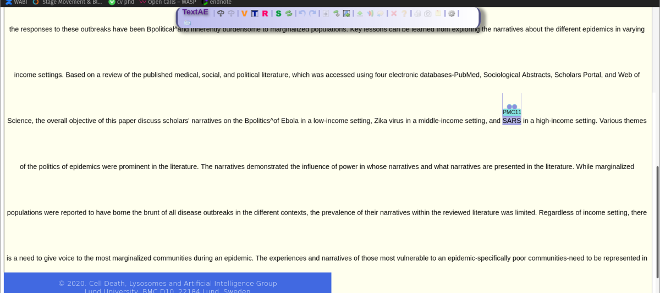
Fulltext/annotation view
The finished product will have more annotations
Uses PubAnnotation viewer TextAE

Slide 9
How is RapidReview customized to you?
Provide a list of keywords from your domain that you want tagged
or
Choose a pre-made profile that fits you: epidemiologist, nurse, policy maker, …more will be generated constantly from our team and user keyword lists

Slide 10
Credits
RapidReview is developed by a team of scientists and students from the Cell Death, Lysosomes and Artificial Intelligence Group at Lund University and their collaborators. The work is made possible through a Swedish Research Council grant of the project leader Sonja Aits and volunteer work.
RapidReviewer makes use of many excellent resources for scientific text mining which others have made freely available. Thank you!
This tool is under development. For current status and full credits please visit:
https://github.com/Aitslab/corona/tree/master/rapidreview

