Slide 1
AIVARA
Insight • Lite
Call-Center-Sentiment-Sample-Data.xlsx
Period: today vs yesterday
Generated 15 Oct 2026 20:29 UTC
Aivara Insight
1 / 10

Slide 2
Contents
Executive
NPS & Sentiment Distribution
Call Duration (Minutes)
Metric Correlation Matrix
Aivara Insight
2 / 10

Slide 3
Executive Summary
Call Duration (Minutes)
29.0%
'+114.8%
Csat Score
4.0%
'-27.3%
Call Duration (Minutes)
29.0%
'+114.8%
Call Duration (Minutes) rose to 29.00% (+114.8% today vs yesterday).
Positive movement was led by 'Below SLA' contributing 78.7% of the change.
Aivara Insight
3 / 10

Slide 4
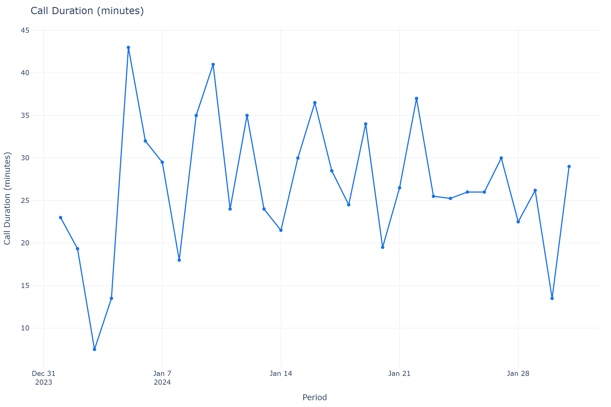
Executive
Call Duration (Minutes)
29.0%
'+114.8%
Csat Score
4.0%
'-27.3%
Call Duration (Minutes) rose to 29.00% (+114.8% today vs yesterday).
Positive movement was led by 'Below SLA' contributing 78.7% of the change.
Next: Scale successful initiatives in 'Below SLA' and assess sustainability across peer segments.
Aivara Insight
4 / 10

Slide 5
Call Duration (Minutes)
Call Duration (Minutes)
29.0%
'+114.8%
Aivara Insight
5 / 10

Slide 6
Drivers — Call Duration (Minutes)
Top contributors
Below SLA: +78.7%
Within SLA: +21.3%
Aivara Insight
6 / 10

Slide 7
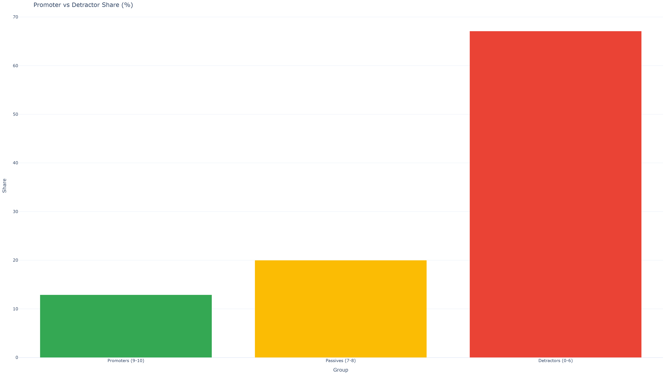
NPS & Sentiment Distribution
Aivara Insight
7 / 10

Slide 8
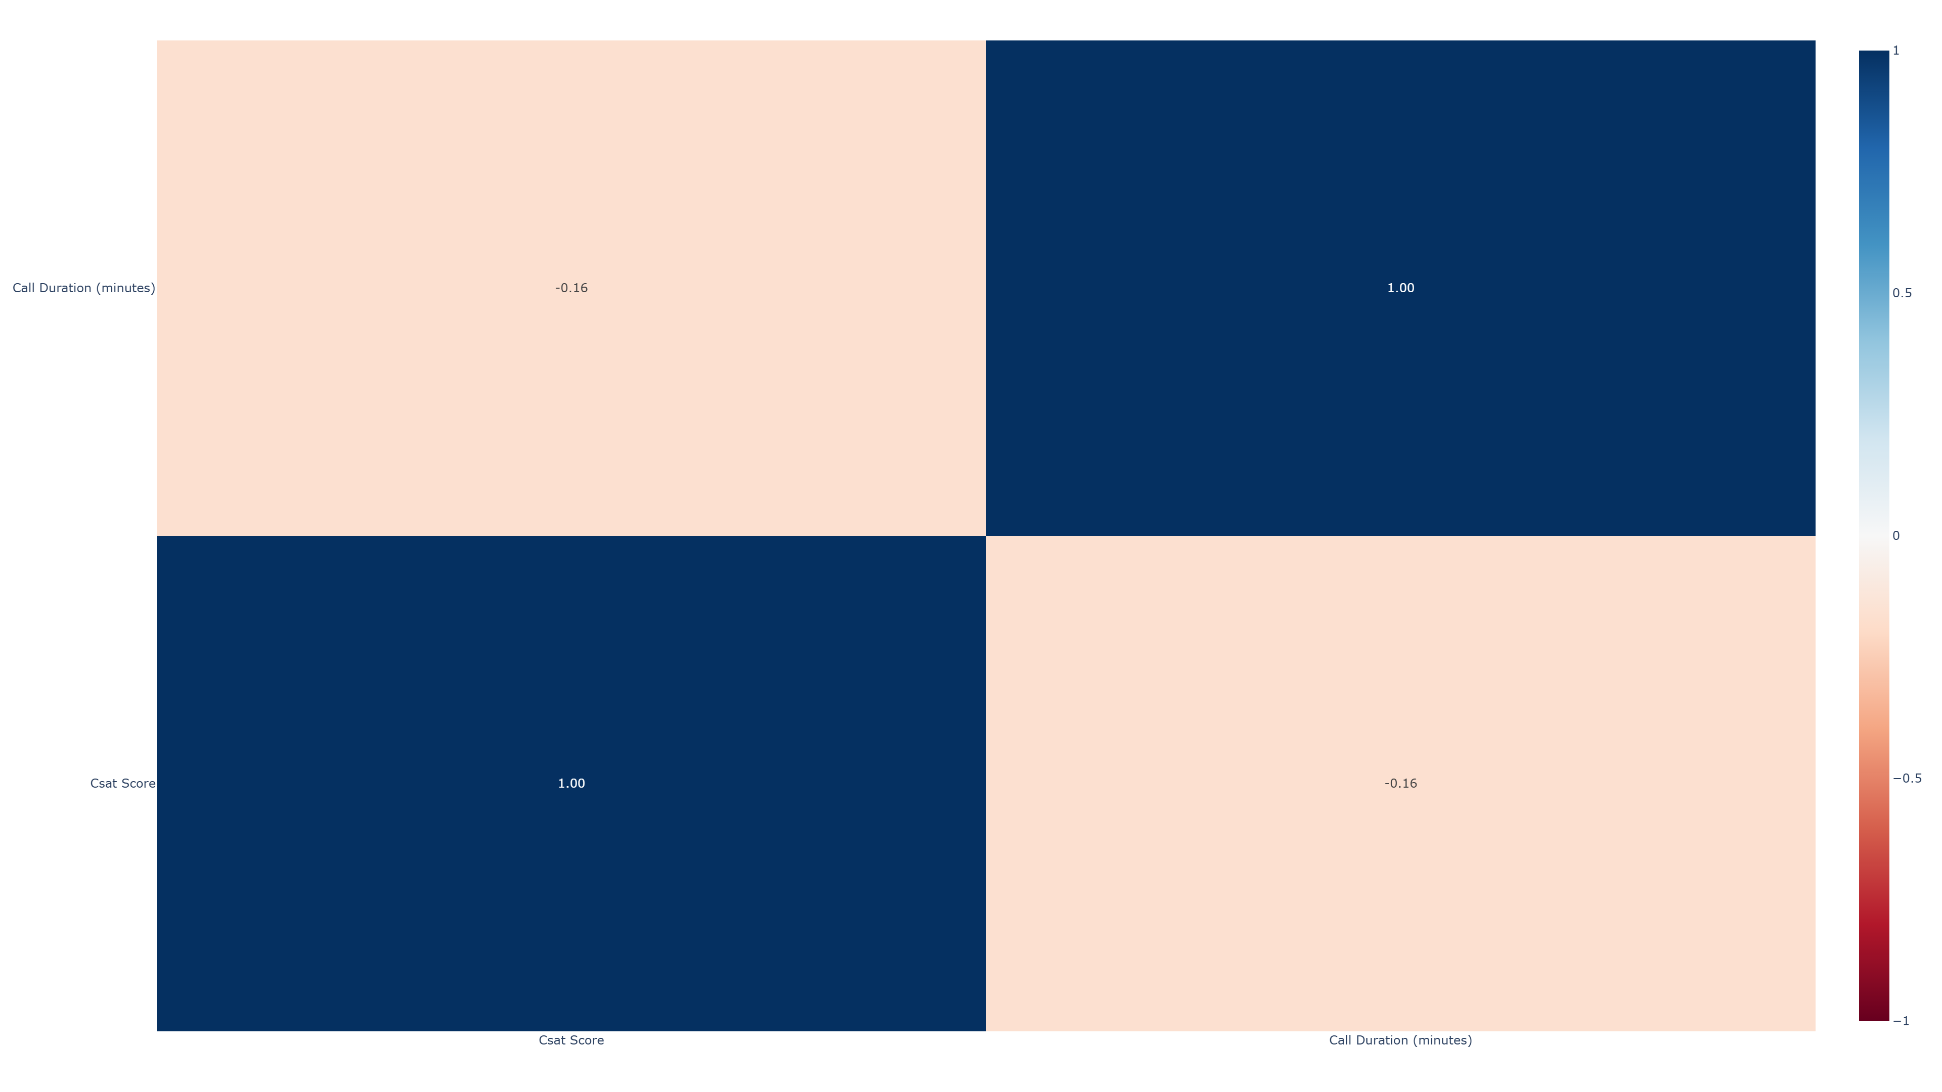
Metric Correlation Matrix
Aivara Insight
8 / 10

Slide 9
Risk Signals
LOW
'Negative' CSAT Score swung +33% period-over-period.
MEDIUM
'Within SLA' CSAT Score swung -45% period-over-period.
HIGH
Call Duration (Minutes) swung +115% period-over-period.
MEDIUM
'Negative' Call Duration (Minutes) swung +53% period-over-period.
HIGH
'Within SLA' Call Duration (Minutes) swung +70% period-over-period.
Aivara Insight
9 / 10

Slide 10
AIVARA
About this report
Generated by Aivara Insight • All figures computed locally from the uploaded dataset • AI narrative
enrichment via OpenRouter (offline fallback available)
Aivara Insight
10 / 10

