Slide 1
Chessboard Understanding with Vision-Language Models and Patch Reordering
Reading boards with Qwen3.5-0.8B and the REOrder framework
Big Data Analytics and Text Mining
Bergonzoni Tommaso · Rambaldi Ivo
ID: 0001177759 ID: 0001169386

Slide 2
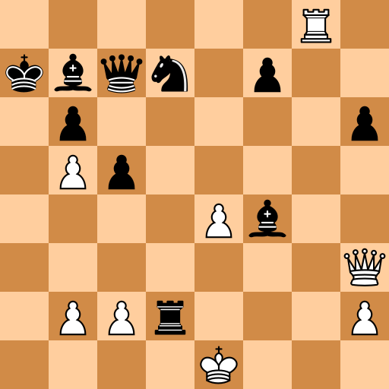
VLMs describe scenes well but cannot read a board
Fine-grained spatial structure is where current multimodal models break down
Ground truth (FEN)
6R1/kbqn1p2/1p5p/1Pp5/4Pb2/7Q/1PPr3P/4K3
Vanilla Qwen3.5-0.8B, zero-shot
e2r1qppppppppppppppppppppppp…
Known failure modes: left/right and above/below relations, reading clocks and grids, transcribing a perfectly clean 2D board.
Our goal: analyze the influence of patch reordering on a fine-tuned VLM and create an end-to-end system to solve specific tasks about chess boards.
2

Slide 3
REOrder: the order of image patches changes accuracy
Kutscher, Chan, Bai, Darrell, Gupta — “REOrdering Patches Improves Vision Models”, NeurIPS 2025
0
1
2
3
±6.4%
4
5
6
7
accuracy swing from patch order alone (Transformer-XL)
0
1
2
3
4
5
6
7
8
9
10
11
12
13
14
15
8
9
10
11
1D sequence, raster scan (row-major)
12
13
14
15
+3.01%
image patches
top-1 accuracy over row-major ordering on ImageNet-1K dataset.
Full self-attention is permutation-equivariant, so order would not matter.
Long-sequence models (Transformer-XL, Longformer, Mamba) approximate attention and become order-sensitive.
Qwen3.5-0.8B is order-sensitive: 18 of its 24 LLM layers are Gated DeltaNet, a recurrent scan like Mamba. At 256px each square is exactly one visual token.
+13.35%
top-1 accuracy over row-major ordering on
fMoW dataset.
3

Slide 4
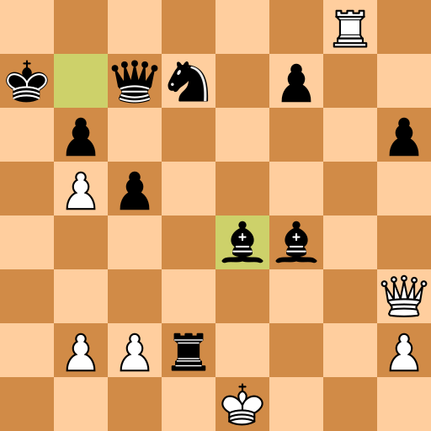
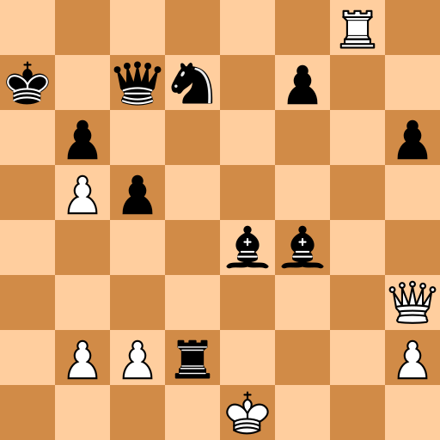
Three benchmark tasks of increasing difficulty
Same 4,000 Lichess puzzles rendered three ways; 400 held-out test samples per task
Task 1 · Image → FEN
Task 2 · Highlighted move
Task 3 · Two-frame delta
t
t+1
Reconstruct the full board state
Name the last move from the highlighted from/to squares
Infer the move between state t and state t+1
Board exact match
Exact match on SAN (e.g. Bxe4)
Exact match on SAN
4

Slide 5
Five fixed scan orders over the 64 squares
Reordering acts on visual tokens inside the model: embeddings and their M-RoPE positions move together
Raster
Zigzag
Spiral (center-out)
File-wise
Hilbert
read first
read last
The board image is never altered. Every token keeps its true 2D position; only the order in which the LLM reads the tokens changes.
5

Slide 6
Fine-tuning is what makes the tasks solvable
Exact match on 400 test samples — vanilla Qwen3.5-0.8B vs LoRA with the default raster order
Task 1
Task 2
Task 3
Board exact match
SAN exact match
SAN exact match
Vanilla
LoRA (raster)
Vanilla
LoRA (raster)
Vanilla
LoRA (raster)
0%
97.0%
0%
60.3%
0.3%
79.8%
98.5% of squares correct
93.8% name the right move
88.5% name the right move
3-shot prompting does not help: 0% board match on Task 1 (8.6% of squares), 0.8% and 0% on Tasks 2 and 3.
6

Slide 7
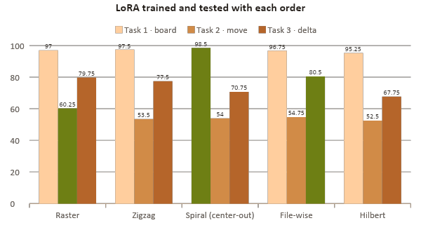
A new order breaks the model; retraining recovers it
Exact match (%) on 400 test samples, 256px · green = best order on each task
Changing the order at test time
Same raster LoRA, no retraining: only the order in which it reads the tokens changes.
Read in
Task 1
Task 2
Task 3
Raster
97.0
60.3
79.8
Zigzag
0.0
52.8
42.3
Spiral
0.0
14.5
5.8
File-wise
0.0
9.8
4.0
Hilbert
0.0
29.0
12.8
Task 1 drops to 0%: the model writes the pieces in the order it reads them, so they land on the wrong squares.
Task 1 winner
Spiral 98.5% (+1.5)
Task 2 winner
Raster 60.3%
Task 3 winner
File-wise 80.5% (+0.75)
7

Slide 8
Learned reordering converges to a near-raster order
REOrder's policy is trained with LoRA (REINFORCE), then the order is frozen and LoRA keeps training
Learned (frozen) vs raster (exact match)
Learned
Raster
Task 1
96.75%
97.00%
Task 2
59.50%
60.25%
Task 1 policy
Task 2 policy
Task 3 policy
Task 3
75.00%
79.75%
Freezing the order helps (Task 3: 57.25% → 75.00%), but the learned order never beats raster.
8

Slide 9
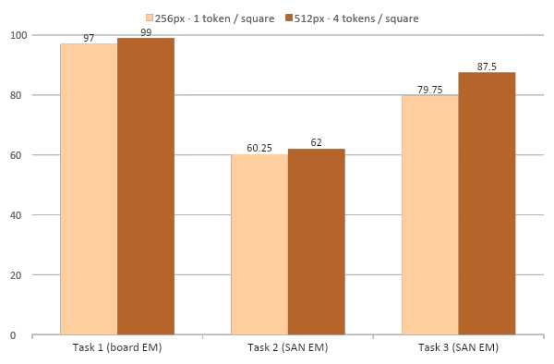
One token per square is not enough; more tokens help
Raster LoRA, same recipe: 256px (1 token per square) vs 512px (2×2 tokens per square)
Patch geometry
+2.00
Points on Task 1 Board Exact Match
+1.75
Points on Task 2 Move Exact Match
+7.75
Points on Task 3 Move Exact Match
1:1 alignment removes tokens that straddle squares, but four tokens per square carry more detail, and that matters most when comparing two frames.
9

Slide 10
Conclusions
1
LoRA turns a 0.8B VLM into a reliable board reader: 0% → 97% (T1), 60% / 94% same move (T2), 80% (T3).
2
Token order matters at inference: a raster-trained model collapses when read in any other order (REOrder's premise holds).
3
When trained with it, no fixed order is a consistent winner: spiral +1.5 (T1), raster (T2), file-wise +0.8 (T3), all near noise.
4
The learned policy settles near raster and does not beat it, even with the order frozen.
5
Resolution beats alignment: 2×2 tokens per square outperform the 1:1 grid, most on Task 3.
Next steps
Token-level reordering at 512px · SAN normalisation in training targets · multiple seeds
10

Slide 11
Appendix
11

Slide 12
Division of labour
Ivo Rambaldi
Tommaso Bergonzoni
Data pipeline, prompting and baseline fine-tuning
REOrder framework, learned routing and patch geometry
Lichess extraction and board rendering with python-chess
Hugging Face datasets for the three tasks
Zero-shot and few-shot evaluation of vanilla Qwen with standardised prompts
LoRA baseline fine-tuning (raster) on all three tasks
Quantitative and qualitative error analysis of the baseline
Integration of d3tk/REOrder into the VLM pipeline
Benchmark of training-free scan orders (zigzag, spiral, file/rank-wise, Hilbert)
Joint training of the learned reordering module with LoRA
Geometric ablation on resolution and patch size (1:1 patch-to-square)
Comparison of reordering against the baselines
12

Slide 13
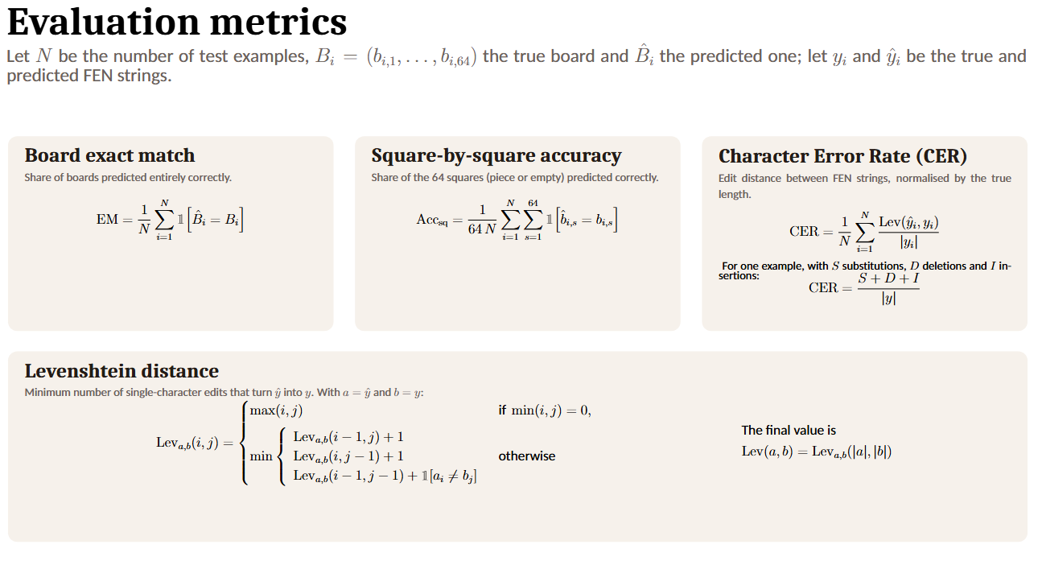
13

Slide 14
Data pipeline and training recipe
Everything (datasets, adapters, evaluations) is cached on the Hugging Face Hub under bdatm-project
1
Lichess puzzle DB
2
Balance
3
Split
4
Render
5
Publish
lichess_db_puzzle.csv
20,000 rows sampled
2,000 White to move + 2,000 Black to move samples
80 % / 10 % / 10 %
3,200 · 400 · 400
python-chess + cairosvg
512px, 12,000 samples, 16 workers
3 HF datasets
dataset_task1/2/3
Model and fine-tuning
Experiment families (per task)
Base: Qwen3.5-0.8B (Qwen-VL family), bf16, GPU: one NVIDIA L4 on Colab
LoRA: r = 16, α = 32, dropout 0.05 on all attention and MLP projections
Optimizer: lr 2e-4, batch 8, up to 10 epochs, early stopping on validation loss (best epoch kept)
Loss: cross-entropy on the answer tokens only
A
Vanilla zero-shot and 3-shot
B
LoRA baseline, raster order
C
Training-free: raster model read in other orders
D
LoRA trained with each fixed order
E
Learned order (REOrder policy + LoRA)
F
Resolution: 256px vs 512px
14

Slide 15
Learned reordering setup and training
REOrder's Plackett-Luce policy over 64 squares, trained jointly with LoRA by REINFORCE
1
2
3
4
5
Warm-up in raster order
Policy proposes orders
Reward = how well the model answers
Compare two orders on the same puzzle
Freeze the order, then fine-tune
The first epoch trains only LoRA, reading tokens in raster order, so the model learns the task before the order starts changing.
A policy gives each of the 64 squares a score; sorting the scores gives a reading order. Noise is added at first to explore new orders, then removed so the policy settles on its best one.
An order gets a high reward if, reading the tokens in that order, the model gives high probability to the correct answer.
Each puzzle is read with two orders and each one is scored against the other. Easy and hard puzzles count the same, so only the effect of the order is learned.
The learned order is frozen and the LoRA keeps training reading only that fixed order, so the final model never sees the order changing.
15

