Slide 1
VQ-VAE + Transformer for Image Generation with CFG
2025.12.08(Thu), Special topics in DeepLearning
Patrick Astorga, Ivo Rambaldi

Slide 2
Outline
00
Motivation and Background
Pipeline
VQ-VAE + training results
Transformer Prior + training results
Classifier Free Guidance (CFG)
Results
Conclusions

Slide 3
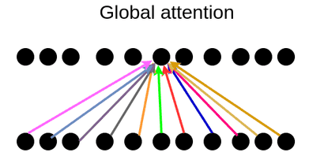
Motivation
01
Generative modeling of images:
Images are sequences of pixels. Since Transformer models dominate with sequence modeling tasks today, can we model images with Transformers?
Upsides of Transformers:
Models long range dependencies just as easy as short range dependencies
Downsides of Transformers:
Computationally expensive, compute grows quadratically with sequence length

Slide 4
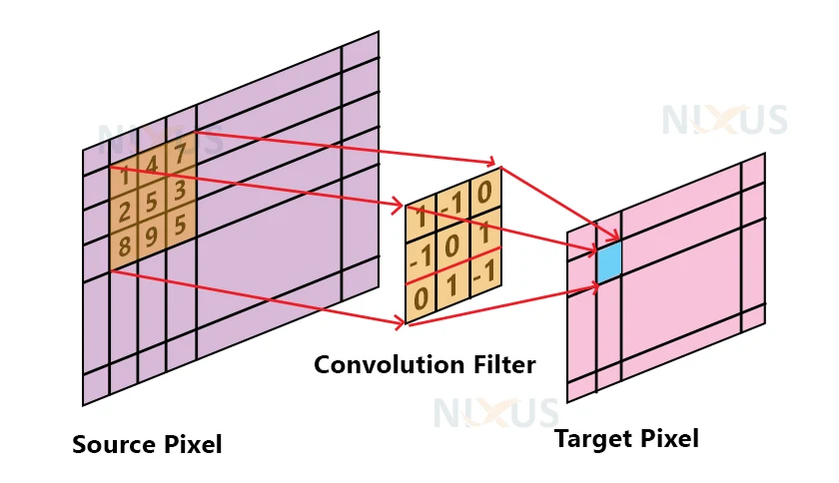
Motivation
01
Generative modeling of images:
Convolutional Neural Networks (CNNs) are tried and true for image data.
Upsides of Convolutional Neural Networks (CNNs):
Models short range pixel dependencies better than Transformers
Computational complexity stays low for high dimensional data
Downsides of Convolutional Neural Networks (CNNs):
Does not model long range dependencies well
Let a CNN model short range dependencies, and a Transformer model long range dependencies!

Slide 5
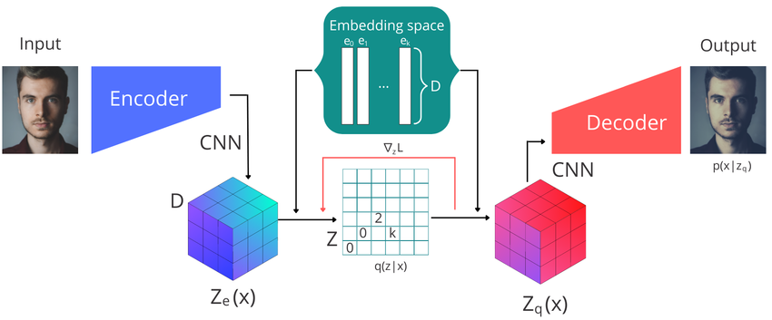
Background
01
VQ-VAE:
Autoencoder (AE) with a Vector Quantization (VQ) layer added to the bottleneck.
AE: Bi-directional mapping from X → Z, allowing us to shift our generative focus to Z
VQ layer: Concentrates probability mass in the decoder
Discrete latent space is compatible with existing generative models.
Originally, a CNN prior is used to model Z

Slide 6
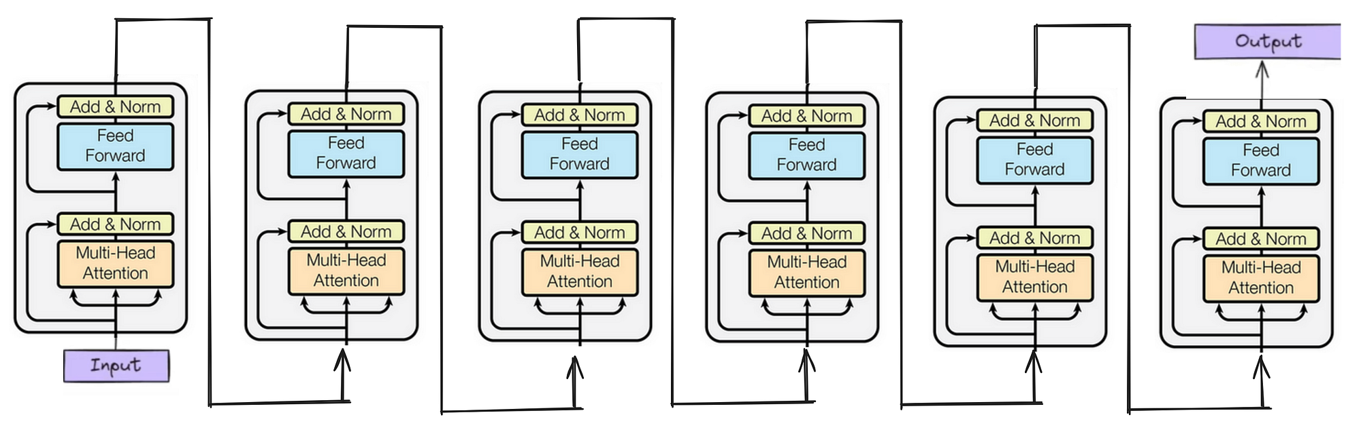
Background
01
Autoregressive Transformer:
Generative model on sequences of discrete tokens
Uses the Attention mechanism to model dependencies between tokens
Alternates attention layers with token-wise MLPs
Output is a probability distribution of the next token in the sequence

Slide 7
Background
01
Classifier-Free Guidance (CFG):
A crucial strategy for conditional generation
Generative model learns conditional + unconditional distribution simultaneously
Conditional distribution “guides” unconditional distribution with adjustable intensity

Slide 8
Overall Pipeline: Training
02
Stage 1: VQ-VAE
Train until convergence on images prioritizing sharp reconstructions
X → Z → X’
Stage 2: Transformer Prior
FREEZE VQ-VAE, learn to predict the next token in a sequence of encoder outputs
z, z, _ → z

Slide 9
Overall Pipeline: Generation
02
Stage 2: VQ-VAE
Decode the new latent sequence into a image using the decoder
Z’ → X’
Stage 1: Transformer Prior
Generate a random latent sequence autoregressively
p(Z) → Z’

Slide 10
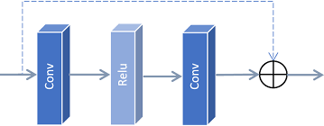
VQ-VAE: Encoder + Decoder
03
Encoder:
Smaller ResNet style, 2 conv downsampling layers and 2 residual blocks
Decoder:
More complex, refines inputs with self-attention before stacked upsamples with convolutional refinement and 2 residual blocks per layer
Details:
4x spacial reduction 64x64 → 16x16
256 hidden channels per layer
ReLU activation function
Residual block
3x3
1x1

Slide 11
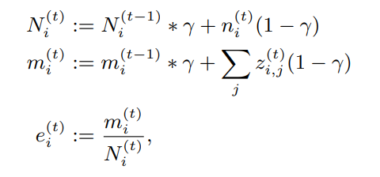
VQ-VAE: Quantization Layer
03
Quantizer:
Codebooks are set to be Exponential Moving Averages (EMA) of the encoder outputs to approximate K-means (as opposed to learning them through gradient descent)
EMA
Details:
K = 512 codebooks
64 dimensional vectors
EMA decay = 0.99

Slide 12

VQ-VAE: Loss
03
Loss:
Gradients propagate through Quantization via straight-through estimator
Opted for a L1 reconstruction loss (we found it promoted sharper images)
Trained with β=0.25

Slide 13
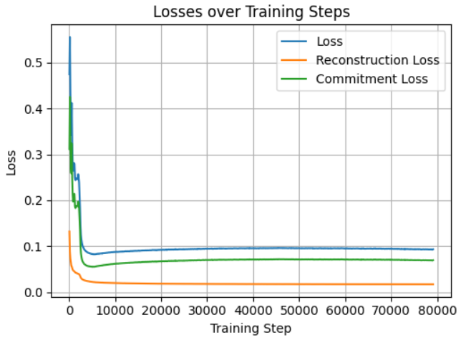
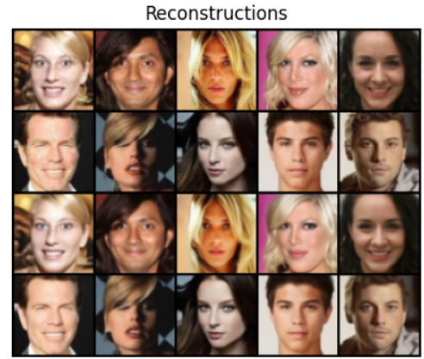
Results: VQ-VAE Training
03

Slide 14
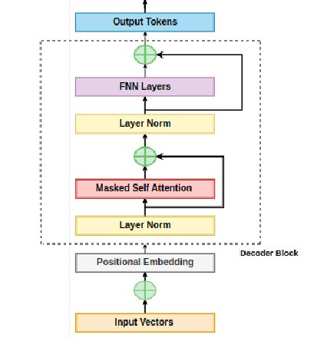
Transformer Prior
04
Decoder-only:
GPT-style architecture
Decoder only, causal self-attention
Uses learnt token and positional embeddings
Outputs a softmax for predicted next token
Details:
K = 512 vocab size
16x16 = 256 sequence length
D_{model} = 256
6 layers, 4 heads and 0.1 dropout Rate

Slide 15
Conditioning and Guidance
05
Conditioning mechanism
12 binary CelebA attributes, each encoded as:
True / False / Masked token
Attribute tokens are prepended to the token sequence
Attention structure
Attribute tokens attend freely to each other
Image tokens attend to:
All attribute tokens
Previous image tokens only (causal mask)

Slide 16
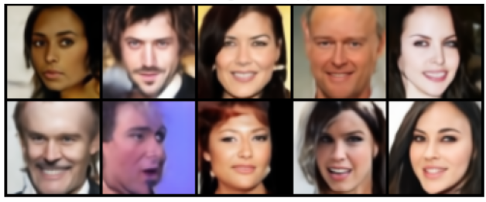
Results: Generation
07
Generated without attribute conditioning, using only the learned Transformer prior over VQ-VAE latent tokens.
The model produces globally coherent face structures.
Some artifacts and local inconsistencies remain

Slide 17
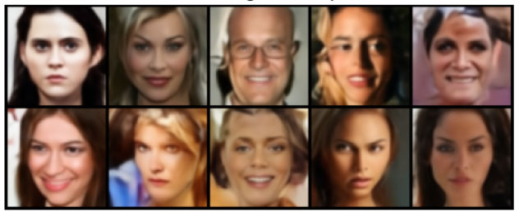
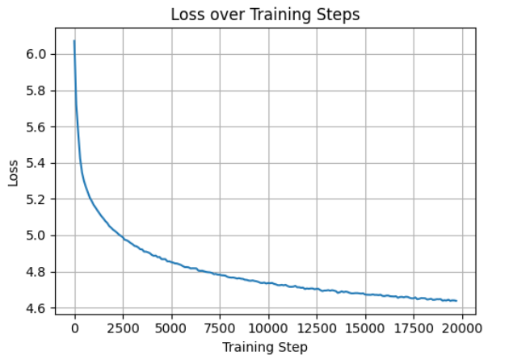
Results: Guided Generation
07
The model produces recognizable, globally coherent faces
Lower quality for rare “Combinations” and posing
Facial structure, pose, and symmetry are largely consistent, and it presents good diversity.

Slide 18
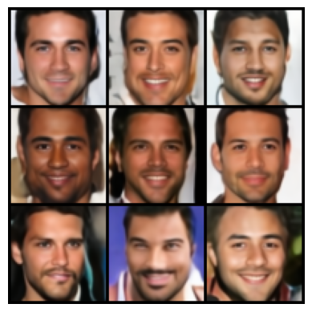
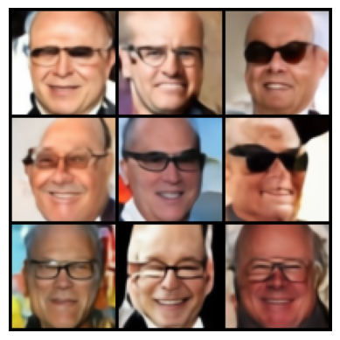
Results: Guided Generation
07
Male, brown hair, smiling
Bald, eyeglasses, smiling

Slide 19
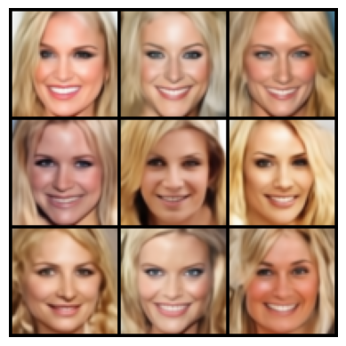
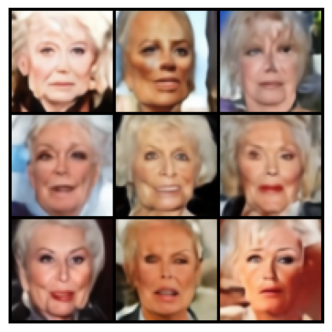
Results: Guided Generation
07
Female, blonde, smiling, attractive
Female, old, not smiling, not attractive

Slide 20
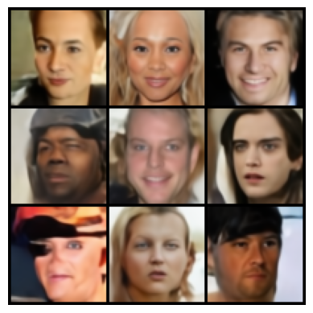
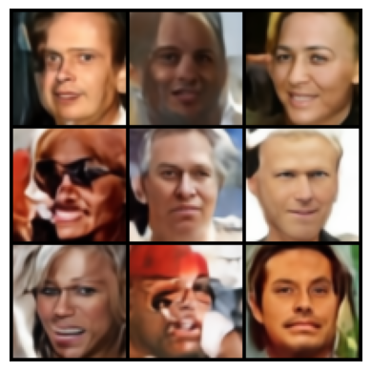
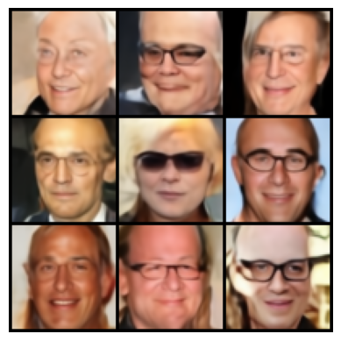
Results: Guided Generation
07
Male, bald, glasses, smiling
w = 0.0
w = 0.5
w = 1.0

Slide 21
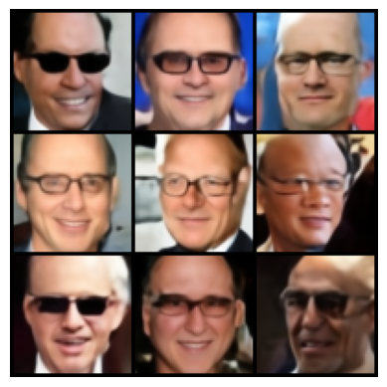
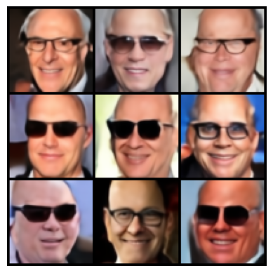
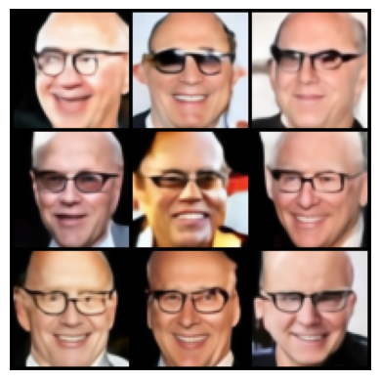
Results: Guided Generation
07
Male, bald, glasses, smiling
w = 2.0
w = 3.0
w = 5.0

Slide 22
Conclusion
08
We implemented a two-stage image generation pipeline combining a VQ-VAE tokenizer with an autoregressive Transformer prior.
The VQ-VAE learns a compact discrete latent representation
The Transformer prior successfully models the distribution of latent tokens
Attribute conditioning via prefix tokens and classifier-free guidance provides control but also presents a challenge in terms of local consistency.

Slide 23
Conclusion
08
Limitations & Future Work
Image quality is constrained by resolution and latent compression.
Future improvements would include larger codebooks, higher-resolution latents, perceptual or adversarial losses (VQ-GAN style) or possignly more complex architectures, and stronger priors.

Slide 24
09
Thank you for your (masked) attention.

