Slide 1
实验2: 创建数据库和完整性约束定义 SQL

Slide 2
实验内容
实验目的：
熟悉DBMS环境
掌握SQL的数据定义和数据操纵的功能
掌握数据库中的完整性约束的基本概念和使用方法
实验要求：
熟练使用SQL Server Manager或MySQL Workbench/command
根据实际问题创建一个数据库并建立相关表，存储实验性数据
根据需要完成检索和修改数据库的功能
掌握View的定义和使用
实验内容：
以University为例，建立数据库及相关表，输入数据，完成查询、 定义和使用View；

Slide 3
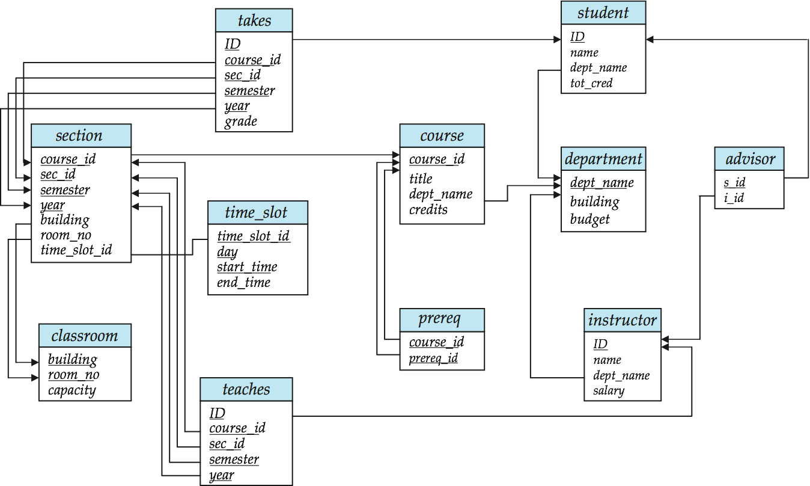
Step 1: Create Database
Create a database named university in SQL Server according to the schema diagram.

Slide 4
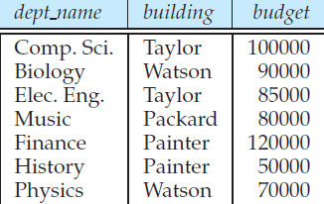
Step 2: Populate Relations (1)
Insert the following data into the relation department
department(dep_name, building , budget)
('Biology', 'Waston', 90000)
('Comp.Sci','Taylor',100000)
('Elec.Eng',Taylor',85000)
('Finance','Painter',120000)
('History','Painter',50000)
('Music','Packard',80000)
('Physics','Watson',70000)

Slide 5
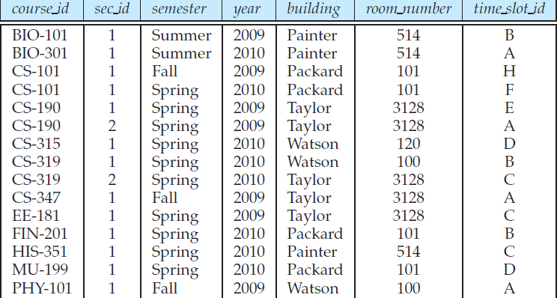
Step 2: Populate Relations (2)
Insert the following data into the relation section
section(course_id,sec_id,semester,year,building,room_mumber,time_slot_id)
('BIO-101',1,'Summer','2009','Painter','514','B')
('BIO-301',1,'Summer','2010','Painter','514','A')
('CS101',1,'Fall','2009','Packard','101','H')
('CS101',1,'Spring','2010','Packard','101','F')
('CS190',1,'Spring','2009','Taylor','3128','E')

Slide 6
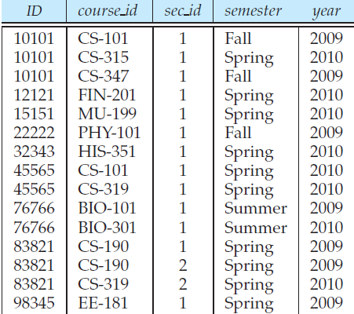
Step 2: Populate Relations (3)
Insert the following data into the relation teaches
teacher(ID, course_id,sec_id,semester,year)
('10101','CS_101',1,'Fall','2009')
('10101','CS-315',1,'Spring','2010')
('12121','FIN-201',1,'Spring','2010')
('15151','MU-199',1,'Spring','2010')
('22222','PHY-101',1,'Fall','2009')
('32343','HIS-351',1,'Spring','2010')
('45565','CS-101',1,'Spring','2010')
('45565','CS-319',1,'Spring','2010')
('76766','BIO-101',1,'Summer','2009')
('76766','BIO-301',1,'Summer','2009')

Slide 7
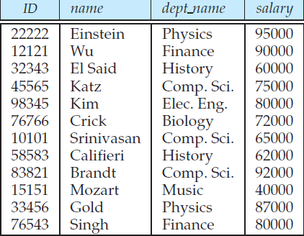
Step 2: Populate Relations (4)
Insert the following data into the relation instructor
instructor(ID,name,dept_name,salary)
('22222','Einstein','Physics',95000)
('12121','Wu','Finance',90000)
('32343','El Said','History',60000)
('45565','Katz','Comp Sic',75000)
('98345','Kim','Elec Eng',80000)
('10101','Srinivasan','Comp Sci',65000)
('83821','Brandt','Comp Sci',92000)

Slide 8
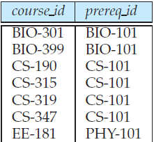
Step 2: Populate Relations (5)
Insert the following data into the relation prerep
prerep(course_id,prerep_id)
('BIO-301','BIO-101')
('BIO-399','BIO-101')
('CS-190','CS-101')
('CS-315','CS-101')
('CS-319','CS-101')
('CS-347','CS-101')
('EE-181','PHY-101')

Slide 9
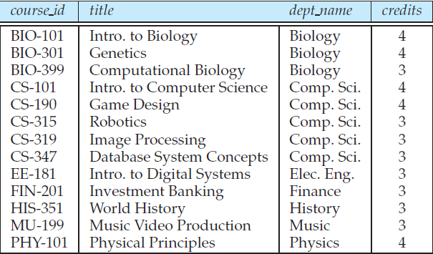
Step 2: Populate Relations (6)
Insert the following data into the relation course
course(course_id,title,dept_name,credits)
('BIO-101','Intro to Biology','Bioloy',4)
('BIO-301','Genetics','Bioloy',4)
('BIO-399','Computational Biology','Biology',3)
('CS-101','Intro to Computer Science','Comp Sci',4)
('CS-190','Game Design','Comp Sci',4)
('CS-315','Robotics','Comp Sci',3)
('CS-319','Image Processing','Comp Sci',3)
('CS-347','Database System Concepts','Comp Sci',3)
('EE-181','Into to Digital Systems','Elec Eng',3)
('FIN-201','Investment Banking','Finance',3)
('MU-1991','Music Video Production','Music',3)

Slide 10
实验报告要求
请参考实验报告模板完成报告（电子版）
记录实验过程
提交报告
Due ：2020年4月2日
To 大夏学堂

