Slide 1
实验3:SQL应用实践

Slide 2
实验内容
实验目的：
掌握SQL的数据定义和数据操纵的功能
掌握数据库中的完整性约束的基本概念和使用方法
实验要求：
熟练使用SQL Server Manager或MySQL Workbench/command
根据实际问题创建一个数据库并建立相关表，存储实验性数据
根据需要完成检索和修改数据库的功能
掌握View的定义和使用
实验内容：
（1）以University为例，建立数据库及相关表，输入数据，完成查询、 定义和使用View；
（2）为例，建立数据库及相关表，输入数据，完成查询、 定义和使用View；

Slide 3
Exercise1

Slide 4
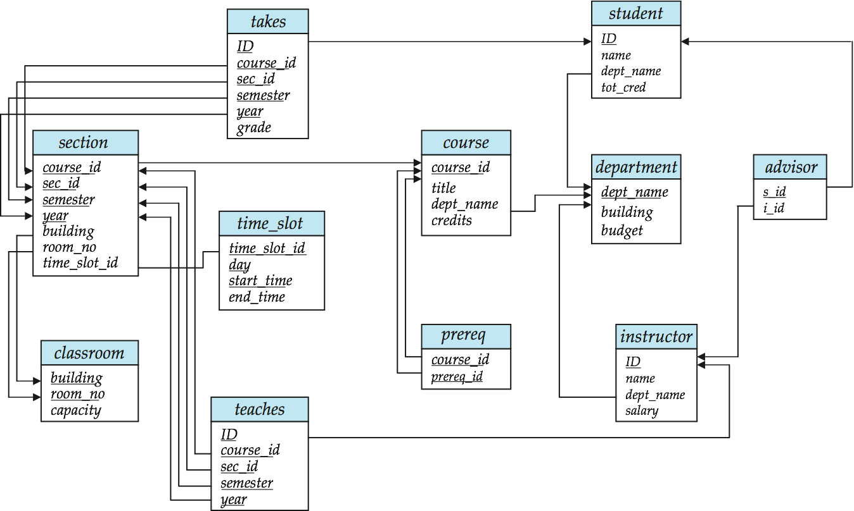
Step 1: Create Database
Create a database named university in SQL Server according to the schema diagram.

Slide 5
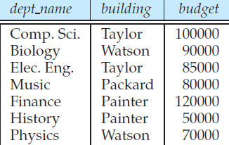
Step 2: Populate Relations (1)
Insert the following data into the relation department
department(dep_name, building , budget)
('Biology', 'Waston', 90000)
('Comp.Sci','Taylor',100000)
('Elec.Eng',Taylor',85000)
('Finance','Painter',120000)
('History','Painter',50000)
('Music','Packard',80000)
('Physics','Watson',70000)

Slide 6
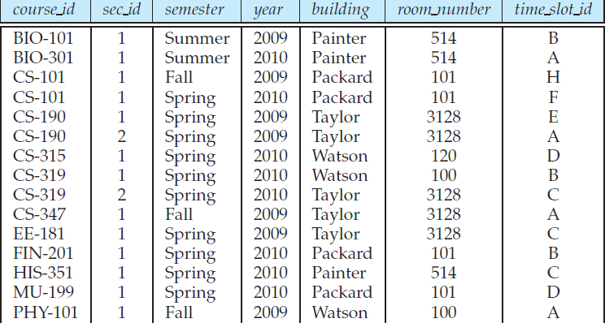
Step 2: Populate Relations (2)
Insert the following data into the relation section
section(course_id,sec_id,semester,year,building,room_mumber,time_slot_id)
('BIO-101',1,'Summer','2009','Painter','514','B')
('BIO-301',1,'Summer','2010','Painter','514','A')
('CS101',1,'Fall','2009','Packard','101','H')
('CS101',1,'Spring','2010','Packard','101','F')
('CS190',1,'Spring','2009','Taylor','3128','E')

Slide 7
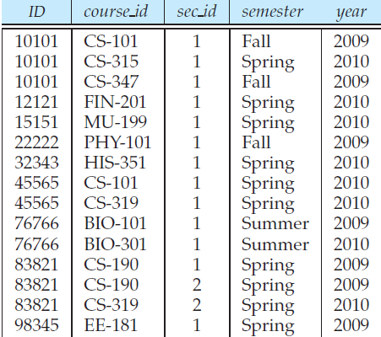
Step 2: Populate Relations (3)
Insert the following data into the relation teaches
teaches(ID, course_id,sec_id,semester,year)
('10101','CS_101',1,'Fall','2009')
('10101','CS-315',1,'Spring','2010')
('12121','FIN-201',1,'Spring','2010')
('15151','MU-199',1,'Spring','2010')
('22222','PHY-101',1,'Fall','2009')
('32343','HIS-351',1,'Spring','2010')
('45565','CS-101',1,'Spring','2010')
('45565','CS-319',1,'Spring','2010')
('76766','BIO-101',1,'Summer','2009')
('76766','BIO-301',1,'Summer','2009')

Slide 8
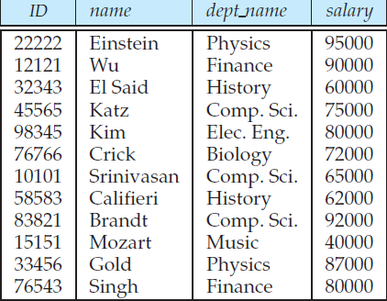
Step 2: Populate Relations (4)
Insert the following data into the relation instructor
instructor(ID,name,dept_name,salary)
('22222','Einstein','Physics',95000)
('12121','Wu','Finance',90000)
('32343','El Said','History',60000)
('45565','Katz','Comp Sic',75000)
('98345','Kim','Elec Eng',80000)
('10101','Srinivasan','Comp Sci',65000)
('83821','Brandt','Comp Sci',92000)

Slide 9
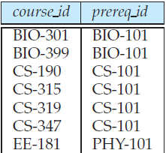
Step 2: Populate Relations (5)
Insert the following data into the relation prerep
prerep(course_id,prerep_id)
('BIO-301','BIO-101')
('BIO-399','BIO-101')
('CS-190','CS-101')
('CS-315','CS-101')
('CS-319','CS-101')
('CS-347','CS-101')
('EE-181','PHY-101')

Slide 10
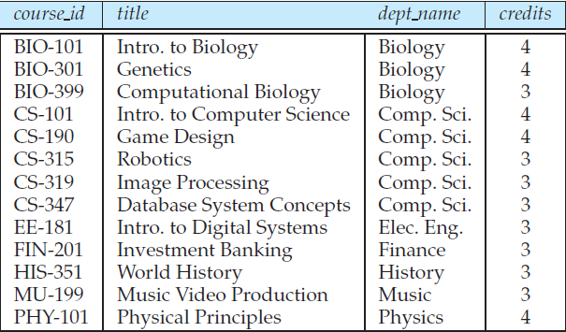
Step 2: Populate Relations (6)
Insert the following data into the relation course
course(course_id,title,dept_name,credits)
('BIO-101','Intro to Biology','Bioloy',4)
('BIO-301','Genetics','Bioloy',4)
('BIO-399','Computational Biology','Biology',3)
('CS-101','Intro to Computer Science','Comp Sci',4)
('CS-190','Game Design','Comp Sci',4)
('CS-315','Robotics','Comp Sci',3)
('CS-319','Image Processing','Comp Sci',3)
('CS-347','Database System Concepts','Comp Sci',3)
('EE-181','Into to Digital Systems','Elec Eng',3)
('FIN-201','Investment Banking','Finance',3)
('MU-1991','Music Video Production','Music',3)

Slide 11
Step 3: Retrieving Data (1)
List all information stored in the table course;
List the dept_name and buildings of all departments;
List the instructor's name appears in the table instructor;
List the instructor's name whose salary is more than 90000 and dept_name is 'Comp Sci' ;
List the instructor's all information after we gave a 10% raise to each instructor;
Show the different dept_name in the table instructor;

Slide 12
Step 3: Retrieving Data (2)
List the course's title ,dept_name,and credits which prerep_id is 'CS-101';
Find the titles of courses in the Comp Sci department the have 3 credits;
List the course_id which prereq_id is 'CS-101';
Find all courses that were offered at least twice in 2010(not unique);
Find the instructor names and the courses they taught for all instructors in the Biology department who have taught some course;
List all courses taught in Fall 2009;

Slide 13
Step 3: Retrieving Data (3)
Find the set of all courses taught either in Fall 2010 or in Spring 2009,or both we write.
Find all courses taught in the Fall 2009 but not in the Spring 2010;
Find the average salary of instructors in the Comp Sci department;
Find the total number of instructors who teach a course in the Spring 2010 semester;
Find the number of tuples in the course relation;

Slide 14
Step 3: Retrieving Data (4)
Find the average salary in each department;
Find the average salary of instructors in those departments where the average salary is more than 42000;
Find the names of all instructors whose salary is greater than at least one instructor in the Com Sic department.

Slide 15
Modification of the DB
Delete all the instroctors with a salary more than 90000;
Adjust the budget of the Comp Sci to 120000;
Salary are increased by 10 percent only the instructors with salary of less than 70000 (not including 70000),and others increased by 5 percent;

Slide 16
View Operation
Create a view named instructor_info with lists the ID,name,and building-name of each instructor.
Find all the instructors whose building name is 'Taylor' by the view you created above.
Try to find the ‘View update policy’ in SQL Server

Slide 17
Exercise2

Slide 18
红十字会捐赠物资数据库
中国红十字会是中华人民共和国统一的红十字组织，是从事人道主义工作的社会救助团体。根据2017年新修订的《中华人民共和国红十字会法》，中国红十字会依法履行相应职责。例如在公共卫生事件等突发事件中，对伤病人员和其他受害者提供紧急救援和人道救助。红十字会应当严格遵守《中华人民共和国慈善法》、《慈善组织公开募捐管理办法》、《慈善组织信息公开办法》等法律法规，依法规范开展募捐等活动，公开的内容为：
捐赠款物的收入和使用情况。
接受捐赠的情况。包括接收的捐赠资金总额和资金明细，接收的捐赠物资品种、数量；对于大额捐赠方需单独列示，捐赠方明确要求不公开的除外。
资金支出和物资分配情况。包括：资金支出总额和明细（按用途和科目分别列示）；物资分配的品种、数量，受助单位等。对有关资金支出用途和物资分配情况，应配发相应的照片作为佐证，并辅以文字说明。

Slide 19
数据及数据访问要求
公开事项涉及到的数据包括（但不限于）
接收单位、接收单位类别、捐赠物品名、规格、计量单位、数量
拨付单位、拨付单位类别、拨付物品名、规格、计量单位、数量
请根据红十字会公开募捐情况的要求，建立捐赠物品数据库，录入数据（来自红十字会官网的数据），完成以下查询，并验证查询结果是否正确。
若课程项目选做项目1：我帮红red会管数据，可以从这个练习开始，逐步优化。
可以到武汉红十字会官方网站获取新的数据。

Slide 20
Finish the following operations
查找蔡甸区卫生健康局接受的捐赠情况
查找浏阳市华盛山庄的捐赠情况
查找2.13到2.14医用口罩捐赠给了哪些单位
查询2.13到2.14社会捐赠的医用口罩的数目
查询2.13到2.14发放的一次性手套大、中、小号各多少只
查询2.14接受了医用N95口罩捐赠的单位有哪几家，各获得多少只
查找获得物资数量超过2000计量单位的单位有哪几家
统计2.13到2.14两天平均每天发放了多少数量口罩
统计2.13到2.14一共发放的防护服的数量
查询获得物资感冒清热颗粒的单位有哪几家，数量分别是多少

Slide 21
实验报告要求
请参考实验报告模板完成报告（电子版）
记录实验过程和查询结果
提交报告
Due ：2020年4月18日
To 大夏学堂

