Slide 1
EXCEL PROJECT

Slide 2
EXCEL TASK
Topics Practised:
Cell Referencing
Index & Match SHEET LINK
Pivot Table
Calculated Fields
VLOOKUP
Conditional Formatting
Hlookup
Charts
If Error
Functions
Macro
CLICK HERE

Slide 3
PROJECT DOCUMENT
Project Title – Candidate Activity Tracker
This project is all about tracking the activities of candidate all at one excel dashboard. It gives various insights of candidate like their Scores,Attendance,Task Completion Activities,Notifications,Profile Details, Fees Details, Top Performers, Overall Performer etc.
The highlight of the project , the project is made of fully excel and its functions.
It even as login facility where it is divided based on Mentor and Candidate login , so particular candidate or mentor can login and work on their allocated sheets.
It also includes important features like Query Form , Notification alerts, Report Download etc.

Slide 4
KEY METRICS
All Information in One Dashboard View.
Security Enabled through Login Credentials.
Based On User Type , sheets are allocated.
Each Data of Candidates are maintained in Separate sheets, all together merged at Raw Data sheet.
Maintained Separate Credentials table based on User Type , so no confusion happens easy to maintain.
Also candidate can raise a query from Dashboard itself.
Candidate can post their query from dashboard itself.
Mentor can download reports of candidate
Datasets – Normal Candidate Data scripted Manually

Slide 5
INSIGHTS
Tracker gives insights about candidate’s :
Score Obtained against total credits
Attendance against total sessions
Task completion status
Notification alerts
Internship tasks
User Profile details
Overall Performance Details
Rating Detail based on criteria
Queries Posted

Slide 6
KPI’S & DOMAIN
KPI’S
Task Completion Rate: Measure the percentage of assigned tasks that candidates successfully complete. This indicates how well candidates engage with the tasks you provide.
Score Improvement: Track the change in candidates' scores over time, such as in assessments or evaluations. This helps gauge their progress and engagement level.
Comprehensive Engagement Index: Create a combined index that factors in task completion rate, score improvement, attendance, and performance metrics. This index offers a holistic view of a candidate's active participation and progress, helping you identify the most engaged and high-performing individuals.
DOMAIN - Performance Management

Slide 7
OBJECTS
Sheets Used:
RawData - All Data Together
Fees_Details - Candidate Fee Details
UserData – Credentials Details
Attendance – Contains Attendance Info
Tasks – Contains Task Completion status of each Candidate
Task_Credits – Mentors can predefine Score for Each tasks
Cand_Credits - Contains Score obtained by each candidate
Tools – Contains Tools installation details
Profile - Contains Candidate Profile details
Queries - Contains queries of candidates
---------Dashboard and Welcome Page ------------

Slide 8
ADVANTAGES
Easy to Understand
Made of Simple Excel functions like If, Index and match etc.
Easy to maintain data
Track all information at one place
Export Functionality

Slide 9
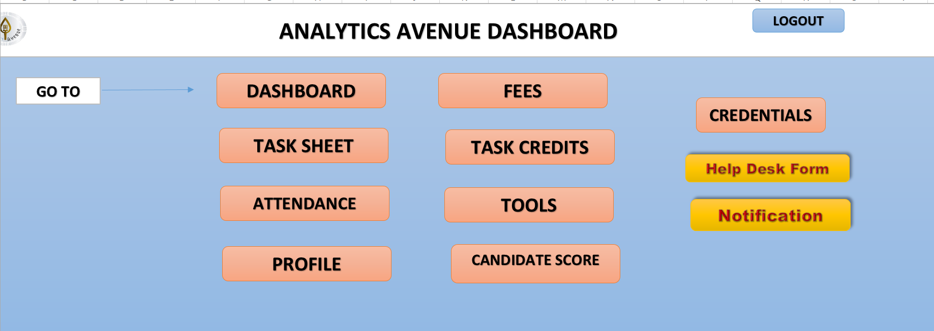
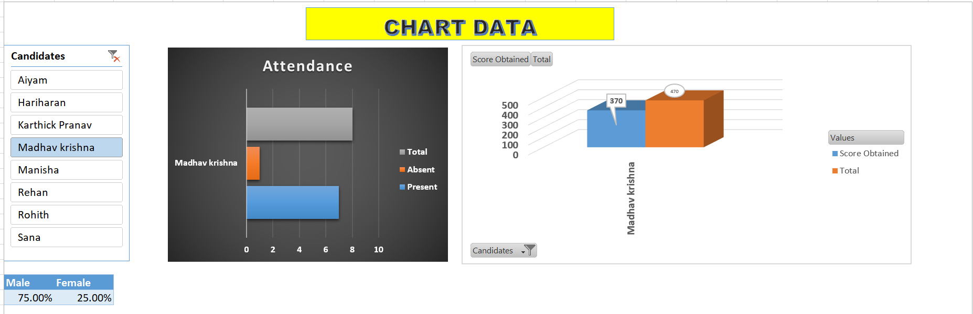
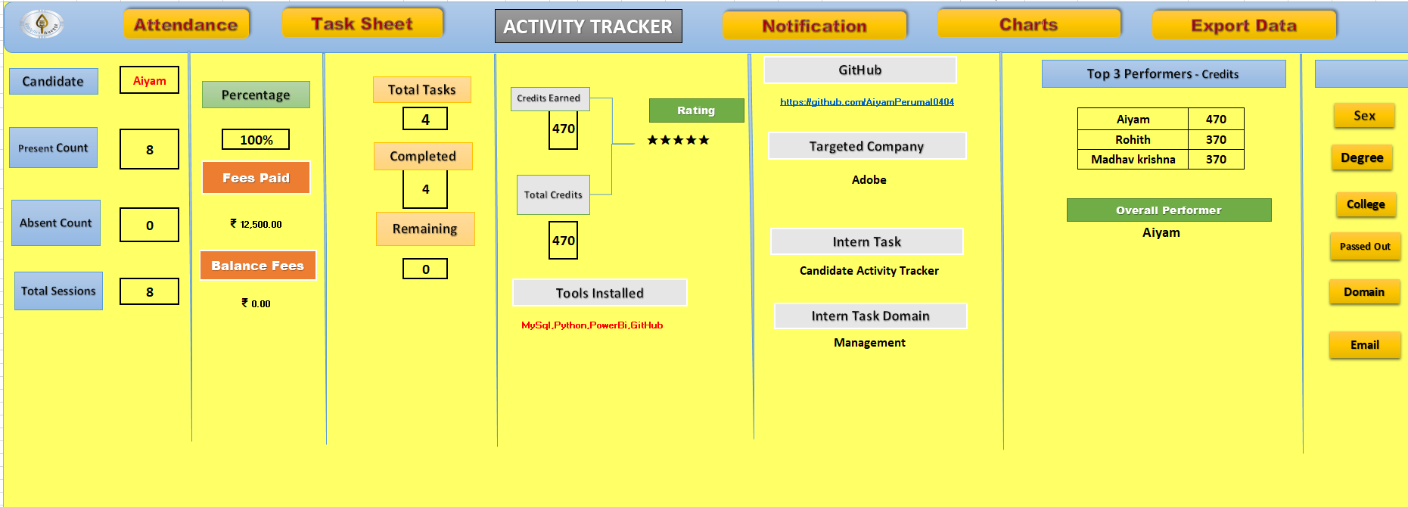
PROJECT PICTURES

Slide 10

CERTIFICATE

Slide 11
FINAL OUTCOME
DASHBOARD FILE
CLICK HERE

