Slide 1
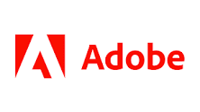
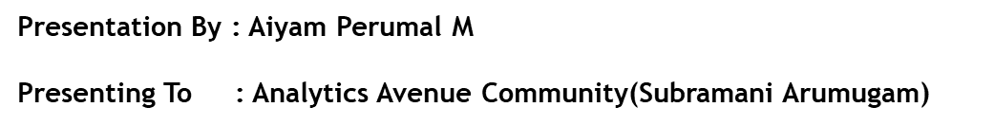
Changing the world through digital experiences

Slide 2
Introduction
Adobe Inc. originally called Adobe Systems Incorporated, is an American multinational computer software company incorporated in Delaware and headquartered in San Jose, California. Adobe was founded in December 1982. It has historically specialized in software for the creation and publication of a wide range of content, including graphics, photography, illustration, animation, multimedia/video, motion pictures, and print. Its flagship products include
Adobe Photoshop – Image Editing
Adobe Illustrator – Vector –based illustrations
Adobe Acrobat Reader and the Portable Document Format (PDF); and a host of tools primarily for audio-visual content creation, editing and publishing
Adobe later developed animation and multimedia through its acquisition of Macromedia, from which it acquired Macromedia Flash, video editing and compositing software with Adobe Premiere, later known as Adobe Premiere Pro low-code web development with Adobe Muse and a suite of software for digital marketing management.
As of 2022, Adobe has more than 26,000 employees worldwide.It is a Product based Company.

Slide 3
Links
Wikipedia - https://en.wikipedia.org/wiki/Adobe_Inc.
Homepage - https://www.adobe.com/
Blog - https://blog.adobe.com/
Careers - https://www.adobe.com/careers.html
LinkedIn - https://www.linkedin.com/company/adobe
Twitter - https://twitter.com/Adobe
News - https://news.adobe.com/news/default.aspx
Note:
Average Adobe Analyst salary in India is ₹ 11.4 Lakhs for experience between 2 years to 11 years. Analyst salary at Adobe India ranges between ₹ 4.7 Lakhs to ₹ 27.0 Lakhs

Slide 4
Scope Of Analytics
The scope of analytics within Adobe's portfolio is significant and covers various aspects of data analysis, reporting, and optimization, particularly in the context of digital marketing and customer experience management. Some of the key areas where analytics plays a role within Adobe's offerings include:
Adobe Analytics: Adobe Analytics is a robust web analytics and reporting solution that helps businesses understand their digital audiences, track user behavior, and optimize online experiences. It provides insights into website and app performance, customer journeys, conversion funnels, and more.
Marketing Analytics: Adobe's marketing solutions, such as Adobe Campaign and Adobe Experience Cloud, leverage data analytics to help businesses create, manage, and optimize marketing campaigns across different channels. This involves analyzing customer interactions, segmenting audiences, and measuring campaign effectiveness.
Machine Learning and AI: Adobe Sensei, Adobe's artificial intelligence and machine learning framework, integrates analytics to automate tasks, predict user behaviors, and offer personalized recommendations.
to be continued…

Slide 5
Personalization and Targeting: Analytics is used to gather data about customer preferences and behaviors, allowing businesses to personalize content and offers. Adobe Target, for instance, uses data-driven insights to deliver targeted experiences, optimize content, and enhance user engagement.
Data Visualization: Adobe tools, like Adobe Data Studio, enable users to create interactive and visually appealing data dashboards and reports. These tools help in presenting complex analytics data in an easily understandable format.
Digital Advertising: Adobe Advertising Cloud incorporates analytics to optimize ad placements, target specific audiences, and measure the impact of digital advertising campaigns across various channels.

Slide 6
Annual Revenue(Last 3 years)
As of May 2023
$18.429B 10.4% increase over last year
2022 was $17.606B 11.54% increase from 2021
2021 was $15.785B 22.67% increase from 2020.

Slide 7
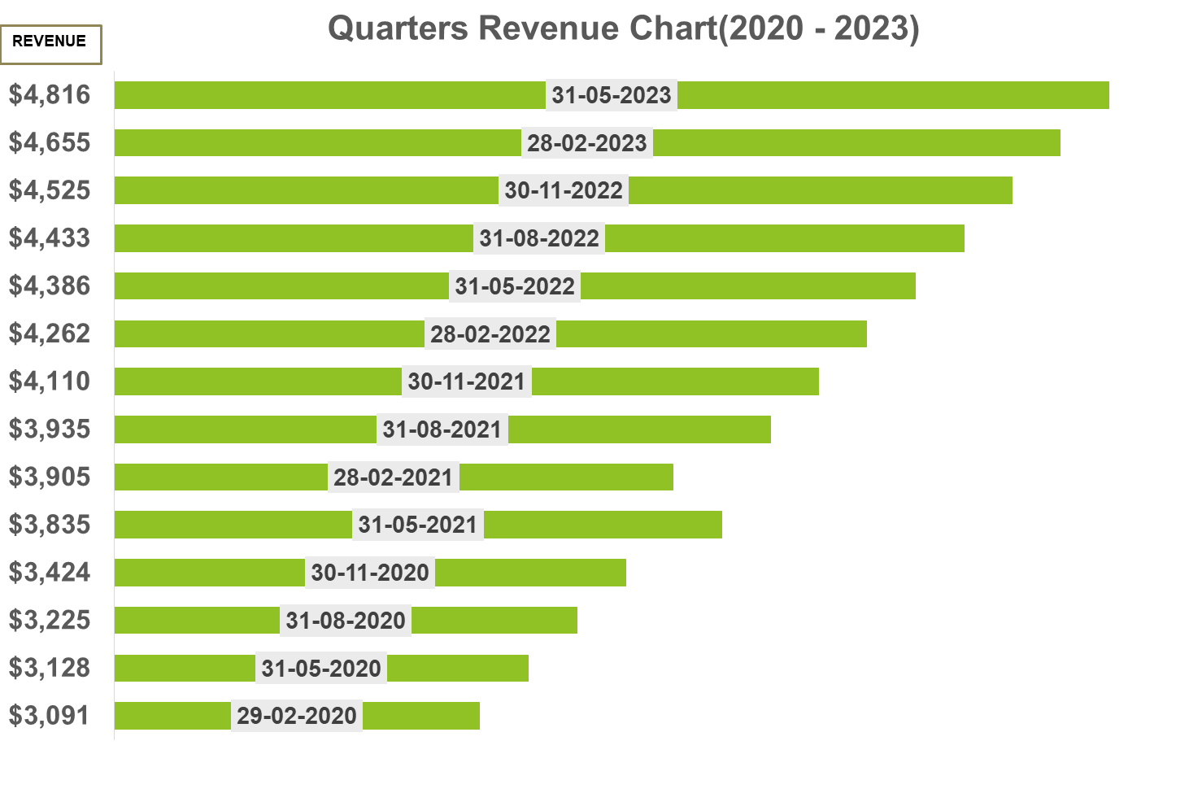

Slide 8
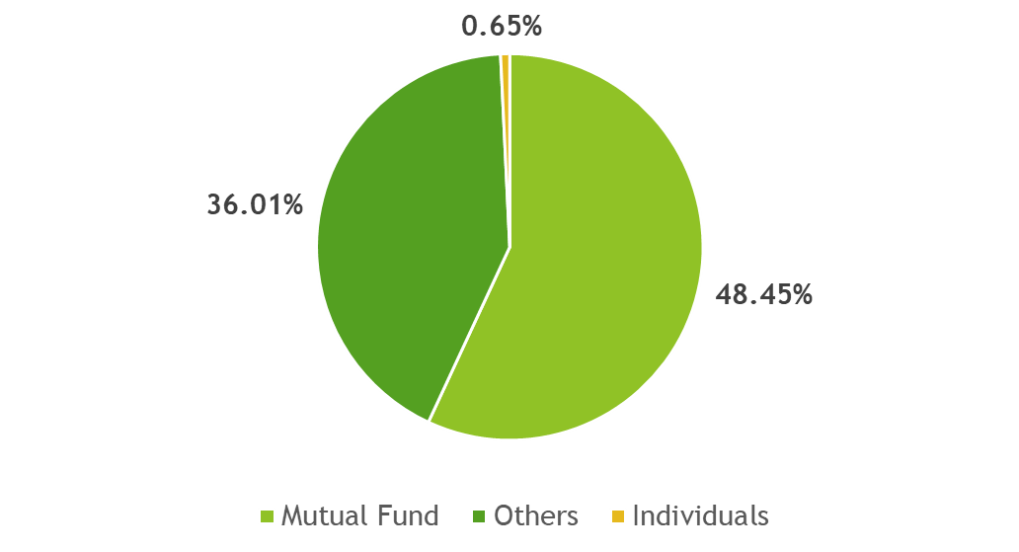
Top Funds
Institutional Ownership
Mutual fund holders 48.45%
Other institutional 36.01%
Individual Stakeholders 0.65%

Slide 9
Top Owner of Adobe Inc.
STOCKHOLDER | STAKE | SHARES OWNED
The Vanguard Group, Inc. | 8.18% | 37,264,644
BlackRock Fund Advisors | 5.10% | 23,247,117
SSgA Funds Management, Inc. | 4.09% | 18,632,322
Geode Capital Management LLC | 2.14% | 9,762,185
Fidelity Management & Research Co. | 2.00% | 9,093,340
PRIMECAP Management Co. | 1.34% | 6,108,578
JP Morgan Investment Management | 1.27% | 5,791,035
Norges Bank Investment Management | 1.15% | 5,221,017
Reference - https://money.cnn.com/quote/shareholders/shareholders.html?symb=ADBE&subView=institutional

Slide 10
Top Mutual funds holding Adobe Inc.
MUTUAL FUND | STAKE | SHARES
Vanguard Total Stock Market ETF | 3.14% | 14,299,194
Vanguard 500 Index Fund | 2.40% | 10,921,555
Invesco QQQ Trust | 1.72% | 7,833,455
Fidelity 500 Index Fund | 1.14% | 5,179,714
SPDR S&P 500 ETF Trust | 1.13% | 5,152,839
Government Pension Fund - Global ... | 1.13% | 5,153,122

Slide 11
Adobe Analytics
Adobe Analytics is designed to collect, process, and analyze the data to help your business produce the information you need to create powerful user experiences.
Needs:
With Adobe Analytics, you can turn this information into actionable insights that can help improve your bottom line by allowing you to better market to your customers and can also use the data to inform decisions about digital products.
Works:
Adobe Analytics couples machine learning and artificial intelligence (AI) with a user-friendly, drag-and-drop interface that gives everyday marketers the power to identify critical information and create ad-hoc database queries, you can capture unique insights that would otherwise be missed.
Features:
Analysis Workspace , Segments, Report Suits , Report Curation, Report Builder, Adobe Analytics Dashboard, Reporting API.
Reference - https://www.hoodoo.digital/platform/what-is-adobe-analytics

Slide 12
REPOSITORY
This repository contains important questions for Data Analytics job role , from interview perspective .Filtered out based on last 2 years most important questions Category wise.
CLICK HERE

Slide 13
THANK YOU !

