Slide 1
London Neighborhood Clustering and Housing Price Analysis

Slide 2
Business Problem
London : Largest/most populated city in the UK
Target Audience: Residents or prospective residents
Problem: Find similar neighborhoods when deciding to move to London
Solution: Create a clustering system based on various factors such as venues nearby and property prices, to group similar neighborhoods.

Slide 3
Data
Area Codes: Wikipedia
Property Prices: propertydata.co.uk
Venue/Amenity Details: FourSquare

Slide 4
Data Preprocessing
Parse
Parse WikiPedia and Property Price data
Remove
Remove unwanted rows/data
Merge
Merge multiple tables to generate single source of truth
Choose
Choose most popular amenities, and ignore less common ones
Convert
Convert categorical data to numeric using one hot encoding

Slide 5
Clustering
Choose best clustering algorithm for the situation
K Means – Optimal for the problem statement
Select optimal number of clusters
Optimal number of 5 clusters chosen based on Elbow Method

Slide 6

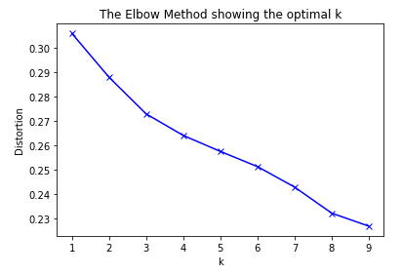



Elbow Method Graph

Slide 7
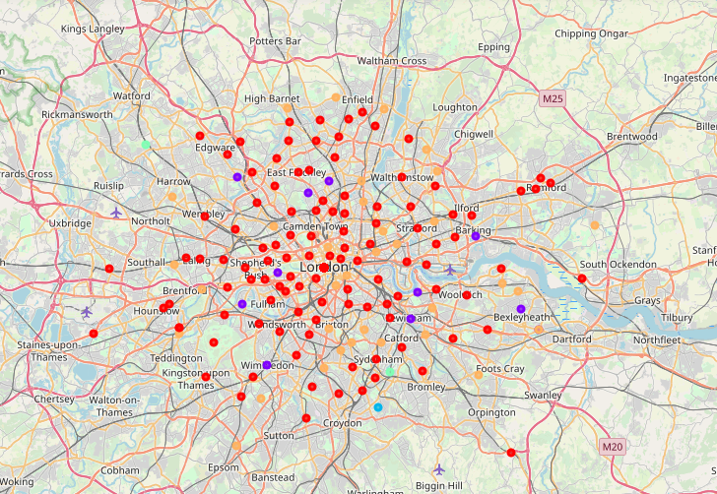
Visualize Clusters

Slide 8
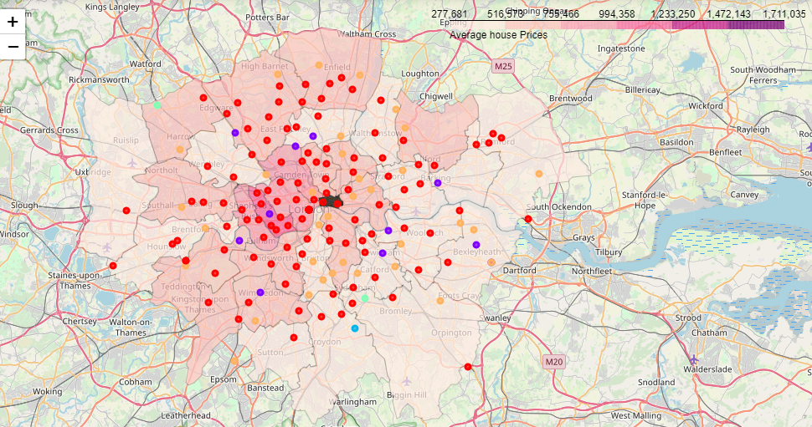
Overlay Property Prices on Map along with Clusters

Slide 9
Conclusion
Systemic clustering of neighborhoods can now make it easier for people to take informed decisions when buying a house or property.
This can also be expanded further into evaluating the impact of each type of venue on the overall property price and grouping.

