Slide 1

THE WORLD IS YOURS .…
G

Slide 2

GUIDE4U
We make your dreams come true with the perfect vacation just for you!
G

Slide 3

SEE WONDERS LIKE NEVER BEFORE…
Because your experience means the world to us….

Slide 4

LET’S PLAN
The most important part!
Choose from a wide variety of destinations ranging from high mountains to the middle of the oceans, from the classy medieval cities to the best amusement parks !. We have Everything, You name it ! . Ladakh, Rajasthan, Manali - anywhere in the world and that too at affordable prices !
G

Slide 5


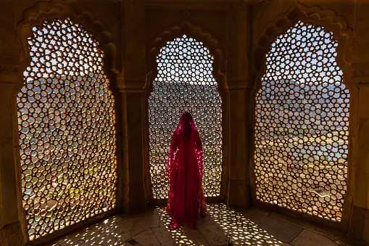
YOU MEAN THE WORLD TO US
You are our lifeline, hence it is our commitment to provide you the best experience of your life and believe me when I say this. You won’t ever regret it….
g

Slide 6
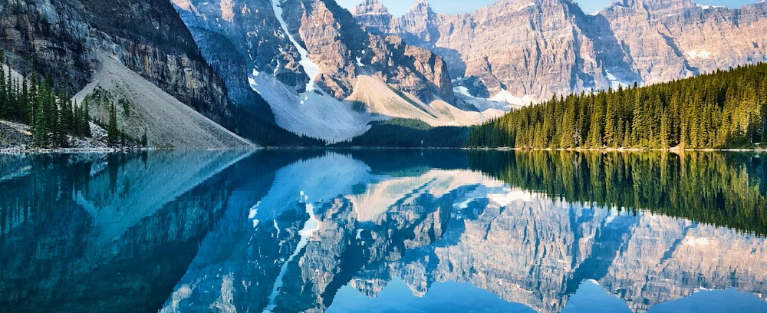

Comparison slide
COMPARISON POINT 1
COMPARISON POINT 2
Each content on the site is based upon the Rating and Reviews of clients . Due to which user will be easy to know more about the place. People can research about the places they want to visit and explore some good photos on our website. Our website allows you to compare prices from a range of airline prices as well as car rental options
Guide4u offers Aa range of useful features such as price alert and a best time to book tour. It provides an user friendly and attractive interface. Guide4u is known for providing access to unique accommodations around the world.
g

Slide 7
OUR SALES
Records of our sales over 2023.
Our sales have been ever increasing thanks to our trusted users and companions and we pledge to hold true to it and trust this voyage that takes both you and us across the skies.
g

Slide 8
Destinations
LOCATIONS | LOCATIONS | LOCATIONS | LOCATIONS
Manali | Amritsar | Maldives | Hongkong
Srinagar | Kolkata | Bangkok | Japan
Mussorie | Ahemdabad | Chicago | Antarctica
Goa | Dalhousie | Las Vegas | Switzerland
Darjeeling | Beijing | New York | Germany
Banglore | Udaipur | Thailand | Dubai
Jaisalmer | Silicon Valley | Sydney | Vatican City
Bombay | Bir billing | London | Malout
g

Slide 9

Our client’s trust us won’t you ?
g

Slide 10




THANK YOU
Aiyaret Sandhu
6280479311
Arsh@margiestravel.com
g

