Slide 1
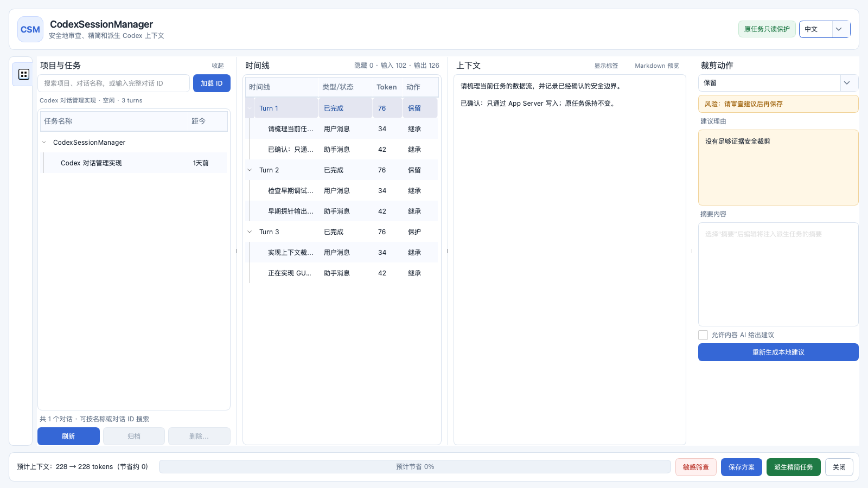
GUI OPERATION GUIDE
CodexSession
Manager
安全管理 Codex 对话与上下文
Safe task and context management
双语操作说明 · Bilingual guide
原任务只读 · Source task remains read-only
2026
Notes:
[Sources]
- /Users/ethen/同步空间/CODE/AI/CodexSessionManager/README-cn.md
- /Users/ethen/同步空间/CODE/AI/CodexSessionManager/README.md
- /Users/ethen/同步空间/CODE/AI/CodexSessionManager/docs/images/gui-overview.png
[/Sources]

Slide 2
01 · WHY
对话越长，越要可审查 / Long work needs control
问题 / Problem
安全原则 / Safety principle
项目、对话与上下文会持续累积，查找、备份、清理和精简逐渐变得困难。
Projects, conversations, and context keep accumulating; review, backup, cleanup, and reduction become harder over time.
原任务只读；在线写入只走 App Server；裁剪只创建派生任务。
The source task stays read-only; online writes use App Server; trimming creates a derived task only.
先计划，再执行；先复核，再写入。 / Plan first. Re-check before writing.
CodexSessionManager · GUI Guide / GUI 操作说明
02
Notes:
[Sources]
- /Users/ethen/同步空间/CODE/AI/CodexSessionManager/README-cn.md
- /Users/ethen/同步空间/CODE/AI/CodexSessionManager/README.md
- /Users/ethen/同步空间/CODE/AI/CodexSessionManager/docs/images/gui-overview.png
[/Sources]

Slide 3
02 · START
三步安装并启动 / Install and launch in three steps
01
02
03
构建 / Build
安装 / Install
启动 / Launch
scripts/build_macos_app.sh
已有 .app 可跳过此步
Skip when the .app already exists
scripts/install_user.sh
dist/CodexSessionManager.app
No administrator access required
~/Applications/
CodexSessionManager.app
Open the standalone GUI
隔离测试 / Isolated test: scripts/install_test_app.sh
CodexSessionManager · GUI Guide / GUI 操作说明
03
Notes:
[Sources]
- /Users/ethen/同步空间/CODE/AI/CodexSessionManager/README-cn.md
- /Users/ethen/同步空间/CODE/AI/CodexSessionManager/README.md
- /Users/ethen/同步空间/CODE/AI/CodexSessionManager/docs/images/gui-overview.png
[/Sources]

Slide 4
03 · ORIENT
先认识四个工作区 / Four panes, one review flow
01
项目与任务
Projects & Tasks
02
时间线
Timeline
03
上下文
Context
04
裁剪动作
Trim action
CodexSessionManager · GUI Guide / GUI 操作说明
04
Notes:
[Sources]
- /Users/ethen/同步空间/CODE/AI/CodexSessionManager/README-cn.md
- /Users/ethen/同步空间/CODE/AI/CodexSessionManager/README.md
- /Users/ethen/同步空间/CODE/AI/CodexSessionManager/docs/images/gui-overview.png
[/Sources]

Slide 5
04 · REVIEW
从项目到上下文，只需两次选择 / Two selections reveal the context
01
02
03
定位对话 / Find
选择事件 / Select
检查上下文 / Inspect
搜索项目或对话名称；也可粘贴完整对话 ID。
Search by project/name, or paste a full conversation ID.
先选对话，再选 turn 或 item；Turn 1–N 按返回顺序显示。
Choose a conversation, then a turn or item.
查看、编辑非保护内容，并切换标签或 Markdown 预览。
Review editable content; toggle tags or Markdown.
提示 / Tip：默认按 turn 操作；item 级审查属于高级模式。 / Turn-level review is the default; item-level review is advanced.
CodexSessionManager · GUI Guide / GUI 操作说明
05
Notes:
[Sources]
- /Users/ethen/同步空间/CODE/AI/CodexSessionManager/README-cn.md
- /Users/ethen/同步空间/CODE/AI/CodexSessionManager/README.md
- /Users/ethen/同步空间/CODE/AI/CodexSessionManager/docs/images/gui-overview.png
[/Sources]

Slide 6
05 · TRIM
四种动作塑造派生上下文 / Four actions shape context
保留 / Keep
排除 / Exclude
原样带入派生任务。
Carry content forward unchanged.
从派生上下文中移除。
Leave content out of the derived context.
摘要 / Summary
保护 / Protect
以人工摘要替代原文。
Replace the original with an edited summary.
明确锁定，不允许裁剪。
Lock content against trimming.
当前请求、进行中 turn 与成组依赖会被硬保护。 / Current requests, in-progress turns, and grouped dependencies are hard-protected.
CodexSessionManager · GUI Guide / GUI 操作说明
06
Notes:
[Sources]
- /Users/ethen/同步空间/CODE/AI/CodexSessionManager/README-cn.md
- /Users/ethen/同步空间/CODE/AI/CodexSessionManager/README.md
- /Users/ethen/同步空间/CODE/AI/CodexSessionManager/docs/images/gui-overview.png
[/Sources]

Slide 7
06 · SCREEN
敏感筛查只在本机给出提醒 / Sensitive scan stays local
本地确定性规则 / Deterministic local rules
敏感筛查
Sensitive scan
• 私钥头、云服务/API key、JWT
• 口令或 token 赋值、邮箱、手机号
• 校验位有效的身份证号与支付卡号
• Private-key headers, cloud/API keys, JWTs
• Password/token assignments, email, phone
• Checksum-valid IDs and payment cards
点击后筛选疑似包含敏感信息的对话，并在上下文中用红底白字标记匹配范围。
Filters likely matches and highlights matched ranges as white text on red.
仍可能误报或漏报；结果用于人工复核。
False positives and false negatives remain possible; review manually.
CodexSessionManager · GUI Guide / GUI 操作说明
07
Notes:
[Sources]
- /Users/ethen/同步空间/CODE/AI/CodexSessionManager/README-cn.md
- /Users/ethen/同步空间/CODE/AI/CodexSessionManager/README.md
- /Users/ethen/同步空间/CODE/AI/CodexSessionManager/docs/images/gui-overview.png
[/Sources]

Slide 8
07 · APPLY
保存方案 ≠ 派生任务 / Save plan ≠ trimmed task
先选择动作并确认预计上下文，再决定只保存审查结果，还是创建新的精简任务。
Review actions and the estimate first; then choose whether to persist the review or create a derived task.
保存方案 / Save plan
派生精简任务 / Create trimmed task
• 只保存不可变 TrimPlan
• 不改变任何对话
• 以后执行时仍需重新复核
• Persist the immutable plan only
• No conversation changes
• Re-check before later execution
• 保存并消费已审查方案
• 复核能力与内容指纹
• 新建派生任务，不自动启动模型
• Save and consume the reviewed plan
• Re-check capability and fingerprints
• Create a derived task without a model turn
原任务始终保留 / The source task always remains
CodexSessionManager · GUI Guide / GUI 操作说明
08
Notes:
[Sources]
- /Users/ethen/同步空间/CODE/AI/CodexSessionManager/README-cn.md
- /Users/ethen/同步空间/CODE/AI/CodexSessionManager/README.md
- /Users/ethen/同步空间/CODE/AI/CodexSessionManager/docs/images/gui-overview.png
[/Sources]

Slide 9
08 · FINISH
完成前检查四件事 / Check four things before you finish
1
加载的是正确对话 / The correct conversation is loaded
2
硬保护项仍然完整 / Hard-protected items remain intact
3
预计上下文与节省量符合预期 / Context estimate and savings look right
4
风险提示已解决并理解动作差异 / Risks are resolved and the two apply actions are understood
需要回退？关闭窗口或返回原任务。 / Need to back out? Close the window or return to the source task.
CodexSessionManager · GUI Guide / GUI 操作说明
09
Notes:
[Sources]
- /Users/ethen/同步空间/CODE/AI/CodexSessionManager/README-cn.md
- /Users/ethen/同步空间/CODE/AI/CodexSessionManager/README.md
- /Users/ethen/同步空间/CODE/AI/CodexSessionManager/docs/images/gui-overview.png
[/Sources]

