Slide 1

DS6410 Lab: Graphical Models & Causal Inference
Estimating Graphs, Learning Structure, and Applying Do-Calculus
Machine Learning II • Live Demo Session

Slide 2

Lab Overview
PART 1
PART 2
PART 3
Undirected Graphical Models
Directed Graphical Models
Causal Inference & Do-Calculus
Estimating sparse Gaussian Graphical Models (GGMs) from continuous data to discover conditional independencies.
Learning the structure of Directed Acyclic Graphs (DAGs) from purely observational data using conditional independence tests.
Applying Pearl's do-calculus to identify causal effects via the backdoor and frontdoor criteria.
R: glasso
R: pcalg
R: dagitty

Slide 3
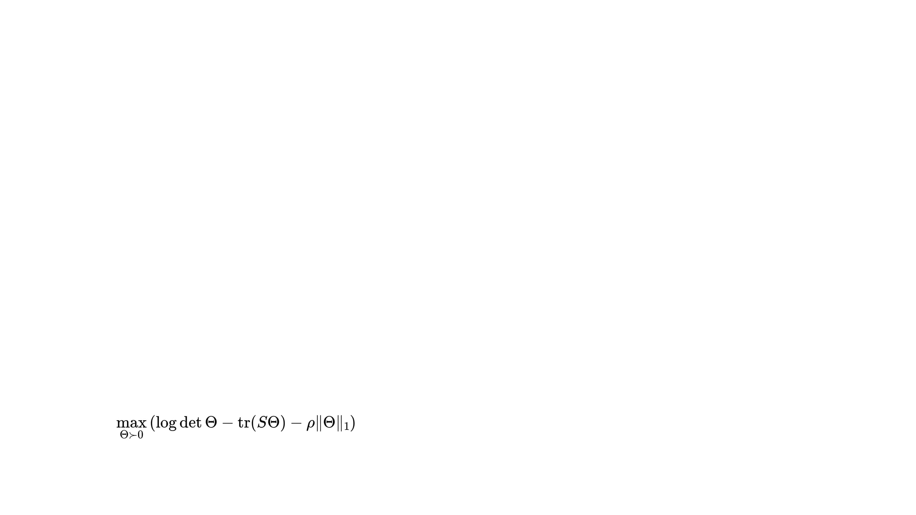
Part 1: Undirected Graphical Models
Gaussian Graphical Models (GGMs)
R Implementation
In a GGM, conditional independencies are encoded in the precision matrix (Θ = Σ⁻¹).
# Load package and compute S library("glasso") # Sample covariance S <- cov(X) # Penalty rho_val <- 0.1 # Fit graphical lasso gl_res <- glasso(s = S, rho = rho_val) # Estimated precision est_precision <- gl_res$wi # View round(est_precision, 2)
If Θ_{ij} = 0, variables X_i and X_j are conditionally independent given the others.
■
The Graphical Lasso
Estimate a sparse graph by maximizing the penalized log-likelihood:
max
(
log
det
Θ
−
tr
(
S
Θ
)
−
ρ
‖
Θ
‖
1
)
Θ
≻
0

Slide 4
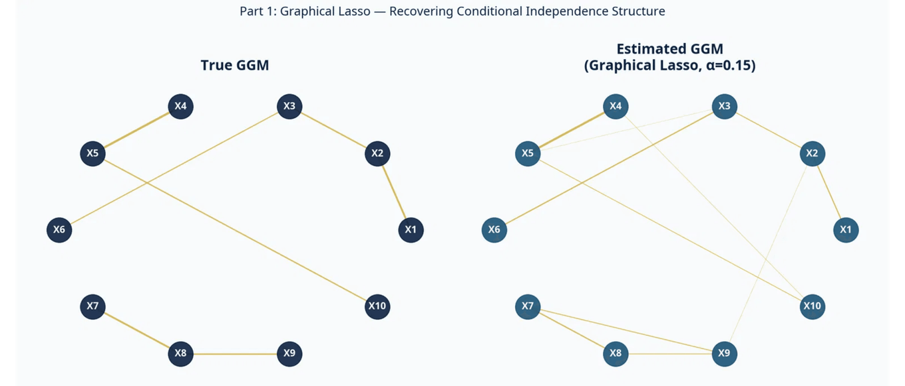
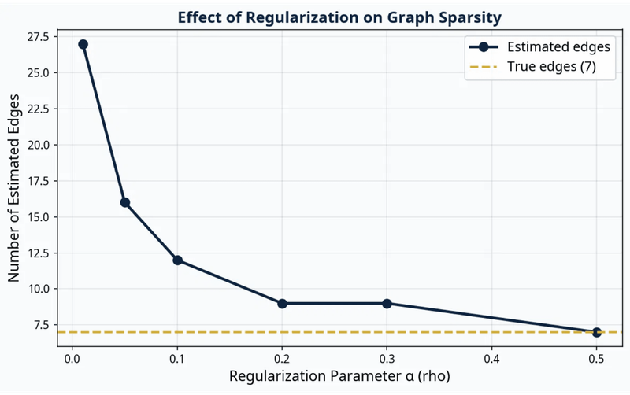
Graphical Lasso in Action
The Role of Penalty (ρ)
The Graphical Lasso successfully recovers the true conditional independence structure (the "skeleton" of the graph) from the sample covariance matrix, even when the sample size is relatively small.
The (L_1) penalty parameter (ρ or α) directly controls the sparsity of the estimated precision matrix.
High ρ: Fewer edges (more false negatives).
Low ρ: More edges (more false positives).

Slide 5
Part 2: Directed Graphical Models
Structure Learning
R Implementation
Before applying do-calculus, we often learn the DAG structure from observational data.
# Load the pcalg package library("pcalg") # Define sufficient statistics suffStat <- list(C = cor(df_dag), n = n_samples) # Run the PC algorithm pc_fit <- pc(suffStat, indepTest = gaussCItest, alpha = 0.01, labels = colnames(df_dag), verbose = FALSE) # Plot the resulting CPDAG plot(pc_fit, main = "Estimated CPDAG")
The PC Algorithm
Constraint-Based: Uses tests for conditional independence to remove edges.
■
Orientation: Finds colliders and orients edges, then applies rules to avoid cycles.
■

Slide 6

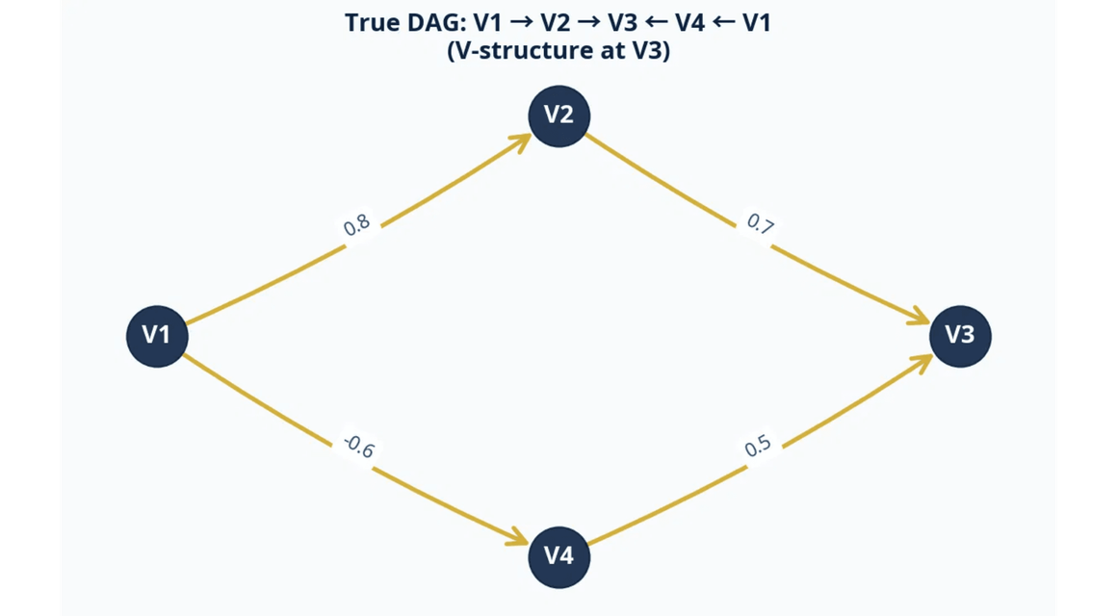
PC Algorithm: Learning the DAG
Interpreting the Output
The PC algorithm outputs a Completed Partially Directed Acyclic Graph (CPDAG). You will notice that not all edges are directed.
MARKOV EQUIVALENCE CLASSES
The Power of V-Structures
The v-structure (V2 → V3 ← V4) is identifiable because V2 and V4 are marginally independent but become dependent when conditioning on V3. The PC algorithm orients these edges.
Observational data alone cannot distinguish between graphs that encode the same conditional independencies (e.g., A → B → C vs A ← B ← C).

Slide 7
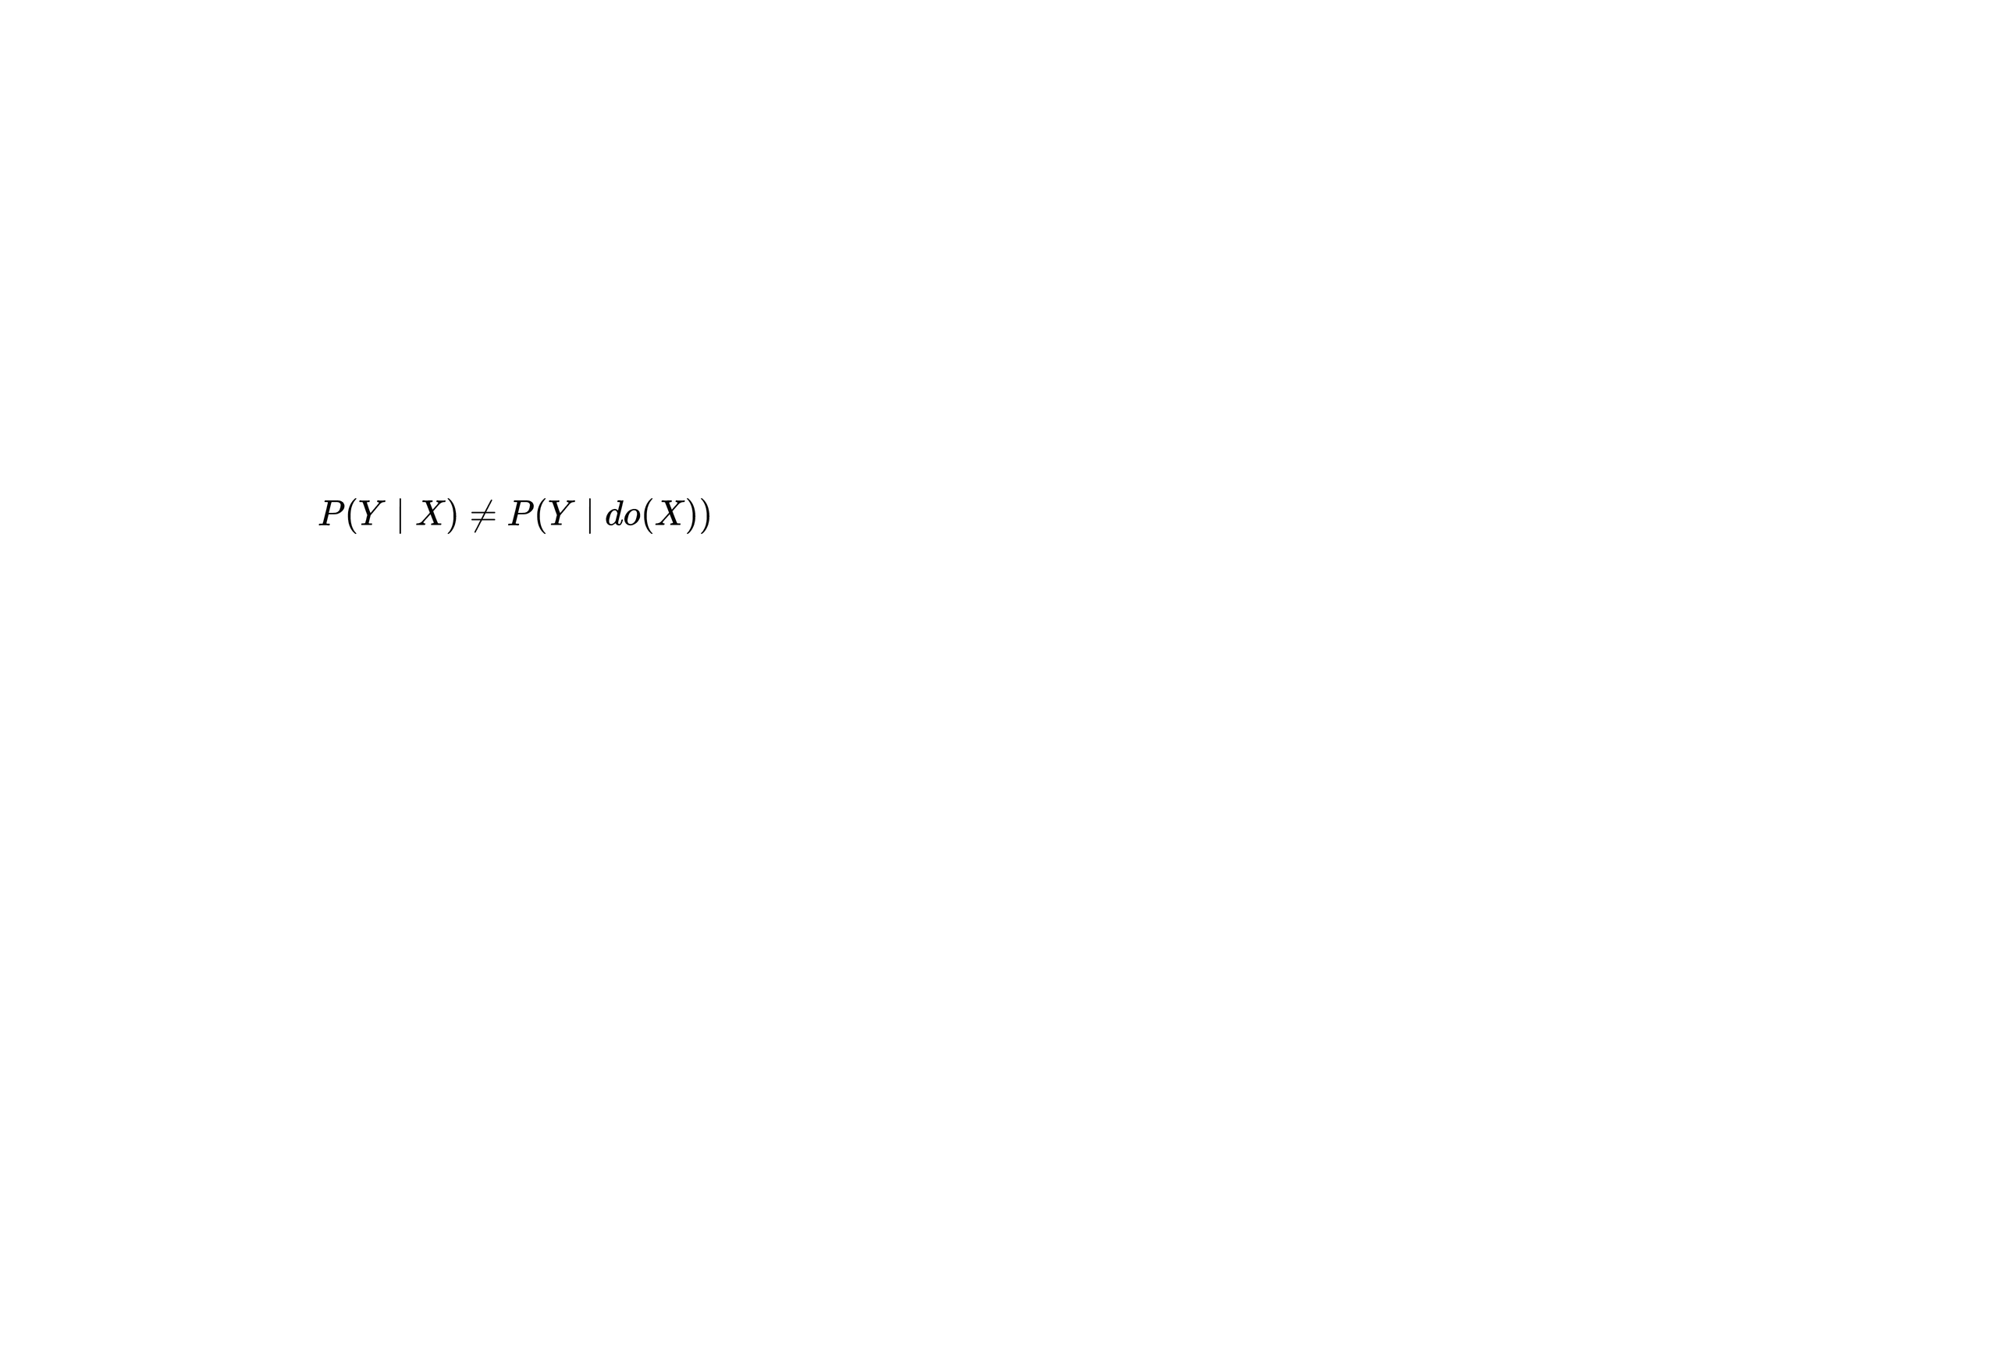
Part 3: Causal Inference & Do-Calculus
From Seeing to Doing
Defining a DAG in R
Once we have a DAG, we can move beyond mere association to estimate causal effects.
# Load and plot DAG
library
(
"dagitty"
P
(
Y
∣
X
)
≠
P
(
Y
∣
d
o
(
X
)
)
);
library
Observing (X): Filters the population to those who naturally chose X.
(
■
"ggdag"
)
Intervening (do(X)): Forces everyone to take X, breaking incoming arrows to X.
# Define & plot in compact form
■
dag_model
<-
dagitty
(
'dag { C [pos="0,1"]; X [exposure,pos="-1,0"]; M
[pos="0,0"]; Y [outcome,pos="1,0"]; C -> X; C ->
Y; X -> M; M -> Y }'
)
ggdag
(dag_model, text_size =
5
) +
theme_dag
()
Note: Use the dagitty package to find adjustment sets and test d-separation.

Slide 8
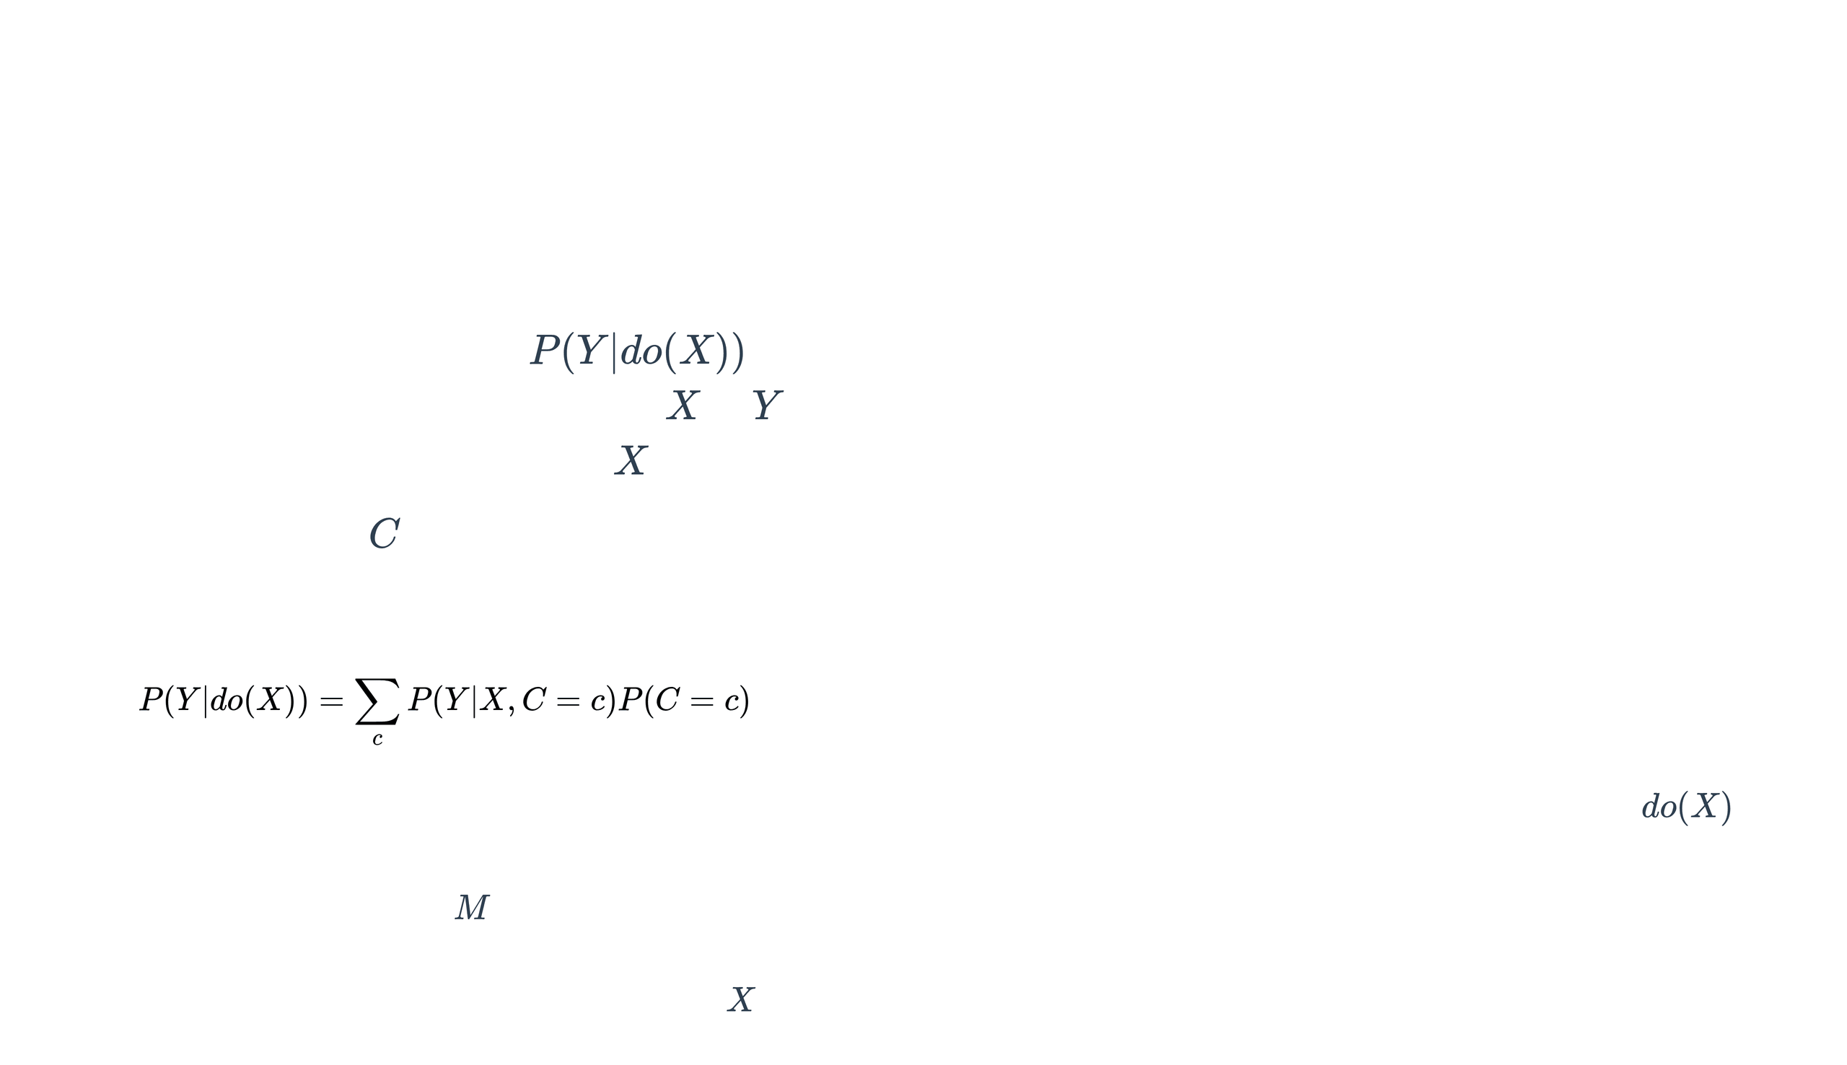
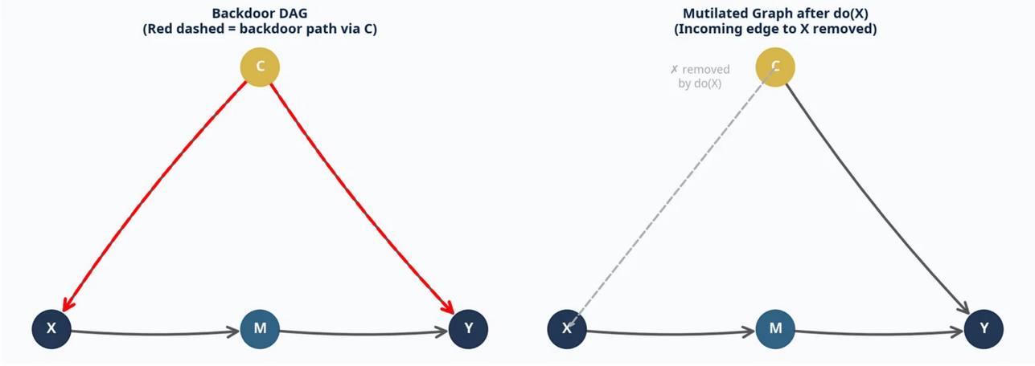
The Backdoor Criterion
Blocking Confounding Paths
To estimate the causal effect
P
(
Y
|
d
o
(
X
)
)
, we
must block all "backdoor" paths from
X
to
Y
(paths with an arrow pointing into
X
).
If a set of variables
C
satisfies the backdoor
criterion, we can use the
adjustment formula
:
P
(
Y
|
d
o
(
X
)
)
=
∑
P
(
Y
|
X
,
C
=
c
)
P
(
C
=
c
)
c
Left: Observational DAG. Right: Mutilated graph under
d
o
(
X
)
.
WHY NOT CONDITION ON M?
Conditioning on a mediator (
M
) blocks the causal
pathway we want to measure! The backdoor criterion
explicitly forbids conditioning on descendants of
X
.

Slide 9
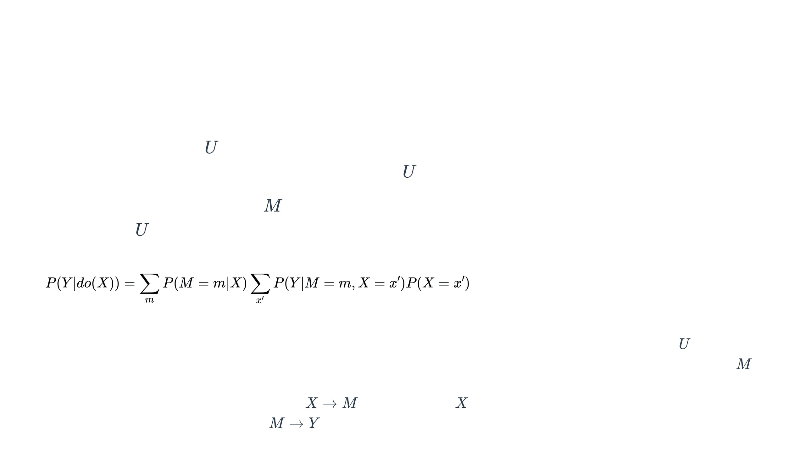
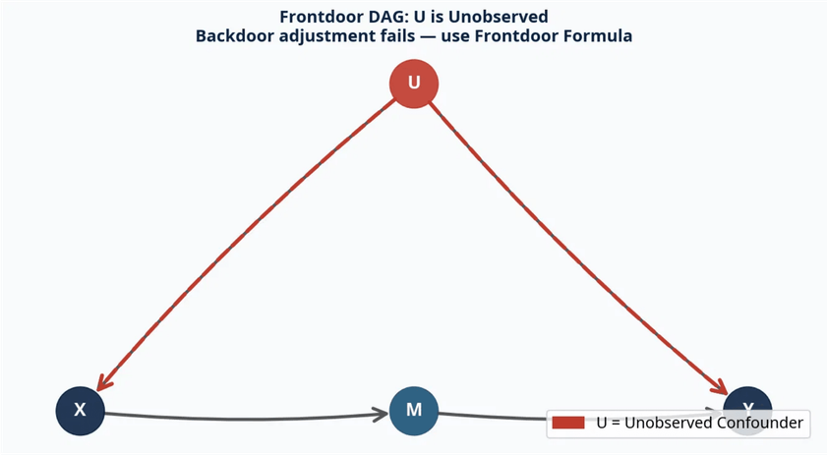
The Frontdoor Criterion
Unobserved Confounding
What if the confounder
U
is
unobserved
? We cannot use the
backdoor criterion because we cannot condition on
U
.
However, if we have a mediator
M
that is fully observed and
isolated from
U
, we can use the
Frontdoor Formula
:
P
(
Y
|
d
o
(
X
)
)
=
∑
P
(
M
=
m
|
X
)
∑
P
(
Y
|
M
=
m
X
=
x
′
)
P
(
X
=
x
′
)
m
′
,
x
The unobserved confounder
U
(red) blocks
TWO SEQUENTIAL BACKDOORS
the backdoor path, but the mediator
M
The frontdoor formula works by applying the backdoor criterion twice:
provides a frontdoor path.
first to estimate the unconfounded effect of
X
→
M
, and then using
X
to adjust for the confounded effect of
M
→
Y
.

Slide 10

Summary of Do-Calculus Rules
Pearl's do-calculus provides a complete set of rules for transforming causal quantities (expressions with the do-operator) into observational quantities (expressions without the do-operator).
If an effect is identifiable, it can be derived using a sequence of these three rules.

Slide 11

Lab Exercises & Next Steps
Open DS6410_Lab_Graphical_Models.Rmd in RStudio.
■
■
Ensure all required packages are installed (
glasso
,
pcalg
,
dagitty
, etc.).
Work through Parts 1, 2, and 3 sequentially.
■
Challenge: In Part 3, try adding an unobserved confounder to the backdoor DAG. Observe how the adjustment set changes, and when the frontdoor criterion becomes necessary.
■
Questions? Raise your hand or ask in the chat.

