Slide 1

Joint Gaussian Copula Model for Mixed Data with Application to Imaging Epigenetics Study of Schizophrenia
Aiying Zhang
Feb 18th,2019
http://www.ninds.nih.gov

Slide 2

Schizophrenia (SZ)
SZ is a chronic and severe mental disorder
Hallucinations, derealization, delusions, loss of initiative,
and cognitive dysfunction
Related to disrupted brain connectivity
Recent techniques: combining heterogeneous data
From various molecular levels (e.g., single nucleotide polymorphisms (SNPs),
DNA methylation) to organ and tissue levels (e.g., brain fMRI).
Provide new perspectives on complex mental diseases like SZ.
Epigenetics
The study of how genes are regulated through reversible
and heritable molecular mechanisms
Modify gene expression
DNA methylation
Imaging-epigenetics:
Provide a promising approach for precision medicine
ALBERTO RUGGIERI / GETTY IMAGES
Michael Greicius et al. , Science

Slide 3
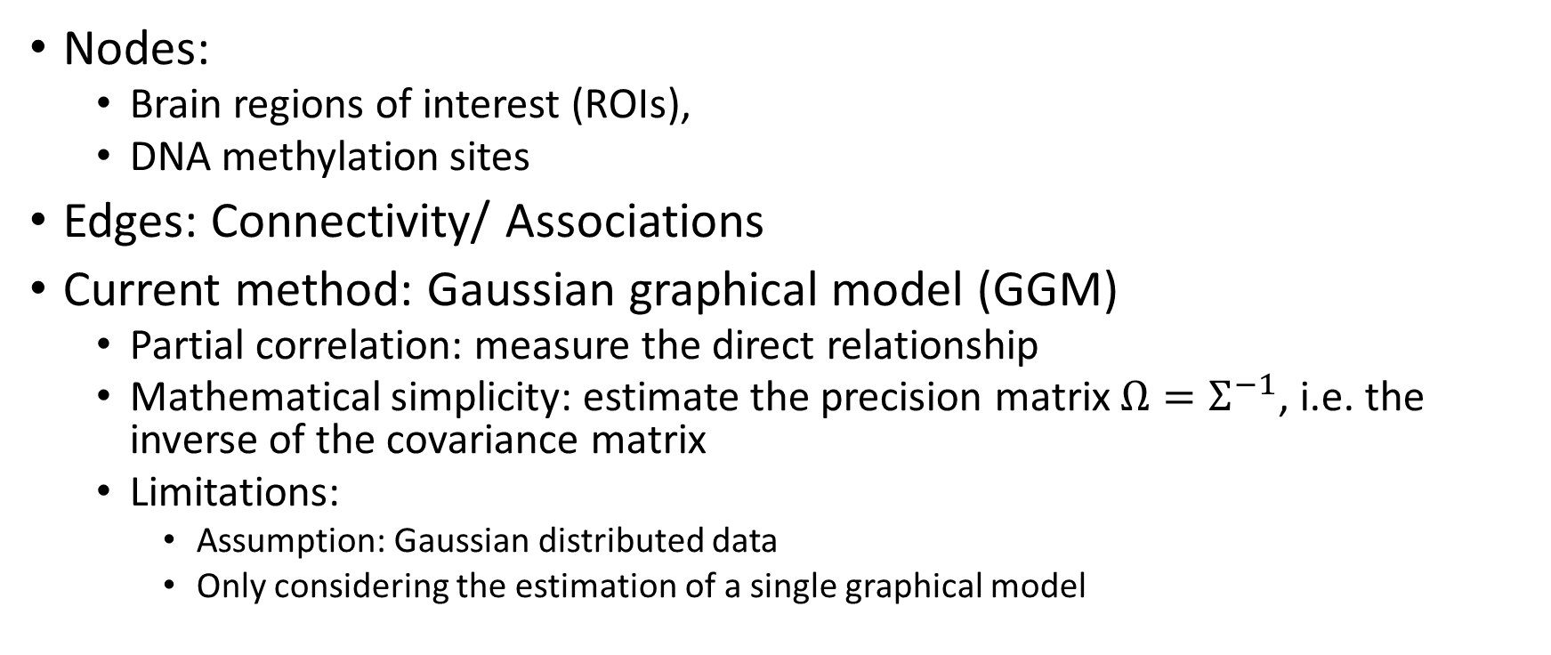
Graphical Models
Nodes:
Brain regions of interest (ROIs),
DNA methylation sites
Edges: Connectivity/ Associations
Current method: Gaussian graphical model (GGM)
Partial correlation: measure the direct relationship
Mathematical simplicity: estimate the precision matrix $Ω=Σ^{−1}$, i.e. the inverse of the covariance matrix
Limitations:
Assumption: Gaussian distributed data
Only considering the estimation of a single graphical model

Slide 4
Motivations
Clinically:
Understand the neuro-epigenetics mechanism of schizophrenia
Provide prospective genes for precision medicine
Mathematically:
Relax the Gaussian assumption
Jointly estimate multiple graphical models

Slide 5
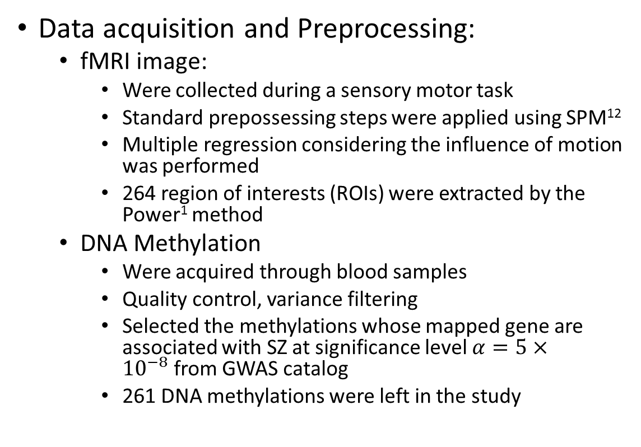
Materials
Data description:
Source: the Mind Clinical Imaging Consortium (MCIC)
Subjects: 183
79 SZ patients
104 healthy controls
Data type:
fMRI image
DNA Methylation
Data acquisition and Preprocessing:
fMRI image:
Were collected during a sensory motor task
Standard prepossessing steps were applied using SPM¹²
Multiple regression considering the influence of motion was performed
264 region of interests (ROIs) were extracted by the Power¹ method
DNA Methylation
Were acquired through blood samples
Quality control, variance filtering
Selected the methylations whose mapped gene are associated with SZ at significance level $α=5×{10}^{−8}$from GWAS catalog
261 DNA methylations were left in the study
¹J. Power, D. Fair, B. Schlaggar, and S. Petersen, “The development of human functional brain networks,” Neuron, 67, 735–748 (2010).

Slide 6
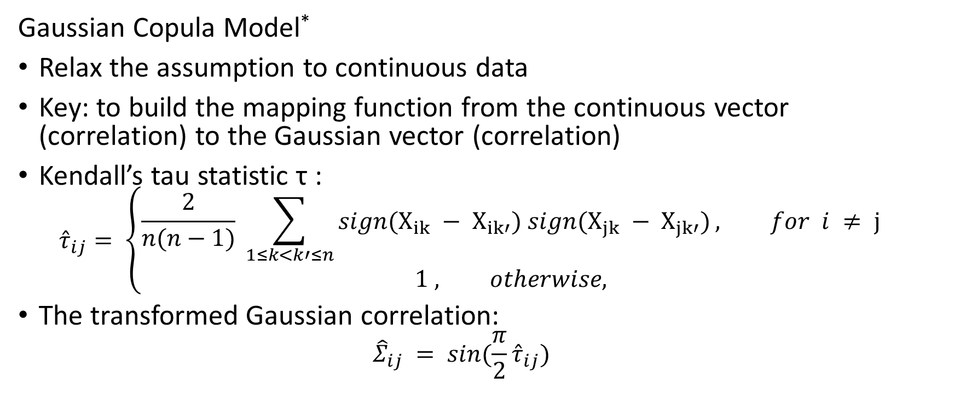
Methods:
Gaussian Copula Model*
Relax the assumption to continuous data
Key: to build the mapping function from the continuous vector (correlation) to the Gaussian vector (correlation)
Kendall’s tau statistic τ :
$${\hat{τ}}_{ij}= \left\{\begin{aligned}\frac{2}{n(n−1)} \sum_{1≤k<k′≤n}{sign(X_{ik} − X_{ik′}) sign(X_{jk} − X_{jk′})}, for i ≠ j \\ 1 , otherwise,\end{aligned}\right.$$
The transformed Gaussian correlation:
$${\hat{Σ}}_{ij} = sin(\frac{π}{2}{\hat{τ}}_{ij})$$
*H. Liu, J. D. Lafferty, and L. A. Wasserman, “The nonparanormal: semiparametric estimation of high dimensional undirected graphs,” J. Mach. Learn. Res.,10, 2295–2328 (2009).

Slide 7
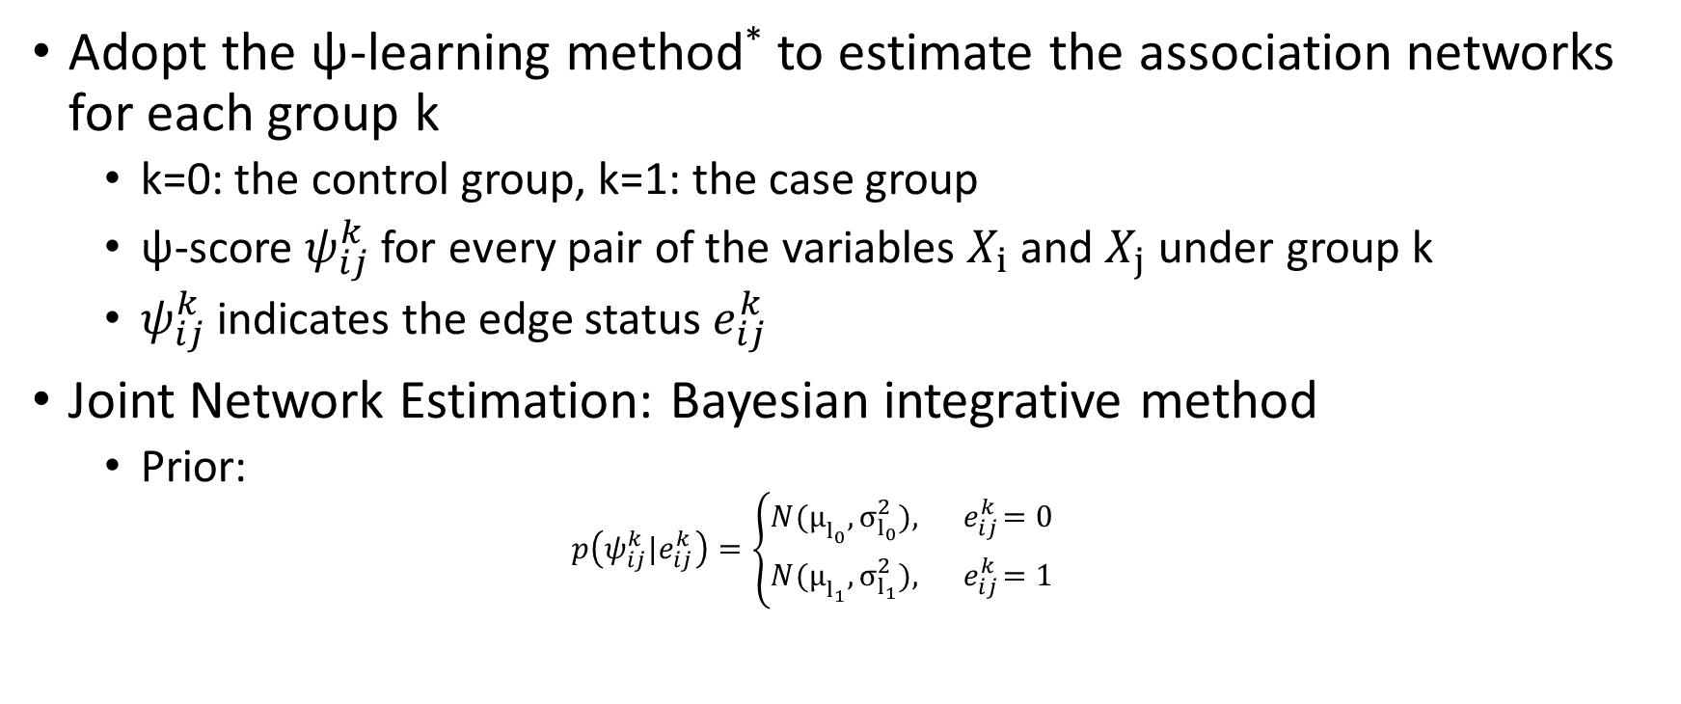
Methods:
Adopt the ψ-learning method* to estimate the association networks for each group k
k=0: the control group, k=1: the case group
ψ-score $ψ_{ij}^{k}$ for every pair of the variables $X_{i}$ and $X_{j}$ under group k
$ψ_{ij}^{k}$ indicates the edge status $e_{ij}^{k}$
Joint Network Estimation: Bayesian integrative method
Prior:
$$p\left({ψ_{ij}^{k}|e}_{ij}^{k}\right)=\left\{\begin{aligned}N(μ­_{l_{0}}, σ_{l_{0}}^{2}), { e}_{ij}^{k}=0 \\ N(μ­_{l_{1}}, σ_{l_{1}}^{2}), { e}_{ij}^{k}=1\end{aligned}\right.$$
*A. Zhang, J. Fang, F. Liang, V. Calhoun and Y. Wang. Aberrant Brain Connectivity in Schizophrenia Detected via Fast Gaussian Graphical Model. IEEE JHBI (2018).

Slide 8
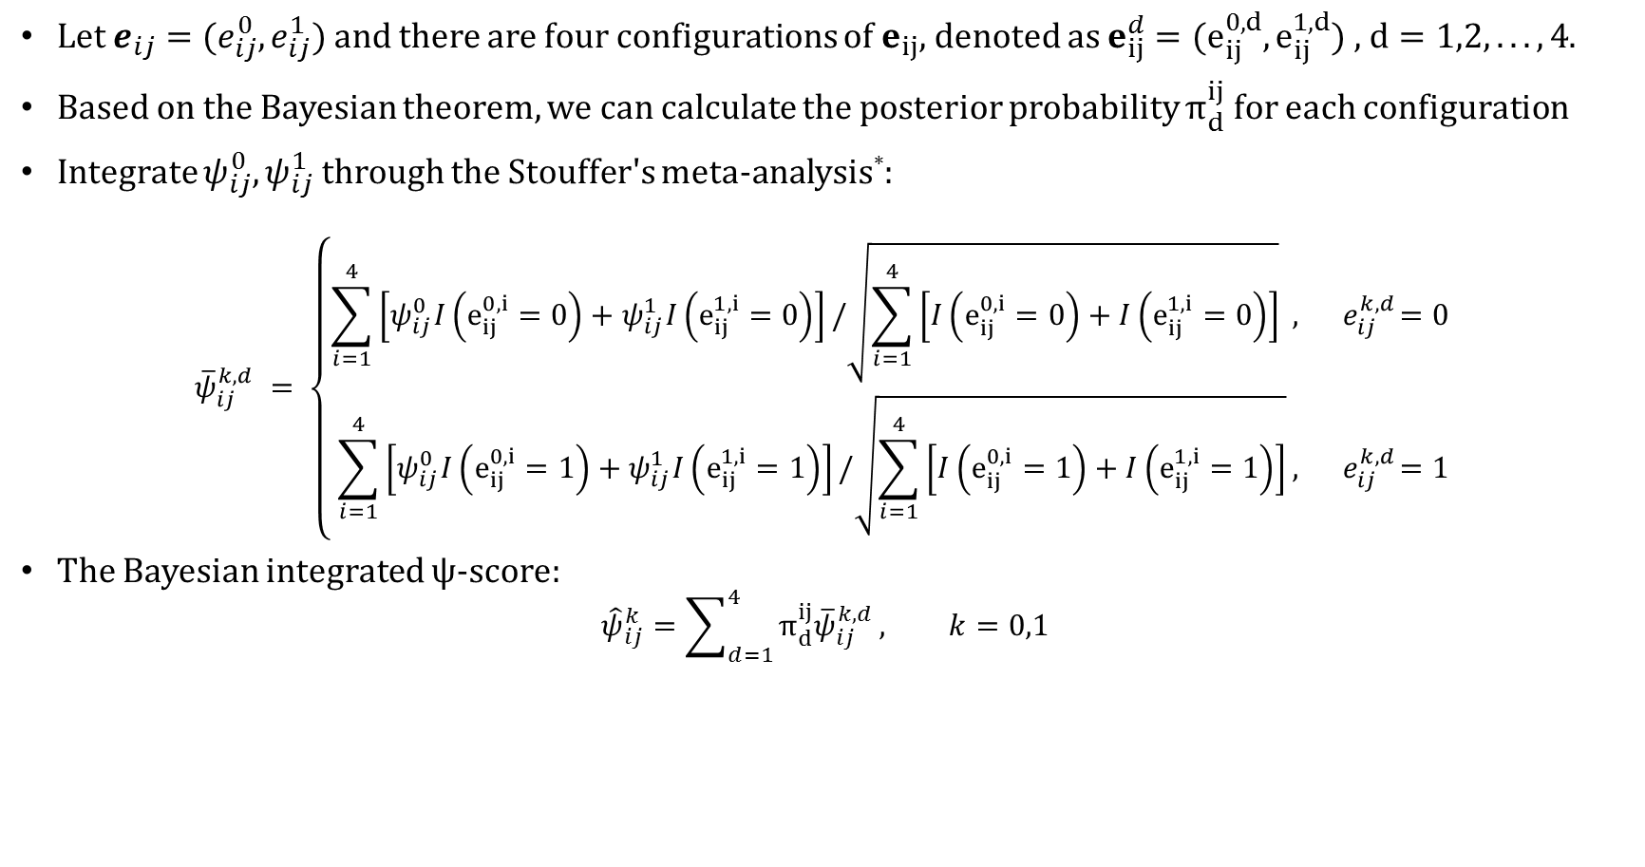
Methods:
Let $e_{ij}=(e_{ij}^{0}, e_{ij}^{1})$ and there are four configurations of $e_{ij}$, denoted as $e_{ij}^{d}=(e_{ij}^{0,d},e_{ij}^{1,d})$ , $d=1,2,...,4$.
Based on the Bayesian theorem, we can calculate the posterior probability $π_{d}^{ij}$ for each configuration
Integrate $ψ_{ij}^{0}, ψ_{ij}^{1}$ through the Stouffer's meta-analysis*:
$${\overline{ψ}}_{ij}^{k,d} = \left\{\begin{aligned}\sum_{i=1}^{4}{\left[ψ_{ij}^{0}I\left(e_{ij}^{0,i}=0\right)+ψ_{ij}^{1}I\left(e_{ij}^{1,i}=0\right)\right]}/\sqrt{\sum_{i=1}^{4}{\left[I\left(e_{ij}^{0,i}=0\right)+I\left(e_{ij}^{1,i}=0\right)\right]}} , { e}_{ij}^{k,d}=0 \\ \sum_{i=1}^{4}{\left[ψ_{ij}^{0}I\left(e_{ij}^{0,i}=1\right)+ψ_{ij}^{1}I\left(e_{ij}^{1,i}=1\right)\right]}/\sqrt{\sum_{i=1}^{4}{\left[I\left(e_{ij}^{0,i}=1\right)+I\left(e_{ij}^{1,i}=1\right)\right]}}, { e}_{ij}^{k,d}=1\end{aligned}\right.$$
The Bayesian integrated ψ-score:
$${\hat{ψ}}_{ij}^{k}=\sum_{d=1}^{4}{π_{d}^{ij}{\overline{ψ}}_{ij}^{k,d}}, k=0,1$$
*Stouffer S. et al., The American Soldier: Adjustment during army life. Vol. 1. Princeton University Press, Princeton (1949).

Slide 9
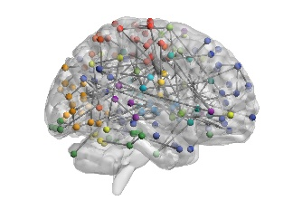
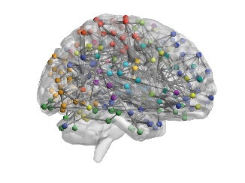
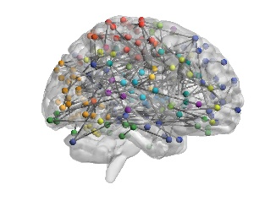

Results:
We have identified 386 and 420 edges for the case and control groups, respectively
Separate estimation
Joint estimation
SZ patients
Healthy
controls
Figure 1. The sagittal views of the brain connectivity patterns visualized by BrainNet viewer*.
*M. Xia, J. Wang, and Y. He, “Brainnet viewer: A network visualization tool for human brain connectomics,” PLoS ONE, vol. 8(7), pp. 1–15,2013.

Slide 10
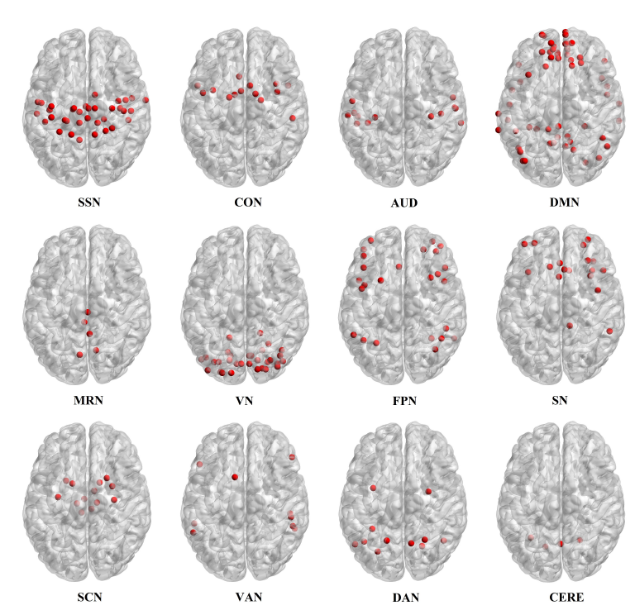
Results:
12 functional network systems
Sensory/somatomotor network (SSN)
Cingulo-opercular task control network (CON)
Auditory network (AN),
Default mode network (DMN),
Memory retrieval network (MRN),
Visual network (VN),
Fronto-parietal task control network (FPN),
Salience network (SN),
Subcortical network (SCN),
Ventral attention network (VAN),
Dorsal attention network (DAN)
Cerebellum network (CERE).
Figure 2. 12 functional networks considered in this paper. These networks are expressed in the 264 nodes of the template defined by Power et al. and visualized through the Brainnet Viewer.

Slide 11
Results:
Table 1. The identified hub ROIs and the hub methylations of the SZ patients
Hubs:
Definition: the variables (nodes) with degrees at least two standard deviation higher than the mean degrees
5 hub ROIs:
middle frontal gyrus,
cingulo-opercular task control functional network
5 DNA methylation hubs
Brain ROI hubs
Index | Anatomical location |  | Functional Networks
87 | Superior frontal gyrus, left |  | Default mode
209 | Extra-nuclear, right |  | Subcortical
181 | Middle frontal gyrus, left |  | Cingulo-opercular task control
40 | Middle frontal gyrus, right |  | Cingulo-opercular task control
56 | Superior temporal gyrus, left |  | Auditory
DNA methylation hubs
ID |  | Mapped gene
cg25477928 |  | ITSN2
cg02240622 |  | PLCB2
cg07163603 |  | HLA-A
cg15271616 |  | RUSC2
cg25519930 |  | CACNA1C

Slide 12
Results:
10 methylation-brain ROI associations for SZ
5 pairs have been reported in the literature
RANBP2 showed an important role in SZ that it has affected the insula¹ and precentral gyrus²
DDR1 has been reported to associate with cingulate gyrus³
KCNA6 has effect on the frontal gyrus⁴
TBX1 has been identified as a risk factor for mental disease with influence on the frontal gyrus⁵
Table 2. Significant neuro-epigenetic interactions for SZ patients
Brain ROIs |  |  | DNA methylation
Index | Anatomical location | Function Network | ID | Mapped gene
58 | Insula, right | Auditory | cg20668607 | DNAJC11
46 | Precentral gyrus, left | Cingulo-opercular task control | cg08028004 | RANBP2
51 | Insula, right | Cingulo-opercular task control | cg08028004 | RANBP2
82 | Precuneus, right | Default mode | cg03811411 | SGCD
42 | Cingulate gyrus, left | Cingulo-opercular task control | cg03270204 | DDR1
174 | Superior frontal gyrus, left | Frontal-parietal task control | cg15691649 | SLC17A3
45 | Medial frontal gyrus, right | Cingulo-opercular task control | cg26162582 | KCNA6
139 | Middle occipital gyrus, left | Visual | cg18236477 | ATP8A2
262 | Uncus, left | Uncertain | cg13619990 | ACSM1
97 | Superior frontal gyrus, left | Default mode | cg16722536 | TBX1
¹Denier, Christian et al., Familial acute necrotizing encephalopathy due to mutation in the RANBP2 gene. J. of Neur. Sci., 345. 1-2 (2014).
²Ferreira, P. A et al. Interconversion of red opsin isoforms by the cyclophilin-related chaperone protein Ran-binding protein 2. Proceedings of the National Academy of Sciences, 94(4), 1556-1561 (1997).
³Zhao, Z., et al., Transcriptome sequencing and genome-wide association analyses reveal lysosomal function and actin cytoskeleton remodeling in schizophrenia and bipolar disorder. Molecular psychiatry, 20(5), 563 (2015).
⁴Van Poucke, M., et al., Experimental validation of in silico predicted KCNA1, KCNA2, KCNA6 and KCNQ2 genes for association studies of peripheral nerve hyperexcitability syndrome in Jack Russell Terriers Neuromuscular Disorders, 22(6), 558-565 (2012).
⁵Hiramoto, T., et al., Tbx1: identification of a 22q11.2 gene as a risk factor for autism spectrum disorder in a mouse model. Human Molecular Genetics, 20(24), 4775–4785 (2011).

Slide 13
Conclusion
Proposed a novel approach to address heterogeneous data and joint network estimation for distinct but related conditions.
Applied the method to a real SZ study which includes the brain fMRI image and the DNA methylation data.
Several of our results have been verified in the literature
Provide some potential brain-gene pathways

Slide 14


Acknowledgement
Funding
NIH (R01GM109068, R01MH104680, R01MH107354)
NSF (#1539067)
Collaborators
Yu-Ping Wang
Tulane University
Vince D. Calhoun
The Mind Research Network

