Slide 1
Page Design
ONE TEAM

Slide 2
Team Logic
Team

Slide 3

Team Manage Page
Team Name
Team Ma
Member
Drop Out
Leader View

Slide 4
Team Manage Page
Team Name
Drop Out
Member View
Member List
Member List
Member List

Slide 5

Team Manage Page
Search
· My Projects
· All Projects Tree

Slide 6
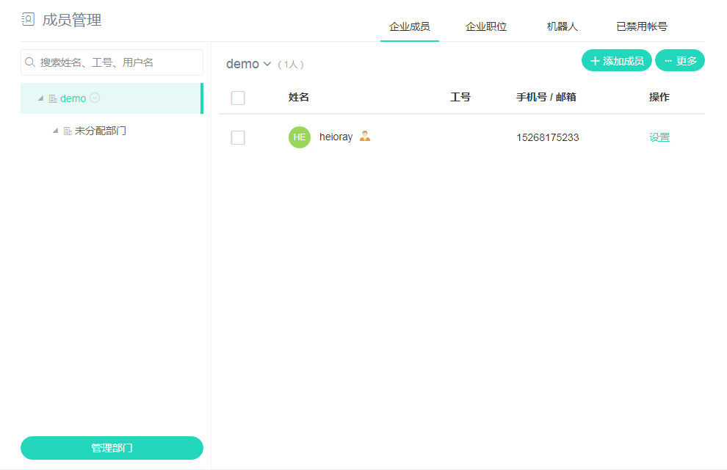
Team Manage Page

Slide 7
Leader Dashboard Page
My Team
My Fellow
All
Search

Slide 8
Leader Dashboard Page
Uniform Header
My Team
My Fellow
All
Search

Slide 9
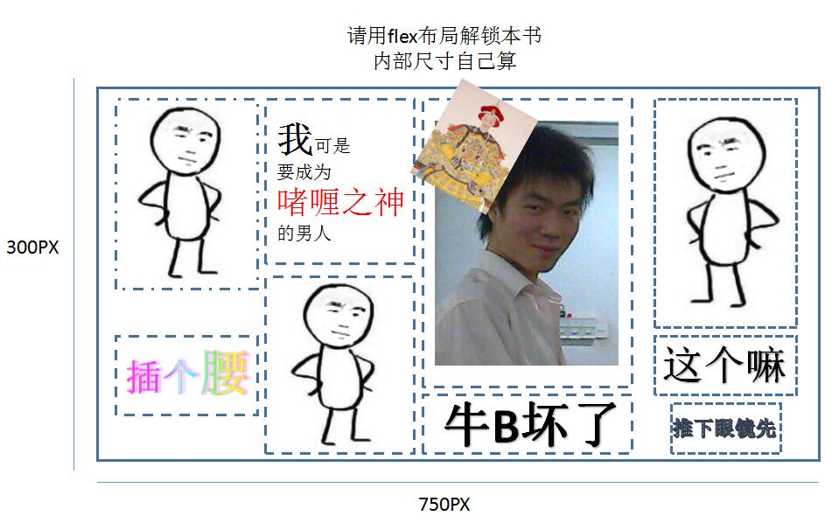
点菜专用图
点菜
点菜
点菜
点菜
点菜
点菜
点菜
点菜
点菜
点菜
点菜
点菜
点菜
点菜
点菜
点菜
点菜
点菜
点菜
点菜
点菜

