Slide 1
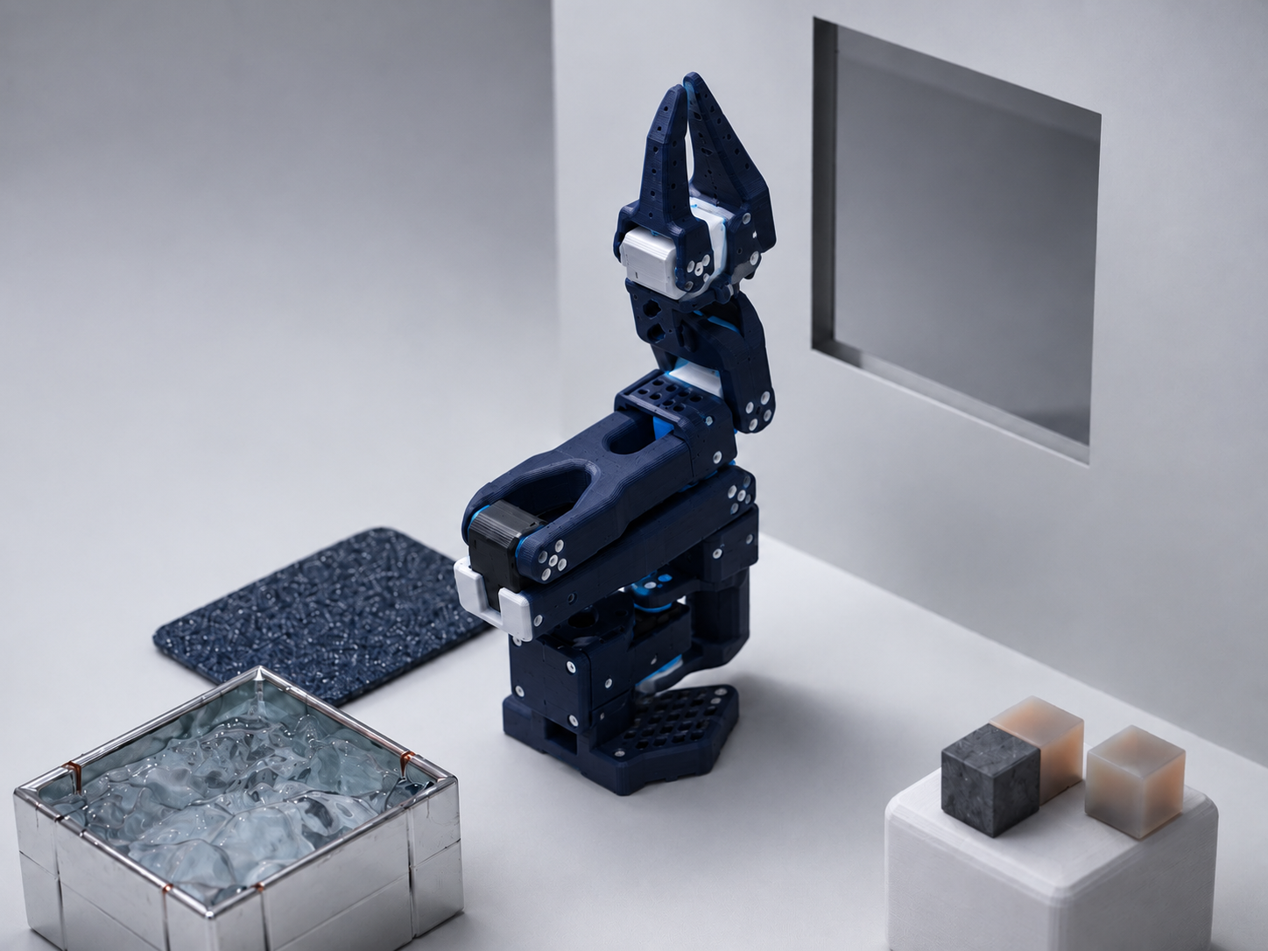

MAKING VIRTUAL OBJECTS FEEL PHYSICAL
Towards building a virtual haptic playground for LeRobot SO101 as a digital twin within Blender
VIRTUAL WALL CONSTRAINT
FRICTION PAD
PHYSICS BLOCKS (Mass / Inertia)
WATER DYNAMICS

