Slide 1
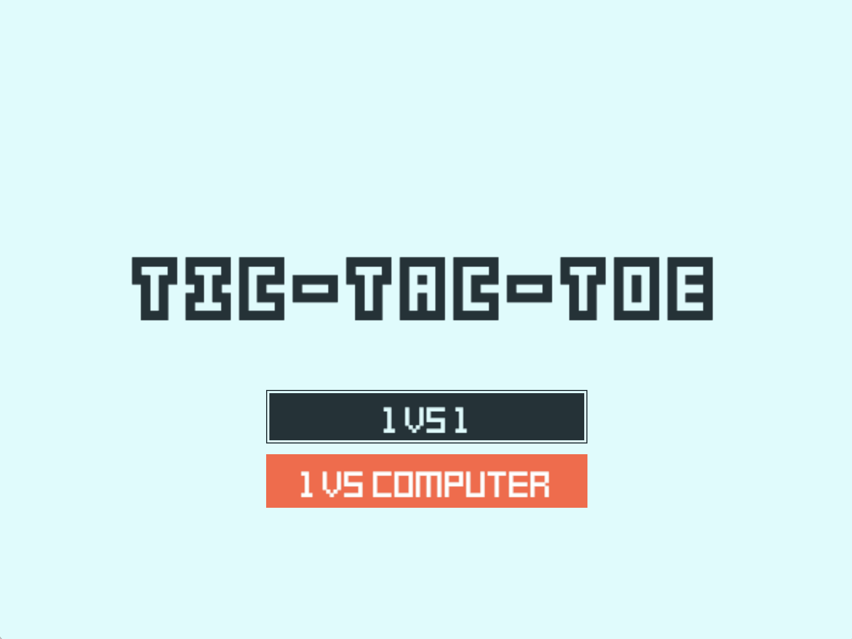
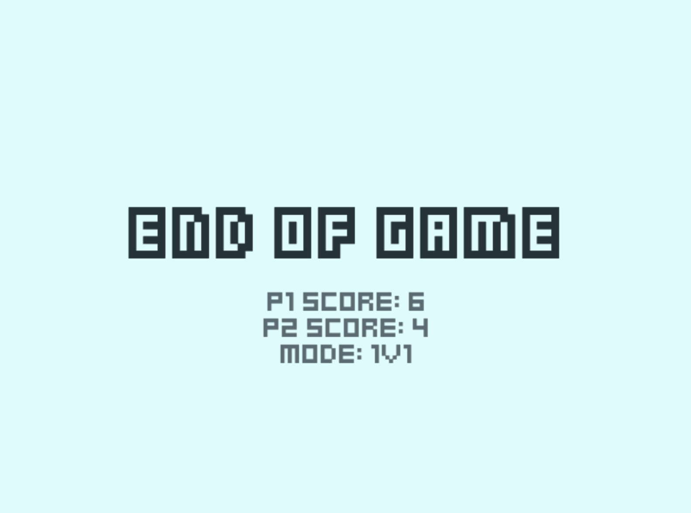
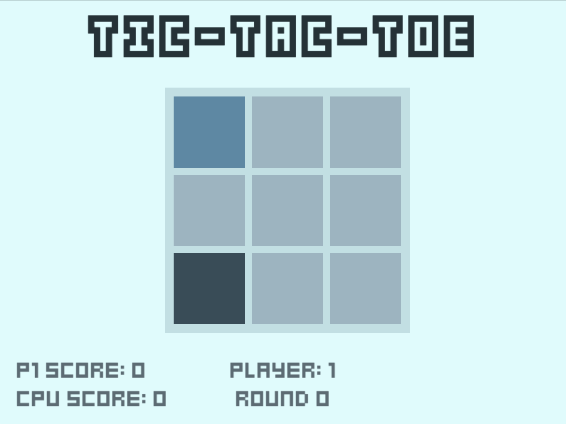
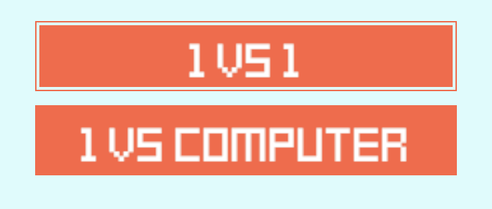
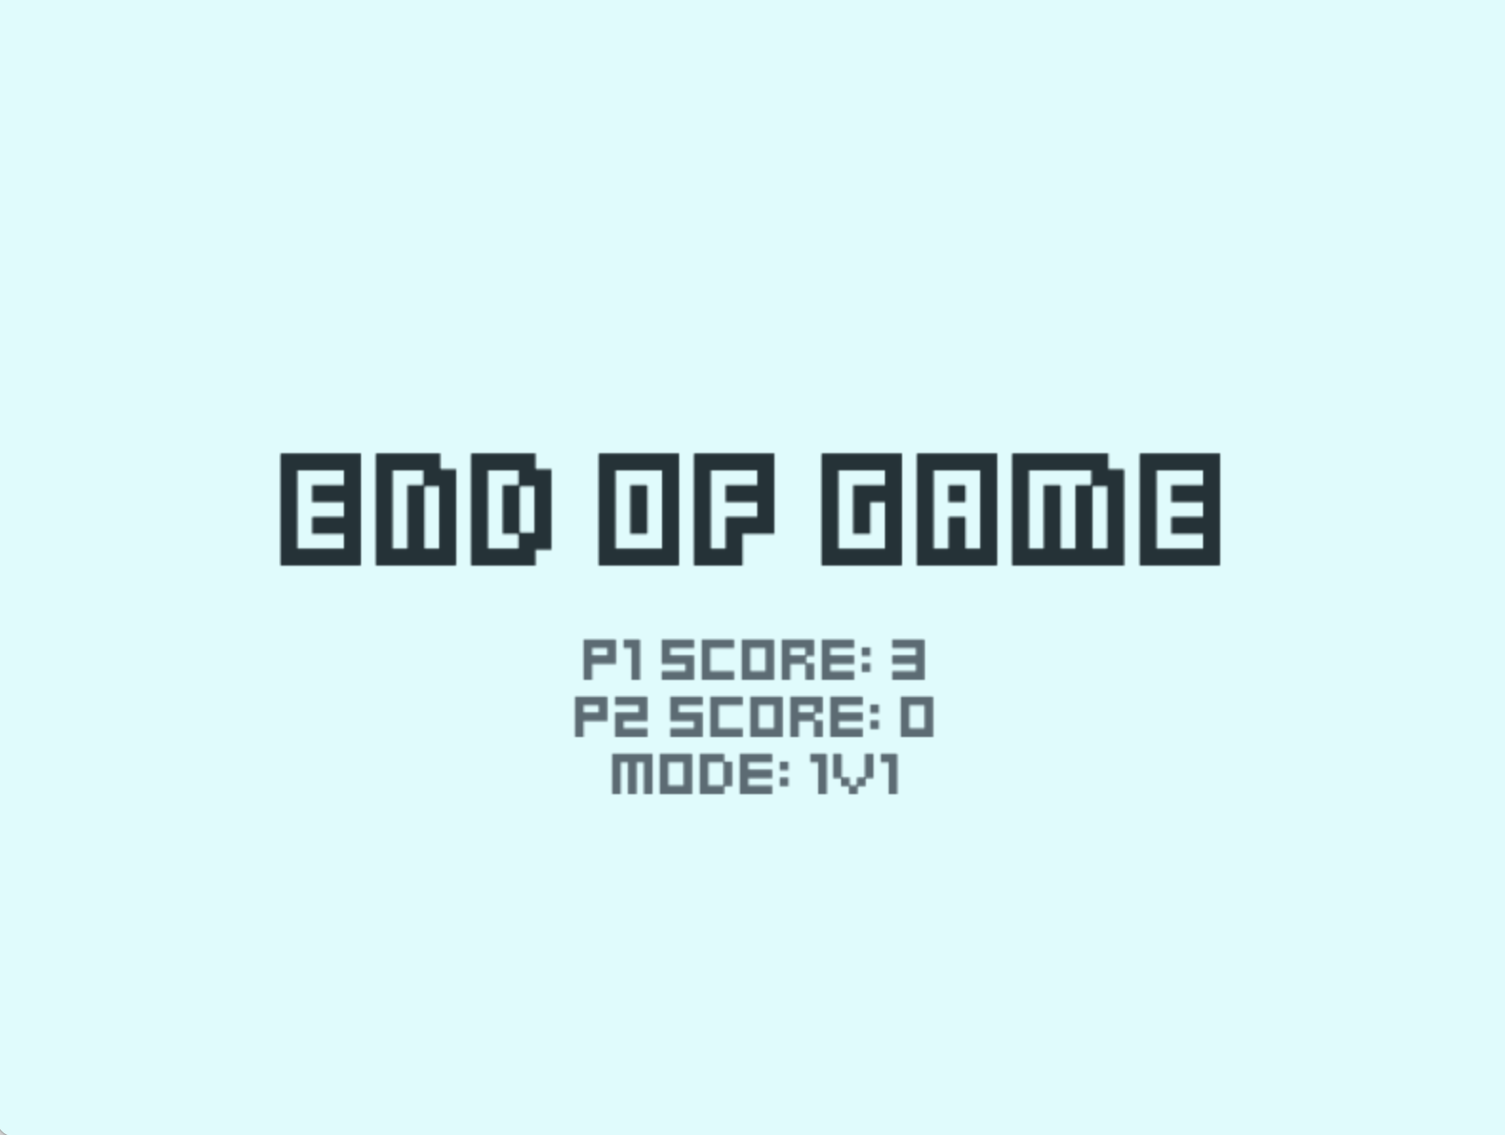
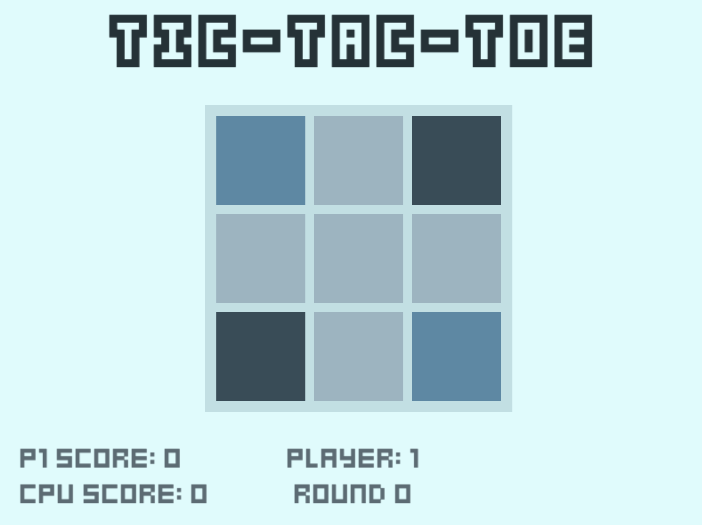
Test 01 Menu Screen 1
Demonstrating selection, normal state and hove state
Test 11 End of Game Screen
Player 1 Score
Player 2 Score
Score Mode
Test 10 CPU “difficult” demonstrating strategy by occupying two corners by going first and blocking the human player.

Slide 2
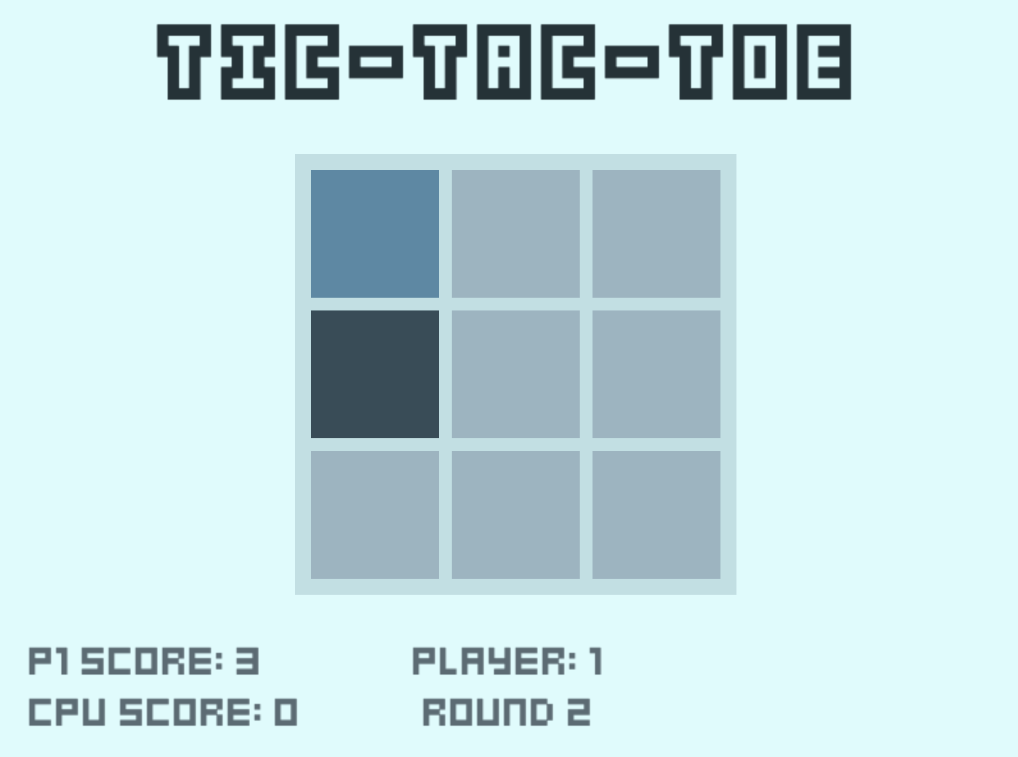
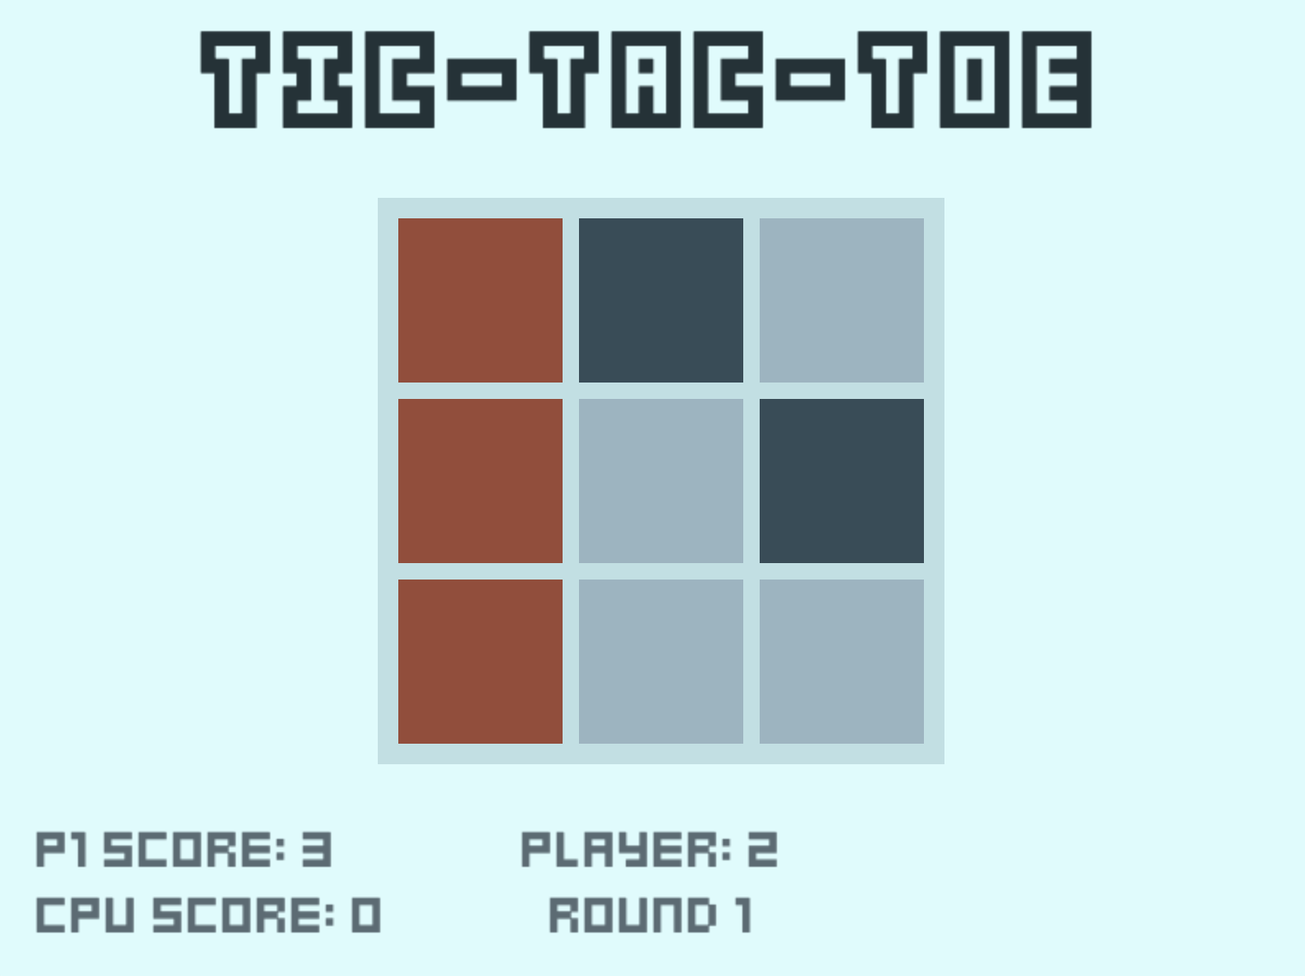
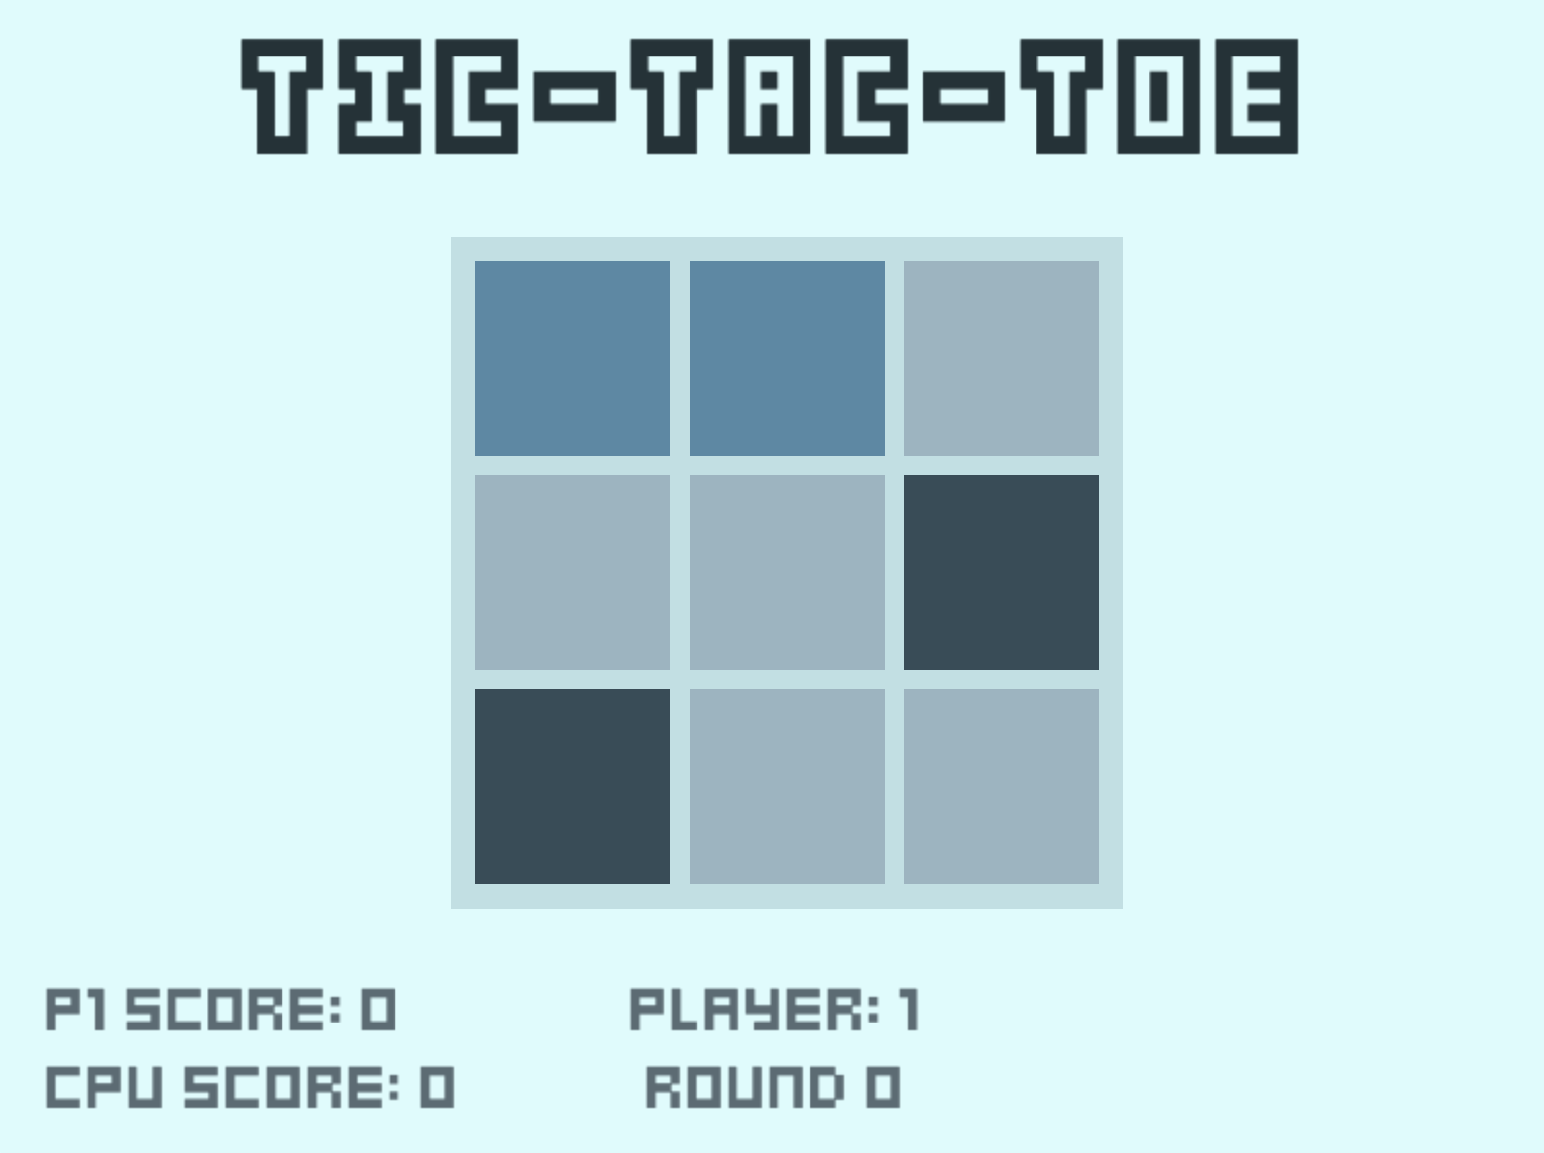
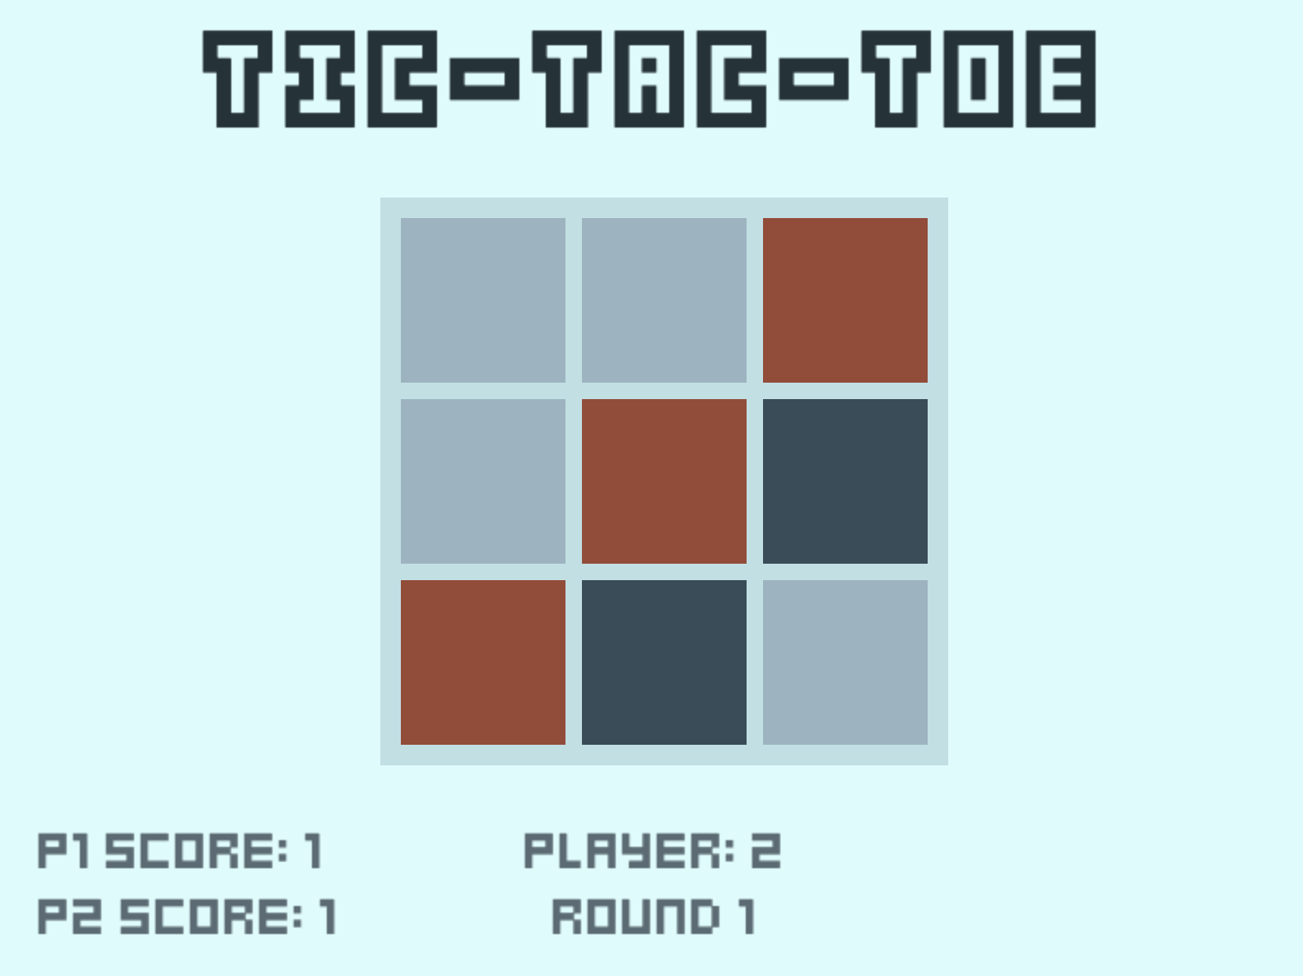
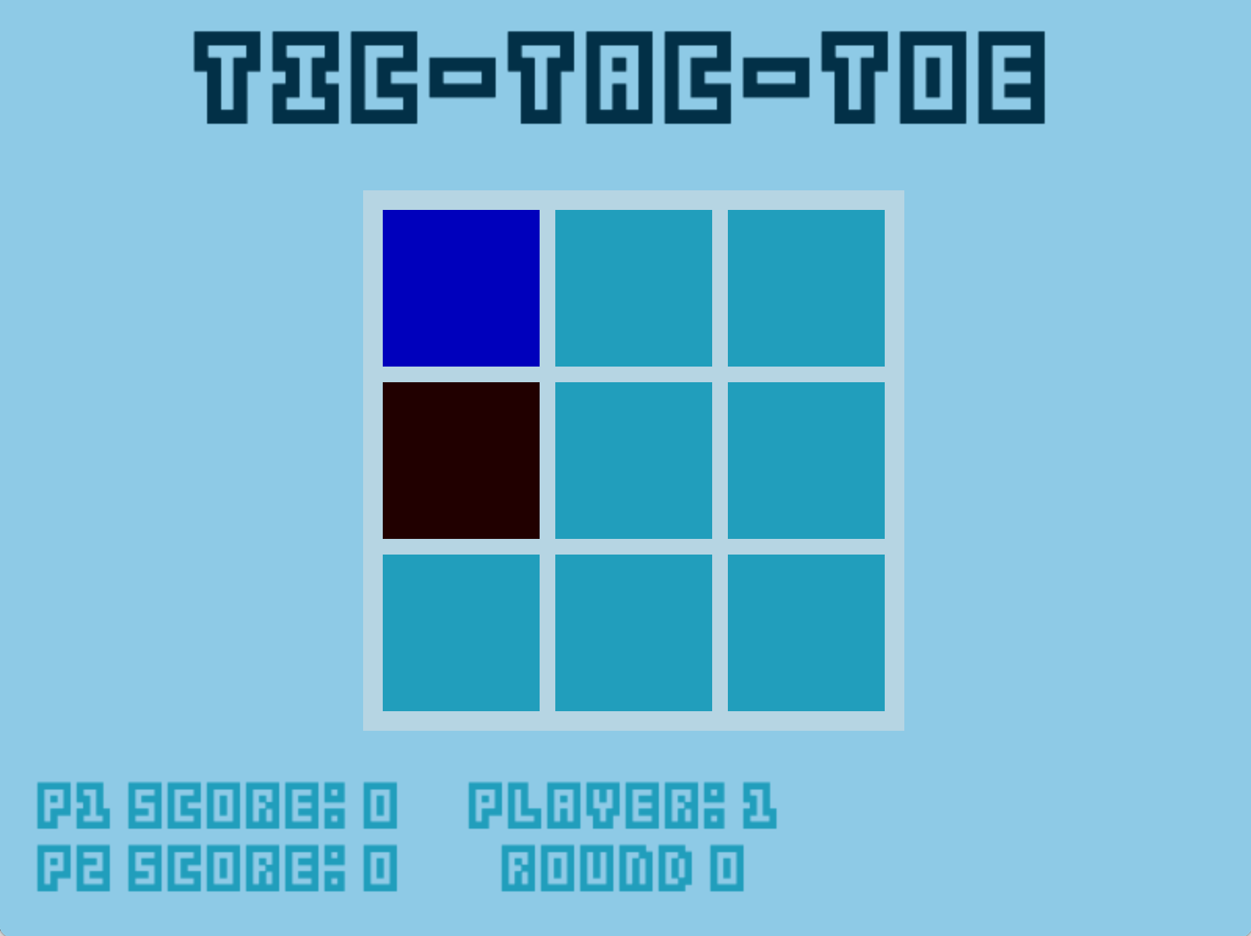
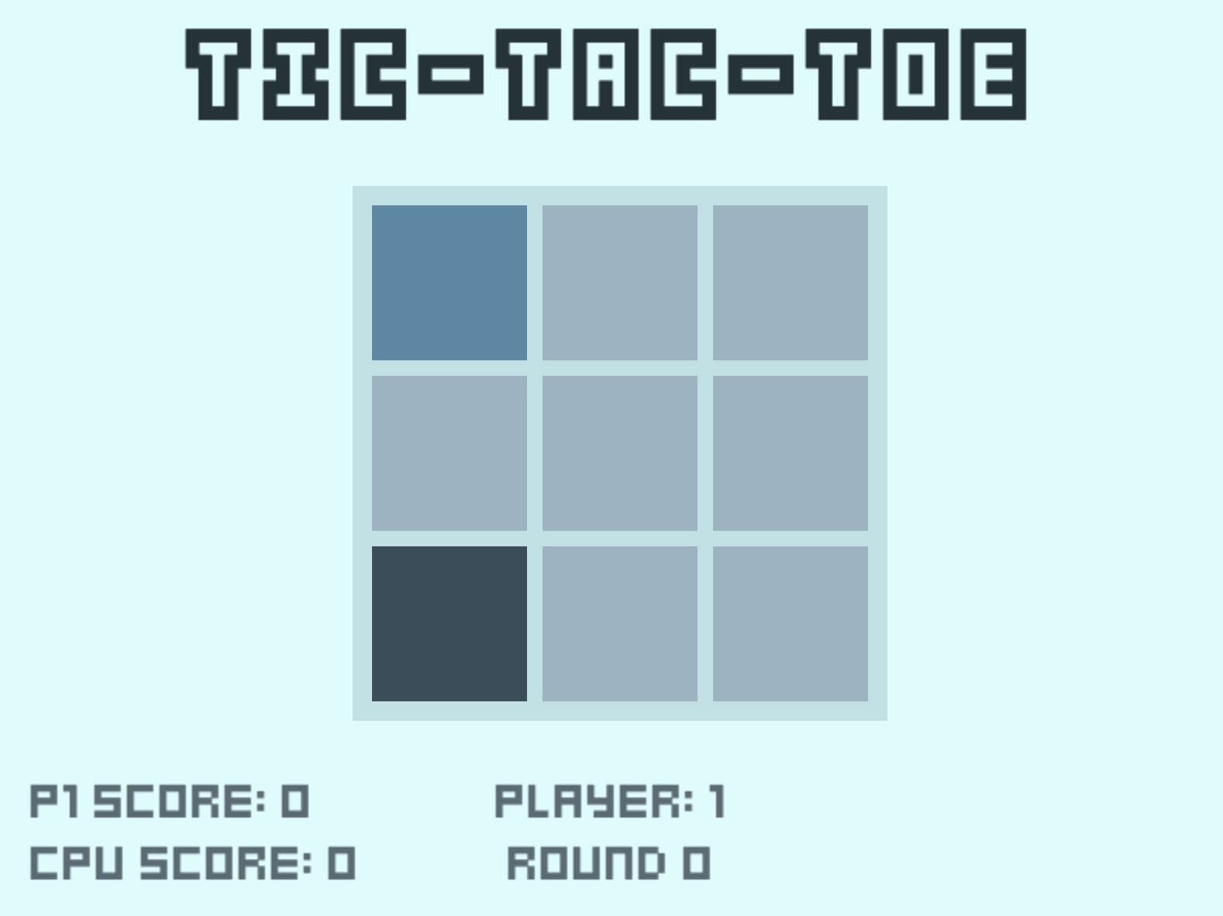
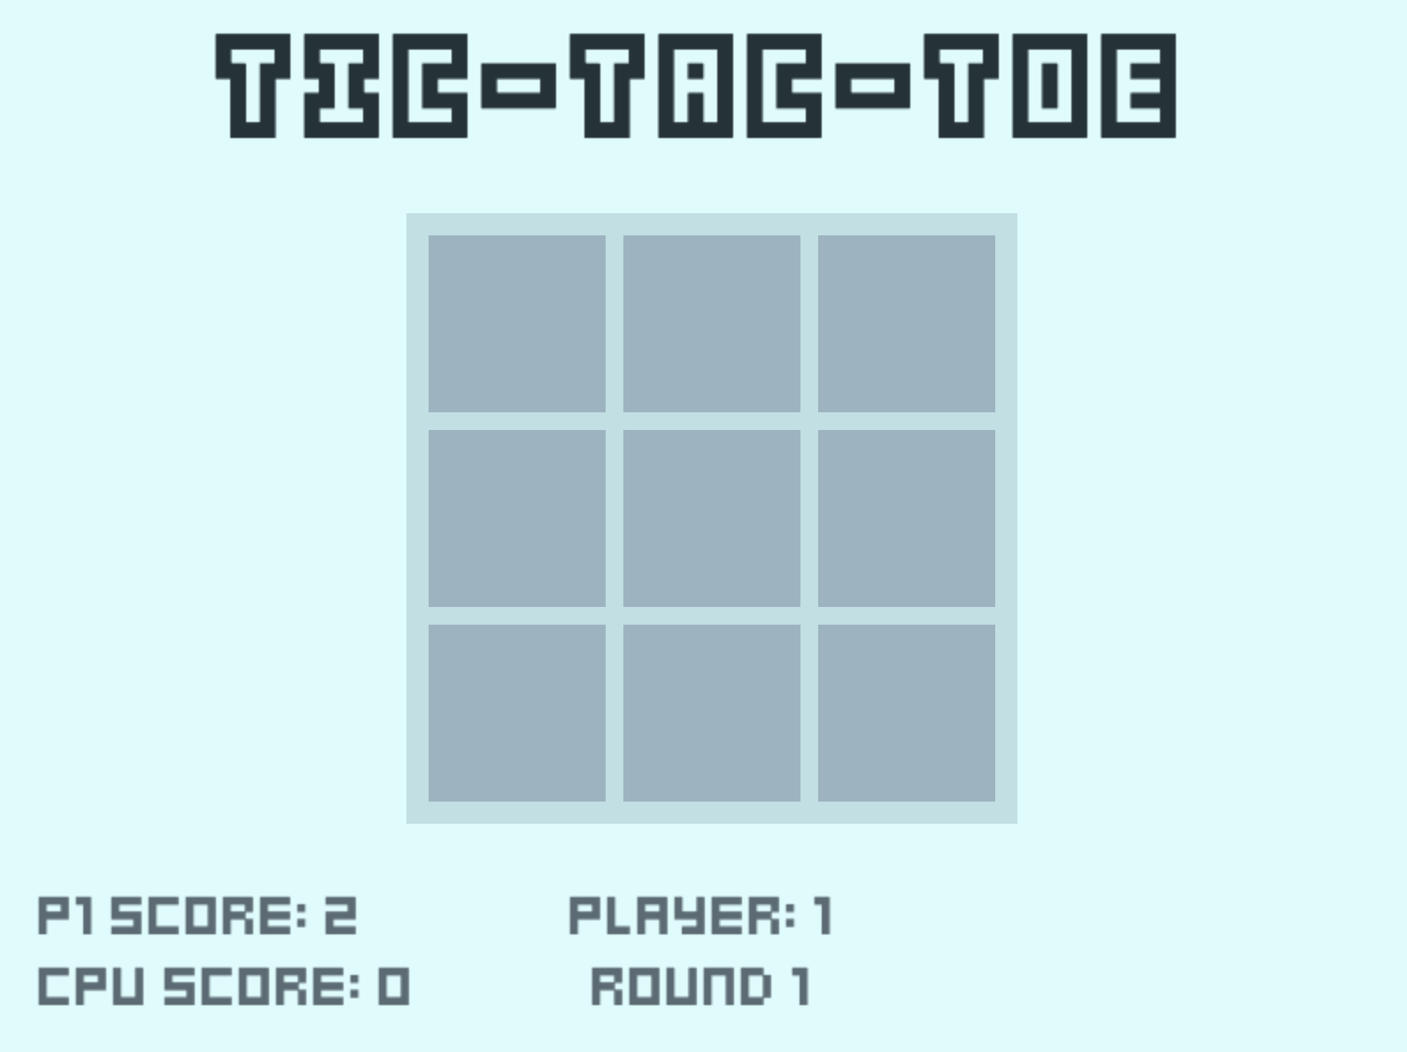
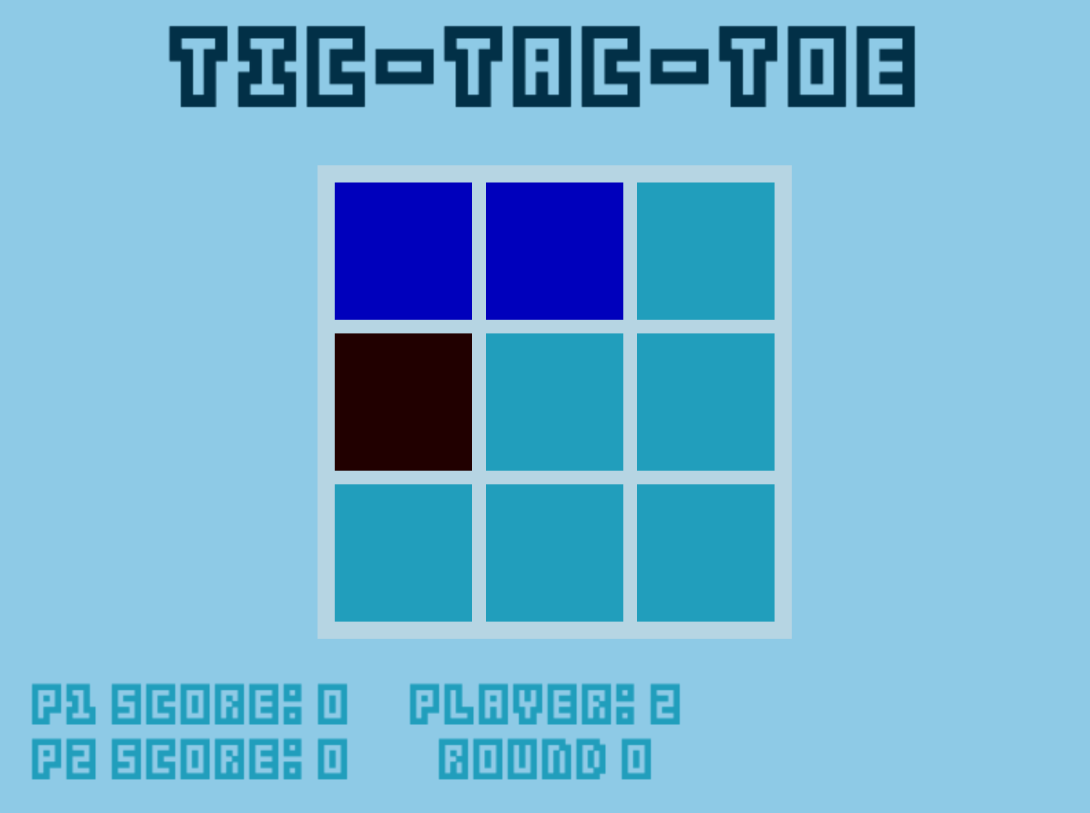
Test 09
Demonstrating the random player selection, 3 similar game scenarios (with different theming), yet it is different player turns who went 1st / 2nd
Test 05: win state on three in a column / diagonal
Test 06: Demonstrating completely random player positions and choices (CPU is dark blue) – run code itself to see more randomness
Test 07: Incremented score at the start of a new round.

Slide 3
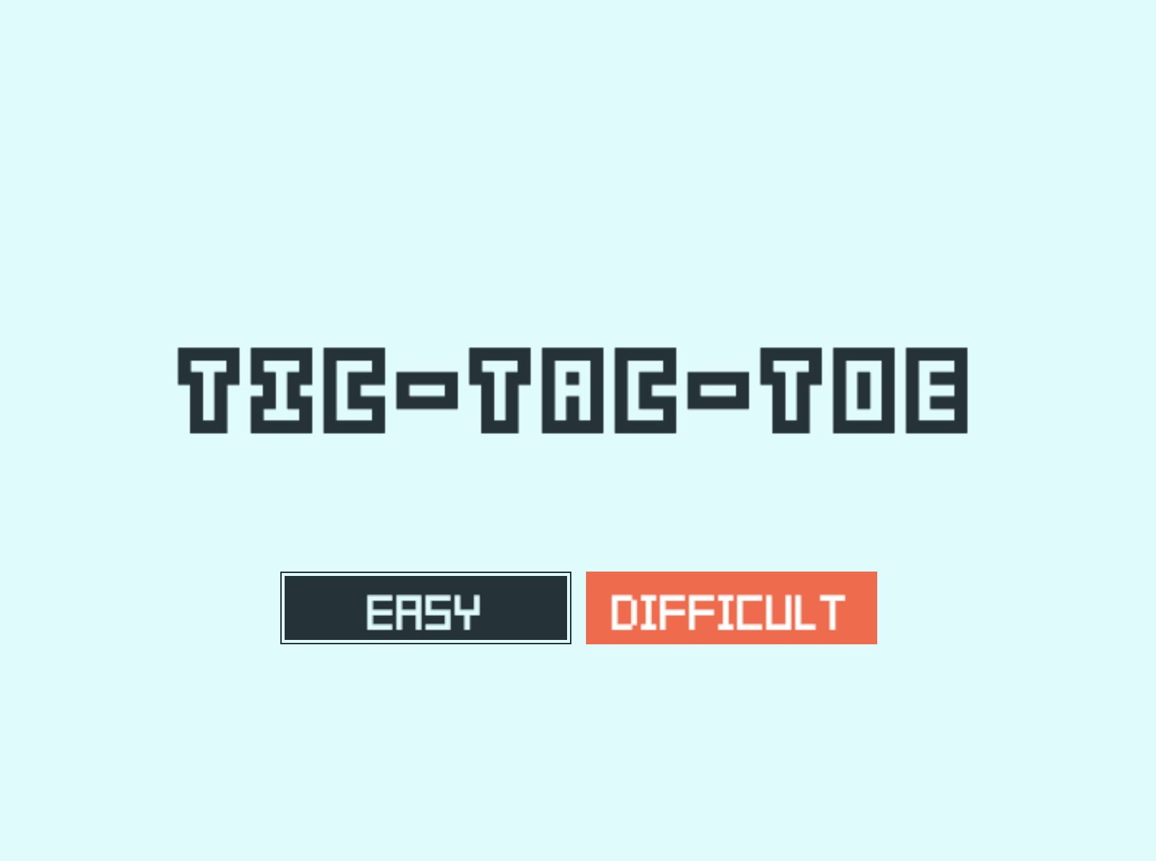
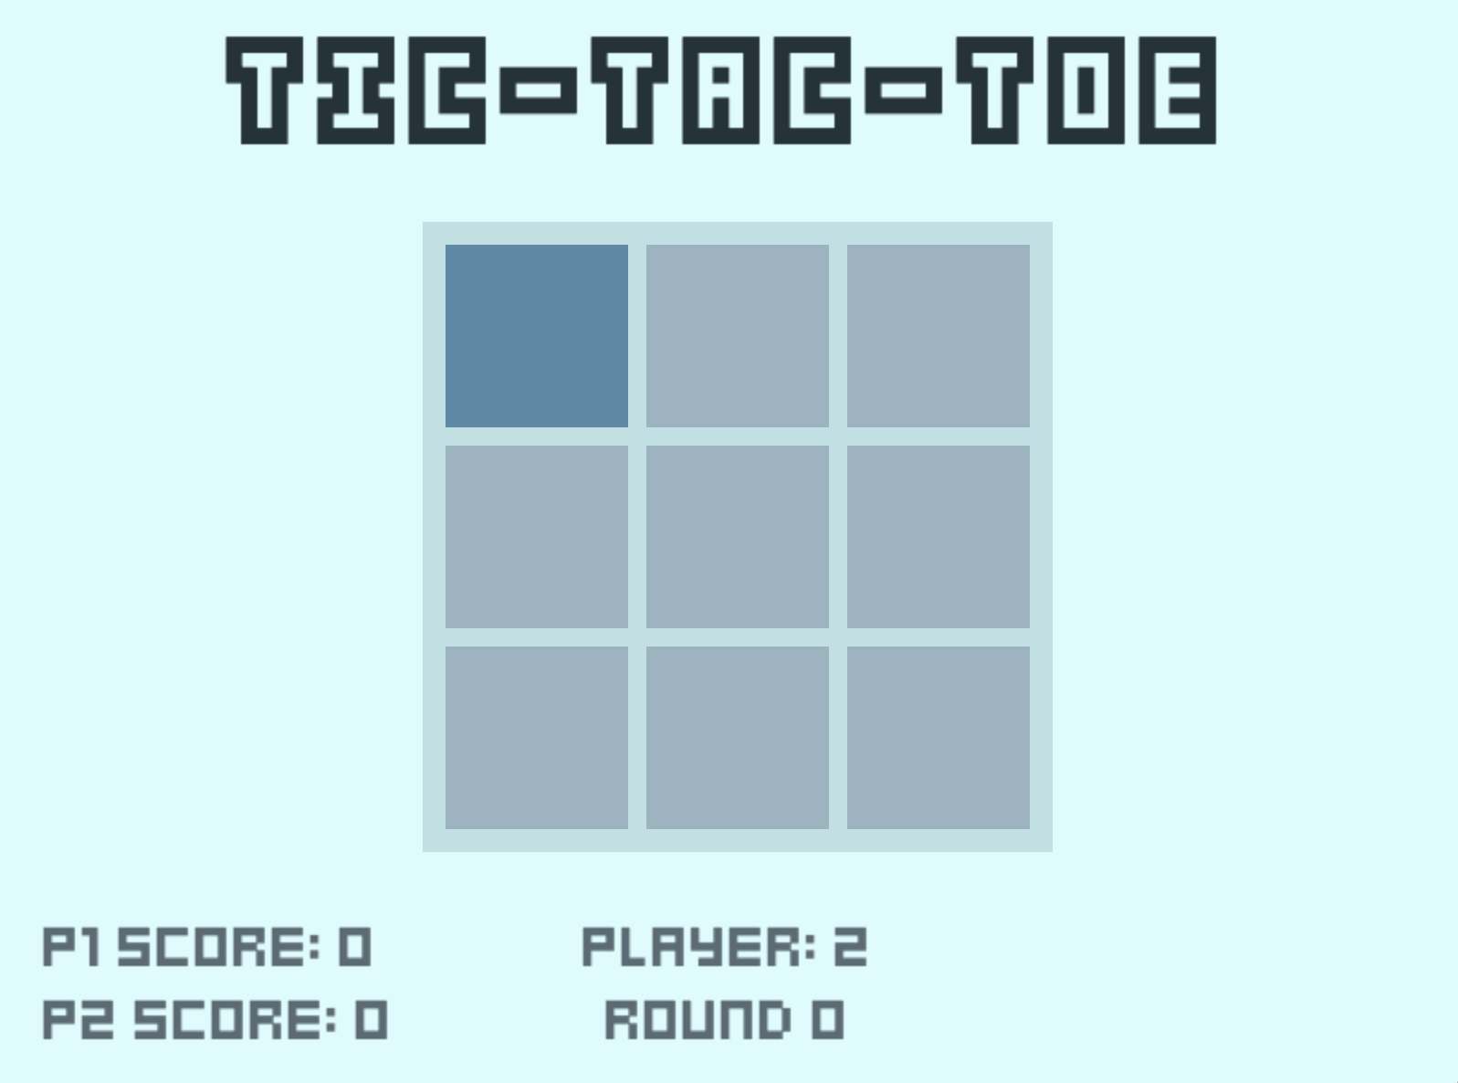
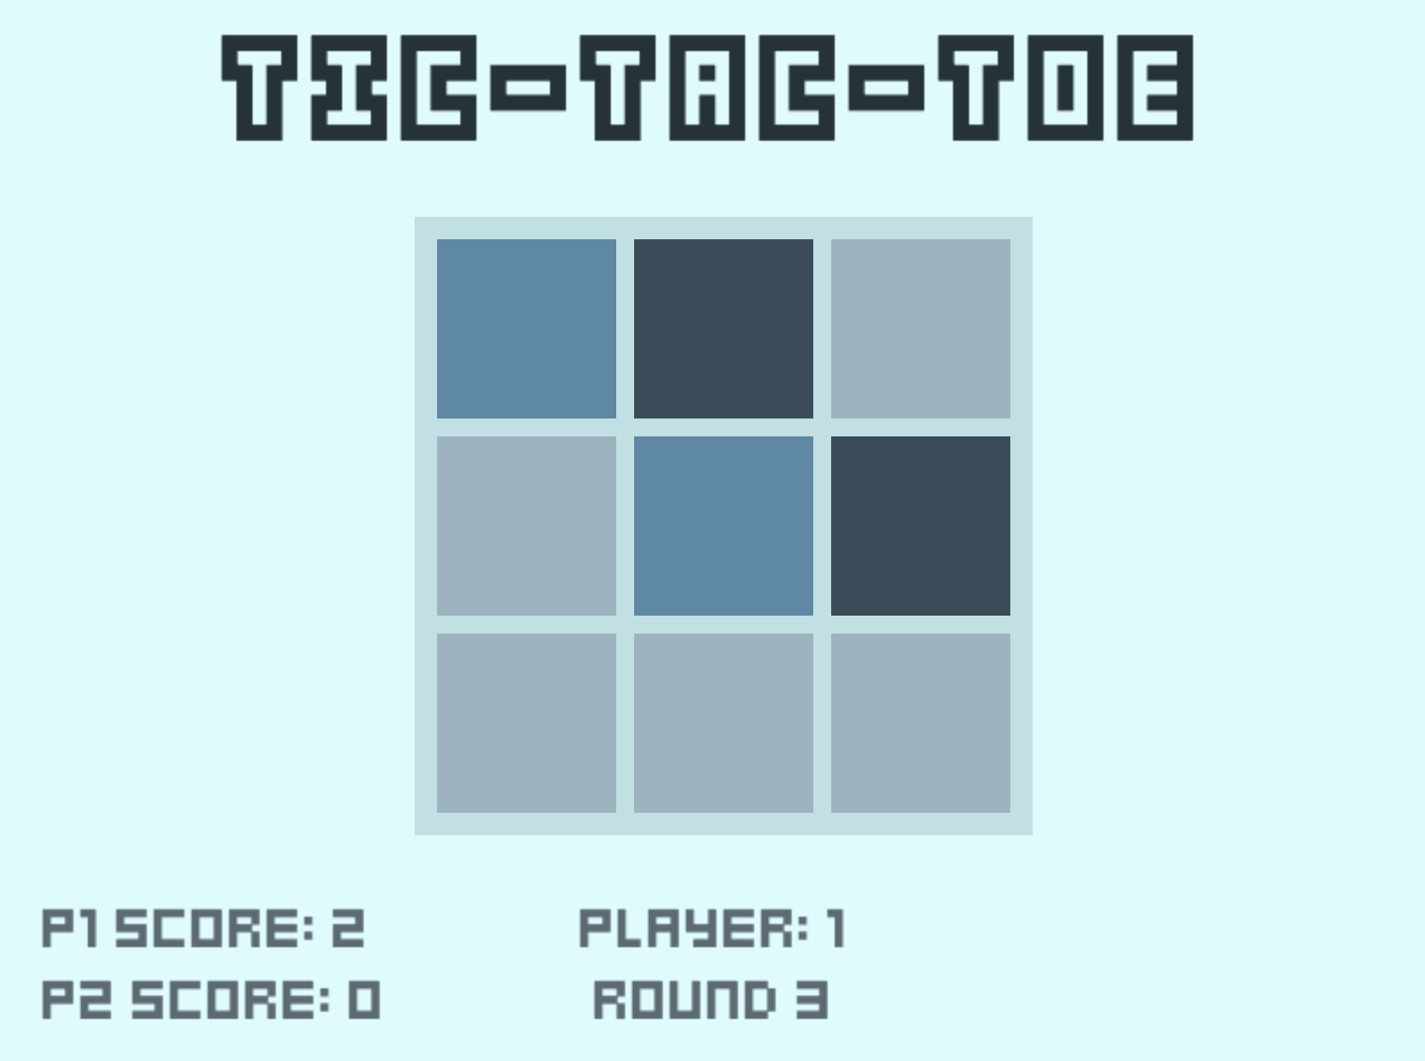
Test 02: Demonstrating simple game-play, screen 1 is a separate game instance showing selecting difficulty. Screens 2/3/4 demonstrate a 1V1 game of 3 rounds and the progression between them, note how the ending screen reflects the final score. * Not included in written test

