Slide 1

CS331
Introduction to Artificial Intelligence:
Search

Slide 2
Summarizing AI Search

Slide 3
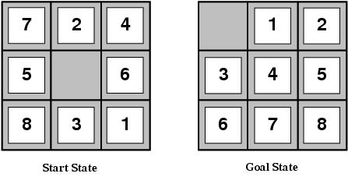
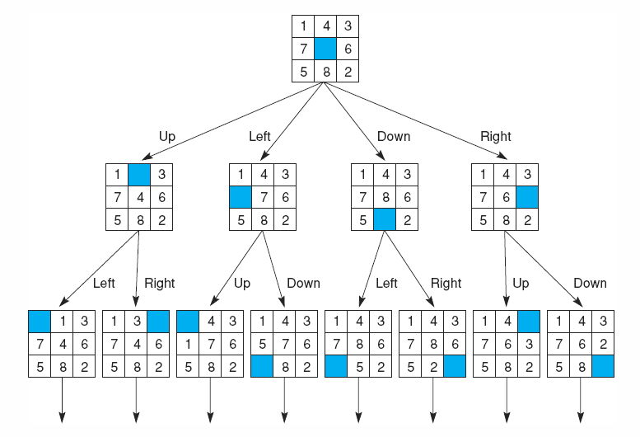
Search Terminology
States: “places” the search can visit
Search space: the set of possible states
Search path
Sequence of states the agent actually visits
Solution
A state which solves the given problem
Either known or has a checkable property
May be more than one solution
Strategy
How to choose the next state in the path at any given state

Slide 4
Basic Idea
Explored States
Unexplored States

Slide 5
Searching Algorithm
Start from the START STATE
Generate all possible states (define frontier)
Test whether the GOAL STATE has been generated
If NO, generate further states (propogate frontier)

Slide 6
Search Representation
State Space can be represented as
TREE
Non cyclic
Search algorithm can be developed for searching the goal in a tree
Expands all paths of a graph
GRAPH
Cyclic
Tree search algorithm can be modified to apply on a graph
Basic Idea: maintain a list of already visited states, avoid visiting them again.
etc.
TREE to GRAPH conversion can be done

Slide 7
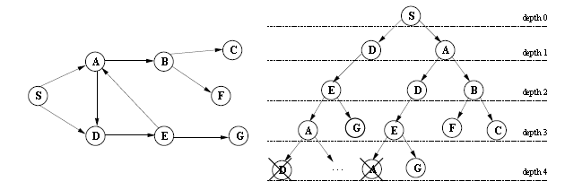
Tree Search
Convert / represent the problem in the form a TREE.
Graphs can be converted to trees, apply search strategy
The set of all possible paths of a graph can be represented as a tree.
A tree is a directed acyclic graph all of whose nodes have at most one parent.
A root of a tree is a node with no parents.
A leaf is a node with no children.
The branching factor of a node is the number of its children.
Graphs can be turned into trees by duplicating nodes and breaking cyclic paths, if any

Slide 8
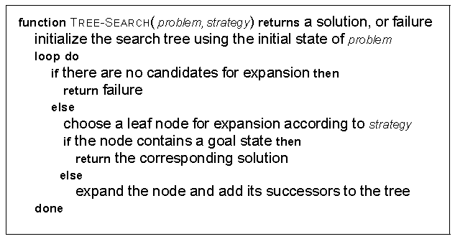
Tree Search Algorithm: Another View

Slide 9
Specifying a Search Problem
1. Initial state
Where the search starts (START STATE)
2. Operators (REMOVE_CHOICE(), RESULT(), etc.)
Function taking one state to another state
How the agent moves around search space
Operators define the search strategies
3. Goal test (CHECKABLE PROPERTY OF STATE)
How the agent knows if solution state found
Search strategies apply operators to chosen states

Slide 10
Branching Factor
Major consideration in choosing bottom up or top down is branching factor
Branching factor of a tree is:
Average number of descendants below each node
It determines the complexity of the problem
Ideally BF needs to be minimized
Generally the BF of bottom up is less, thus bottom up is more efficient

Slide 11
Branching Factor (BF or b)
BF=4
BF=2

Slide 12
Search Types: Classifications
State Transition Strategy
BFS (shortest path first)
DFS (longest path first)
Iterative deepening (BFS+DFS, depth limited)
Heuristic (goal directed)
Uniform Cost (cheapest first)

Slide 13

How can you evaluate a Search Strategy?

Slide 14
Strategy Comparison?
How to compare and evaluate a strategy ?
Complexity
Time and space
Completeness
Always reaches goal
Optimality
Admissibility
Irrevocability
Always finds the best solution
Finds the solution in quickest possible time/does not overestimates the solution cost
No backtracking is allowed, therefore only one path is considered

Slide 15
How can you evaluate a State in a Search Tree

Slide 16

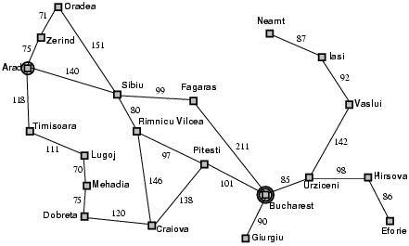
Evaluate the given State
Present State

Slide 17
f(n)=g(n)+h(n)
Path Already Traversed g(n)
Present State: n
Path to be Traversed h(n)
(estimated cost)
Path Already Traversed g(n)

Slide 18
All Search Strategies have cost variant of:
f(n)=g(n)+h(n)

Slide 19
All Search Strategies have cost variant of:
Breadth first Search: f(n)=g(n), where state to state cost (consecutive states) is always 1, and h(n)=0
Uniform Cost Search: f(n)=g(n), where state to state cost (consecutive states) isvarries, and h(n)=0
Best first Search: f(n)=h(n), where g(n)=0
A*: f(n)=g(n)+h(n),

Slide 20
Comparing Search Strategies

Slide 21
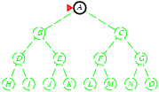
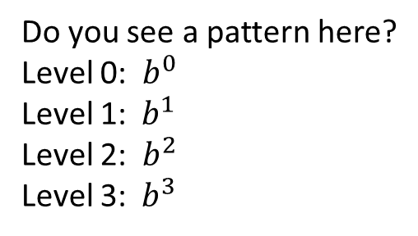

BFS
Expands the shortest path first rather than the longest path as in DFS.
Level 0
Frontier [A], nodes to be explored Ex: 1
Level 1:
Pop[A], Frontier[B,C], Ex:2
Level 2:
Pop B and C, Frontier[D,E,F,G], Ex: 4
Level 3:
Pop D E F and G, frontier[H I J K L M N O],
Ex: 8
Do you see a pattern here?
Level 0: ${ b}^{0}$
Level 1:${ b}^{1}$
Level 2: ${ b}^{2}$
Level 3:${ b}^{3}$
$${ Level m, b}^{m}$$

Slide 22

DFS
For every level 1 node is explored
b-1 are left in the frontier to be explored
(Note: Here unexplored those that remain in the frontier to be expanded further)
So at
level 0: 1 node is explored (start node)
Level 1: 1 node B is explored, C is left
Level 2: D is explored, and E is left
And so on.
Total nodes to be explored at level m:
Addition of all unexplored nodes at all levels
m*(b-1), where b is the avg. branching factor
In other words: bm nodes are explored while reaching depth m.
Expands the longest path first rather than the shortest path as in BFS.
$${ Level m, bm+1}^{}$$

Slide 23
Depth-First Search
Same as breadth-first search
But new states are put at the top of agenda
Graph analogy
Expand deepest and leftmost node next
But search can go on indefinitely down one path
D, DD, DDD, DDDD, DDDDD, …
One solution to impose a depth limit on the search
Sometimes the limit is not required
Branches end naturally (i.e. cannot be expanded)
Searching all the way down the length of a branch until either a solution is found or a terminal state is hit
If terminal node is hit, backtracking is done only until to descend to an unsearched branch
This is especially usefull if numerous solution states exist long way down the branches (may be efficient in such situations).
If any of the branches of the tree go infinite, finding a solution may not be possible

Slide 24
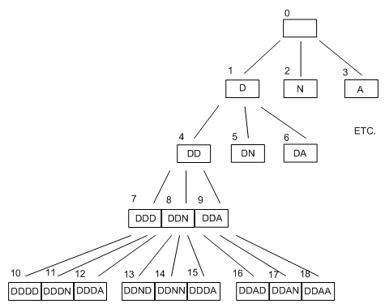
Depth-First Search (Depth Limit 4)
LIFO queue, i.e., put successors at front

Slide 25
Uniform Cost search
BFS will always give the shortest path length to the goal.
BFS uses the path cost ie., number of steps in the path, and assumes that cost of reaching any consecutive state from a given state is same ie., unit or 1.
Uniform cost search looks at the path cost rather than the path length before expanding a node.
The node with the smallest total cost is expanded first.
CHEAPEST FIRST
Uniform cost search gives cheapest path in term of cost to the goal.

Slide 26
Uniform Cost Search
From A expand B, and then E and so on
So the idea is to expand CHEAPEST FIRST
5
10
3
2

Slide 27
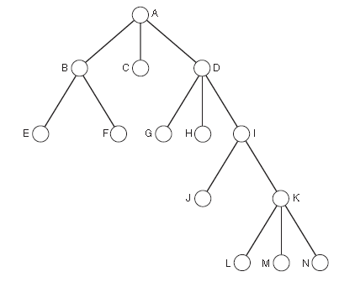
Uniform-Cost Search
5 2 4
Breadth-first search
Guaranteed to find the shortest path (in terms of no. Of steps) to a solution
Not necessarily the least costly path
Uniform path cost search
Choose to expand node with the least path cost
Guaranteed to find a solution with least cost
If we know that path cost increases with path length
This method is optimal and complete
But can be very slow
BFS may expand B,C,D
If Left to Right rule is applied
B will be expanded
Uniform path cost will expand C,As its has minimum path cost.
In BFS every node traversal has same cost
In uniform search every traversal has different path cost

Slide 28
Comparing BFS, Uniform Cost
goal
goal

Slide 29
Depth- v. Breadth-First Search
Suppose branching rate b
Breadth-first
Complete (guaranteed to find solution)
Requires a lot of memory
At depth d needs to remember up to b^{d-1} states
Depth-first
Not complete because of indefinite paths or depth limit
But is memory efficient
Only needs to remember up to b*d states

Slide 30
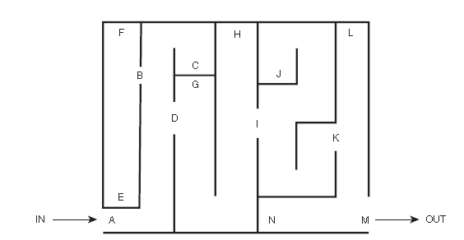
Breadth vs Depth First
Humans use Breath or Depth ?
Examples:
Traversing a maze
Searching for a gift
Depth first search, why?

Slide 31
Depth-limited search
depth-first search with depth limit L
nodes at depth L have no successors
Do not apply depth first after a certain depth
Iterative Deepening tries almost all depth limits
Searches the tree with L=0, L=1, L=2, etc…

Slide 32
Iterative Deepening Search
Idea: do repeated depth first searches
Increasing the depth limit by one every time
DFS to depth 1, DFS to depth 2, etc.
Completely re-do the previous search each time
Most DFS effort is in expanding last line of the tree
e.g. to depth five, branching rate of 10
DFS: 111,111 states, IDS: 123,456 states
Repetition of only 11%
Combines best of BFS and DFS
Complete and memory efficient
But slower than either

Slide 33
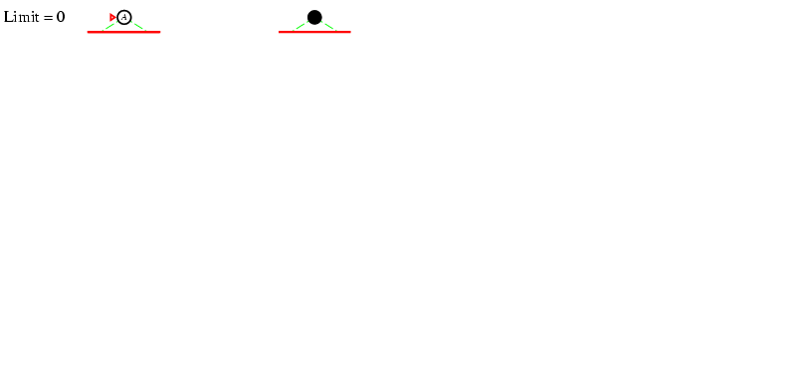
Iterative deepening search L=0
For depth 0, evaluate the root node and stop

Slide 34
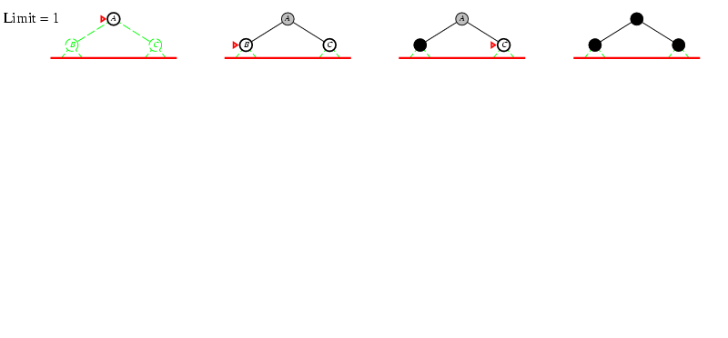
Iterative deepening search L=1

Slide 35
Iterative deepening search L=1

Slide 36
Iterative deepening search L=1

Slide 37
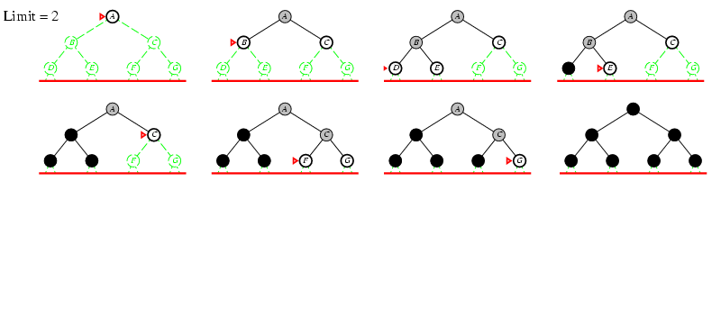
Iterative deepening search L=2

Slide 38
Iterative deepening search L=2

Slide 39
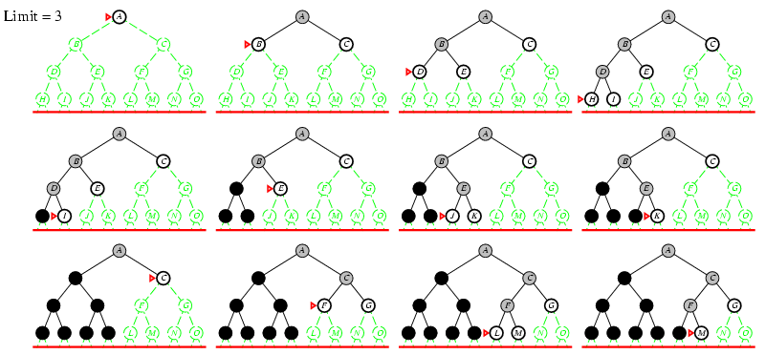
Iterative deepening search L=3

Slide 40
Number of Nodes Expanded
At d=0, start node is expanded, it expanded again for d=1, and again for d=2, and so on, until the depth d is reached, so how many times, in total, the start node is expanded
Start Node: d+1 times (node expanded=1)
Nodes at level 1: d times (nodes expanded= b¹ )
Nodes at level 2: d-1 times (nodes expanded= b² )
…
Nodes at level d: 1 time (nodes expanded= b^{d} )
Total Nodes expanded:
N_{IDS} = (d+1)b⁰ + d b¹ + (d-1)b² + … + 3b^{d-2} +2b^{d-1} + 1b^{d}

Slide 41
Iterative deepening search
Number of nodes generated in a depth-limited search to depth d with branching factor b:
N_{DLS} = b⁰ + b¹ + b² + … + b^{d-2} + b^{d-1} + b^{d}
Number of nodes generated in an iterative deepening search to depth d with branching factor b:
N_{IDS} = (d+1)b⁰ + d b¹ + (d-1)b² + … + 3b^{d-2} +2b^{d-1} + 1b^{d}
For b = 10, d = 5,
N_{DLS} = 1 + 10 + 100 + 1,000 + 10,000 + 100,000 = 111,111
N_{IDS} = 6 + 50 + 400 + 3,000 + 20,000 + 100,000 = 123,456
Overhead = (123,456 - 111,111)/111,111 = 11%

Slide 42
Properties of iterative deepening search
Complete? Yes
Time? (d+1)b⁰ + d b¹ + (d-1)b² + … + b^{d} = O(b^{d})
Space? O(bd)
Optimal? Yes, if step cost = 1

Slide 43
Example: Solving a Maze

Slide 44
Bidirectional Search
If you know the solution state
Work forwards and backwards
Look to meet in middle
Only need to go to half depth
Difficulties
Do you really know solution? Unique?
Must be able to reverse operators
Record all paths to check they meet
Memory intensive
Liverpool
Leeds
Nottingham
Manchester
Birmingham
Peterborough
London

Slide 45
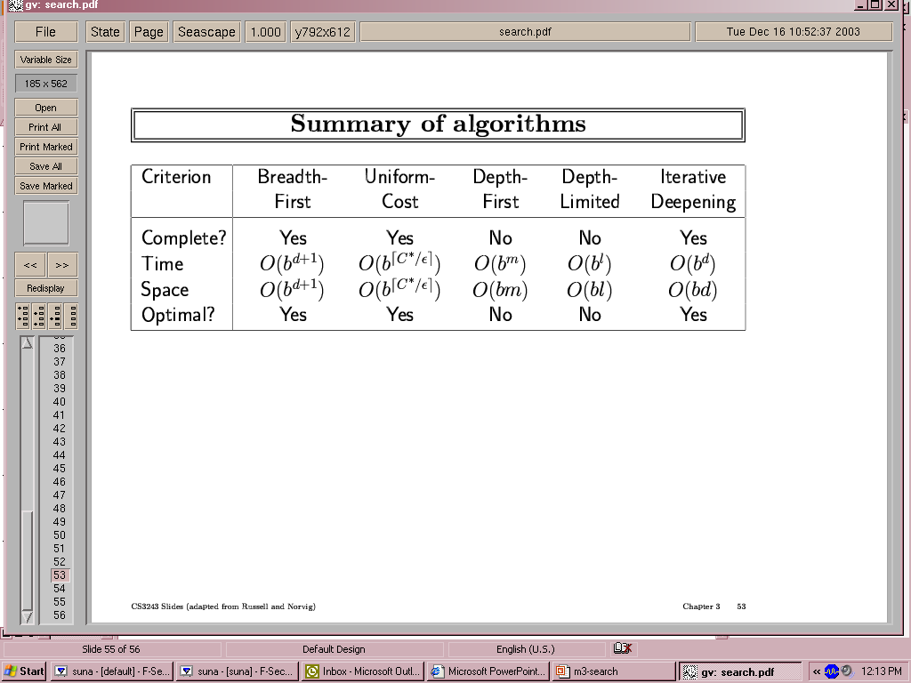
Summary of algorithms

Slide 46
Final Word
BFS, at depth d, the number of nodes expanded are b^{d}
DFS, at depth d, the number nodes expanded are bd
Iterative deepening combines the two search to take the best of the two into account.
Uniform Cost search gives the path with the minimum total path cost
All of these explore all nodes that may or may not be in the direction of the goal.

Slide 47
Summary: Blind Search
BFS
Shortest Path
Queue
DFS
Longest Path
Stack
UCS
Cheapest Path
Priority Queue
Complete
Incomplete
Complete

Slide 48

The End?

