Slide 1
Fog-EnabIed Smart Security
A Real-Time Intrusion Detection System Using Edge Computing

Slide 2
The Problem
Why traditional cloud-only security models are inefficient, slow, and unreliable for real-time alerts.

Slide 3
Limitations of Cloud-Only IoT
High Latency
Sending sensor data to the cloud, processing it, and sending an alert back takes valuable seconds. In security, every second counts.
Bandwidth Waste
Constantly streaming data (like "no motion detected" or "light level is 400") 24/7 clogs the network and increases data costs.
Poor Reliability
If the internet connection fails, the entire system is blind. The cloud receives no data, and the user receives no alerts.

Slide 4
The Solution
A Fog-Enabled Architecture that brings intelligence and decision-making to the "edge" of the network.

Slide 5
What is Fog / Edge Computing?
1. The "Fog/Edge" Node
An "edge" device (our ESP32) sits locally with the sensors. It processes data "instantly” and makes decisions on its own, without asking the cloud first.
2. The "Cloud"
The central cloud (Blynk) is now used only for what it's best at: receiving “critical alerts" and displaying the system status on a global dashboard.

Slide 6
Project Methodology & Tools
Edge Node (The "Fog"): ESP32 Microcontroller
Sensors: PIR Motion Sensor & LDR Light Sensor
Simulation: Wokwi Virtual Environment
Cloud Dashboard: Blynk IoT Platform
Logic: Local processing on the ESP32 to filter data before transmission.

Slide 7
System Architecture
1. Local Processing (Fog)
The ESP32 constantly reads the PIR sensor. It makes an *instant local decision’ if motion is 1 (Detected).
2. Critical Alert (Cloud)
Only if motion is detected, the ESP32 sends a "Security Alert" (V1) and sensor data (V2, V3) to the Blynk cloud.
3. Global Dashboard
The Blynk app instantly displays the LED alert and updates gauges, providing a real-time status to the user anywhere in the world.

Slide 8
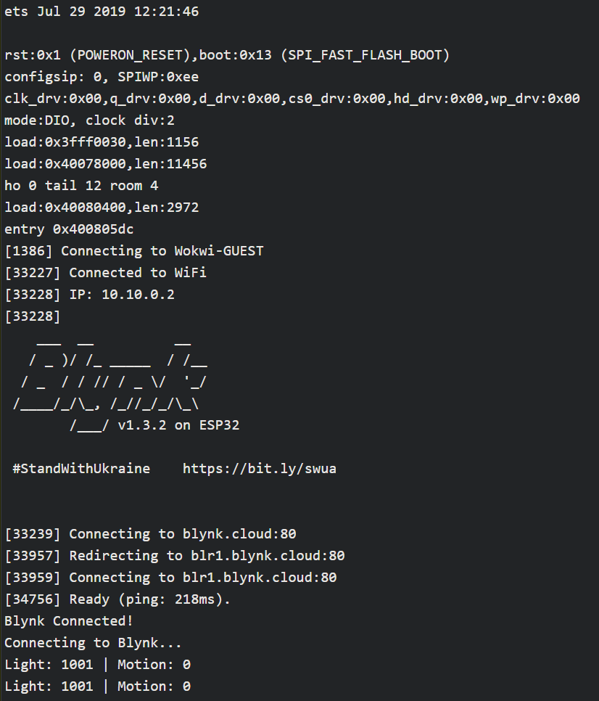
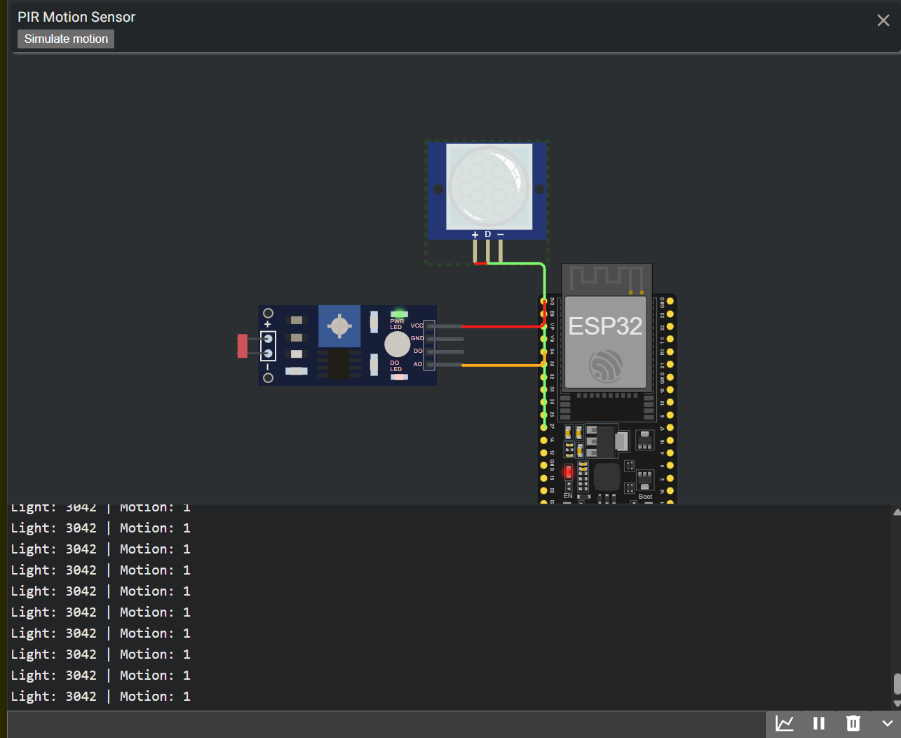
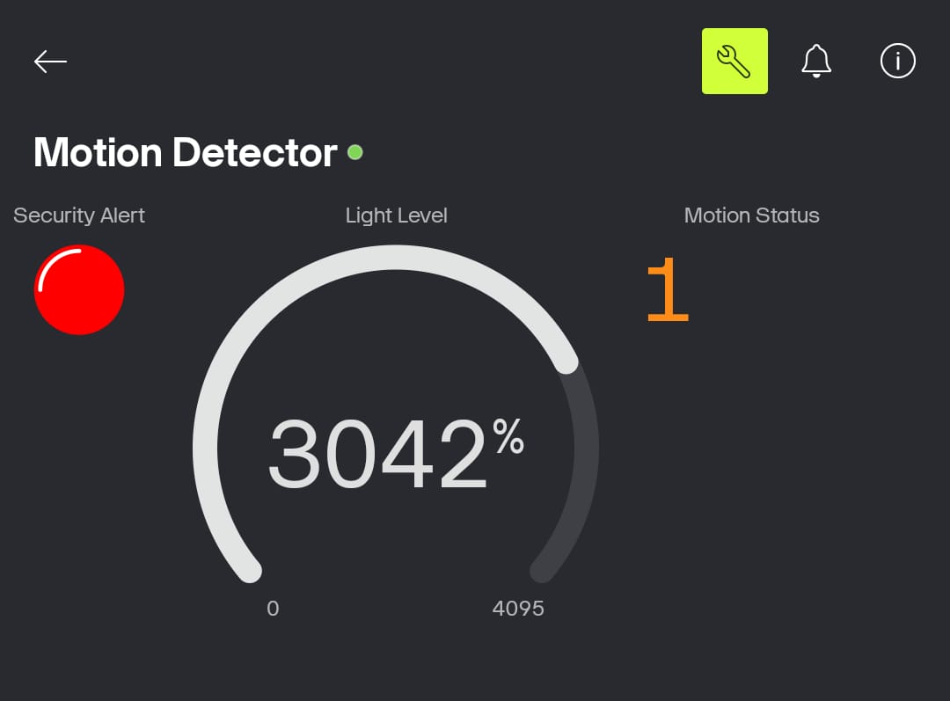
Implementation: Simulation & Dashboard
The Edge Node: ESP32 processes sensor data locally.
The Sensors: PIR and LDR simulated in Wokwi.
The Cloud: Blynk dashboard displays real-time alerts.

Slide 9




Key Result: Efficiency
Data Filtering at the Edge
Instead of sending 60 data points per minute (1 per sec) to the cloud, the system only sends data when motion is ”actually’
detected (e.g., 2-3 times per day). This is the core benefit of fog computing, saving bandwidth and power.
Reduction in Network Traffic

Slide 10

Performance: Cloud vs. Fog
Cloud-Only Latency (Alert
Time)
Fog-Enabled Latency Cloud-Only Bandwidth Use Fog-Enabled Bandwidth Use
The fog-enabled model shows a significant reduction in both latency(alert time) and bandwidth usage.

Slide 11
Conclusion & Future Work
This project successfully demonstrates a fog computing model that is more efficient, reliable, and faster than traditional cloud-only systems for security. Future work could include adding a camera for local image verification.

Slide 12
Questions?
Thank you.
Fog-Enabled Smart Security System

