Slide 1

Analyzing home prices
By Aizhan Baibolot

Slide 2
Business objective
Analyze factors affecting home prices
Recommendations based on analysis

Slide 3
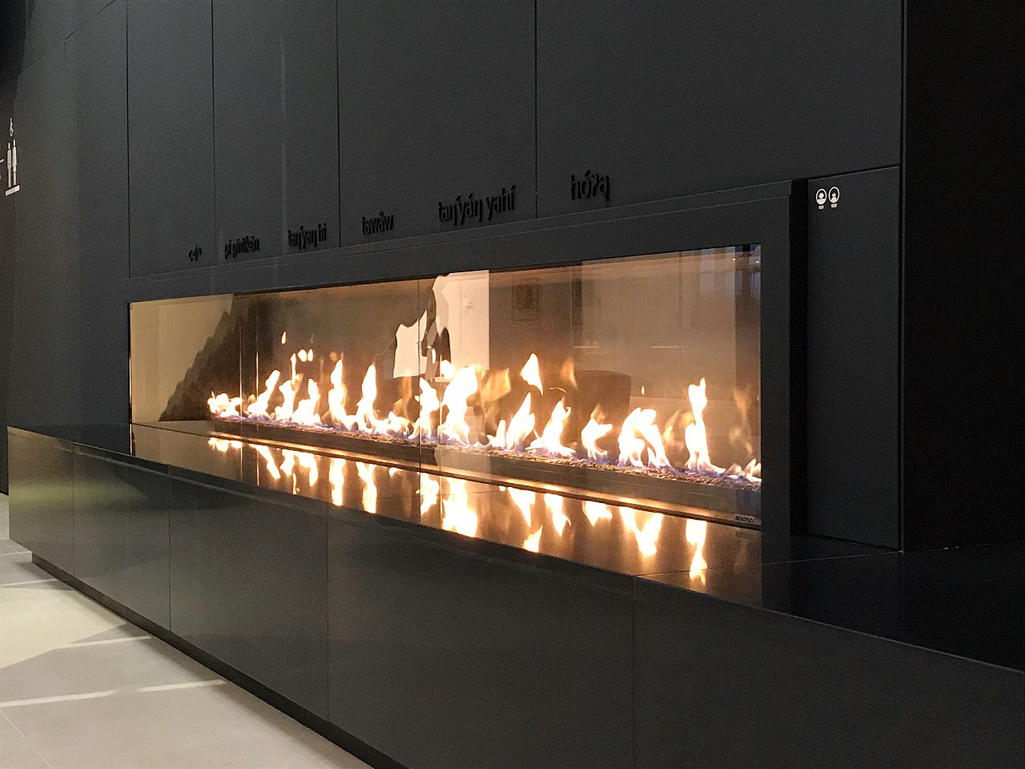
Project goal
The price of the houses
With fireplace vs without
With more than 2 garage cars vs with 1 or 0 garage car

Slide 4
Hypotheses
Null Hypothesis 1 (Ho):
The price of the houses with fireplace is not more than the ones without.
Alternate Hypothesis 1 (Ha):
The price of the houses with fireplace is more than the ones without.
Null Hypothesis 2 (Ho):
The price of the houses with more than 2 garage cars is not more than the ones with 1 or 0 garage car.
Alternate Hypothesis 2 (Ha):
The price of the houses with more than 2 garage cars is more than the ones with 1 or 0 garage car.

Slide 5
Data Analyzed
Total 1460 houses.
690 houses without fireplace while 770 with fireplace.
450 houses with 1 or 0 garage car while 1010 with more than 2 garage cars.
Conducted statistical analyses(t-test) to see if there is any statistically significant difference between them.

Slide 6
Analysis of Hypothesis 1
There is a statistically significant difference between the prices of the houses with and without fireplace
Average house price with fireplace $216 400, whereas without fireplace $141 000
Average difference $75 400

Slide 7
Analysis of Hypothesis 2
There is a statistically difference between the prices of the houses with 1 or 0 garage car versus more than 2 garage cars
Average house price with more than 2 garage cars $206 500 whereas less than 2 garage cars $123 700
Average difference $82 800

Slide 8
Final message and recommendations
The statistical analyses showed that
The price of the houses with fireplace is more than the ones without.
The price of the houses with more than 2 garage cars is more than the houses with 1 or 0 garage car.
Recommendation:
Consider the options of extending garage cars and adding fireplaces.

Slide 9
Thank you

