Slide 1
Best Cities and Countries for Startups
By Aizhan Baibolot

Slide 2
The Dataset
The dataset being used contains scores of different cities and countries for startups. For reference, original dataset is here.
There are 1000 records across 9 fields.

Slide 3
The fields are identified as follows:
Position integer (current position of the cities)
Change in position from 2020 integer (number of positions changed from 2020)
City object
Country object
Total score float
Quality score float
Quantity score float
Business score float
Sign of change in position Boolean

Slide 4
The Research Questions
There are two questions that will be addressed in this analysis.
If there is any correlation between quantity score and quality score of the countries.
If there is a significant difference between total scores for cities with sign of change in position and without.

Slide 5
The Hypotheses
There are two hypotheses related to the previous research questions, as follows:
Hypothesis #1: The country scores are correlated. This means that countries that scored well in one field are likely to score well in other fields.
Hypothesis #2: There is no difference between the total scores of the cities with sign of change in position and without.

Slide 6
How will the data test the hypotheses?
Visualizations will show a correlation between quality and quantity scores of the cities. Pearson r will test for correlation.
T-test will show the significance of score differences for the cities with the sign of change in position and without.

Slide 7
Who will find the findings valuable, and how will they use them?
The startupers will be interested in knowing which country or city to choose to realize their ideas.
Also, investors can use the findings to choose the correct location to invest their money and predict approximate scores.

Slide 8
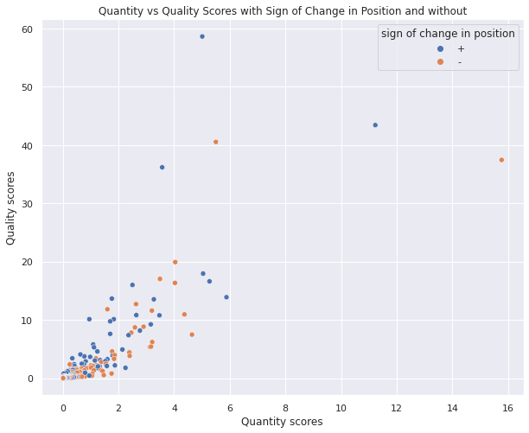
The analyses – hypothesis #1
The scatterplot shows correlation between quantity and quality scores of the cities.
Colors indicates if there is a sign of change in position or not.
P-value is less than alpha(.05) Pearson r test
There is a statistically significant linear relationship between quantity score and quality score of the countries. The relationship is positive.

Slide 9
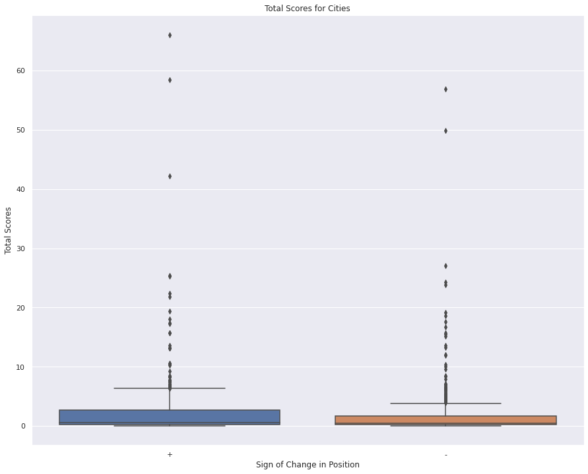
The analyses – hypothesis #2
The boxplot visually shows the distributions between the cities with the sign of change in position and without the sign of change in position.
An independent samples t-test was used to support the hypothesis
P-value = 0.13
The t-test confirmed the hypothesis 2.

Slide 10
Project Summary
Hypothesis 1 has been rejected. There is a positive correlation between quality and quantity scores. Which means cities performing well in one field also perform well in the other one.
Hypothesis 2 has been confirmed. There is no statistically significant difference in the average total score of the cities with the sign of change in position and without the sign of change in position.

Slide 11
Recommendations
Investors:
Look for quantity and quality scores of the cities when deciding to invest your money, since they indicate successfulness of the project you are investing in.
Startupers:
Pick anywhere to start realizing your ideas regardless of the position of the countries. You can enter the market online which gives you wider audience and the location won't make any sense.

Slide 12

Thank you

