Slide 1

Final Project in R
"Team Y“ Yuval Segal & Eran Aizikovich
Introduction
Decision-making by software is seemingly sterile and free from prejudice. But that isn’t truly the case, these types of decision-making created a new type of social problem called “Algorithms bias”. For this project, we decided to dig into this field & the inequality that follows it.
The question: Could there be a significant biased connection between the annotator’s background and the way they will rate hate speech?
Why is this so important? & What is already done in this field?

Slide 2



Dissecting racial bias in an algorithm used to manage the health of populations
Research published in Science AAAS; The U.S. health care system uses commercial algorithms to guide health decisions. Obermeyer et al. find evidence of racial bias in one widely used algorithm, such that Black patients assigned the same level of risk by the algorithm are sicker than White patients
Algorithmic Bias? An Empirical Study into Apparent Gender-Based Discrimination in the Display of STEM Career Ads
Research published in SSRN; how an algorithm delivered ads promoting job opportunities in the Science, Technology, Engineering, and Math (STEM) fields. This ad was explicitly intended to be gender-neutral in its delivery. Empirically, however, fewer women saw the ad than men.

Slide 3
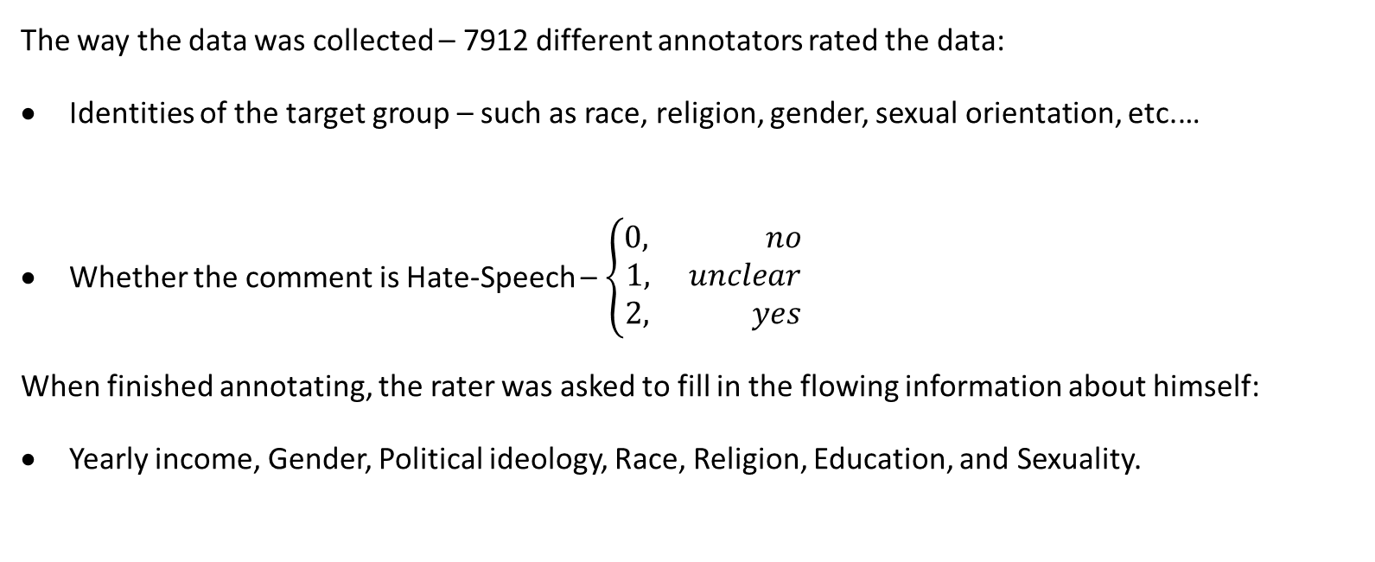
Data Overview
The data we used has been published in an article from Berkeley University
The way the data was collected – 7912 different annotators rated the data:
Identities of the target group – such as race, religion, gender, sexual orientation, etc.…
Whether the comment is Hate-Speech – $\left\{\begin{aligned}0, no \\ 1, unclear \\ 2, yes\end{aligned}\right.$
When finished annotating, the rater was asked to fill in the flowing information about himself:
Yearly income, Gender, Political ideology, Race, Religion, Education, and Sexuality.

Slide 4
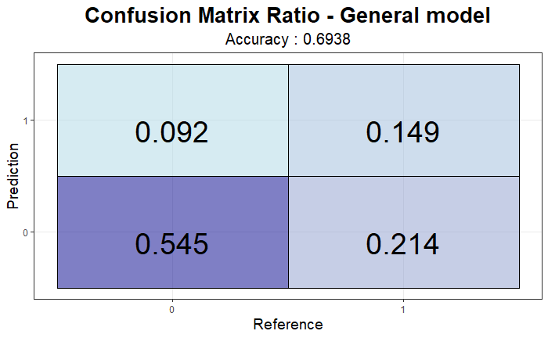
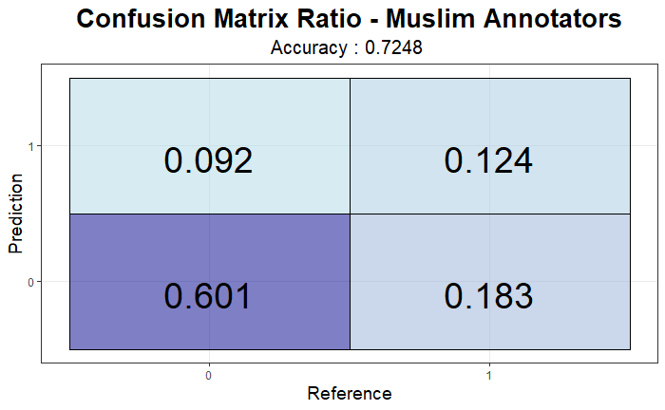
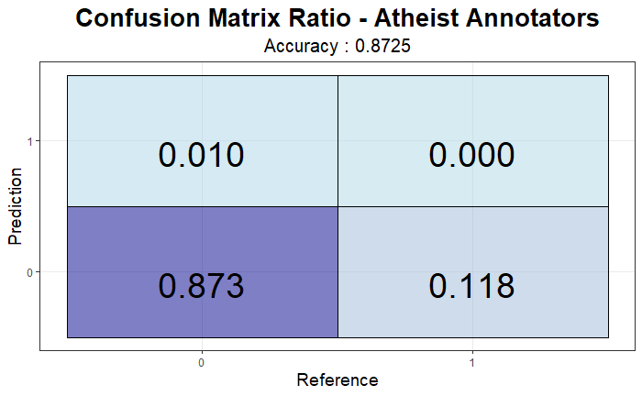
Findings
Better Prediction to hate Speech when focused on
The Models were fitted with the same features, but The significance coefficients addressed different targets groups

