Slide 1

Our Research Question
Could there be a significant biased connection between the annotator’s background and the way they will rate hate speech?

Slide 2



Why is this so important?
What is already done in this field?
Dissecting racial bias in an algorithm used to manage the health of populations
The U.S. health care system uses commercial algorithms to guide health decisions. This research found evidence of racial bias in one widely used algorithm.
Algorithmic Bias? An Empirical Study into Apparent Gender-Based Discrimination in the Display of STEM Career Ads
How an algorithm delivered ads promoting job opportunities in STEM fields that was explicitly intended to be gender-neutral in its delivery. Empirically, however, fewer women saw the ad than men.

Slide 3
Data Overview
The data we used has been published in an article from Berkeley University.
The original data contain 131 variables. We focused on variables that were filled by the annotators.
7912 different annotators were given posts to rate.
In total our data contains 135,556 records

Slide 4
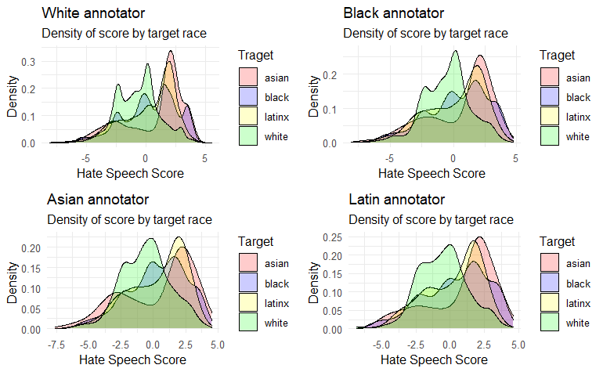
Data Overview

Slide 5
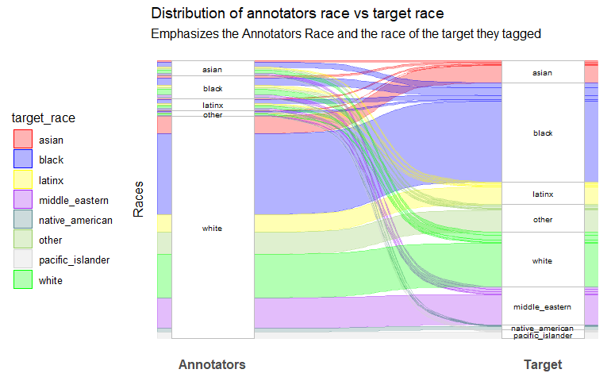
Data Overview

Slide 6
Workflow & Methods
Data preparation
Fit logistic-Reg model to predict hate speech
Fit logistic-Reg to the different annotator’s background
Evaluate the models and Analyzing the results

Slide 7
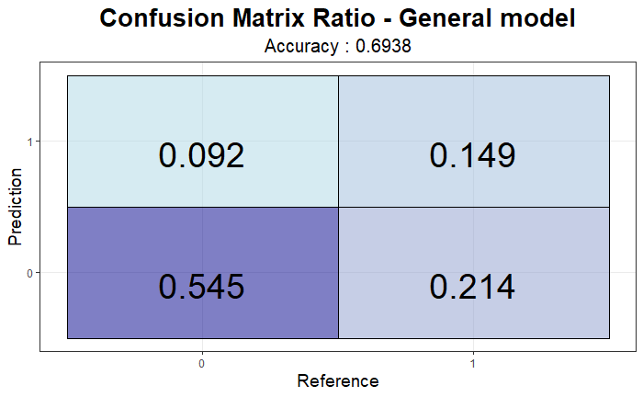
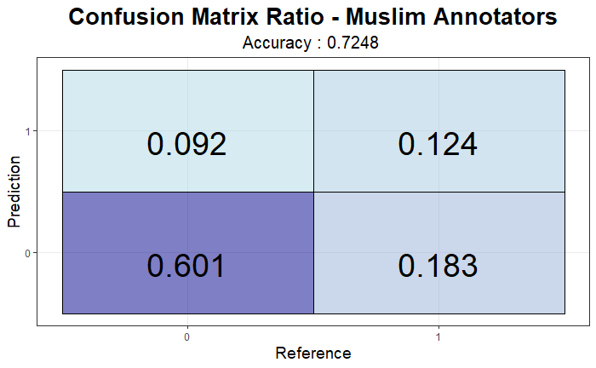
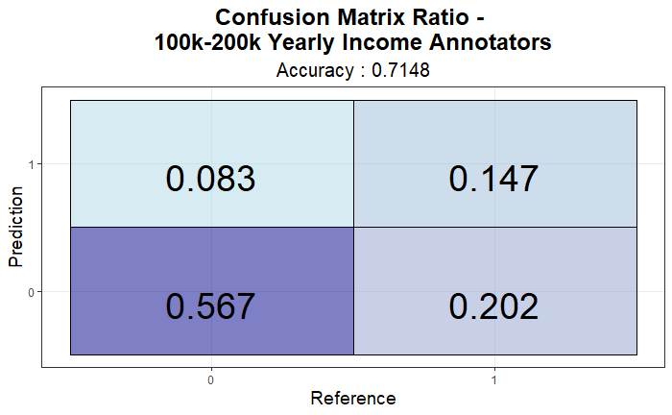
Findings & Key results
By addressing the data through the different categories in the annotator’s background the models :
Predict better than the general model in some cases
Notes:
sc

Slide 8
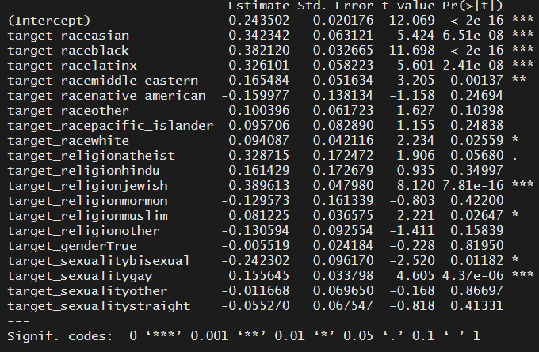
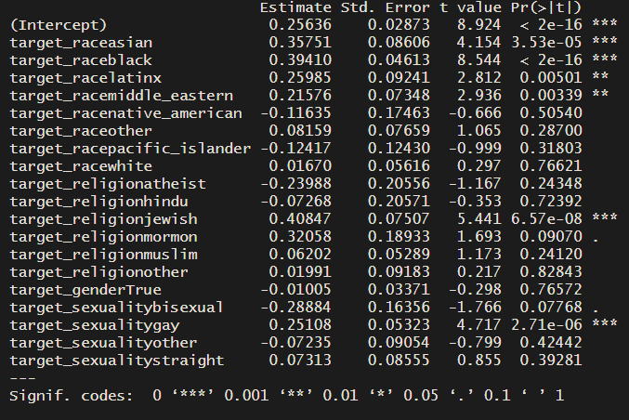
Findings & Key results
2. From the significant coefficients, we learned that groups with different backgrounds grasp different posts that target specific sectors.
Professional Deg
PHD
Notes:
sc

Slide 9
Final Project in R
"Team Y“ Yuval Segal & Eran Aizikovich
Presentation

