Slide 1

Introduction to Shader development
h_da WS2020/21
Paul Nasdalack
info@paul-nasdalack.com
@littleBugHunter

Slide 2
Congrats!
Texture mapping
UV scrolling
Displacement mapping
Tinting

Slide 3

You can go pretty much anywhere from here

Slide 4
So what now?

Slide 5
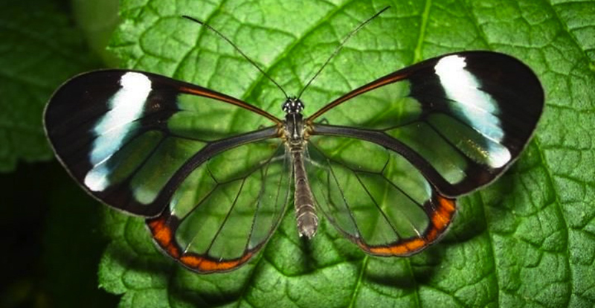
TRANSPARENCY!

Slide 6

How does the GPU Render Objects
What is in front and what is behind?
Painters Algorithm
Zbuffer Compare

Slide 7
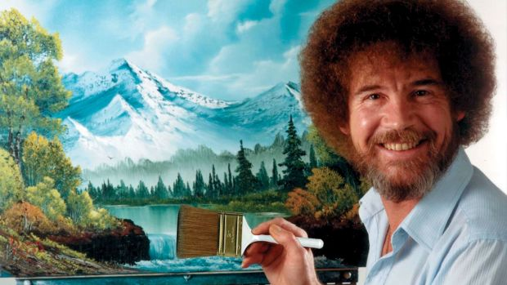
Painters Algorithm

Slide 8



Painters Algorithm
Draw Objects from back to front
Like Photoshop Layers

Slide 9
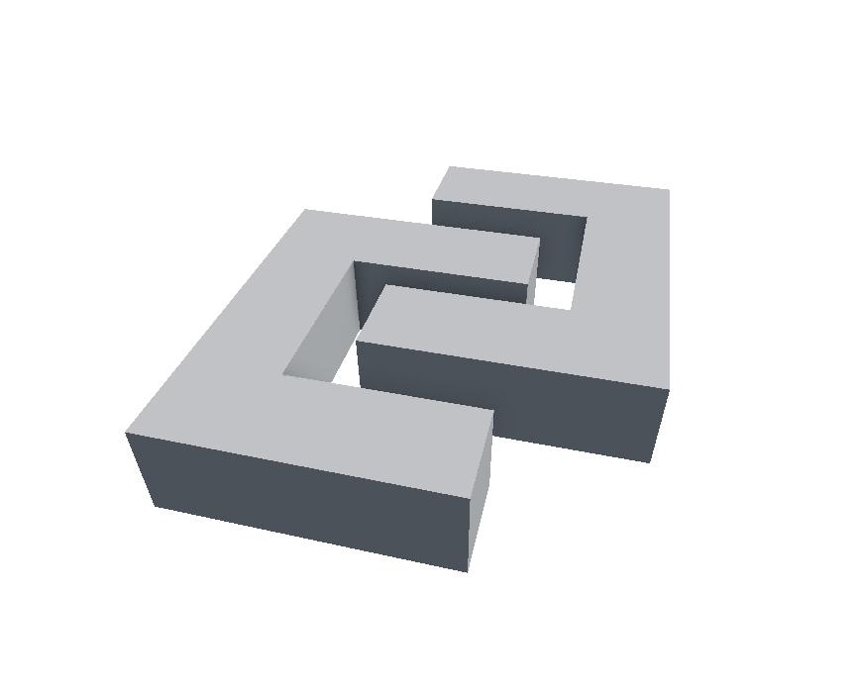

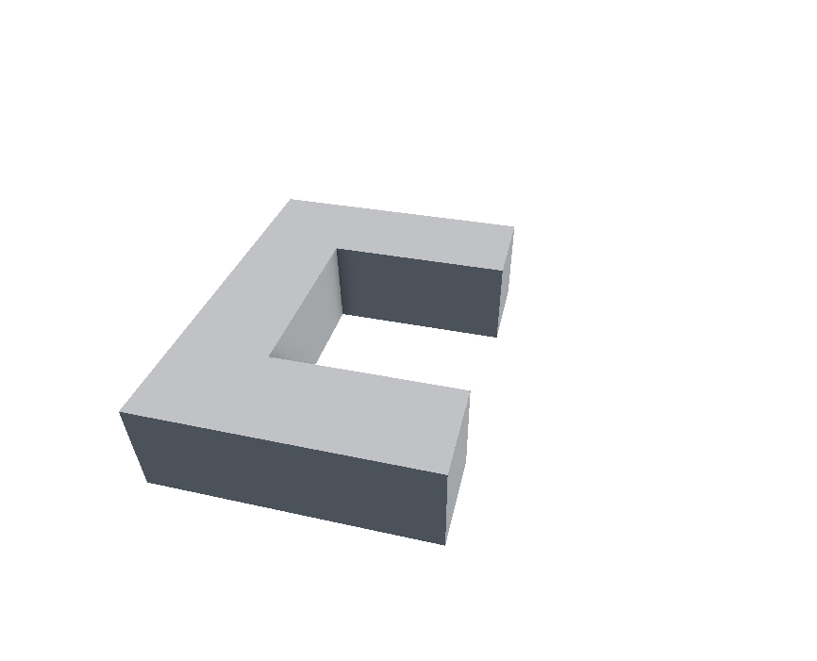
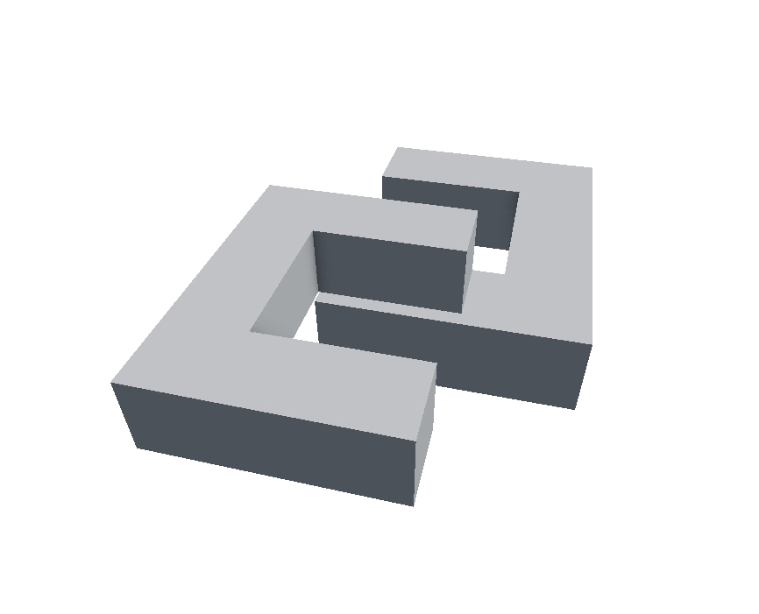
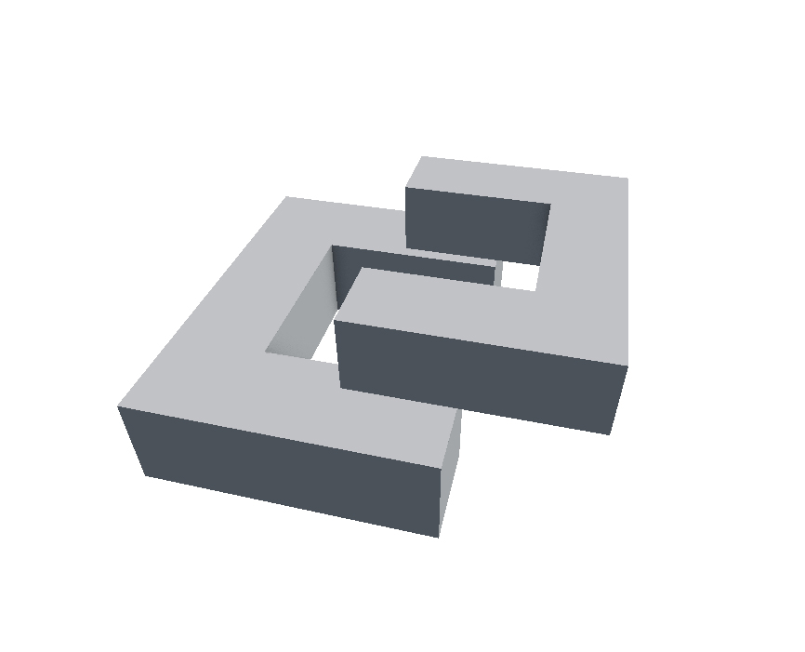
Painters Algorithm

Slide 10
Painters Algorithm
We have to cut objects in pieces (at runtime?!)
Renders a ton of stuff, that is later overdrawn
Works ok for simple scenes
We need something better

Slide 11
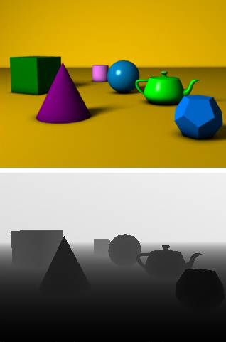
ZBuffer
Distance from the camere
Stored in a second Texture
Rasterizer checks each Pixels distance
Resolved per pixel, not per object

Slide 12
ZBuffer
Works much better for complex scenes
Objects can be rendered front to back to avoid overdraw
Soo… YAY?

Slide 13
Back to Transparency!

Slide 14
We have a problem
We render front to back
We discard all pixels, that are behind our object
There is nothing behind the transparent object

Slide 15
We have a problem
BACK TO PAINTERS ALGORITHM!

Slide 16
How Objects are Rendered
Render all opaque objects using Z-Buffer
Sort transparent objects back to front
Render transparent objects using Painters Algorithm
Also check the Z-Buffer, but don‘t write to it

Slide 17
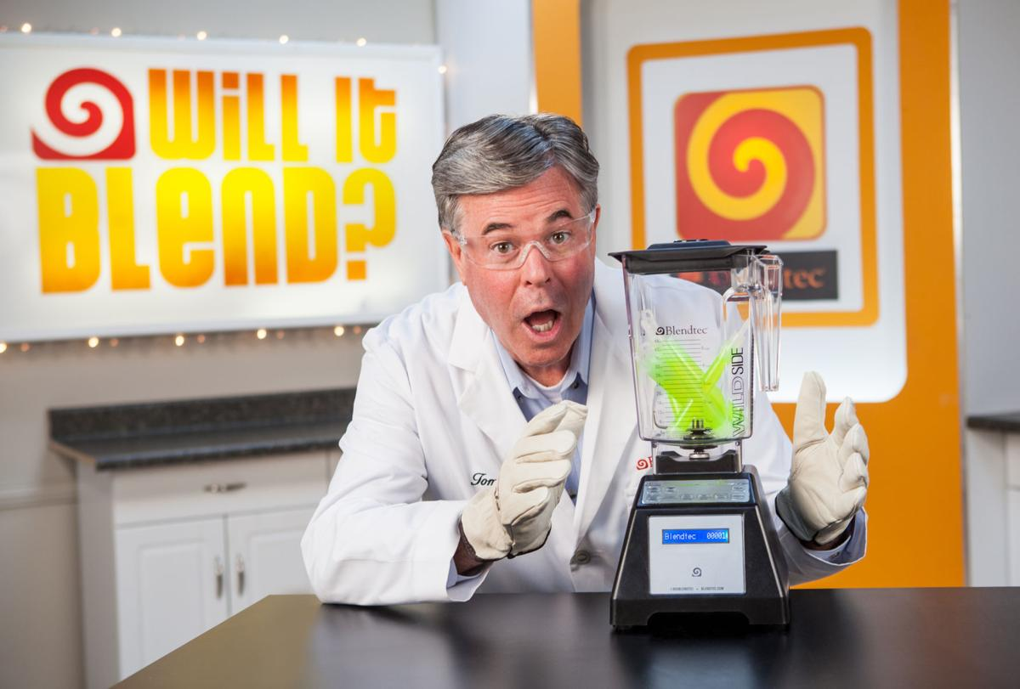
(how) Will it BLEND?

Slide 18
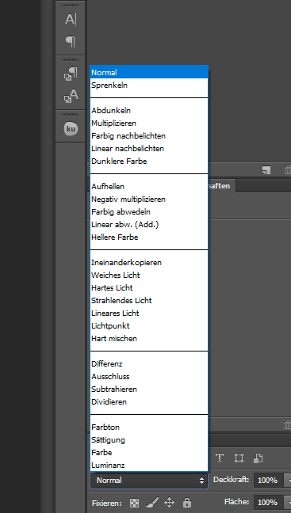
Blend Modes
How to blend the object with the background
Kind of like layer blend modes
Always follow this formular:
(You can look them up online)
SrcColor*SrcBlend + DstColor*DstBlend

Slide 19
Blend Modes
SrcColor*SrcBlend + DstColor*DstBlend
DstColor
SrcColor

Slide 20
Blend Modes
SrcColor*SrcBlend + DstColor*DstBlend
One | The value of one - use this to let either the source or the destination color come through fully.
Zero | The value zero - use this to remove either the source or the destination values.
SrcColor | The value of this stage is multiplied by the source color value.
SrcAlpha | The value of this stage is multiplied by the source alpha value.
DstColor | The value of this stage is multiplied by frame buffer source color value.
DstAlpha | The value of this stage is multiplied by frame buffer source alpha value.
OneMinusSrcColor | The value of this stage is multiplied by (1 - source color).
OneMinusSrcAlpha | The value of this stage is multiplied by (1 - source alpha).
OneMinusDstColor | The value of this stage is multiplied by (1 - destination color).
OneMinusDstAlpha | The value of this stage is multiplied by (1 - destination alpha).
Source: https://docs.unity3d.com/Manual/SL-Blend.html

Slide 21
Blend Modes
SrcColor*SrcBlend + DstColor*DstBlend
One | The value of one - use this to let either the source or the destination color come through fully.
Zero | The value zero - use this to remove either the source or the destination values.
SrcColor | The value of this stage is multiplied by the source color value.
SrcAlpha | The value of this stage is multiplied by the source alpha value.
DstColor | The value of this stage is multiplied by frame buffer source color value.
DstAlpha | The value of this stage is multiplied by frame buffer source alpha value.
OneMinusSrcColor | The value of this stage is multiplied by (1 - source color).
OneMinusSrcAlpha | The value of this stage is multiplied by (1 - source alpha).
OneMinusDstColor | The value of this stage is multiplied by (1 - destination color).
OneMinusDstAlpha | The value of this stage is multiplied by (1 - destination alpha).
Source: https://docs.unity3d.com/Manual/SL-Blend.html

Slide 22
Blend Modes
SrcColor*One + DstColor*One
One | The value of one - use this to let either the source or the destination color come through fully.
Zero | The value zero - use this to remove either the source or the destination values.
SrcColor | The value of this stage is multiplied by the source color value.
SrcAlpha | The value of this stage is multiplied by the source alpha value.
DstColor | The value of this stage is multiplied by frame buffer source color value.
DstAlpha | The value of this stage is multiplied by frame buffer source alpha value.
OneMinusSrcColor | The value of this stage is multiplied by (1 - source color).
OneMinusSrcAlpha | The value of this stage is multiplied by (1 - source alpha).
OneMinusDstColor | The value of this stage is multiplied by (1 - destination color).
OneMinusDstAlpha | The value of this stage is multiplied by (1 - destination alpha).
Source: https://docs.unity3d.com/Manual/SL-Blend.html

Slide 23
Blend Modes
SrcColor*1 + DstColor*1
One | The value of one - use this to let either the source or the destination color come through fully.
Zero | The value zero - use this to remove either the source or the destination values.
SrcColor | The value of this stage is multiplied by the source color value.
SrcAlpha | The value of this stage is multiplied by the source alpha value.
DstColor | The value of this stage is multiplied by frame buffer source color value.
DstAlpha | The value of this stage is multiplied by frame buffer source alpha value.
OneMinusSrcColor | The value of this stage is multiplied by (1 - source color).
OneMinusSrcAlpha | The value of this stage is multiplied by (1 - source alpha).
OneMinusDstColor | The value of this stage is multiplied by (1 - destination color).
OneMinusDstAlpha | The value of this stage is multiplied by (1 - destination alpha).
Source: https://docs.unity3d.com/Manual/SL-Blend.html

Slide 24
Blend Modes
SrcColor + DstColor
One | The value of one - use this to let either the source or the destination color come through fully.
Zero | The value zero - use this to remove either the source or the destination values.
SrcColor | The value of this stage is multiplied by the source color value.
SrcAlpha | The value of this stage is multiplied by the source alpha value.
DstColor | The value of this stage is multiplied by frame buffer source color value.
DstAlpha | The value of this stage is multiplied by frame buffer source alpha value.
OneMinusSrcColor | The value of this stage is multiplied by (1 - source color).
OneMinusSrcAlpha | The value of this stage is multiplied by (1 - source alpha).
OneMinusDstColor | The value of this stage is multiplied by (1 - destination color).
OneMinusDstAlpha | The value of this stage is multiplied by (1 - destination alpha).
Source: https://docs.unity3d.com/Manual/SL-Blend.html

Slide 25
Blend Modes
SrcColor + DstColor = Additive Blending
One | The value of one - use this to let either the source or the destination color come through fully.
Zero | The value zero - use this to remove either the source or the destination values.
SrcColor | The value of this stage is multiplied by the source color value.
SrcAlpha | The value of this stage is multiplied by the source alpha value.
DstColor | The value of this stage is multiplied by frame buffer source color value.
DstAlpha | The value of this stage is multiplied by frame buffer source alpha value.
OneMinusSrcColor | The value of this stage is multiplied by (1 - source color).
OneMinusSrcAlpha | The value of this stage is multiplied by (1 - source alpha).
OneMinusDstColor | The value of this stage is multiplied by (1 - destination color).
OneMinusDstAlpha | The value of this stage is multiplied by (1 - destination alpha).
Source: https://docs.unity3d.com/Manual/SL-Blend.html

Slide 26
Multiplicative Blending (NewColor*OldColor)
SrcColor*SrcBlend + DstColor*DstBlend
One | The value of one - use this to let either the source or the destination color come through fully.
Zero | The value zero - use this to remove either the source or the destination values.
SrcColor | The value of this stage is multiplied by the source color value.
SrcAlpha | The value of this stage is multiplied by the source alpha value.
DstColor | The value of this stage is multiplied by frame buffer source color value.
DstAlpha | The value of this stage is multiplied by frame buffer source alpha value.
OneMinusSrcColor | The value of this stage is multiplied by (1 - source color).
OneMinusSrcAlpha | The value of this stage is multiplied by (1 - source alpha).
OneMinusDstColor | The value of this stage is multiplied by (1 - destination color).
OneMinusDstAlpha | The value of this stage is multiplied by (1 - destination alpha).
Source: https://docs.unity3d.com/Manual/SL-Blend.html

Slide 27
Multiplicative Blending (NewColor*OldColor)
SrcColor*SrcBlend + DstColor*DstBlend
One | The value of one - use this to let either the source or the destination color come through fully.
Zero | The value zero - use this to remove either the source or the destination values.
SrcColor | The value of this stage is multiplied by the source color value.
SrcAlpha | The value of this stage is multiplied by the source alpha value.
DstColor | The value of this stage is multiplied by frame buffer source color value.
DstAlpha | The value of this stage is multiplied by frame buffer source alpha value.
OneMinusSrcColor | The value of this stage is multiplied by (1 - source color).
OneMinusSrcAlpha | The value of this stage is multiplied by (1 - source alpha).
OneMinusDstColor | The value of this stage is multiplied by (1 - destination color).
OneMinusDstAlpha | The value of this stage is multiplied by (1 - destination alpha).
Source: https://docs.unity3d.com/Manual/SL-Blend.html

Slide 28
Multiplicative Blending (NewColor*OldColor)
SrcColor*DstColor + DstColor*Zero
One | The value of one - use this to let either the source or the destination color come through fully.
Zero | The value zero - use this to remove either the source or the destination values.
SrcColor | The value of this stage is multiplied by the source color value.
SrcAlpha | The value of this stage is multiplied by the source alpha value.
DstColor | The value of this stage is multiplied by frame buffer source color value.
DstAlpha | The value of this stage is multiplied by frame buffer source alpha value.
OneMinusSrcColor | The value of this stage is multiplied by (1 - source color).
OneMinusSrcAlpha | The value of this stage is multiplied by (1 - source alpha).
OneMinusDstColor | The value of this stage is multiplied by (1 - destination color).
OneMinusDstAlpha | The value of this stage is multiplied by (1 - destination alpha).
Source: https://docs.unity3d.com/Manual/SL-Blend.html

Slide 29
Multiplicative Blending (NewColor*OldColor)
SrcColor*DstColor + DstColor*0
One | The value of one - use this to let either the source or the destination color come through fully.
Zero | The value zero - use this to remove either the source or the destination values.
SrcColor | The value of this stage is multiplied by the source color value.
SrcAlpha | The value of this stage is multiplied by the source alpha value.
DstColor | The value of this stage is multiplied by frame buffer source color value.
DstAlpha | The value of this stage is multiplied by frame buffer source alpha value.
OneMinusSrcColor | The value of this stage is multiplied by (1 - source color).
OneMinusSrcAlpha | The value of this stage is multiplied by (1 - source alpha).
OneMinusDstColor | The value of this stage is multiplied by (1 - destination color).
OneMinusDstAlpha | The value of this stage is multiplied by (1 - destination alpha).
Source: https://docs.unity3d.com/Manual/SL-Blend.html

Slide 30
Multiplicative Blending (NewColor*OldColor)
SrcColor*DstColor
One | The value of one - use this to let either the source or the destination color come through fully.
Zero | The value zero - use this to remove either the source or the destination values.
SrcColor | The value of this stage is multiplied by the source color value.
SrcAlpha | The value of this stage is multiplied by the source alpha value.
DstColor | The value of this stage is multiplied by frame buffer source color value.
DstAlpha | The value of this stage is multiplied by frame buffer source alpha value.
OneMinusSrcColor | The value of this stage is multiplied by (1 - source color).
OneMinusSrcAlpha | The value of this stage is multiplied by (1 - source alpha).
OneMinusDstColor | The value of this stage is multiplied by (1 - destination color).
OneMinusDstAlpha | The value of this stage is multiplied by (1 - destination alpha).
Source: https://docs.unity3d.com/Manual/SL-Blend.html

Slide 31
Configuration
Global states we can set (like in the old days)
Usually handled by the Engine
In UE4 and Untiy ShaderGraph you set the States in the Material Properties
In Unity you can use the Meta language, that wraps the shader
In your own Engine you‘ll directly call the GPU through DirectX or OpenGL

