Slide 1

Introduction to Shader development
h_da WS2020/21
Paul Nasdalack
info@paul-nasdalack.com
@littleBugHunter

Slide 2
Quick Recap

Slide 3

How does the GPU Render Objects
What is in front and what is behind?
Painters Algorithm
Zbuffer Compare

Slide 4

Painters Algorithm

Slide 5
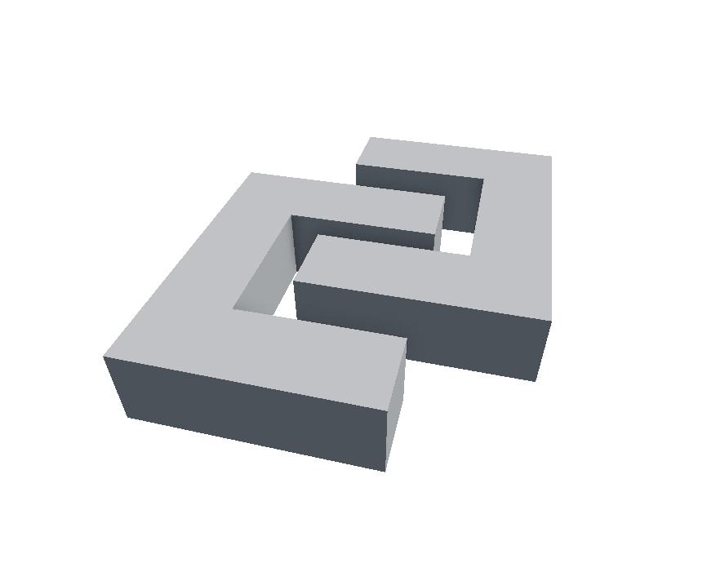

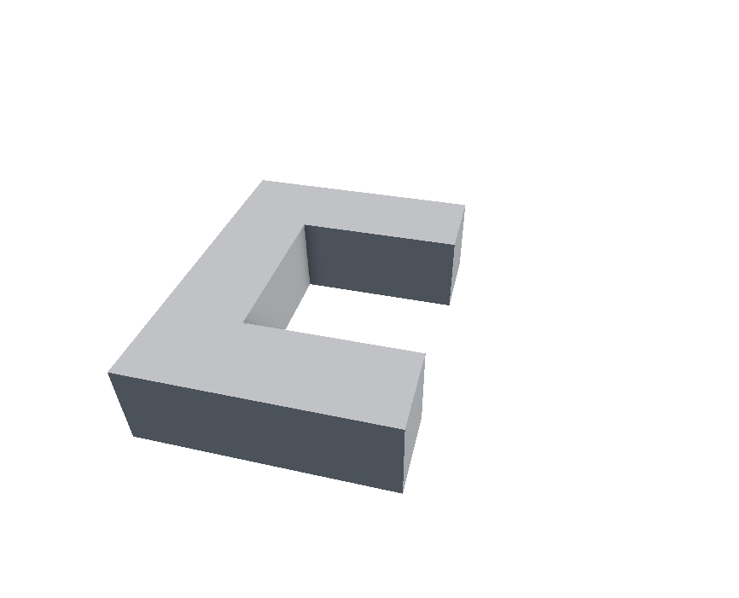
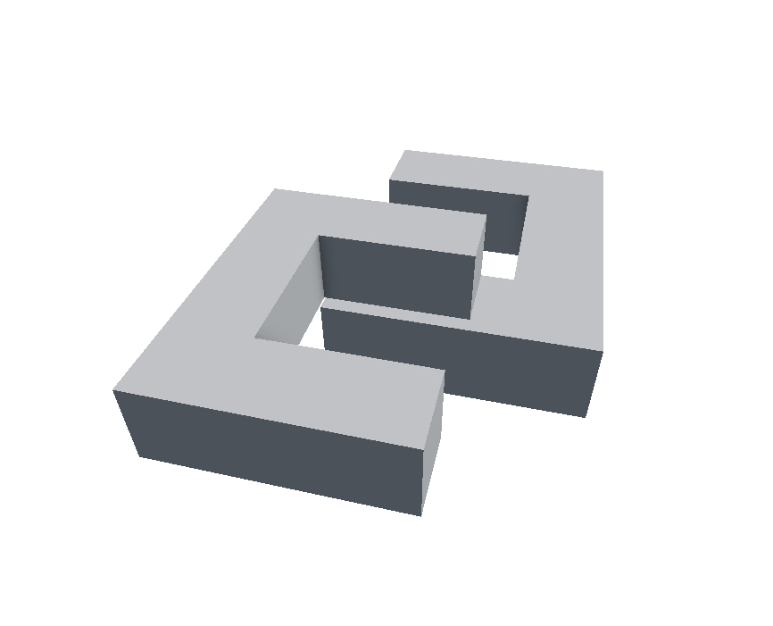
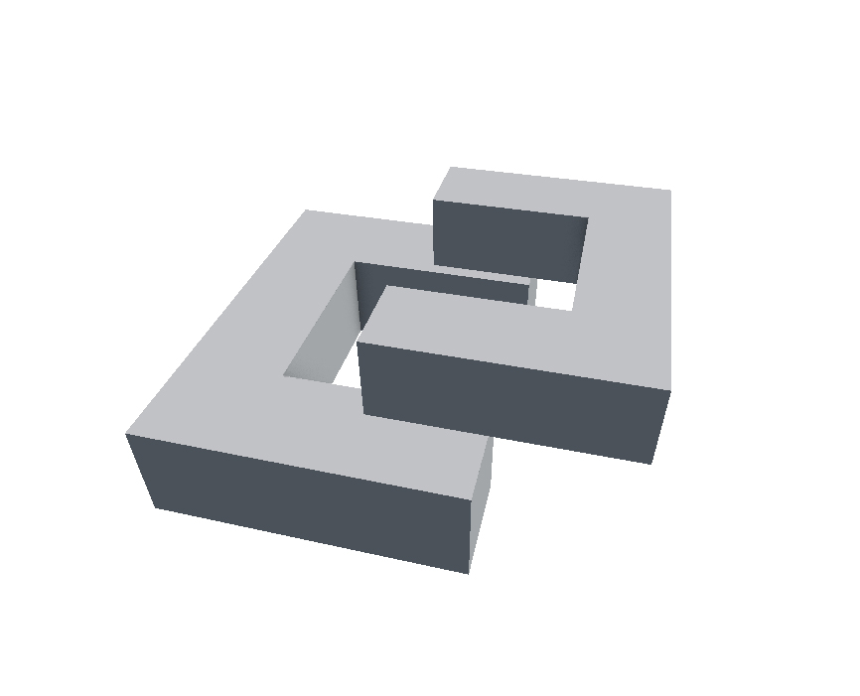
Painters Algorithm

Slide 6
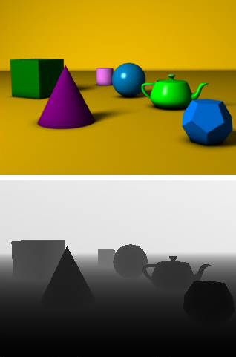
ZBuffer
Distance from the camera
Stored in a second Texture
Rasterizer checks each Pixels distance
Resolved per pixel, not per object

Slide 7
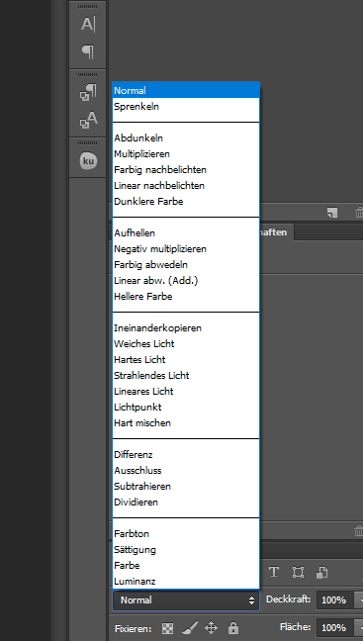
Blend Modes
How to blend the object with the background
Kind of like layer blend modes
Always follow this formular:
(You can look them up online)
NewColor*SrcBlend + OldColor*DstBlend

Slide 8
Congratulations!
You basically know the entire Graphics Pipeline now
Direct X 9.0c that is
Let’s have a rundown of the entire thing

Slide 9
Graphics Pipeline
https://www.opengl.org/wiki/Rendering_Pipeline_Overview
Uniforms
Uniforms
Vertex Data
Vertex Data
Vertex Shader
Clipping
Triangle List
Primitive Assembly
Viewport Transform
Perspective Divide
GPU
Engine
Cull States
Culling
Rasterizer
Fragment Data
Stencil States
Stencil Test
Scissor Test
Fragment Shader
Depth States
Depth Test
Blend States
Blending
Logical OP
Write Mask

Slide 10
Uniforms
Current Data:
Uniforms
Engine
Uniforms
Uniforms
GPU
OpenGL concept (DX is a bit more complicated)
Global Variables, set from the engine
Unity Material Parameters for example
Can not be changed by the shader

Slide 11
Vertex Data
Current Data:
Vertex Data
Engine
Vertex Data
Vertex Data
Vertex Shader
Clipping
GPU
Our appdata Struct
There is one struct for each Vertex in the Mesh
Positions, Normals, UVs, Tangents, etc.
Order is important!

Slide 12
Vertex Shader
Current Data:
Vertex Data
Engine
Vertex Data
Vertex Shader
Clipping
GPU
First Shader
Goes over each appdata struct and modifies it
Typically moves vertices into screen space

Slide 13
Clipping
Current Data:
Vertex Data
Engine
Vertex Data
Vertex Shader
Clipping
GPU
All Vertices outside the view get thrown away, we don’t have to do any more calculations on them

Slide 14
Perspective Divide
Current Data:
Vertex Data
Engine
Primitive Assembly
Viewport Transform
Perspective Divide
GPU
Some Matrix Multiplications modify the 4th component of a Vector
we are in 3D space and need to renormalize the 4th dimension
We actually divide every position by it’s 4th component

Slide 15
Viewport Transform
Current Data:
Vertex Data
Engine
Primitive Assembly
Viewport Transform
Perspective Divide
GPU
The positions are moved from NDC space to actual window space
NDC = Normalized Device Coordinates
-1,1
1,1
0,1080
1920,1080
0,0
-1,-1
1,-1
0,0
0,1920
NDC
Window space

Slide 16
Primitive Assembly
Vertex Data
Current Data:
Triangle List
Engine
Triangle List
Primitive Assembly
Viewport Transform
Perspective Divide
GPU
Assemble Triangles from the Triangle list
Vertices were pushed a specific order, so they can just be numbered
Triangle list is just connecting numbered points :P

Slide 17
Culling
Current Data:
Primitives
(Triangles)
Engine
Cull States
Culling
Rasterizer
Fragment Data
GPU
Remove Triangles
Facing away from the camera
Facing to the camera
Or none at all
Depending on Cull State

Slide 18
Rasterizer
Current Data:
Primitives
(Triangles)
Engine
Culling
Rasterizer
Fragment Data
GPU
Goes through each triangle
Creates a Fragments for each pixel covered by it
If multiple triangles are overlapping there will be multiple fragments per pixel

Slide 19
Fragment Data
Current Data:
Fragment Data
Engine
Culling
Rasterizer
Fragment Data
GPU
Each Fragment contains interpolated vertex output data (v2f struct)
Green Vertex
Interpolated Yellow Fragment
Red Vertex
Red Vertex

Slide 20
Fragment Shader
Current Data:
Fragment Data
Engine
Stencil Test
Scissor Test
Fragment Shader
GPU
Second Shader
Runs on each Fragment
Typically calculates Texturing, Lighting etc.
Returns a Color

Slide 21
Scissor Test
Current Data:
Fragment Data
Engine
Stencil Test
Scissor Test
Fragment Shader
GPU
Discards any Fragments outside the Scissor Rectangle
Rectangle can be specified to cover a certain area of the screen
E.g. Split Screen
Typically Scissor just covers the entire screen

Slide 22
Stencil Test
Current Data:
Fragment Data
Engine
Stencil States
Stencil Test
Scissor Test
Fragment Shader
GPU
Special Buffer for custom user operation
Stores integer values for each pixel ranging from 0-255
Can be compared, incremented, decremented or set
Used for various effects:
Portals
Dynamic holes
UI clipping
Etc.

Slide 23
Depth Test
Current Data:
Fragment Data
Engine
Depth States
Depth Test
GPU
Compares each fragment with the Depth buffer
Is it closer to the camera, than what we’ve already written?
If comparison fails, fragments will be discarded
If comparison succeeds, overrides the old Depth value

Slide 24
Blending
Current Data:
Fragment Data
Engine
Blend States
Blending
Logical OP
Write Mask
GPU
Gets the old Color from the Screen (DstColor)
Blends the new Value (SrcColor) with the old Value
Uses this Formula:
(You can look up the values online)
SrcColor*SrcBlend + DstColor*DstBlend

Slide 25
Logical OP
Current Data:
Fragment Data
Engine
Blending
Logical OP
Write Mask
GPU
Custom Bitwise Operations on Color
Used rarely nowadays

Slide 26
Write Mask
Current Data:
Fragment Data
Engine
Blending
Logical OP
Write Mask
GPU
Can discard certain components of the Fragment
Colors per channel
Eg. Only let red and blue pass and discard Green
Depth
Disable Depth write for transparent objects
Stencil Buffer with a bitmask for custom operations

Slide 27

Why?

Slide 28
Why?
Every GPU out there follows this pipeline
Every time you interact with the GPU to render something it will follow these steps
Vendor agnostic (Nvidia, AMD, Intel all use this pipeline)
Every PC, Mac, Phone, Console and Raspberry PI runs like this

