Slide 1

Introduction to Shader development
h_da WS2020/21
Paul Nasdalack
info@paul-nasdalack.com
@littleBugHunter

Slide 2
LIGHT

Slide 3
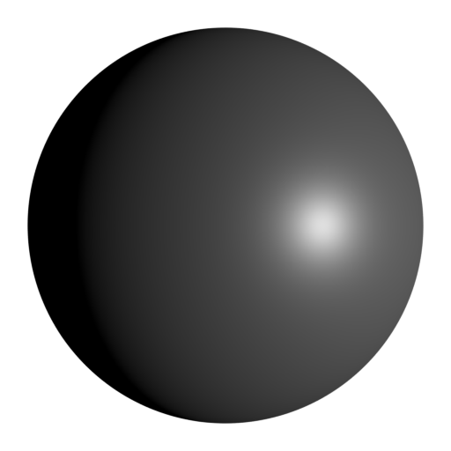
Light
Two types of Light:
Diffuse Light
Specular Highlight

Slide 4
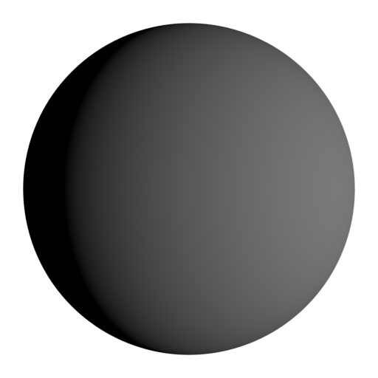
Diffuse Light
Darkens with distance (distance Falloff)
Lights one half of the object softly
Colored by the Albedo of the Material

Slide 5
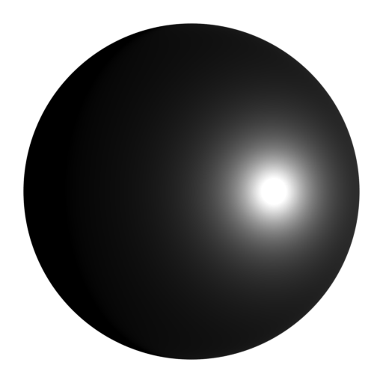
Specular Light
Darkens with distance (distance Falloff)
One Highlight
View direction dependent
Colored by the Specular Color of the Material

Slide 6
Diffuse Light

Slide 7
Diffuse Light (how it works)

Slide 8
Diffuse Light (how it works NOT)
This is
Specular Roughness

Slide 9
Diffuse Light (how it works)

Slide 10
Diffuse Light (how to fake it)
Darkens with distance (distance Falloff)
Darkens with angle (Lambertian reflection)
Colored by the Albedo of the Material

Slide 11
Diffuse Light (how to fake it)
Darkens with distance (distance Falloff)
The further away a Vertex/Fragment is from the Light source, the darker it gets
float distance = length(_LightPos-i.worldPos);
float falloff = 1/(distance*distance); //inverse square falloff

Slide 12
Diffuse Light (how to fake it)
Darkens with angle (Lambertian reflection)
Compare the Light direction with the surface normal, the steeper the angle, the less light is reflected
float distance = length(_LightPos-i.worldPos);
float falloff = 1/(distance*distance); //inverse square falloff
float lightDir = normalize(i.worldPos-_LightPos);
float lambert = saturate(dot(i.worldNormal, - lightDir));

Slide 13
Diffuse Light (how to fake it)
Colored by the Albedo of the Material
Simply multiply the light with the Albedo Color
float distance = length(_LightPos-i.worldPos);
float falloff = 1/(distance*distance); //inverse square falloff
float lightDir = normalize(i.worldPos-_LightPos);
float lambert = saturate(dot(i.worldNormal, - lightDir));
float4 diffuse = falloff * lambert * _LightColor * _AlbedoColor;

