Slide 1

Introduction to Shader development
h_da WS2020/21
Paul Nasdalack
info@paul-nasdalack.com
@littleBugHunter

Slide 2
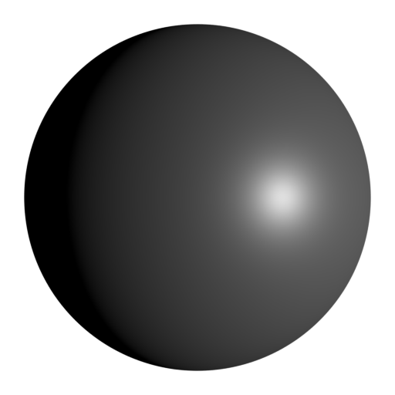
Light
Two types of Light:
Diffuse Light
Specular Highlight

Slide 3
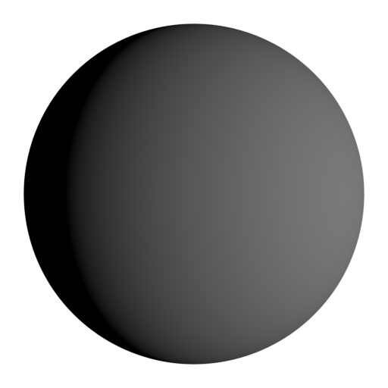
Diffuse Light
Darkens with distance (distance Falloff)
Lights one half of the object softly
Colored by the Albedo of the Material

Slide 4
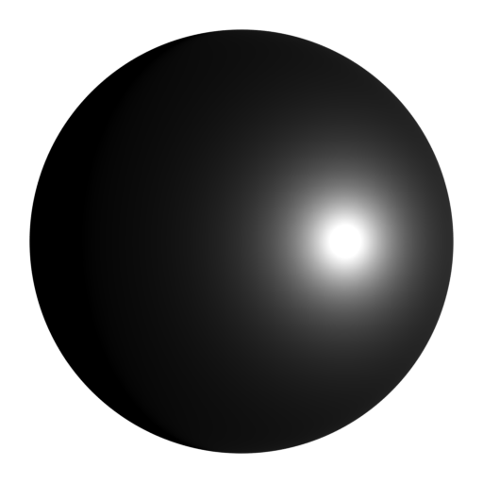
Specular Light
Darkens with distance (distance Falloff)
One Highlight
View direction dependent
Colored by the Specular Color of the Material

Slide 5
Specular Light

Slide 6
Specular Light

Slide 7
Specular Light (how it works)

Slide 8
Specular Light (how it works)

Slide 9
Specular Light (how to fake it)
Darkens with distance (distance Falloff)
One Highlight
View direction dependent
Colored by the Specular Color of the Material

Slide 10
Specular Light (how to fake it)
Darkens with distance (distance Falloff)
The further away a Vertex/Fragment is from the Light source, the darker it gets
float distance = length(_LightPos-i.worldPos);
float falloff = 1/(distance*distance); //inverse square falloff

Slide 11
Specular Light (how to fake it)
D

Slide 12
Specular Light (how to fake it)
D

Slide 13
Specular Light (how to fake it)
D

Slide 14
Specular Light (how to fake it)
D

Slide 15
Specular Light (how to fake it)
D

Slide 16
Specular Light (how to fake it)
D

Slide 17
Specular Light (how to fake it)
D
D

Slide 18
Specular Light (how to fake it)
D

Slide 19
Specular Light (how to fake it)
D

Slide 20
Specular Light (how to fake it)
D

Slide 21
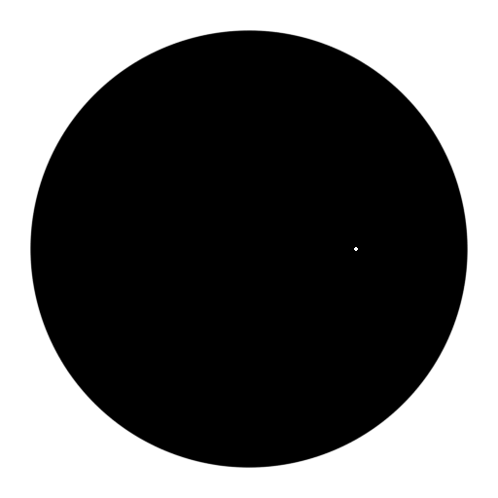
Specular Light (how to fake it)
One Highlight
float3 lightDir = normalize(i.pos – lightPos);
float3 viewDir = normalize(i.pos – cameraPos);
float lightAngle = dot(normal, lightDir);
float viewAngle = dot(normal, viewDir);
bool isReflected = lightAngle == viewAngle;
if(isReflected)
{
//ADD SPECULAR STUFF
}

Slide 22
ROUGHNESS!

Slide 23
Specular Light (how to fake it)
D

Slide 24
Specular Light (how to fake it)
D

Slide 25
Specular Light (how to fake it)
D

Slide 26
Specular Light (how to fake it)
D

Slide 27
Specular Light (how to fake it)
D

Slide 28
Specular Light (how to fake it)
D

Slide 29
Specular Light (how to fake it)
One Highlight
float3 lightDir = normalize(i.pos – lightPos);
float3 viewDir = normalize(i.pos – cameraPos);
float lightAngle = dot(normal, lightDir);
float viewAngle = dot(normal, viewDir);
bool isReflected = lightAngle == viewAngle;
if(isReflected)
{
//ADD SPECULAR STUFF
}

Slide 30
Specular Light (how to fake it)
One Highlight
float3 lightDir = normalize(i.pos – lightPos);
float3 viewDir = normalize(i.pos – cameraPos);
float lightAngle = dot(normal, lightDir);
float viewAngle = dot(normal, viewDir);
float angleDiff = 1-abs(lightAngle – viewAngle);
float specular = angleDiff;

Slide 31
Specular Light (how to fake it)
One Highlight
float3 lightDir = normalize(i.pos – lightPos);
float3 viewDir = normalize(i.pos – cameraPos);
float lightAngle = dot(normal, lightDir);
float viewAngle = dot(normal, viewDir);
float angleDiff = 1-abs(lightAngle – viewAngle);
float specular = pow(angleDiff, glossiness);

Slide 32
Specular Light (how to fake it)
One Highlight
float3 lightDir = normalize(lightPos - i.pos);
float3 viewDir = normalize(i.pos – cameraPos);
float3 halfLightView = normalize(lightDir + viewDir);
float halfAngle = dot(normal, halfLightView);
float blinnPhong = pow(halfAngle, glossiness);

Slide 33
Specular Light (how to fake it)
D

Slide 34
Specular Light (how to fake it)
D

Slide 35
Specular Light (how to fake it)
D

Slide 36
Specular Light (how to fake it)
D

Slide 37
Specular Light (how to fake it)
D

Slide 38
Specular Light (how to fake it)
D

Slide 39
Specular Light (how to fake it)
D

Slide 40
Specular Light (how to fake it)
D

Slide 41
Specular Light (how to fake it)
One Highlight
float3 lightDir = normalize(lightPos - i.pos);
float3 viewDir = normalize(i.pos – cameraPos);
float3 halfLightView = normalize(lightDir + viewDir);
float halfAngle = dot(normal, halfLightView);
float blinnPhong = pow(halfAngle, glossiness);

Slide 42
Specular Light (how to fake it)
Colored by the Specular of the Material
Simply multiply the light with the Specular Color
float3 lightDir = normalize(lightPos - i.pos);
float3 viewDir = i.pos – cameraPos);
float3 halfLightView = normalize(lightDir + viewDir);
float halfAngle = dot(normal, halfLightView);
float blinnPhong = pow(halfAngle, glossiness);
float4 specular = falloff * blinnPhong * _LightColor * _SpecularColor;

