Slide 1

Introduction to Shader development
h_da WS2020/21
Paul Nasdalack
info@paul-nasdalack.com
@littleBugHunter
Heavily based on: https://learnopengl.com/PBR/Theory
All formulas taken from there

Slide 2

Physically Based Rendering

Slide 3
What is PBR
Based on Physical light interaction
Must be energy conserving
Looks “correct” in almost all lighting scenarios

Slide 4
What is not PBR (aka the crimes we‘ve committed so far)
fixed3 diffuse = lambert();
fixed3 specular = blinnPhong();
return diffuse + specular;
Lambert is an ok abstraction of physically based diffuse light
BlinnPhong is not physically based at all
Simply adding diffuse and specular light components is a big no no!

Slide 5
Why can‘t we add diffuse and specular
fixed3 diffuse = lambert();
fixed3 specular = blinnPhong();
return diffuse + specular;
Diffuse and specular functions calculate light interactions of the same ray
By adding them together we double the energy of that ray
We need to split the ray into two parts with separate energies
(kS and kD)

Slide 6
Why can‘t we add diffuse and specular
float3 kS = SpecularPart;
float3 kD = 1-kS;
fixed3 diffuse = lambert();
fixed3 specular = blinnPhong();
return diffuse * kD + specular * kS;

Slide 7
Why can‘t we add diffuse and specular
float3?!
float3 kS = SpecularPart;
float3 kD = 1-kS;
fixed3 diffuse = lambert();
fixed3 specular = blinnPhong();
return diffuse * kD + specular * kS;

Slide 8
Why can‘t we add diffuse and specular
float3?!
float3 kS = SpecularPart;
float3 kD = 1-kS;
fixed3 diffuse = lambert();
fixed3 specular = blinnPhong();
return diffuse * kD + specular * kS;
The Split is not always constant over the whole color spectrum
Metals usually have a colored specular component
Non metals are usually non Colored

Slide 9
Why can‘t we add diffuse and specular
Specular Part?!
float3 kS = SpecularPart;
float3 kD = 1-kS;
fixed3 diffuse = lambert();
fixed3 specular = blinnPhong();
return diffuse * kD + specular * kS;
The Split is not always constant over the whole color spectrum
Metals usually have a colored specular component
Non metals are usually non Colored

Slide 10
The „specular part“
aka specular component
aka Fresnel term
(speak: “Freh-nel”)
(the “s” is silent)
(because it’s cool)
(and french)

Slide 11
Fresnel
Fresnel is what light does at low viewing angles
The flatter you look at a surface, the more light will be reflected
You can try this at home with your desk
In theory at a 90° viewing angle 100% of the light is reflected and none is absorbed

Slide 12

Fresnel Function
cosTheta?!
float3 fresnelSchlick(float cosTheta, float3 F0)
{
return F0 + (1.0 - F0) * pow(1.0 - cosTheta, 5.0);
}
Just a fancy word for ViewDir dot HalfViewDir (halfway point between Light and View Direction)

Slide 13
Fresnel Function
float3 fresnelSchlick(float cosTheta, float3 F0)
{
return F0 + (1.0 - F0) * pow(1.0 - cosTheta, 5.0);
}
F0?!
F0 describes the specular component at the worst case Scenario of viewing the surface from the top
At 90° it’s always white
Note how this is just a fancy lerp between F0 and white with some power curve applied to cosTheta

Slide 14
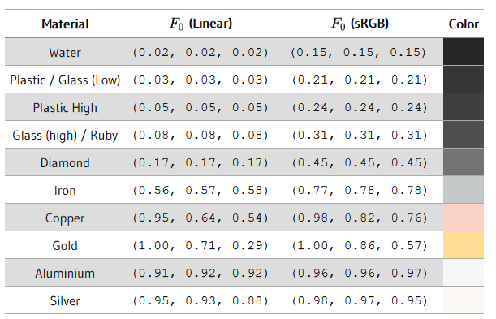
F0
F0 can be measured and there are tables online for it
Non metals usually stay between 0.02 and 0.17
We can simply set it to 0.04 and it will look ok

Slide 15
F0
F0 can be measured and there are tables online for it
Metals have a much bigger range and are colored
As metals don’t have an albedo, we can use the albedo color here

Slide 16
Why can‘t we add diffuse and specular
float3 kS = fresnelSchlick(NdotV, F0);
float3 kD = 1-kS;
fixed3 diffuse = lambert();
fixed3 specular = blinnPhong();
return diffuse * kD + specular * kS;
This whole code part is called BRDF (bidirectional reflectance distribution function)

Slide 17
Why can‘t we add diffuse and specular
fixed3 brdf()
{
float3 kS = fresnelSchlick(NdotV, F0);
float3 kD = 1-kS;
fixed3 diffuse = lambert();
fixed3 specular = blinnPhong();
return diffuse * kD + specular * kS;
}
This whole code part is called BRDF (bidirectional reflectance distribution function)

Slide 18
Why can‘t we add diffuse and specular
fixed3 brdf()
{
float3 kS = fresnelSchlick(NdotV, F0);
float3 kD = 1-kS;
fixed3 diffuse = lambert();
fixed3 specular = blinnPhong();
return diffuse * kD + specular * kS;
}
This whole code part is called BRDF (bidirectional reflectance distribution function)
Lambert and BlinnPhong are pretty bad, we can do better

Slide 19
Cook-Torrance

Slide 20


Cook-Torrance
Lambert is back!
We divide by PI to counteract some later calculations

Slide 21
Cook-Torrance
(The specular part)

Slide 22

Cook-Torrance (The specular part)
DFG stands for:
normal Distribution function
Fresnel
Geometry
We already know Fresnel
The other two are functions are dependent on roughness

Slide 23
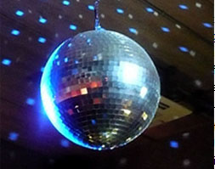
INTRODUCING: MICROFACETS
Image source:
https://commons.wikimedia.org/wiki/File:Disco_ball4.jpg

Slide 24
Microfacets
Material roughness can be approximated with many tiny little mirrors

Slide 25
Microfacets
Material roughness can be approximated with many tiny little mirrors
Two things are happening:
The reflected light gets more spread out (Normal distribution)
Some rays are obstructed by microbumps (geometry obstruction)

Slide 26

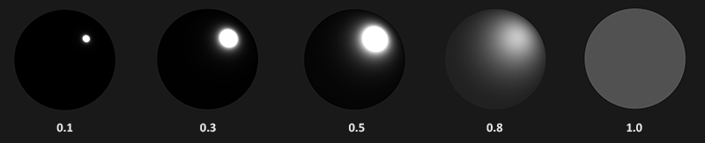
Normal distribution(The reflected light gets more spread out )
a is our roughness
n is the surface normal
h is the half normal (viewDir + lightDir)
Just like in blinnPhong comparing the angle between the halfNormal and the surface normal gives the distance to the highlight center

Slide 27

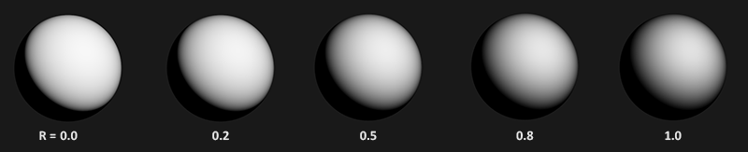
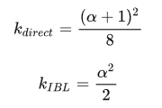
Geometry Obstruction(The reflected light sometimes hits microbumps)
n is the surface normal
v is the view Direction
k is a function that is switched depending on direct or indirect lighting

Slide 28
Cook-Torrance (The specular part)
DFG stands for:
normal Distribution function
Fresnel
Geometry

Slide 29
Cook-Torrance
Lambert is back!
We divide by PI to counteract some later calculations
Fresnel and microfacet interaction describe how specular light is reflected

Slide 30
The big one:
The last part is quite complex for area lights, but for point lights collapses nicely to:
lightCol * falloff * NdotL
Lo stands for Light out
fr is our BRDF
(Lambert+Cook-Torrance)
!
Integral over OMEGA?!
(it’s just math telling us to do this for every light)

Slide 31
The big one
float3 light = float3(0,0,0);
for (uint i = 0; i < MAX_LIGHTS; ++i){
float3 F = fresnelSchlick(…);
kS = F;
kD = (1-kS);
float3 diffuse = (albedo * kD) / PI;
float3 specular = cookTorrance(…);
float NdotL = dot(N, L);
float3 radidance = lightColor[i] * falloff(…);
light += (diffuse + specular) * radiance * NdotL;
}

