Slide 1

HR PEOPLE ANALYTICS dASHBOARD
Ajith Kumar
06-08-2026

Slide 2

Hr people Analytics
Executive Summary
Methodology
KPI Dashboard
Hiring Trend
Gender Distribution
Racial Diversity
Department Volume
Employee Location
Recommendations
Limitations

Slide 3
Executive summary
This report presents an end-to-end HR analytics project covering data extraction, cleaning, and visualization for a 22,214-employee workforce dataset.
Data was sourced from a MySQL database, cleaned and validated using Python, and visualized through an interactive Power BI dashboard featuring 5 KPIs and 6 visualisations.
The analysis reveals a stable, Ohio-concentrated, Engineering-heavy workforce (30% of headcount) with balanced gender representation, moderate racial diversity, and a turnover rate of 12.95% against a strong average tenure of 14.49 years. Key recommendations focus on department-specific retention strategy, remote work evaluation, and geographic hiring expansion

Slide 4
MethodoLogy
Employee data was extracted from a MySQL database using Python (PyMySQL, SQLAlchemy) and loaded into Pandas for cleaning and transformation.
The cleaning process included converting date fields to proper datetime format, resolving time zone inconsistencies, identifying and reclassifying 1,053 records with invalid future termination dates, and validating null values and duplicates across all columns. (PYTHON – mostly Pandas)
The cleaned dataset was then imported into Power BI, where 5 KPIs were built using custom DAX measures, alongside 6 visualizations covering hiring trends, gender distribution, and workforce breakdowns by department, race, and location

Slide 5
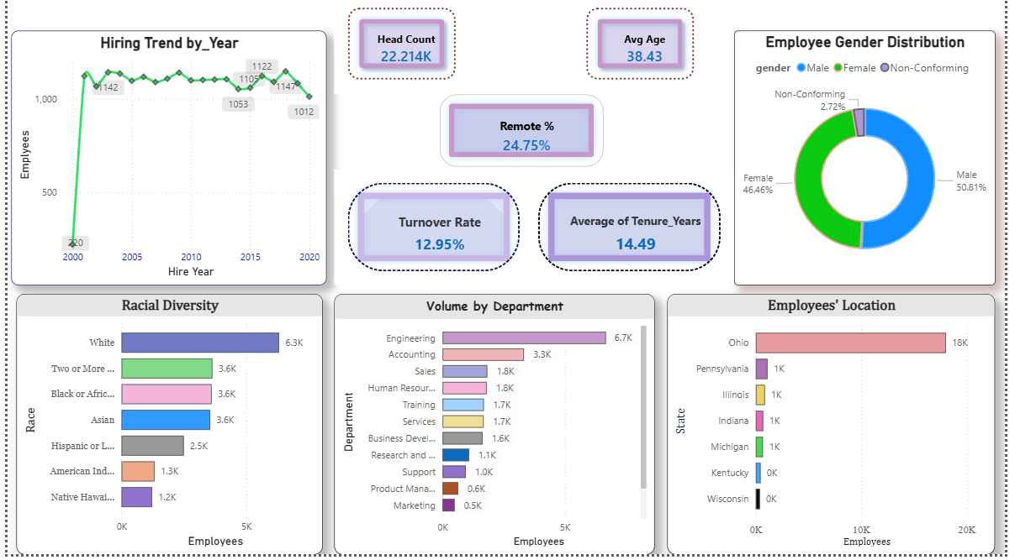
hr Dashboard (Power bi)

Slide 6
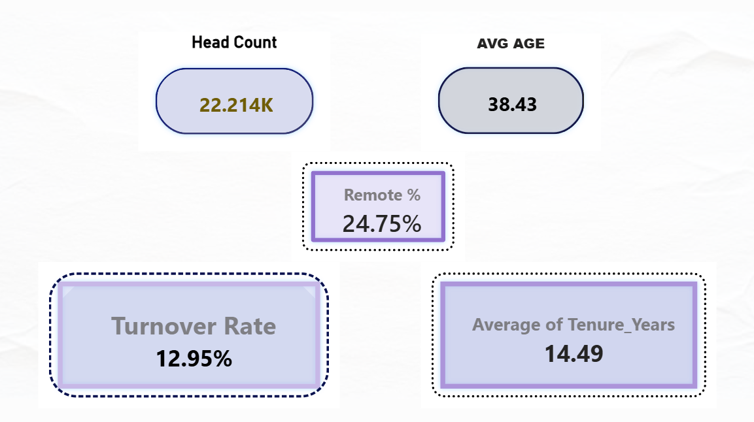
KPI Dashboard
Headcount: 22,214 | Avg Age: 38.43 | Remote %: 24.75% | Turnover: 12.95% | Avg Tenure: 14.49 years
- The workforce is HQ-heavy (roughly 75% on-site vs 25% remote), fairly experienced (avg tenure of 14.5 years suggests that strong retention historically), yet turnover sits close to 13% - worth flagging as a metric to watch, not alarming on its own, but worth comparing to industry benchmarks if you have them.

Slide 7
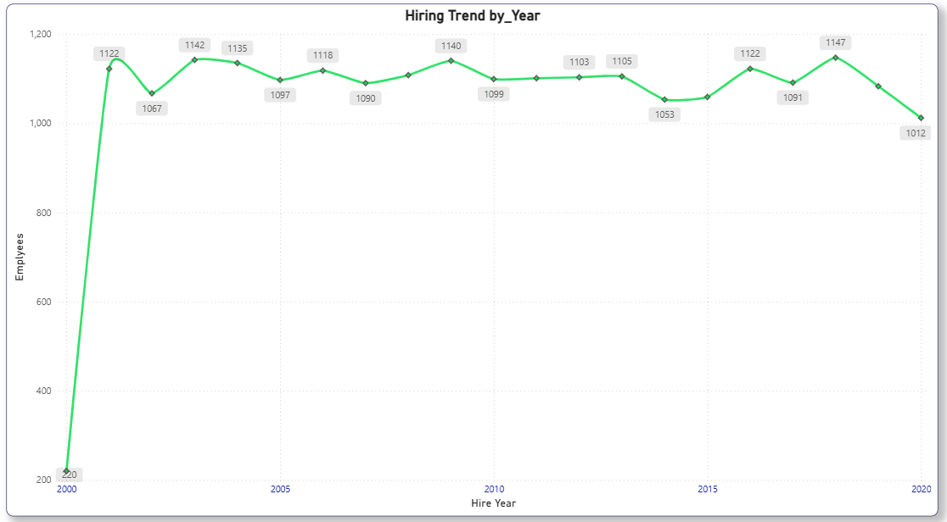
Hiring Trend
- Hiring Volume has remained stable at approximately 1050 – 1150 new hires per year from 2001 to 2019, with no clear upward or downward trend.
- The unusually low counts in 2000 and 2020 likely to reflect partial-year data rather than downward hire shifts. 2000 – 220 hires, a real outlier, far below every other year. (Hiring was low due to data parting issue or the company itself started in 2000.2000 – 2019 – hovers steadily between 1050 and 1150 – hiring has been remarkably consistent for nearly two decades. No major growth or decline but a flat stable line.

Slide 8
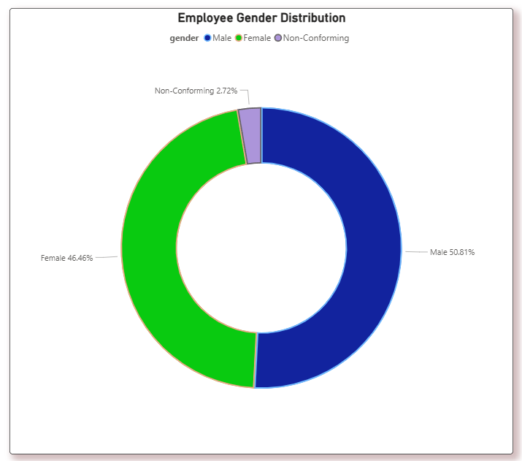
Gender distribution
- Gender Distribution – Male 50.81%, Female 46.46%, non-conforming 2.72%.
- Gender split is close to balanced (roughly 51/49 between the largest groups), which is a genuinely positive, reportable finding – not every company can say that.
Non-conforming representation at 2.72% is also worth naming explicitly rather than lumping into “Other.”

Slide 9
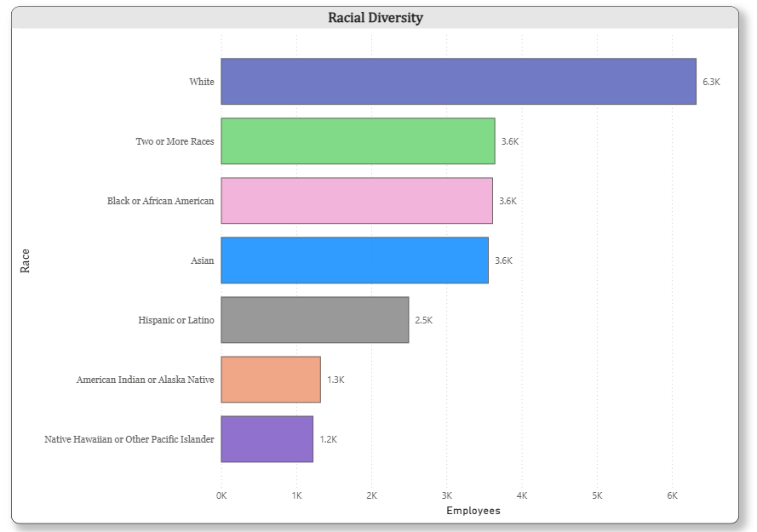
Racial diversity
- White 6.3k clearly leads; Two or more races at 3.648k, black or African American at 3.619k each; Hispanic or Latina 2.5k; American Indian/Alaska Native 1.2k; and Asians at 3.562k.
- White employees represent the largest single group but not an overwhelming majority – the remaining 65% is spread across several groups fairly evenly. Worth noting three groups hover around 3.6k as a real pattern, not coincidence (checked that it’s rounding).

Slide 10
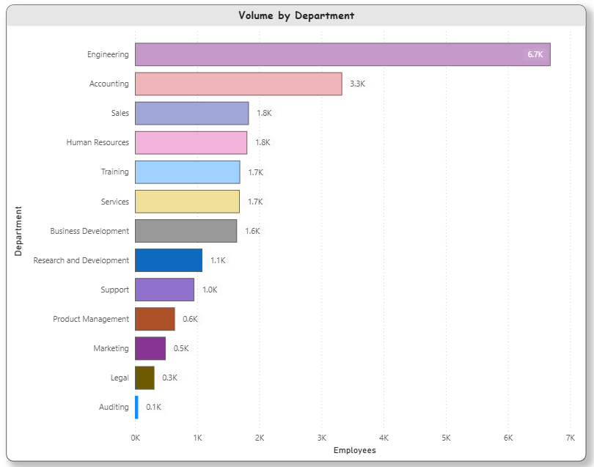
Department volume
- Engineering Dominates at 6.7k – more than double the next largest (Accounting, 3.3k). Long tail down to Auditing at just 0.1k.
- This is a Heavily Engineering-Weighted company (roughly 30% of the entire work force in one department). That’s the single most important structural fact in this dataset – it should probably the Headline of my project as it explains a lot of the “why behind other numbers (e.g, Why average age might skew a certain way, why hiring stayed steady – engineering -heavy companies often hire consistently)

Slide 11
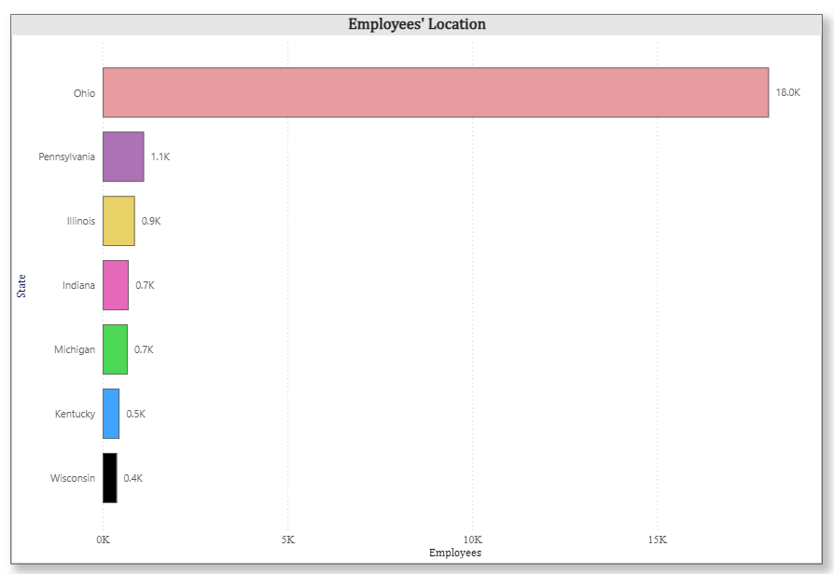
Employee location
- Ohio dominates overwhelmingly at 18.0k vs. every other state combined (5.3k total across PA, IL,IN,MI,KY,Wi)
- This confirms my earlier “HQ Cleveland, Ohio” detail from way back – the company is essentially Ohio-based with small satellite presence in neighboring states. Combined with my 24.75% Remote KPI, this tells a clear story here: that most “remote” workers are probably still regionally clustered near HQ, not distributed nationally. (Worth Checking if remote employees are still Ohio-based or spread out – that is a genuinely interesting follow-up question for us)

Slide 12
RECOMMENDATIONS
Given engineering represents – 30% of headcount, confirm hiring pipelines, onboarding capacity, retention programs are specifically resourced for this department, not just company-wide averages.
With turnover at 12.95% consider a focused review of exit reasons, especially since average tenure is strong (14.49 years), a turnover spike among newer hires vs long-tenured staff would be a different story worth separating out.
Since 75% of staff are HQ based, despite modern remote-work norms, evaluate weather remote work is underutilized or if it’s intentional based on role type, worth surveying employee sentiment.
Workforce diversity is reasonably balanced across gender and several racial groups, worth highlighting as a strength in any external reporting. (e.g; ESG, recruiting materials)

Slide 13
LIMITATIONS
Missing birthdate data: Approximately 61% of birthdate values (13,581 of 22,214 records) were missing. This did not affect the analysis, as the Age field was fully populated and used in its place, but it limits any future analysis requiring exact date-of-birth precision.
Future-dated terminations: 1,053 records contained termination dates set years in the future, determined to be a data quality issue rather than genuine planned exits (verified against age and role patterns, which showed no retirement-age concentration). These records were reclassified as Active employees for accurate turnover reporting.
Partial-year hiring data: Hiring counts for 2000 and 2020 appear notably lower than surrounding years, most likely reflecting incomplete data for those years rather than genuine hiring slow down

Slide 14

Thank you
REFERENCE:
A file (ipynb) is attached for clarification as to how the cleaning was taken care of on python (using pandas on numpy).

