Slide 1
CHESS ENGINE WITH AI-DRIVEN EVALUATION
Minimax Search with Alpha-Beta Pruning & Texel-Tuned Evaluation
IT255 — Artificial Intelligence Mini Project

Slide 2
PROJECT OVERVIEW
A complete chess engine built from scratch in Python, combining:
• Classical AI search: Negamax with Alpha-Beta Pruning, Iterative Deepening
• Data-driven optimization: 803-parameter Texel Tuning via L-BFGS-B
• Knowledge integration: Polyglot Opening Book + Syzygy Endgame Tablebases
• Interactive UI: Full Pygame chessboard with drag-and-drop, eval bar, and clocks
Team Members: <Name 1> | <Name 2> | <Name 3> | <Name 4>
Guide: <Professor Name>

Slide 3
TABLE OF CONTENTS
01
02
03
04
INNOVATION & NOVELTY
PROBLEM STATEMENT & OBJECTIVE
What makes this engine unique — hybrid classical + data-driven AI [1.5 Marks]
The challenge of building a competitive chess engine [1 Mark]
METHODOLOGY & WORKFLOW
IMPLEMENTATION
Search algorithms, evaluation function, and tuning pipeline [2 Marks]
System architecture, code structure, and UI design [2.5 Marks]

Slide 4
WHY THIS ENGINE IS DIFFERENT
Most chess engines rely purely on hand-tuned evaluation functions. Our engine uniquely combines classical Minimax search with machine learning-style parameter optimization — 803 evaluation parameters tuned against 50,000+ Stockfish-evaluated positions using the L-BFGS-B gradient-based optimizer. This hybrid approach achieves measurably stronger play than the hand-tuned baseline.

Slide 5
01
INNOVATION & NOVELTY
What makes this chess engine unique and innovative [1.5 Marks]

Slide 6
KEY INNOVATIONS
★ Full-stack chess engine built entirely from scratch in Python
★ Hybrid AI: Classical search (Minimax + Alpha-Beta) combined with data-driven Texel Tuning
★ 803-parameter evaluation function optimized via L-BFGS-B on Stockfish training data
★ PeSTO Piece-Square Tables with Texel-tuned refinement for accurate positional assessment
★ Specialized endgame heuristics for KBN vs K, KBB vs K, and KRK mating patterns
★ Tapered evaluation with smooth middlegame ↔ endgame phase transition (0–24 scale)
★ Polyglot opening book + Syzygy endgame tablebases for knowledge integration
★ Self-play benchmarking framework with live Pygame visualization

Slide 7
HYBRID ARCHITECTURE
CLASSICAL AI LAYER
DATA-DRIVEN LAYER
Negamax search with alpha-beta pruning provides the core game tree exploration. Iterative deepening with aspiration windows ensures any-time best-move availability. Null-move pruning, LMR, and PVS dramatically reduce search space.
Texel Tuning optimizes 803 parameters: 10 material values, 768 piece-square table entries, and 25 bonus/penalty weights. L-BFGS-B minimizes MSE between engine and Stockfish predictions across 50,000+ quiescent positions.

Slide 8
TEXEL TUNING PIPELINE
DATA GENERATION
OPTIMIZATION
RESULTS
Mercury is the closest planet to the sun
Venus has a beautiful name, but it’s hot
Material values refined (Pawn 82→100, Knight 337→411). Hanging piece penalties increased. Tuned engine outperforms original in self-play.

Slide 9
EVALUATION FUNCTION COMPONENTS
MATERIAL + PST
PAWN STRUCTURE
Separate MG/EG piece values with 64-entry PSTs per piece per phase. PeSTO tables, Texel-refined.
Doubled (-18), isolated (-24) penalties. Passed pawn bonuses by rank. Connected passers, rook behind passer.
KING SAFETY
ENDGAME
King pawn shield (+12 per pawn). Hanging piece penalties: N:-195, B:-201, R:-305, Q:-549.
Mop-up evaluation for decisive advantages. KBN/KBB corner-driving heuristics. 50-move rule decay.

Slide 10
SEARCH ENHANCEMENTS
NULL-MOVE
PVS
Skip move, search at depth-3. Prune if score ≥ β.
Zero-window search for non-PV moves; re-search on fail-high.
LMR
Reduce depth for late quiet moves to speed search.
KILLERS
TT
2 killer moves per ply for improved move ordering.
1M-entry hash table with depth-preferred replacement.

Slide 11
KNOWLEDGE SOURCES & MOVE ORDERING
OPENING BOOK
TABLEBASES
TT MOVE
Polyglot .bin format, weighted-random selection
Syzygy WDL+DTZ for perfect ≤5-piece endgame play
Hash move from transposition table searched first
MVV-LVA
HISTORY
KILLERS
Most Valuable Victim - Least Valuable Attacker ordering
depth² bonus for moves that improved alpha
Quiet moves that caused beta cutoffs at same depth

Slide 12
803 PARAMETERS
TUNED BY MACHINE LEARNING

Slide 13
— THE TEXEL TUNING METHOD
"The key insight of Texel Tuning is that evaluation parameters can be optimized by minimizing the difference between the engine's predicted game outcome and the actual result, using gradient-based optimization on large datasets of positions."

Slide 14

CHESS ENGINE UI — INTERACTIVE PYGAME INTERFACE

Slide 15


USER INTERFACE FEATURES
Full Pygame GUI with drag-and-drop piece movement, legal move highlighting, animated evaluation bar, chess clocks, premove support, captured pieces display, promotion popup, and game-over detection. Non-blocking engine search via threading.

Slide 16
50,000+
Stockfish-evaluated positions used to train the Texel Tuning system.
Each position evaluated at depth 12 with strict quiescence filtering.

Slide 17
KEY ENGINE STATISTICS
803
1M
725
TUNED PARAMETERS
TT ENTRIES
EVAL LOC
10 material + 768 PST + 25 bonus parameters optimized by Texel Tuning
Transposition table with 1 million entry capacity for position caching
Lines of code in evaluation.py — the most complex single module

Slide 18
02
PROBLEM STATEMENT & OBJECTIVE
Defining the challenge and goals of this project [1 Mark]

Slide 19
PROBLEM STATEMENT
CHALLENGE
OBJECTIVES
Search
★★★★★
Traditional chess engines rely on hand-tuned evaluation functions, leading to suboptimal piece valuations. Can we combine classical search with data-driven weight optimization?
Eval
★★★★★
■
■
Design comprehensive evaluation: Material + PST + Pawn structure + King safety
TUNING GOAL
PRIMARY GOAL
UI/UX
★★★★★
Optimize 803 eval parameters using Texel Tuning to outperform hand-tuned baseline
Build a complete chess engine from scratch with Minimax + Alpha-Beta pruning
Create interactive Pygame GUI and integrate opening book + tablebases

Slide 20
PROJECT OBJECTIVES
470 LOC
725 LOC
428 LOC
SEARCH ENGINE
EVALUATION
OPTIMIZATION
Implement Negamax with α-β pruning, iterative deepening, and aspiration windows
Design tapered eval with material, PST, pawn structure, king safety, endgame heuristics
Texel-tune 803 parameters against Stockfish ground truth using L-BFGS-B

Slide 21
TECHNOLOGY STACK
ENGINE CORE
A full-stack chess engine with search, evaluation, tuning, and GUI components
LANGUAGE:
Python 3.x
LIBRARIES:
python-chess, NumPy, SciPy (L-BFGS-B), Pygame
SEARCH
470 LOC
EVALUATION
725 LOC
TUNING
428 LOC
The engine is modular: search.py, evaluation.py, texel_tuning.py, transposition.py, move_ordering.py
Negamax + α-β pruning with TT, NMP, LMR, PVS, quiescence search
Material + PST + pawn structure + king safety + endgame + Texel-tuned weights

Slide 22
ENGINE PIPELINE (PER MOVE)
EVALUATE
TABLEBASE
Tapered eval: Material + PST + Pawn + King safety + Endgame heuristics
Syzygy probe for ≤5 pieces → return DTZ-optimal move
SEARCH
OPENING BOOK
Iterative deepening: depth 1..N with dynamic endgame boost (+6 for ≤4 pieces)
Polyglot book probe → return weighted-random book move if found

Slide 23
DEVELOPMENT METHODOLOGY
STEP 01
STEP 02
STEP 03
STEP 04
TEXEL TUNING
UI & TESTING
BOARD & MOVES
SEARCH & EVAL
Generate training data, build design matrix, L-BFGS-B optimization
Pygame GUI, self-play benchmarking, opening book & tablebase integration
Board representation using python-chess with legal move generation
Negamax + α-β with evaluation function design and quiescence search

Slide 24
OUR TEAM
<TEAM MEMBER 1>
<TEAM MEMBER 2>
Role and contribution details go here
Role and contribution details go here

Slide 25

SYSTEM ARCHITECTURE
The engine follows a clean modular architecture:
• search.py (470 LOC) — Negamax, α-β, ID, PVS, LMR, NMP, Quiescence
• evaluation.py (725 LOC) — Material, PST, Pawn structure, Endgame
• texel_tuning.py (428 LOC) — L-BFGS-B optimizer, 803-param design matrix
• transposition.py (106 LOC) — 1M-entry hash table
• move_ordering.py (65 LOC) — MVV-LVA, Killers, History
• openingbook.py (93 LOC) — Polyglot reader
• tablebase.py (120 LOC) — Syzygy WDL+DTZ
• UI/main.py (1164 LOC) — Full Pygame GUI

Slide 26

NEGAMAX ALGORITHM
function negamax(board, depth, α, β, ply):
if repetition → return 0 (draw)
if TT hit → return cached (score, move)
if game_over → return evaluate(board)
if depth ≤ 0 → return quiescence(α, β)
null_move_pruning(board, depth, β)
for each move in ordered_moves:
if first_move: full window search
else: PVS zero-window + LMR reduction
if score ≥ β: cutoff + store killer
store in TT → return (best_score, best_move)

Slide 27
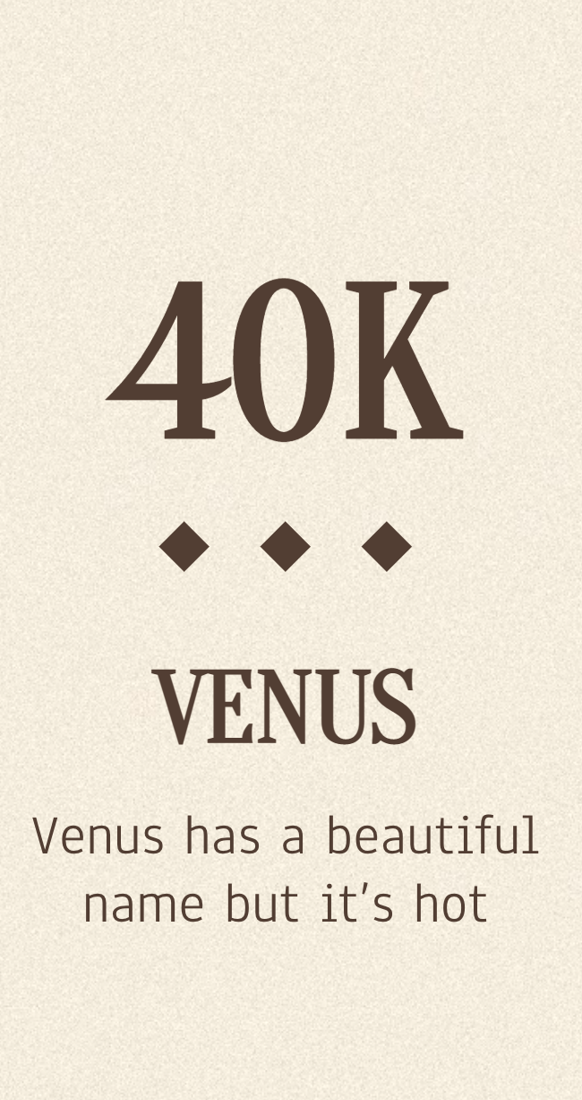
SELF-PLAY BENCHMARKING
Validation Framework:
• N-game match: Tuned vs Original engine
• Alternating colors for fairness
• All 784 parameters swapped atomically per move
• TT cleared on engine switch (no score leakage)
• Live Pygame visualization of matches
• Tracks: score, eval per move, game results
Result: Tuned engine consistently outperforms the hand-tuned baseline

Slide 28
THANK YOU!
QUESTIONS & DISCUSSION
IT255 — Artificial Intelligence Mini Project
Please keep this slide for attribution

