Slide 1
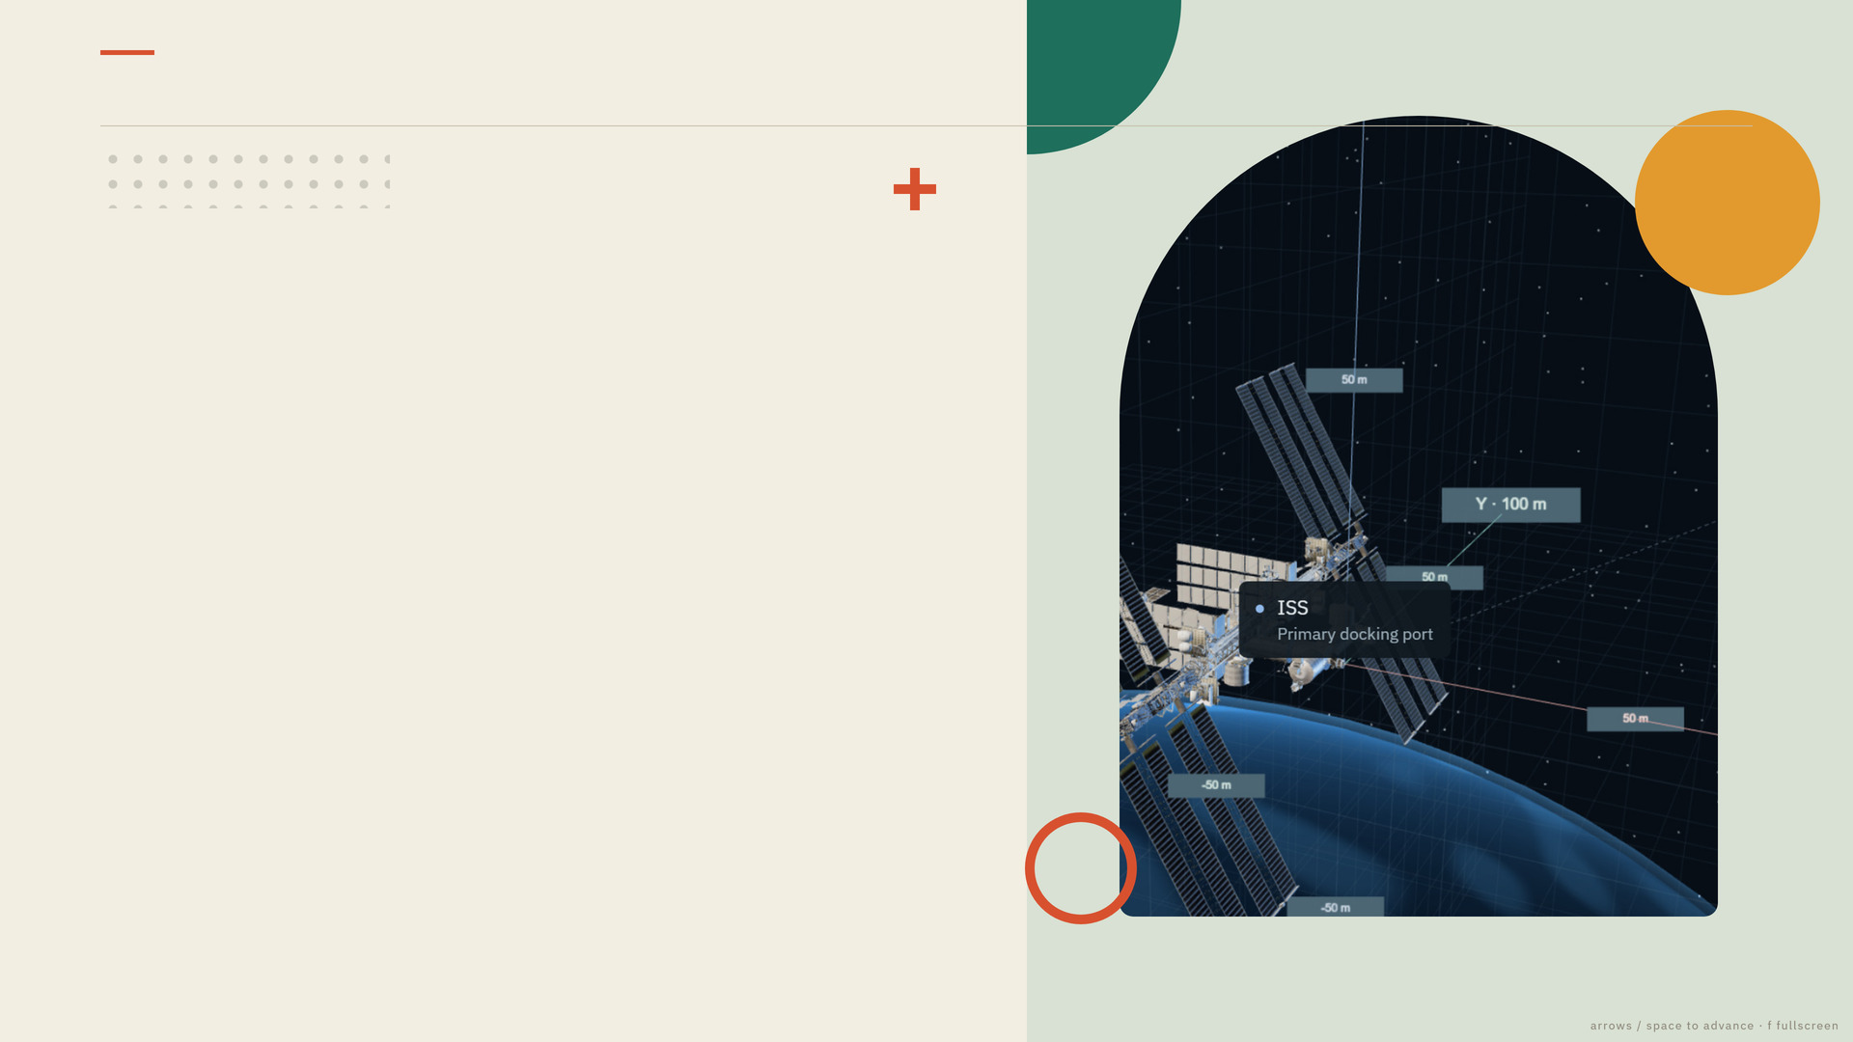
DOCKING LAB · OCTOBER 2026
DOCKING LAB · INVESTOR BRIEF
A spacecraft that
docks itself.
And shows its work.
An LLM plans the manoeuvre, a learned policy advises it, and an independent safety channel gates every command — over real orbital dynamics, in one dashboard.
THE LAST RECORDED RUN
1.945
cm
0.004
m/s
0
fallbacks
final port separation
relative speed at capture
two provider decisions, both applied
cover capture · this project's own dashboard, 100 m approach
01
/ 16
Notes:
Open on the button: this is a working system, not a concept video.
Say in one breath: an LLM, a learned policy and an independent safety channel fly a 500 kg chaser from 100 metres to a centimetre-class capture — and every claim in this deck traces to a file.
Numbers on screen: 1.945 cm, 0.004 m/s, zero fallbacks — proofs/precision-vertex-docking/checks.json.

Slide 2

THE PROBLEM
DOCKING LAB · INVESTOR BRIEF
The final 100 metres
decide the mission.
One controller per target
A new vehicle or a new port means another hand-tuned control law and another test campaign.
Rendezvous is unforgiving: close on a moving target, null your motion down to centimetres, and touch down softly enough to latch.
Rehearsal is scarce
On-orbit proximity rehearsal is expensive and rare; ground rigs cannot reproduce contact dynamics or sensor dropouts.
0.005
m/s
the permitted capture speed at the shared gate — every method, human or learned, is judged against the same number.
Autonomy nobody can question
A planner a reviewer cannot interrogate cannot be signed off — the capability stalls at the demo stage.
gate defaults · src/app/simulation/safety.py
02
/ 16
Notes:
Frame the pain in plain terms: proximity operations carry the mission risk, every new target restarts the control-law and verification campaign, and autonomy that cannot explain itself never gets certified.
The 0.005 m/s figure is this simulator's shared capture gate (src/app/simulation/safety.py) — present it as the class of tolerance, not as an ISS requirement.

Slide 3

WHY NOW
DOCKING LAB · INVESTOR BRIEF
Three things got cheap — all at once.
The bottleneck moved. Planning, advice and verification are now implementable in one week of engineering time.
01
02
03
Tool-using models
Learned advice on a budget
Evidence-first engineering
The planner calls measurement tools, previews a manoeuvre before submitting it, and records the alternatives it rejected. Interrogable, not a black box.
An expert-initialized PPO policy trains to 200,704 environment steps on two T4 GPUs and is evaluated on held-out seeds. It advises; it never actuates.
Every run exports configuration, decisions, tool readings, telemetry and SHA-256 hashes — a reviewer re-derives each number instead of trusting a slide.
planning · src/app/llm/reasoning_agent.py · src/app/llm/tools.py
03
/ 16
Notes:
The 'why now': the pieces are individually unremarkable, the composition is new.
Each card cites its artifact — the tool loop in src/app/llm/tools.py, PPO evidence in proofs/kaggle-final-seed-42/, exports in proofs/precision-vertex-docking/.

Slide 4
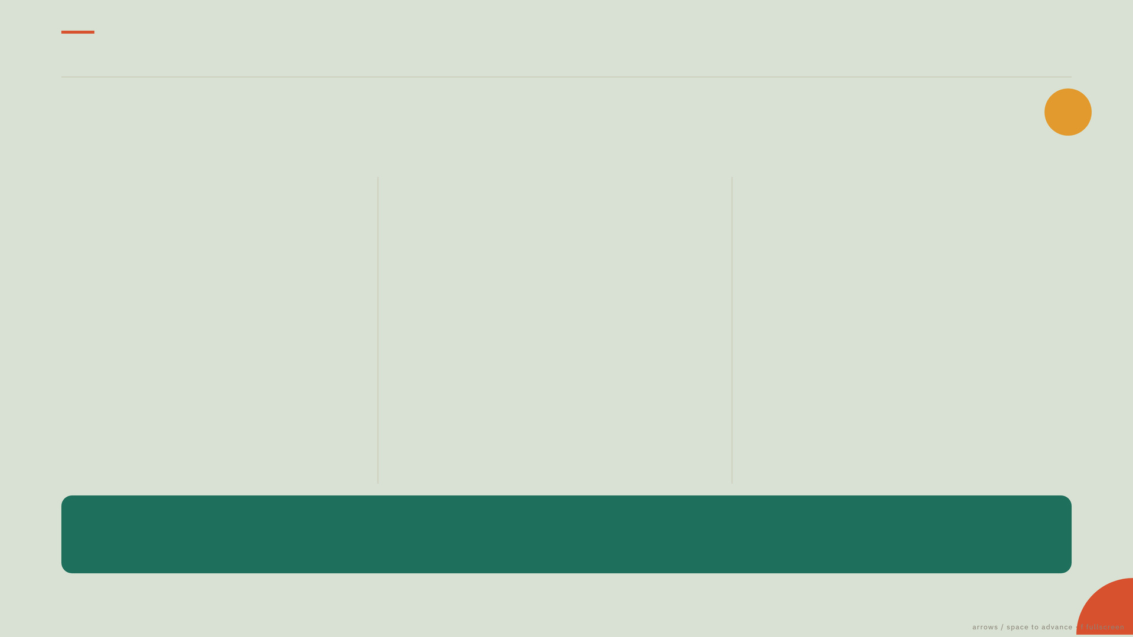
THE SYSTEM
DOCKING LAB · INVESTOR BRIEF
One dashboard. One closed loop.
PLAN
ADVISE
FLY
A planner with six tools
A policy that suggests
A controller that never guesses
A LangChain planner calls six inspection and submission tools. Vertex AI by default; OpenAI, Groq, OpenRouter and Anthropic selectable.
It measures, checks the gate, previews the manoeuvre, then submits — with a rationale.
An expert-initialized PPO advisor supplies a learned proposal — a 4-second lookahead closing vector.
The planner may adopt it, cap it or reject it, and every decision records which, with a reason.
An LQR controller tracks the accepted target continuously, under per-axis force, torque, acceleration and stopping-distance envelopes on a 500 kg chaser.
Physics never waits for the planner — it keeps stepping while guidance is pending.
AND UNDERNEATH EVERYTHING
An independent safety channel reads simulator truth, enforces the motion and capture gates, and performs fault braking — surviving provider loss and stale sensor data.
architecture · src/app/simulation/runner.py · src/app/llm/tools.py
04
/ 16
Notes:
Walk left to right: plan, advise, fly — then the band underneath.
The architectural claim for a technical reviewer: deterministic physics and safety sit outside the planner, so provider latency or failure cannot corrupt the state.
Sources: src/app/simulation/runner.py, dynamics.py, safety.py, src/app/llm/reasoning_agent.py, tools.py.

Slide 5
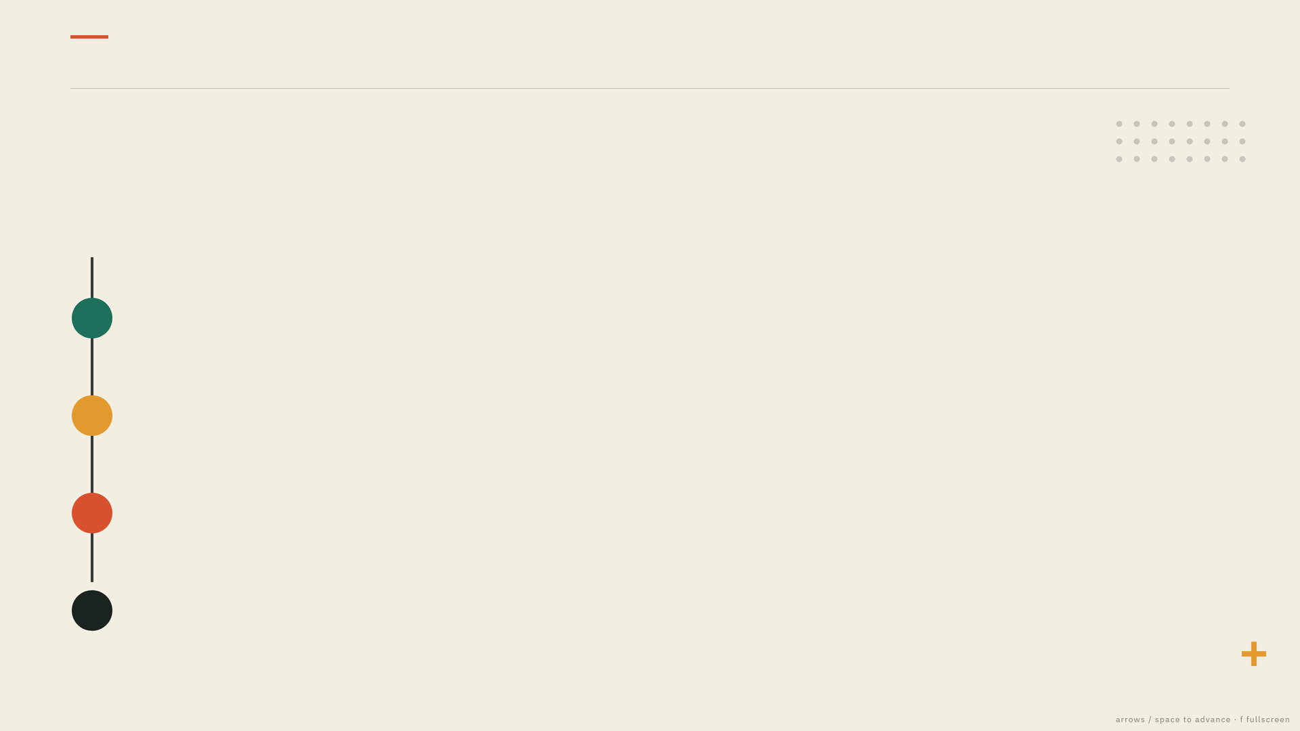
CONTROL ARCHITECTURE
DOCKING LAB · INVESTOR BRIEF
Nothing flies unchallenged.
Four lanes. Only the first two can be wrong.
1
PLANNER
Vertex AI by default
four providers selectable
An LLM over a six-tool loop: measure distance, inspect the capture gate, inspect actuators, read the learned proposal, preview a manoeuvre, submit — returning targets, a rationale and the alternatives it rejected.
2
ADVISOR
advice, never authority
Expert-initialized PPO proposes a 4 s lookahead closing vector. The planner may adopt it, cap it or reject it — every decision records which, with a reason.
3
EXECUTOR
propellant follows
applied impulse
LQR tracking under per-axis force and torque, total thrust, acceleration and stopping-distance envelopes on a 500 kg chaser: 50 N total, 20 N·m per axis, 0.1 m/s² local acceleration.
4
SAFETY CHANNEL
survives provider loss
and stale sensor data
Independent of the planner and the policy. It reads simulator truth, enforces the motion and capture gates, discards expired plans and labels the recovery manoeuvre.
In the recorded run, accepted decisions carried 24.4 s and 22.6 s plan age while the simulation kept advancing.
lanes · src/app/simulation/runner.py · src/app/llm/rl_advisor.py
05
/ 16
Notes:
The line for engineers: only lanes 01 and 02 can be wrong, and neither can actuate anything directly.
Provider failure produces labelled deterministic guidance, never silence.
Numbers: 50 N, 20 N·m, 0.1 m/s², 500 kg; plan ages 24.4 s and 22.6 s from proofs/precision-vertex-docking/decisions.json.

Slide 6
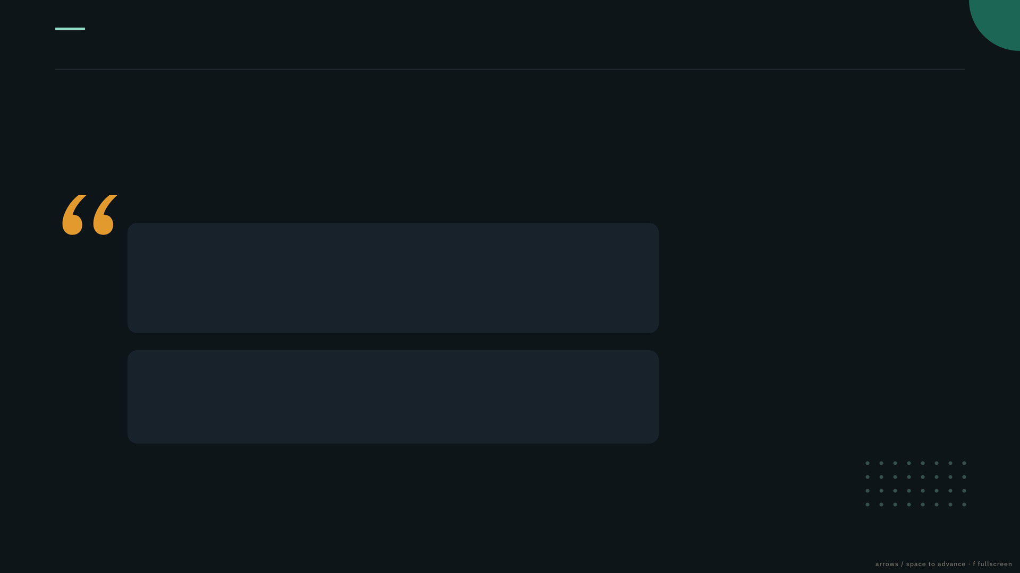
LIVE TRACE
DOCKING LAB · INVESTOR BRIEF
It argued with its own advisor — and won.
WHAT THE RUN RECORDS
“Adopt the RL short-horizon waypoint at 0.65 m/s: rejected — it creates an unnecessary intermediate stop and underutilizes the 2.0 m/s approach envelope at 100 m range.”
2
decisions
0
fallbacks
Vertex gemini-3.8-flash · decision 1 of 2 · plan age 24.4 s · applied
45.3
° initial error
“The RL velocity direction aligns well with the line of sight; the short lookahead is rejected to prevent stopping mid-trajectory.”
449
steps of force + torque
Vertex gemini-3.8-flash · decision 2 of 2 · range 2.49 m · plan age 22.6 s · applied
Both plans were validated against the state at submission, then re-gated by the safety channel before actuation.
This is the reviewable part: the model states its target, its reason, and the proposal it declined — with the measurement that justified the choice. Short explanations are surfaced; private deliberation is not.
verbatim quotes · proofs/precision-vertex-docking/decisions.json
06
/ 16
Notes:
Slow down here. This slide separates the project from a demo video: quoted decisions with plan age, an applied flag and the rejected alternative, all in proofs/precision-vertex-docking/decisions.json.
The model overrode its learned advisor using the configured envelope — judgment, not improvisation.

Slide 7
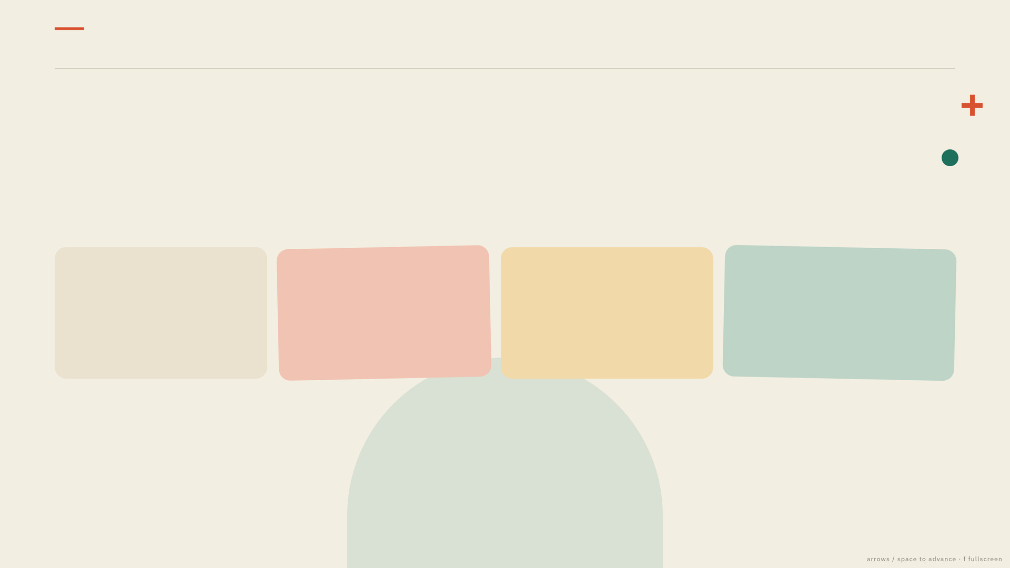
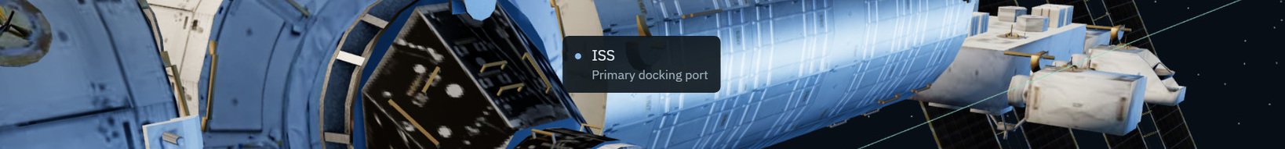
CAPTURE CRITERIA
DOCKING LAB · INVESTOR BRIEF
Capture is a contract.
All four checks must pass, plus one second of stable alignment and entry into a 5 cm lateral corridor. Manual and automatic capture share the same gate.
RANGE
RELATIVE SPEED
ATTITUDE ERROR
ROTATION RATE
2
cm
0.005
m/s
1
°
0.01
rad/s
shared gate · max 3 cm
max 0.01 m/s
default tolerance
relative, at contact
A stopping-distance envelope brakes the chaser before the near-port zone, then tightens to capture speed. All four checks are satisfied together, not in sequence.
07
/ 16
Notes:
The gate is code, not convention: safety.py evaluates all four checks plus stability and corridor entry.
The announced capture only fires after server confirmation — the UI cannot claim eligibility during abort or sensor dropout.
Imagery is a real capture from this project's dashboard.

Slide 8
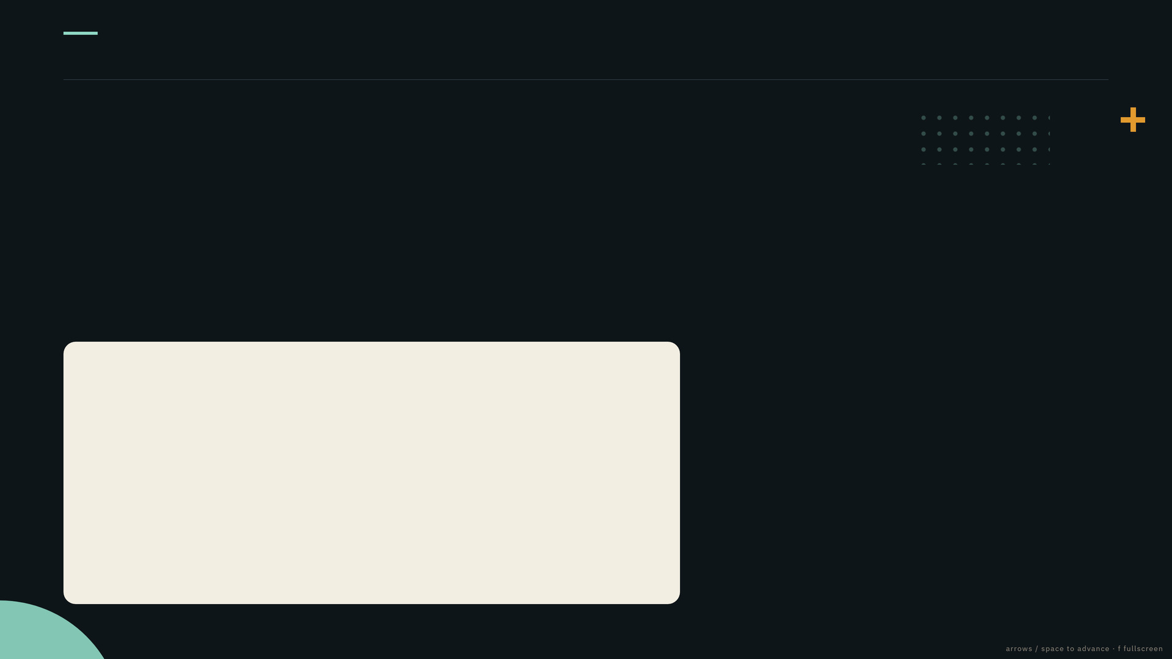
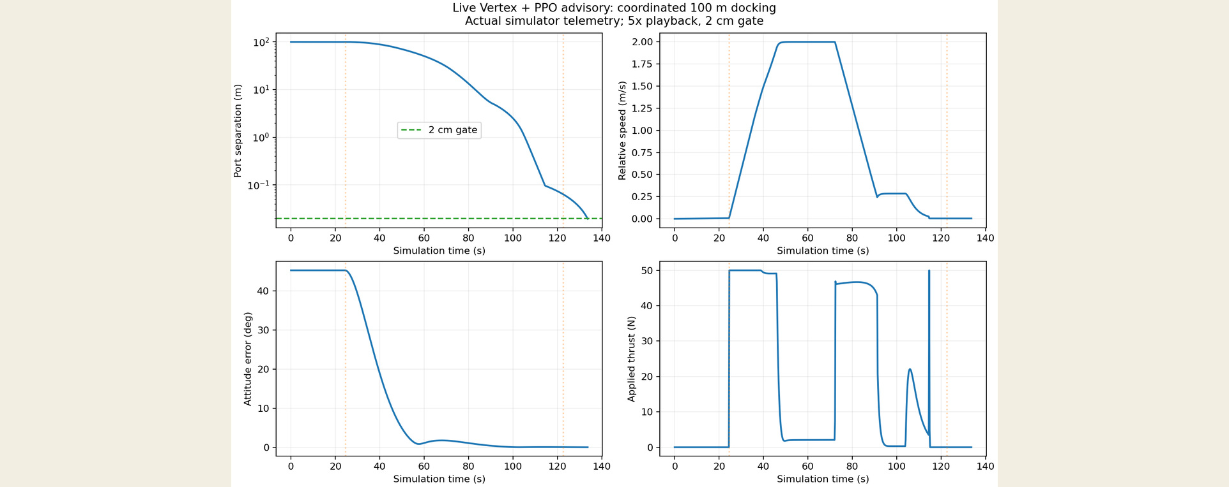
RESULT
DOCKING LAB · INVESTOR BRIEF
100 metres to 1.945 cm. Zero fallbacks.
1.945
cm
0.004
m/s
133.6
s
5×
/ 75.4 s
FINAL SEPARATION
SPEED AT CAPTURE
SIMULATED TIME
PLAYBACK / WALL CLOCK
ENVELOPE ACTUALLY USED
max speed 1.999 m/s
max thrust 50.0 N
max accel 0.100 m/s²
gate checks 4 / 4 passed
LLM calls 2 applied
fallbacks 0
Speed and thrust sat exactly at the configured ceilings — the envelope bound the manoeuvre, not the model's optimism.
Measured telemetry · live Vertex + PPO advisory · one accelerated demonstration at a 2 cm simulated gate
08
/ 16
Notes:
Lead with the constraint, not the number: the chaser used its full configured envelope (2 m/s, 50 N) and still arrived at 0.004 m/s.
Chart from proofs/precision-vertex-docking/approach-curves.png.
Say the scope out loud: one accelerated live demonstration at a 2 cm simulated gate, not a hardware accuracy claim.

Slide 9
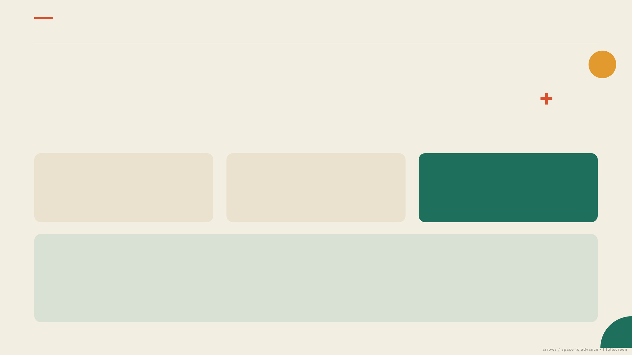
LEARNED ADVISOR
DOCKING LAB · INVESTOR BRIEF
Fly the expert. Then improve on it.
Reproducible training: expert, cloning, PPO, matched normalisers, held-out seeds.
STEP 01 · THE EXPERT
STEP 02 · THE DEMONSTRATION
STEP 03 · THE REFINEMENT
LQR trajectories
Behaviour cloning
PPO fine-tuning
100 expert episodes over the same dynamics.
50 epochs on normalised observations.
200,704 steps, 8 environments, two T4 GPUs.
HELD-OUT EVALUATION · SEEDS 70000–70049 · 5–80 M STARTS
METHOD
SEED 42
SEED 137
LQR with deterministic planner
50 / 50 docked
50 / 50 docked
PID with deterministic planner
50 / 50 docked
50 / 50 docked
PPO with deterministic planner
50 / 50 docked
50 / 50 docked
LQR with PPO advice — recommended
50 / 50 docked
50 / 50 docked
The archived policy was trained at a 1.25 m gate — these results do not establish centimetre precision. Every 50/50 carries a Wilson 95% interval of ≈92.9–100%.
training + evaluation · proofs/kaggle-final-seed-42/ · proofs/kaggle-final-seed-137/
09
/ 16
Notes:
Be scrupulous; a technical reviewer will attack this slide.
Say plainly: the archived policy was trained and evaluated at a 1.25 m gate; the notebook packages the 2 cm environment for fresh training.
The value on the table is pipeline reproducibility — expert, cloning, PPO, matched normalisers, held-out seeds.
Sources: proofs/kaggle-final-seed-42/ and -137/.

Slide 10
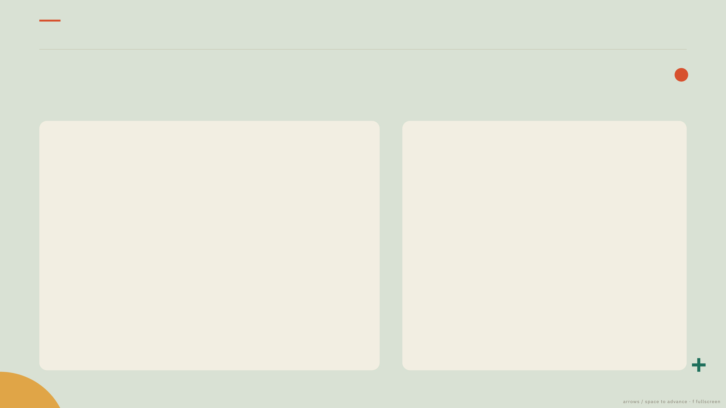
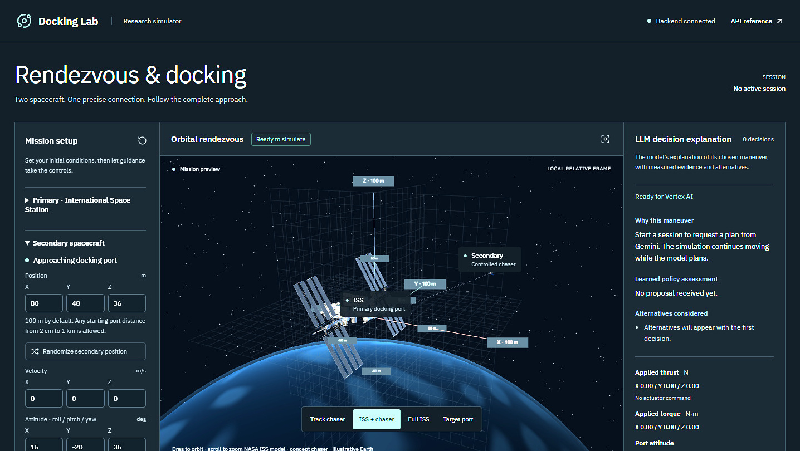
EVIDENCE
DOCKING LAB · INVESTOR BRIEF
Every number has a file behind it.
PROOFS TREE · COMMITTED, HASHED, REVIEWED
kaggle-final-seed-42/ 200,704 training steps
kaggle-final-seed-137/ independent seed
evaluation.json every held-out trial
manifest.json SHA-256 hashes
precision-vertex-docking/ live Vertex + PPO run
decisions.json rationale, rejected options
telemetry.csv range, speed, thrust
code-audit/ 30 + 5 modules audited
verification.json pytest · ruff · proofs
DASHBOARD · DECISION LOG AND EXPORT
Every session exports its configuration, decisions, tool readings and terminal checks — raw material for a replay. Runs that failed are kept beside the successes.
Hashes establish integrity, not endorsement — the reports say so in their own words.
10
/ 16
Notes:
Hand a reviewer the folder, not a slide. Offer the live dashboard and the export of any session they want to poke at.
If asked what the hashes prove: file integrity, and that the numbers were not edited after the run. They do not certify the simulator.
Verification entry points: python -m pytest; python -m ruff check src tests scripts; python scripts/verify_proofs.py.

Slide 11
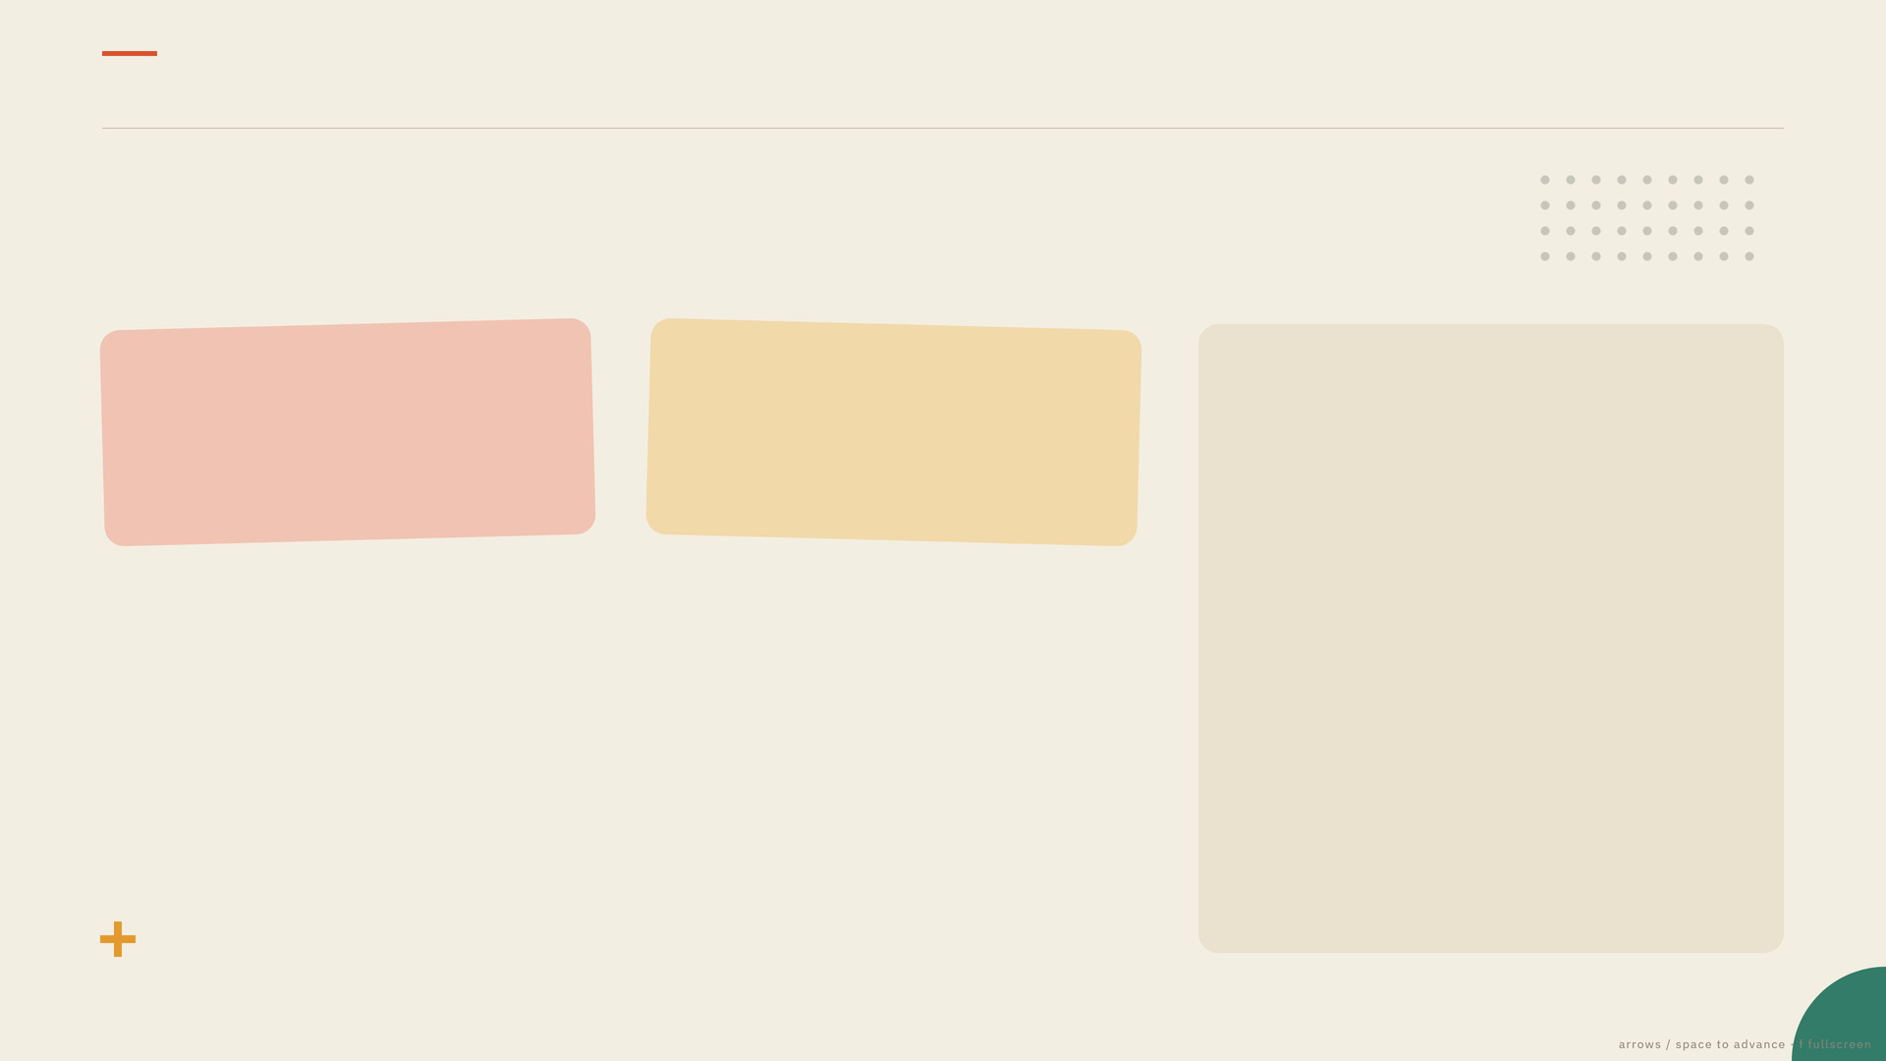
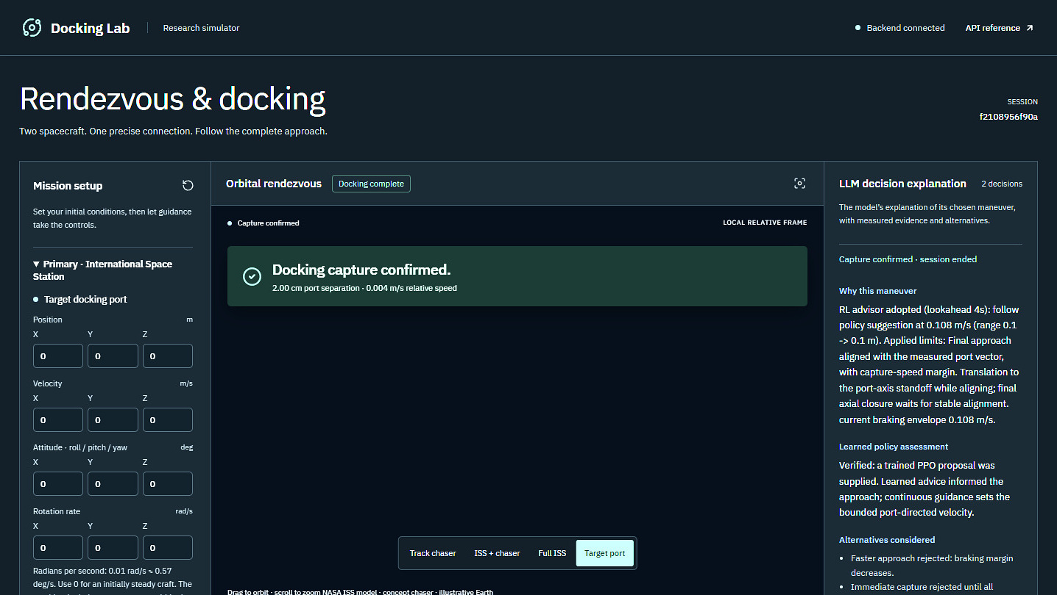
SAFETY & VERIFICATION
DOCKING LAB · INVESTOR BRIEF
The safety channel trusts only the state.
15
6
audit findings checked against execution — and fixed
of them P1, including fault braking moved to an independent channel
SELECTED P1 CORRECTIONS
Learned advice was silently off by default → an inference probe now enables it, and Reset restores that verified default.
Corrupt policy files passed capability checks → dimensions, normalisation and a finite prediction are validated before a session exists.
Expired provider responses installed braking holds → they are discarded and current-state guidance sustains the approach.
CAPTURE CONFIRMED IN THE DASHBOARD
130 automated tests, ruff clean and a passing production build at the time of the run.
Provider failure and invalid output take a labelled deterministic path.
Safety here is a simulation-time envelope contract, not flight certification — the roadmap starts with latency and sensor models.
11
/ 16
Notes:
This slide answers 'how do you know it is safe to even run?'. The audit is the strongest artifact in the repository: every finding names its correction and its file.
Say the caveat yourself: simulation-time envelope contract, not flight certification.
Full table: proofs/code-audit/README.md.

Slide 12

SCOPE
DOCKING LAB · INVESTOR BRIEF
What this is not.
Stated up front, because the first serious question is: what does this actually prove?
NOT FLIGHT-CERTIFIED
DEMONSTRATIONS, NOT RATES
Research software, with no certification of any kind.
Provider runs are individual live checks, not a success rate.
LOCAL LINEARISED DYNAMICS
ARCHIVED POLICY LIMITS
The primary's motion is prescribed, not controlled.
Stored checkpoints were trained at a 1.25 m gate; the 2 cm environment is packaged for fresh training.
NO CONTACT MODEL
PROCESS-LOCAL SESSIONS
No contact mechanics, structural dynamics or plume interaction.
Four active and 32 retained sessions in memory, no authentication.
NO SENSOR ESTIMATION
FUEL AND GEOMETRY ARE ASSUMED
The safety channel reads simulator truth — not a flight-ready estimator.
Thruster efficiency, lever arm and inertias are editable simulator assumptions.
12
/ 16
Notes:
Do not skip this slide. For any technical audience it is the credibility purchase: you are disclosing the same limits their reviewers would find.
It also points the conversation at what a partner can change — their propagator, their sensor model, their latency budget.
Sources: proofs/README.md, proofs/code-audit/README.md, README.md.

Slide 13

INTEGRATION
DOCKING LAB · INVESTOR BRIEF
Bring your vehicle. Keep the loop.
YOU SUPPLY
WE KEEP
A reference vehicle
The planner contract
Mass properties, thruster and torque limits, propellant model, port geometry, capture tolerances.
The same six tools, so plans stay inspectable and comparable across vehicles.
Your dynamics
The safety contract
Propagator or relative-motion model, attitude coupling, actuator response.
An independent gate over your limits, evaluated on your state estimates.
A mission profile
The evidence pipeline
Start corridor, approach constraints, abort criteria, and sensor or timing reality.
Decisions, telemetry and hashes in one shape, so reviewers read one format.
SWAP POINTS
dynamics — replace Clohessy–Wiltshire with your propagator controller — replace LQR with your GNC law policy — plug your own policy into the advisor slot, it stays advisory
interfaces · src/app/llm/tools.py · src/app/simulation/safety.py
13
/ 16
Notes:
This is the commercial slide. Do not sell a black box; sell the interface and the evidence format.
The ask follows naturally: one vehicle model and one mission profile, and we re-run the reference scenarios on your dynamics.
Interfaces: src/app/llm/tools.py, src/app/simulation/safety.py, src/app/api/routes.py.

Slide 14
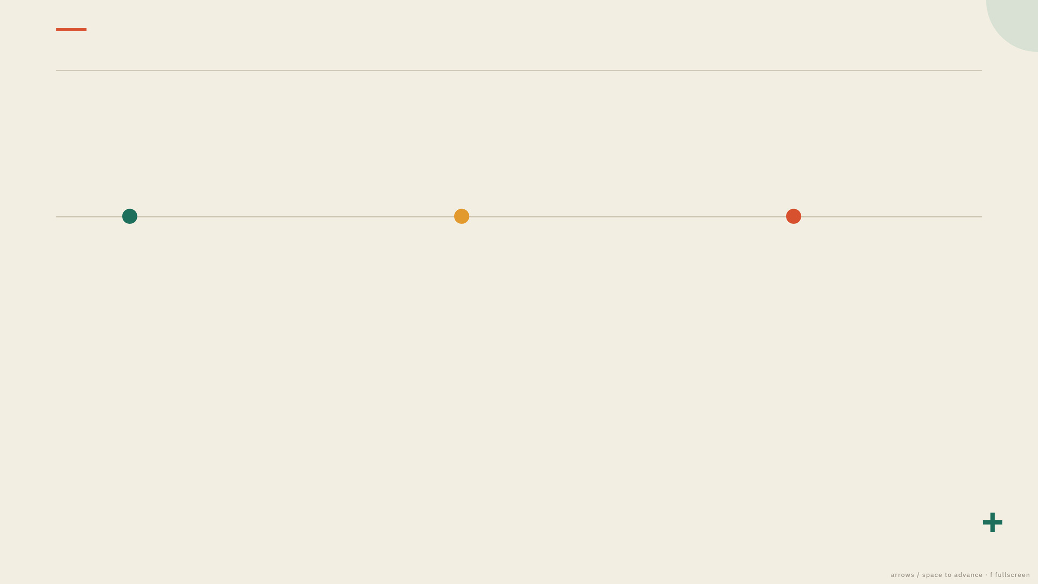
ROADMAP
DOCKING LAB · INVESTOR BRIEF
From simulator to qualification.
Three phases, proposed with a partner — none has started.
PHASE 01
PHASE 02
PHASE 03
Partner dynamics
Hardware in the loop
Qualification pack
Plug a partner propagator and actuator model in, re-run the reference scenarios, and publish a paired comparison against the current stack.
Real flight-computer timing, sensor models and injected comms latency — then verify that stale plans are discarded and recovery stays bounded.
Traceability from requirement to scenario to telemetry to hash, with failure cases retained and a reviewer-runnable bundle.
Exit: the same capture gate passed on partner dynamics.
Exit: latency-bounded replanning demonstrated.
Exit: an independent reviewer reproduces a claim unaided.
What stays constant across all three phases: the gate that decides what counts as capture, the six tools the planner may call, and the evidence format a reviewer reads. The vehicle underneath them is yours.
14
/ 16
Notes:
Phases are proposals, not commitments — say so explicitly and let the partner choose the order. Most aerospace teams start with phase 02, because latency is their real worry.
If asked about timeline or cost: that is a scoping conversation, not a number on this slide.

Slide 15

THE ASK
DOCKING LAB · INVESTOR BRIEF
One vehicle model. One mission profile.
A PILOT NEEDS FROM YOU
YOU GET BACK
A reference vehicle
Your scenarios, re-run
Mass properties, thruster limits, port geometry, capture tolerances.
The reference captures on your dynamics, with the same gate, the same tools, the same telemetry.
A mission profile
A paired comparison
The scenario you would actually fly, and the failure cases you care about.
Your controller against the current stack on identical seeds, reported with intervals.
An evaluation owner
An evidence bundle
Someone who will tell us the run is wrong and why. That is the fastest route to a defensible result.
Decisions, tool readings, telemetry and hashes — including the runs that did not work.
Everything in this deck is reproducible from the files in proofs/ — including the failures.
pilot scope · draft for partner discussion
15
/ 16
Notes:
Adapt the closing sentence to the room before presenting: name the specific team and vehicle you want to fly.
If they push on maturity, concede it and redirect: the loop runs end to end today with an audit trail; what changes with them is the vehicle model and the mission profile.
Do not quote a price or a schedule from this slide.

Slide 16
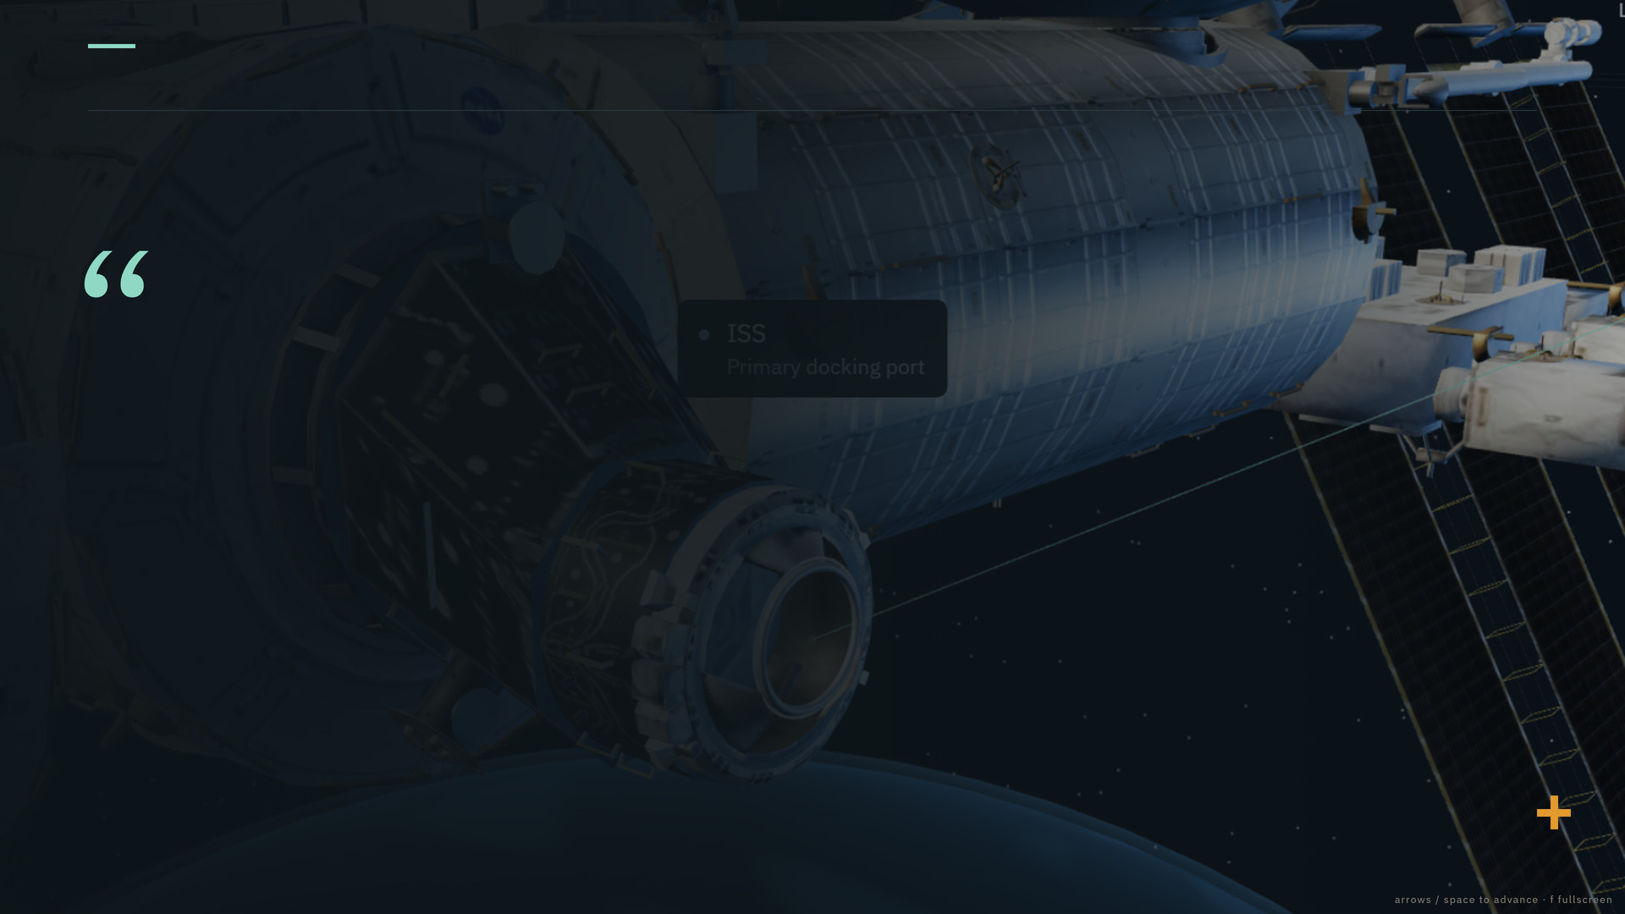
DOCKING LAB
DOCKING LAB · INVESTOR BRIEF
Point it at
your vehicle.
The loop already runs end to end: planner, advisor, executor, safety channel, dashboard and evidence bundle.
WATCH THE RUN
loom.com/share/fc396b5ea4f344659464c48dba367314
OPEN THE EVIDENCE
proofs/ · dashboard at 127.0.0.1:8000 · API docs at /docs
Contact: [ name · email ] — replace before sending
16
/ 16
Notes:
Close by handing over the artifacts, not by summarising: offer the live dashboard, the proofs folder, and the exported session of any run they want to audit.
Replace the placeholder contact line before sending this deck out.
Demo link as published in README.md.

