Slide 1

GUIDE PROF. RANJANA BADRE
School of Computer Engineering
PRESENTATION FOR TY MINI PROJECT
(FINAL PRESENTATION)
EMOJIFY
STUDENTS NAME:
VARUN DANGRI (SCETTY121)
HUTESH VIDHATE (SCETTY123)
AJIT KUMAR (SCETTY223)

Slide 2
Index
Introduction
Literature survey
Problem Statement
Objectives
Functionalities
Proposed Block Diagram and its explanation
Design and Analysis(Mathematics behind algorithm)
Implementation
Methodology
Databse
Output
Citations
References

Slide 3


Introduction
Emoji's have become a new language and Standard for online communication
It can be more effective to add emoji to text messages to show more emotional and sentimental feelings.
The keyboard can predict emoji's but only base on certain keywords
Tags are associated with emoji's.
A prediction system can be integrated with the keyboard which predicts emoji.
After typing a sentence, the user has to manually select an emoji
This also reduces time and the use of available emoticons.
There will be automatic emoji prediction which will reduce time and efforts for searching emoji.

Slide 4
Literature Survey
Sr. No | AUTHOR NAME | TITLE OF PAPER | VOLUME | PUBLISHER | FINDINGS
01 | Rahman Mahte Ranjith Nair Vysakh Nair Athira Pillai Prof. Manasi Kulkarni | Emoticon Suggestion with Word Prediction using NLP | Volume: 07 Issue: 5|May|20 | IRJET | This system contain two systems Word prediction Emoticon prediction Word prediction model : It uses brown corpus. Implementing bigram and trigram word prediction is achieved. Emoticon prediction : This data is fed to the second part i.e emoticon suggestion which uses ‘GloVe Vector’ and cosine similarity.

Slide 5
Literature Survey
Sr. No | AUTHOR NAME | Publish date | Book | PUBLISHER
02 | Toshiki Tomihira, Atsushi Otsuka, Akihiro Yamashita, Tetsuji Satoh | 2018/11/19 | proceedings of the 20th international conference on information integration and web-based applications & services | In recent years, Unicode has been standardized; and with the penetration of SNSs, the use of emojis has become common. Emojis, as they are also known, are most efective in expressing emotions in sentences. Sentiment analysis in natural language processing so far has involved learning by manual labeling of sentences. By using suitable emojis estimated from sentences, people might express their emotions more clearly and laconically. In this paper, we propose a new model that learns from sentences using emojis as labels, collecting Japanese tweets from Twitter as the corpus. We verify and compare multiple models based on EncoderDecoder Model of Recurrent Neural Network (RNN) and Convolutional Neural Network (CNN). Our sophisticated experiments demonstrate that emojis are efective in expressing tweet emotion

Slide 6
Literature Survey
Sr. No | AUTHOR NAME | Publish date | Description
03 | Rahman Mahte, Ranjith Nair, Vysakh Nair, Athira Pillai, Manasi Kulkarni | 2020 | Emojis are a very important part of communication in today’s world. It is used to express emotions during a conversation. Building a system which can suggest emoticons based on the text provided can be very useful. It can be used to express emotions efficiently and easily. While dealing with the semantics of the sentence it can be used to predict the emotion in the sentence and emojis can be predicted accordingly. Typing each and every word to complete a sentence is also a very time consuming task with the help of word prediction models this task can be made much easier. So in our project combining two models ie Word prediction and emoji suggestion will improve textual communication. Emoticons add life to sentences and word prediction helps in framing correct sentences. It makes sentences more understandable and appealing. A system which can help in quoting the correct emoji into a sentence easily can be very useful in today’s world.

Slide 7
Literature Survey
Sr. No | AUTHOR NAME | TITLE OF PAPER | VOLUME | PUBLISHER | FINDINGS
04 | Phillip Wicke Joao Miguel cunha | An approach to text to emoji translation | Conference paper-September 2020 | ResearchGate | How the text is converted to emoji using inforest system
05 | Nikhil Bija. Mountain View,CS(US); Satheeshkumar karuppussamy | System and methods for suggestion emoji | Jun. 29,2017 | Patent application publication | The present disclosure relates to language direction and, in particular system and methods for suggestion for suggesting emoji.

Slide 8
Literature Survey
Sr. No | AUTHOR NAME | TITLE OF PAPER | VOLUME | PUBLISHER | FINDINGS
06 | Dineshika Dulanjalee Wijerathna | RNN based Emoticon Suggestion | Volume: 09 Issue: 4|June|17 | ResearchGate | RNN are used for the prediction of emoticons. First layer, the hidden layer and the last layer. Sequence will recorded and thus one of the neurons in the first layer would hold the value. No. of times the emoticon is used in particular sequence, weightage of that neuron increase. Many such neurons would be holding different values or different sequences When the user types a sentence, its sequence would be used to predict the emoticon.

Slide 9
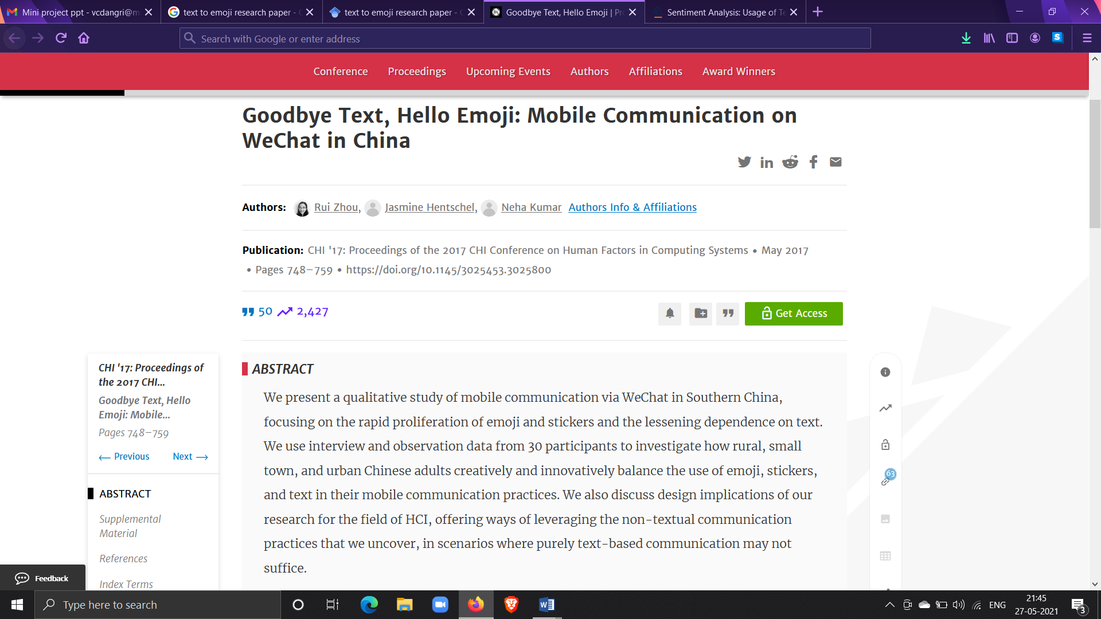
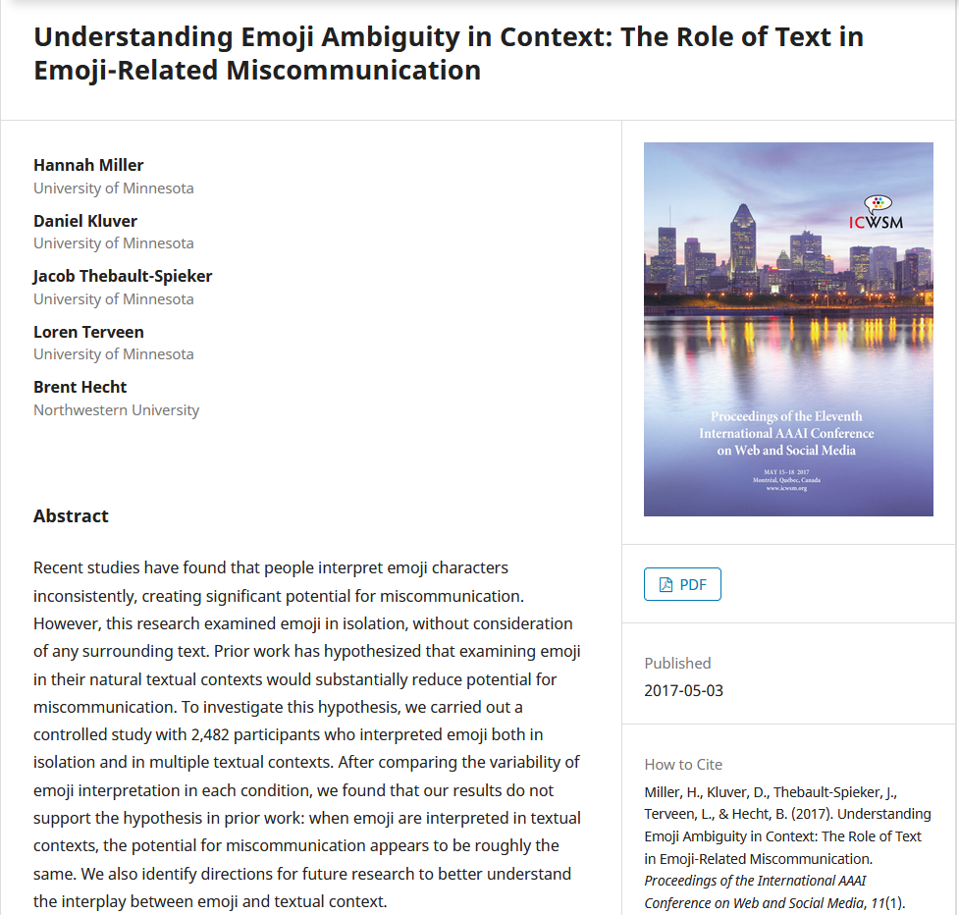

Slide 10
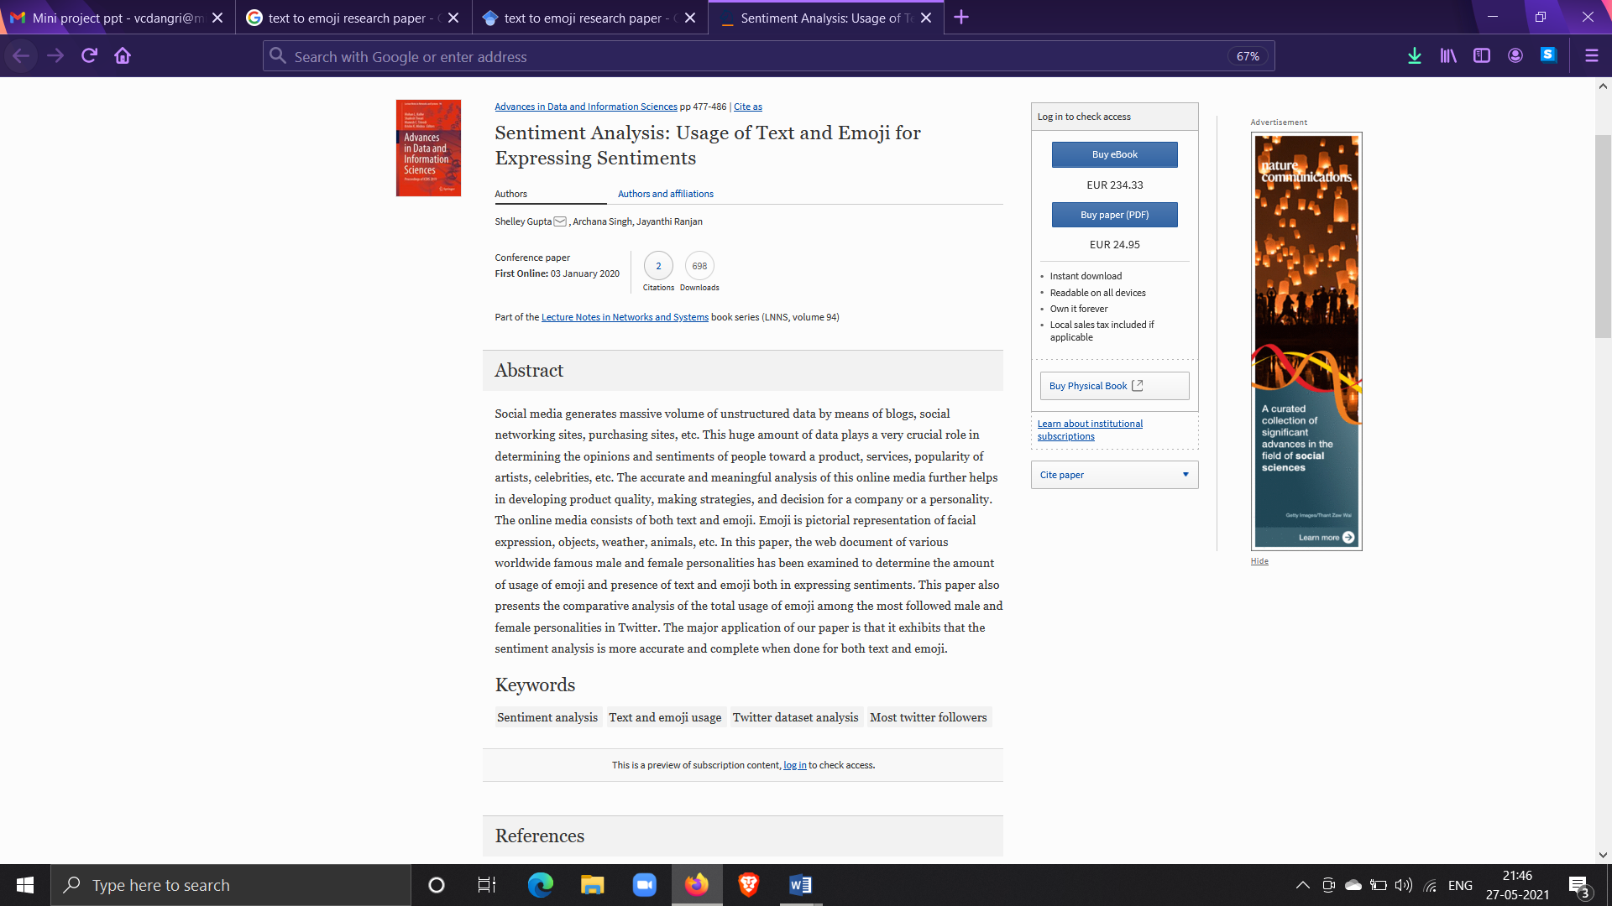

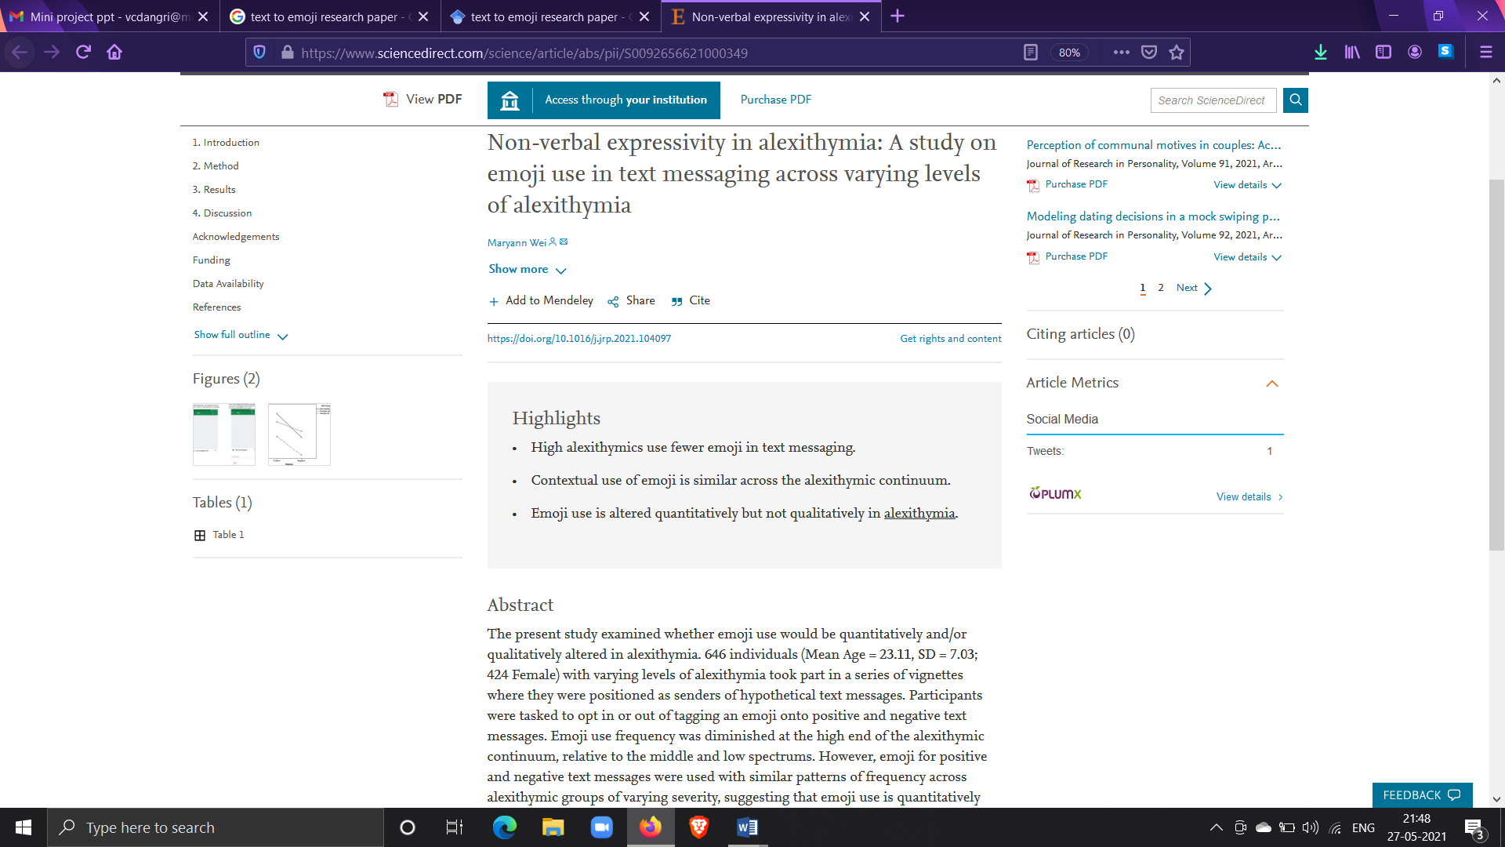
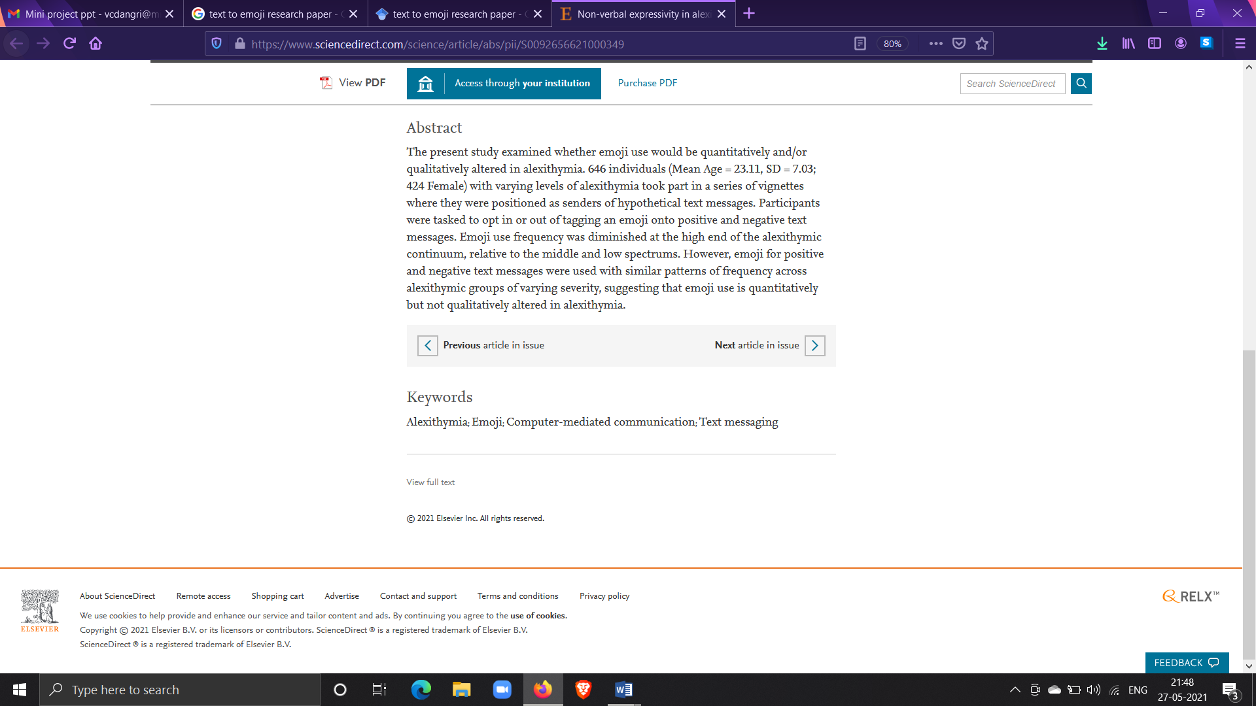

Slide 11
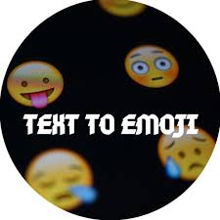

Problem statement
Design and develop the system to predict the emoji based on emotion and meaning of sentences using LSTM & RNN algorithm.

Slide 12
Objectives
To have a effective communication.
To draw the reader’s attention and enhance the understanding of the messages.
To have a effective communication.
To reduce the time to pick the correct emojis from a list .(By writing sentence it will predict emoji automatically)

Slide 13
Functionalities
Text conversion to emoji
Sentiment analysis
App or website
emoji (https://pypi.org/project/emoji/)
Keras
numpy

Slide 14
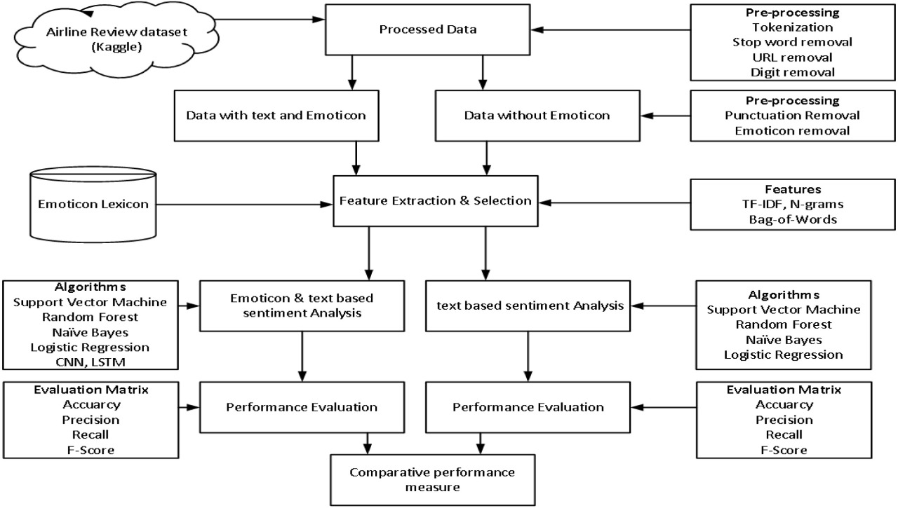
Proposed Block System

Slide 15
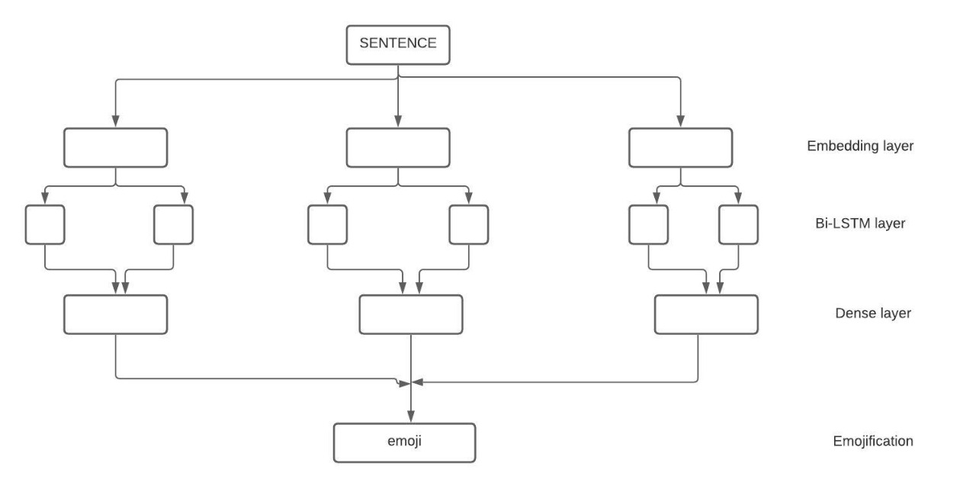
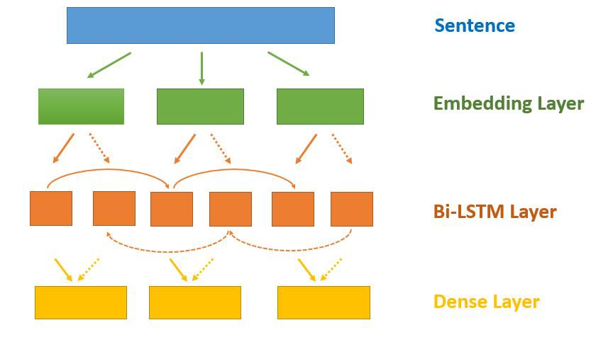
Proposed Block System

Slide 16
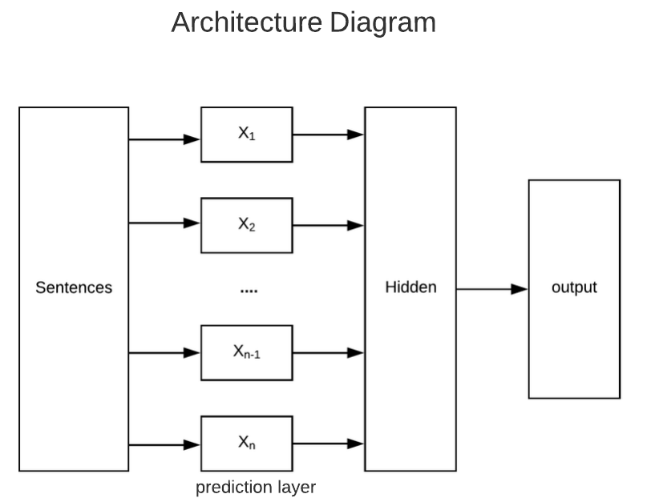
Architecture

Slide 17
Implementation
Two solutions for this problems by using 1st solution :
1] By using LSTM
2] By using NLP(alternative)
Continued…………

Slide 18
Methodology
The portal is divided into two ends : front-end and back-end
Front – end :- Docker and JavaScript, html, CSS
Back – end :- python <LSTM and RNN> algorithm
LSTM:
-It is special kind of recurrent neural network
-It is capable of learning long term dependencies in data.
-The recurring module of the model has a combination of four layers interacting with each other.

Slide 19
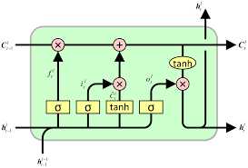
LSTM cell
Source : https://colah.github.io/posts/2015-08-Understanding-LSTMs/?source=post_page---------------------------

Slide 20
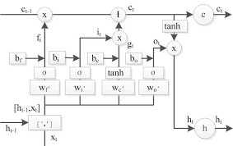
LSTM cell Architecture:
Source :https://colah.github.io/posts/2015-08-Understanding-LSTMs/?source=post_page---------------------------

Slide 21
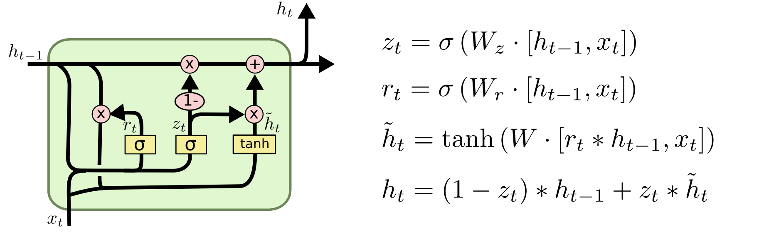
Mathematical expression:
Expression
Source : https://colah.github.io/posts/2015-08-Understanding-LSTMs/?source=post_page---------------------------

Slide 22
Database set:
Emojify
We have Two datasets training and testing
The shape of training datsets (315, 4)
The shape of testing datsets (56, 2)
Link :-https://www.kaggle.com/alvinrindra/emojify
GloVe: Global Vectors for Word Representation
Content :
This dataset contains English word vectors pre-trained on the combined Wikipedia 2014 + Gigaword 5th Edition corpora (6B tokens, 400K vocab). All tokens are in lowercase. This dataset contains 50-dimensional, pre trained word vectors.
Link :- https://www.kaggle.com/rtatman/glove-global-vectors-for-word-representation

Slide 23
Output
[
funny lol 😄 'i', 'am', 'hungry'] [4]

Slide 24
Conclusion
The human brain processes images 60,000 times faster than it processes text. Including an emoji with the message can help the reader better understand what he/she is trying to say and avoid any confusion that might be had.
The word to emoji model converts each and every word to an emoji if it crosses a certain threshold (cosine similarity). Each word is then compared to this map and the emoji with the highest cosine similarity is printed.
Number of emojis = 3415

Slide 25
Selected References
Emoji Report 2016
https://emojipedia.org/stats/
http://blog.emojics.com/emojis-increase-user-engagement/
https://www.zipwhip.com/blog/heres-how-each-generation-prefers-to-text-with-your-business/
http://blog.emojics.com/emojis-increase-user-engagement/

Slide 26
.
THANK YOU !!!

