Slide 1
Chatbot Storytelling
Abdi jabar Mohamed-Muktar
05/05/2024

Slide 2
Background
The project’s goal is to develop an interactive storytelling chatbot designed to cater to individuals of all ages. This chatbot provides entertainment and friendship.
The chatbot has has an easy-to-use UI and voice recognition capabilities, lets senior people have chats, request stories in different genres such as (romance, thriller, fantasy).
The project also focuses on making sure everyone can use it easily, no matter how much they know technology. The project helps people to feel connected and not lonely, especially older folks who might enjoy talking to the chatbot hearing stories

Slide 3
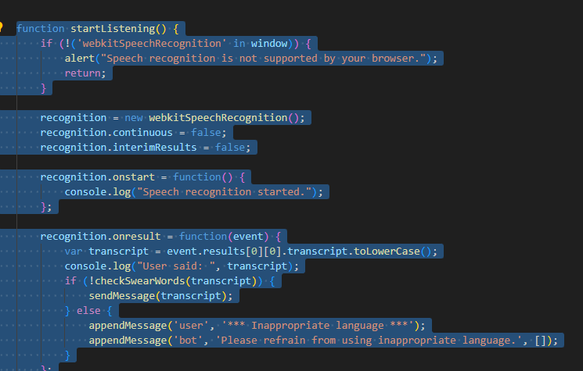
Tools
Flask: I used this for backend.
HTML, CSS, and JavaScript.
OpenAI’s Language model.
Voice recognition technology.
Trello

Slide 4
Testing
Unit Testing: Developed unit tests to verify the functionality of individual components, such as input processing, API interaction and response generation.
Integration Testing: performed integration testing to ensure that different modules of the application work together as expected.
Speech Recognition Testing. Tested speech recognition feature across various browser and devices to assess compatibility and accuracy.
Accessibility Testing: ensured the chat interface is accessible to users with disabilities.

Slide 5
Algorithms
API integration: sends user input OpenAI, receives response from openai and it displays response in chat interface
Voice system: converts text response to speech and also plays speech to user.

Slide 6
Conclusion
Enhance User Experience.
Enhanced Chatbot Functionality: integrate more advanced natural language processing to improve the chatbot’s responses.
Emotions
Accessibility
Error handling
Community Engagement and feedback.
More Testing

