Slide 1

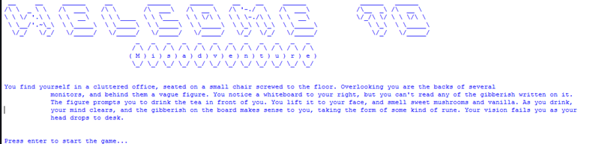
Misadventure
Group 22

Slide 2
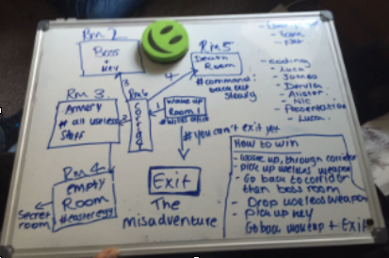
Planning
To begin we created a map of the game including how it is possible to win the game and the routes that must be taken in order to succeed.

Slide 3
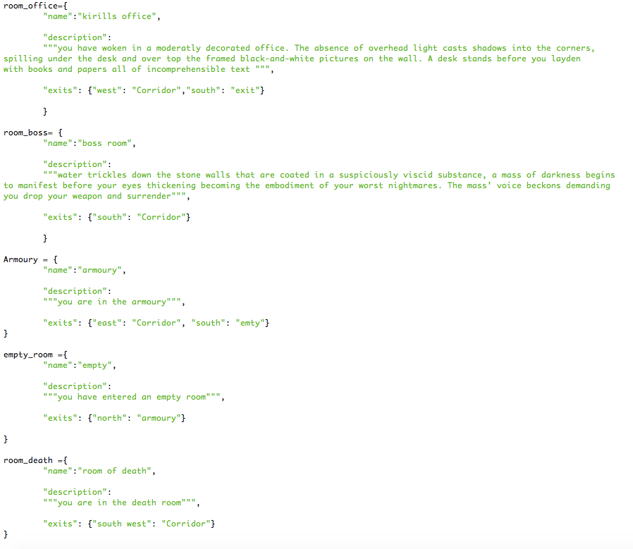
Map code
We created the code for the map first which is the template of the game.

Slide 4
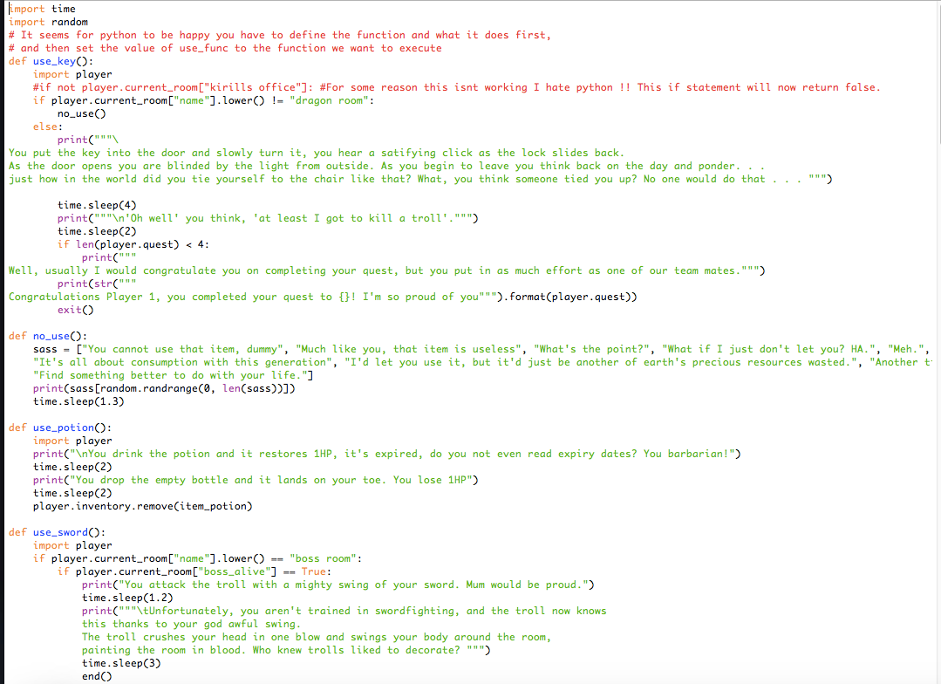
Inventory code
We then created an inventory of items for the player to use and are essential to win the game

Slide 5
Intentions of the game
group 22
Your task is to defeat the many obstacles that face you using cunning and counter intuition in order to exit the dungeon!
Keep an eye out for easter eggs they are more obvious than they seem!

Slide 6
Why buy the game?
Group 22
This replay-able game with multiple endings is addictive and can absorb your attention for hours.
The game allows for the users imagination to take control of the game and how the story will play out.

Slide 7
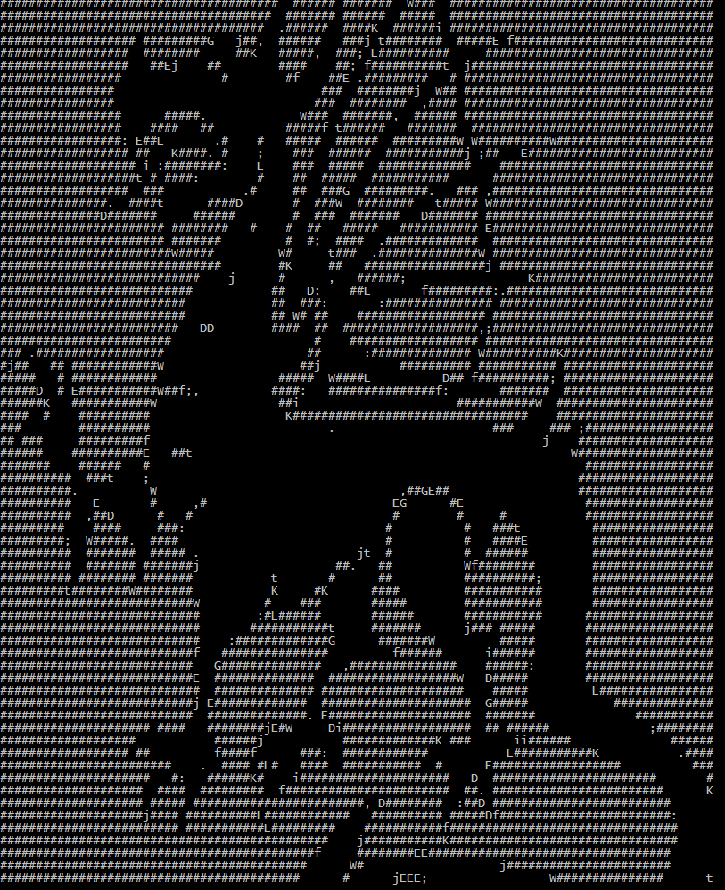
James,dervla,sam, Alastair,luca, natalie, nick + mystery man
Group 22

