Slide 1
Advanced Persistent Threat (APT) Life Cycle Management

Slide 2

















APT Life Cycle
Advanced Persistent Threat(s)
1
APT compromises supplier website / sends email attachment to an internal user.
2
User visits compromised website and/or opens infected attachment.
3
10
Threat Fusion Teams conducts attribution analysis on Attack Group; tasks probes with new signature and behaviours; and informs external partners (depending on policy).
Software downloaded to User’s machine
Regular successful connections to camouflaged C2 domain
FTP connections over non-
standard port
SOC Tier II+
SOC Tier I
4
Collected by Network Probe:
From devices within Network:
9
DNS Requests
User/Machine/IP (AD Log Entry)
User’s machine passed to the Forensics Lab for analysis. Malware Lab generates new IOCs.
HTTP Request
Proxy Log Entries
Netflow Log Entries
Browsing History
Automated Data Analysis Reveals Behaviours:
8
5
Beaconing
Remediation team carries out actions and closes incident.
Camouflaged C2 Domain
6
DNS Requests contain keywords
7
ALERT
Correlated Events
Invalid Port/Protocol Combination
SOC Analyst investigates alert & raises Security Incident.
Unknown Software Downloaded

Slide 3
Typical APT Primary Mission Flows
Recon / Plan
Attack Phase
Initial Infection
Command & Control
Internal Pivot / Escalation
Data Prep and Exfill
Improve Trade-Craft / Data Analysis
Update Knowledge Base
Recon / Plan
Improve Trade-Craft / Data Analysis
Attack Phase
Knowledge
Base
Data Prep and Exfill
Initial Infection
Internal Pivot / Escalation
Command & Control

Slide 4
Recon / Plan
Attackers
Open Source Collection and Target Identification
Attack and Command & Control (C2) Domain Setup / Registration
C2 Framework Development (Usually Custom)
Persistence and Stealth
Reverse Shell Access (On Beacon) Primary Goal
Defenders
Open Source Foot Printing - Understand How Attackers See You
Information Sharing and Open Source Intel Collection on Attackers / Tools / Underground Sites
Prepare Defensive Controls
Training for all, more for High-Value / High-Exposure Users
Canaries / Miss-Information – to Detect / Mislead Attackers
Update Defensive Controls… w/ Intel from Above

Slide 5
Attack Phase
Attackers
Gain initial foothold once attack code is executed
Prepare and package 0-Day or N-Day Exploits
Embed customized exploit and payload (no previous signatures)
Make sure attack is not detected by conventional detection tools
Utilize Previous Research to Attack Likely Targets via Spear-Phishing and/or Water-Hole Attack
Gain initial foothold once attack code is executed
Defenders
Hopefully have pre-deployed defenses against these attacks
Advanced Anti-Malware for Email / Web (behavioral analysis)
Sensors Configured To Alert / Log to SIEM
Updated AV, Patching, Limited Admin, and Other Controls
Disrupting or Limiting Egress Traffic
Good Intel to Pre-Blacklist / Pre Gray-Listing C2 domains is effective

Slide 6
Initial Infection / Command & Control (C2)
Attackers
Ride the “Initial Infection” (reverse shell) into the enterprise
Usually done near real-time (the initial attack is not usually persistent)
Escalation of initial foothold via installation of one or more Command and Control (C2) binaries that beacon out and wait for instructions / reverse shell
Get additional login credentials and beacon hosts
“A Team” and “B Team” hand-off
Defenders
Defenders quickly to triage this initial access and prevent C2 client installations
Disruption of this C2 (and Initial Infection) is highly valuable when achievable
Good credential management, limiting admin rights, and multi-factor auth help greatly (as does restricting or not enabling RDP)
Heuristically looking for unusual login times, unusual RDP use, or “beacon tells”
White-Listing of known executables does wonders to prevent this stage
Don’t let servers connect to the internet unless to a White-List site
Backdoors and side-doors into your network need to be defended

Slide 7
Internal Pivot / Escalation
Attackers
At this point the “B Team” (collection specialists) are usually in control of the operation
Attackers use RDP over the Web C2 as it beacons out
Will often use previously compromised credentials to move between hosts and look for data (traffic will fan out from these C2 client hosts)
Escalate credentials and look for pivot points between networks
Sometimes the “B Team” asks the “A Team” to further enable their access…
Attackers will identify data and systems for exfill
Defenders
Good credential management, limiting admin rights, and multi-factor auth help greatly (as does restricting or not enabling RDP)
Heuristically looking for unusual login times / “beacon tells” / unusual uses of RDP / unusual data movements (volumes, types of data)

Slide 8
Data Prep and Exfill
Attackers
Attackers will collect data and move it to a host for exfill
Of note these hosts are usually not the originally compromised host nor one of the C2 client hosts or first-hops off that host
Data will be in encrypted archive (often RAR, sometimes ZIP)
When enough data has been collected it will be sent back to the attacker via FTP, Email, HTTP/HTTPS (including web email) are their favorite protocols
Often the remote endpoint is not a previously used domain
Any intermediary files / tools will be securely deleted from host
Defenders
Watch for uncharacteristic file types (RAR, ACE, GZIP, etc.)
Heuristic watch for unusual data collection points / transfers (internal hosts)
Watch for large bundled data transfers out of your network

Slide 9
Improve Trade-Craft / Data Analysis (APT)
Attackers
Receives data (new external host) and sends to home base for analysis
Attackers extract the archive(s) and analyze the data
Data analysis yields collection requirements to be executed
Attackers will track and monitor C2 beacon hosts and come back in and re-infect if your IT staff gets too good at finding their C2 hosts
If they lose access they will restart the recon / attack phase
Attackers use their previous Intel of network info, download personnel lists / email addresses, identified admin and admin hosts, dumped AD / SAM files, documented / identified key information flows / information brokers to facilitate and plan future attacks
Defenders
Defenders have limited options in this phase
Innovation, unpredictable / evolving defenses help

Slide 10
Typical CND Primary Mission Flows
Collect Sensor Data
Data Ingest
Analytics and Alerting
SOC Operations
Incident Response
Analysis and Data Fusion
Improve Trade-Craft / KB
Update Sensors / Active Defense
Update Knowledge Base / Manage Threat & Risk
Sensors: Client & Gateway
Improve Trade-Craft / KB
Data Ingest
Knowledge
Base
Analysis and Data Fusion
Analytics and Alerting
Incident Response
SOC
Operations

Slide 11
Collect Sensor Data / Data Ingest
Attackers
Improving Trade-Craft to evade sensors
Attackers will look for side door / back door not being watched
Attackers test packages against your AVs / IDSes to avoid detection
Defenders
Sensors will block some of the attacks on your network (good Intel helps)
Network choke points used to watch the traffic crossing them
Watch ingress / egress traffic (egress may be of higher value)
Lock and watch any side doors / back doors to your network
Log / ingest as much as possible / practical to analytics / SIEMs
Perform as much full packet / netflow capture as possible
Collect at the perimeter of the network and at “crown jewels” of your network

Slide 12
Analytics and Alerting
Attackers
Use low and slow / fragmented attacks to avoid detection
Attempt to overload your sensors with data and/or false positives to make the analysis and alerting more difficult to process
Defenders
Collect as much data as you can process and store, but focus on the most critical alerts first
The value of your analytics & alerting will be a direct function of:
The tools you are using
The value added Intel / signatures you generate internally, you buy, or you get from your friends and family network
The timeliness and accuracy of your alerts to the SOC
Running internally developed tools in addition to commercial tools likely will add additional value
A thorough understanding of the “normal baseline” helps for identifying “anomalies”

Slide 13
SOC Operations
Attackers
Attackers have limited activities during CND Mission Flow / SOC Operations
Will target SOC users to be able to understand / watch your defenses
Defenders
Standup of a dedicated SOC is essential to counter sophisticated threats
Need solutions that address business and off hours
Many of the APTs will not be working your business hours or will target attacks just before normal working hours end
SOC staff training is important as the SOC ends up being the first responders and decides how the alerts are processed
Escalate alerts, filter out obvious noise, cleanup obvious attacks
Reporting and measuring of SOC effectiveness is critical to management support and improvement in operation
Improving “cycle time” for all SOC functions is critical

Slide 14
Analysis and Data Fusion
Attackers
Attackers have limited activities during Analysis and Data Fusion
Many APTs are however improving their Trade-Craft to combat these functions by being more sophisticated in their C2 use
Defenders
Analysis and data fusion is critical to an advanced SOC
Internal Analysis of malware, indicators, and threats
Extraction of C2 resources, analysis, and signature generation
Analysis and OSINT on attackers for predictive purposes
Tracking of campaigns by threat actors, understanding of who in your org is being targeted and how/why
Updating internal defenses from all above
External coordination of malware, indicators, and threats
Sourcing indicator data from open, commercial, and friends/family sources
Managing how / what you will share with others

Slide 15
Improve Trade-Craft / KB (Defenders)
Attackers
Attackers Trade-Craft is improved in their attack lifecycle
Defenders
Implement lessons learned and do root cause analysis
Migrate defense from reactive to proactive and try get in front of the attackers with strong analysis and information sharing functions
Exploit open source, commercial, and industry data feeds
Continuously strive to improve efficiencies in defensive operations
Drive dwell time to zero (as a goal)
Automate the things that can be automated
Provide updated training to your defenders and your end users
Keep intel on attackers, attacks, threats, and targets current
Your network is not static – make sure your defenses are not

Slide 16
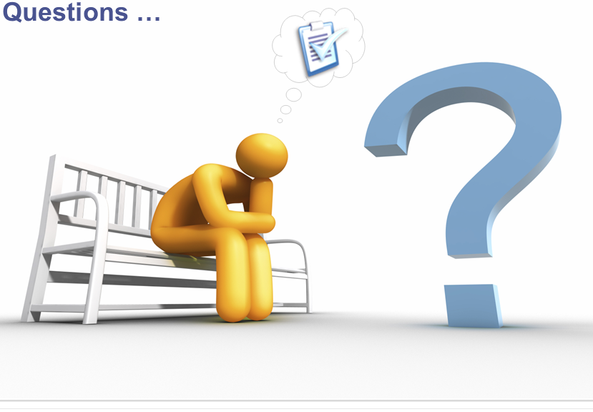

Questions?

Slide 17

Presenter Bio
Monty D. McDougal is a Raytheon Intelligence, Information and Services (IIS) Cyber Engineering Fellow. He has worked for Raytheon for the last 16+ years performing tasks ranging from programming to system administration and has an extensive web development / programming background spanning 18+ years. His work has included development/integration / architecture / accreditation work on numerous security projects for multiple government programs, internal and external security / wireless assessments, DCID 6/3 compliant web-based single sign-on solutions, PL-4 Controlled Interfaces (guards), reliable human review processes, audit log reduction tools, mail bannering solutions, and several advanced anti-malware IRADs / products / patents.
Monty holds the following major degrees and certifications: BBA in Computer Science / Management (double major) from Angelo State University, MS in Network Security from Capitol College, CISSP, ISSEP, ISSAP, GCFE, GAWN-C, GSEC, and serves on the SANS Advisory Board. Monty has previously held the GCIH, GCFA, GREM, GCUX, and GCWN certifications. Monty is also the author of the Windows Forensic Toolchest (WFT).
E-mail: Monty_D_McDougal@raytheon.com
<mug shot>

Slide 18
Abstract
Advanced Persistent Threat (APT) Life Cycle Management
This presentation will cover the full Advanced Persistent Threat (APT) Life Cycle and Management of the resulting intrusions. It will cover both what the APTs are doing as attackers and what we as defenders should be doing for both the APT Mission Flows and the Computer Network Defense (CND) Mission Flows.
The APT Mission Flows cover:
Recon / Plan, Attack Phase, Initial Infection, Command and Control, Internal Pivot / Escalation, Data Prep and Exfill, Improve Trade-Craft / Data Analysis
The Computer Network Defense (CND) Mission Flows cover:
Collect Sensor Data, Data Ingest, Analytics and Alerting, SOC Operations, Incident Response, Analysis and Data Fusion, Improve Trade-Craft / KB

