Slide 1

REMOTE CONTROL SYSTEM V5.3
www.hackingteam.it

Slide 2
Introduction

Slide 3
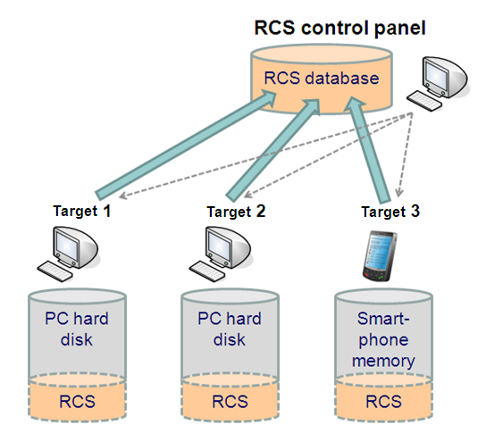
System Architecture

Slide 4
Backdoor Functionalities (PC & Mobile)

Slide 5
PC Version Monitoring and Logging
Remote Control System can monitor and log any action performed by means of a personal computer
Web browsing
Opened/Closed/Deleted files
Keystrokes (any UNICODE language)
Printed documents
Chat, email, instant messaging
Remote Audio Spy
Camera snapshots
VoIP (Skype, MSN, etc.) conversations
…

Slide 6
PC Version Online Captured data transmission
Connects through the internet to the collection node
Works both in home and enterprise environments
Network Firewalls (passed through)
Web Proxies (passed through)
Domain credentials (stolen)
6
© Hacking Team
All Rights Reserved
6
© Hacking Team
All Rights Reserved

Slide 7
PC Version Offline data retrieving
No internet connection required
Data can be exported in an encrypted format to any external device (eg: USB dongle)
Data can later be imported into the database
7
© Hacking Team
All Rights Reserved
7
© Hacking Team
All Rights Reserved

Slide 8
PC architectures
Windows XP
Windows 2003
Windows Vista
Mac OS X (Leopard 10.x)

Slide 9
Mobile Version Monitoring and Logging
Remote Control System can monitor and log any action performed by means of a smartphone
Call history
Address book
Calendar
Email messages
SMS/MMS interception
Localization (cell signal info, GPS info)
Remote Audio Spy
Camera snapshots
Voice calls interception
…
9
© Hacking Team
All Rights Reserved
9
© Hacking Team
All Rights Reserved

Slide 10
Mobile Version Online Captured data transmission
Connection via GPRS/UMTS/3G to the Collection Node
Connection through any open/preconfigured WiFi network to the Collection Node
Connection via BlueTooth/WiFi to the Mobile Mediation Node (data can later be sent to the database)
10
© Hacking Team
All Rights Reserved
10
© Hacking Team
All Rights Reserved

Slide 11
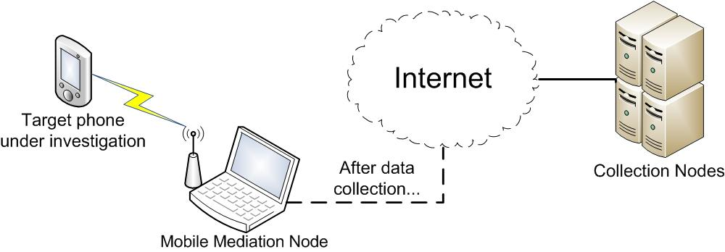
Mobile Version Mediation Node
Useful if the target cannot access any WiFi or 3G/GPRS Network
11
© Hacking Team
All Rights Reserved
11
© Hacking Team
All Rights Reserved

Slide 12
Mobile Configuration
As for the PC version, Remote Control System for Mobile devices can be re-configured after each synchronization...
... And ‘on the fly’:
Control SMS: messages sent from a pre-configured phone number can be used to control the backdoor.
Control SMS are completely invisible to the user and they leave no trace on the phone.

Slide 13
Mobile architectures
Windows Mobile 5
Windows Mobile 6
Windows CE 4.2 (for Thuraya)*
iPhone OS 2.x
* Under development

Slide 14

Clear technology & product roadmap to market dominance
CONFIDENTIAL
Symbian
Injection Proxy Appliance
iPhone 2.x
Mac OS X Leopard (10.5)
Windows Mobile 5/6
Windows 2003/XP/Vista
Today
Q2 2009
Q3 2009
Q4 2009
Launch of RCS Corporate
RCS Corporate edition with restricted infection capabilities to be released H1 09
© Hacking Team
All Rights Reserved

Slide 15

Clear technology & product roadmap to market dominance
CONFIDENTIAL
Linux
iPhone 3.x
Mac OS X Snow Leopard (10.6)
Windows Mobile 6.5 & 7
Windows 7
Q1 2010
Q2 2010
Q3 2010
Q4 2010
© Hacking Team
All Rights Reserved

Slide 16
System features

Slide 17
Invisibility
After the installation, Remote Control System cannot be detected by any bugged user
Existing files are not modified
No new files appear on the computer’s hard disk
No new processes are executed
No new network connections are established
Antivirus, antispyware, anti-key-loggers cannot detect our bug
E.g., Gartner Endpoint Security Magic Quadrant

Slide 18
Flexibility
Goes beyond logging and monitoring
Allows performing actions on a bugged device
Search and view data on the hard disk
Execute commands remotely
Possibly modify hard disk contents
Inner logic for automated response (No human interaction required)

Slide 19
Inner Logic (1)
It is based on an Event/Action paradigm
Events:
On ScreenSaver
Time based
On process execution
On SMS reception
On GPS position
...
Actions:
Synchronize
Uninstall
Start/Stop Agent
Send SMS
Execute command

Slide 20
Inner Logic (2)
Some examples...
Screen saver starts -> Send data
SIM changes -> Send SMS with SIM information
Received Covert SMS -> Send SMS with GPS position
On GPS position -> Start the Microphone capture and Send SMS with GPS position

Slide 21
Infection

Slide 22
Attack/Infection vectors
Remote Control System is software, not a physical device
Which can be installed remotely
Computer can be bugged by means of several infection vectors
Intelligence information about remote target mandatory
… but local installation remains an option
Usually very effective

Slide 23
PC Remote installation
Remote infection vectors
Executable melting tool
HTTP Injection Proxy
HT Zero-day Exploits library (library is “indirectly” accessed by customer)
HT consultancy: anonymous attack scenario analysis
E.g., Moving target using Skype

Slide 24
PC Local (physical) installation
Local infection vectors
Bootable CDROM or USB pen drive
Direct hard disk infection by means of tampering with computer case
Firewire Port/PCMCIA attacks
HT consultancy: anonymous attack scenario analysis
E.g., Internet Café using DeepFreeze

Slide 25
Mobile Installation
Local Infection:
Memory Card
ActiveSync direct connection
Remote Infection:
Remote CAB delivery*
SIM Application*
* Under development

Slide 26
Demo time!

Slide 27
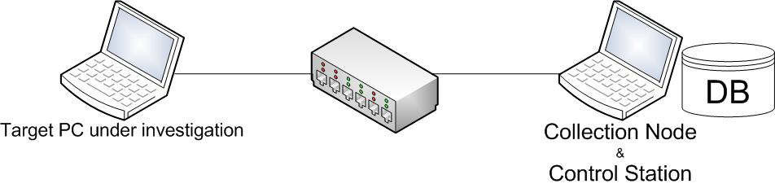
PC Demo setup

Slide 28
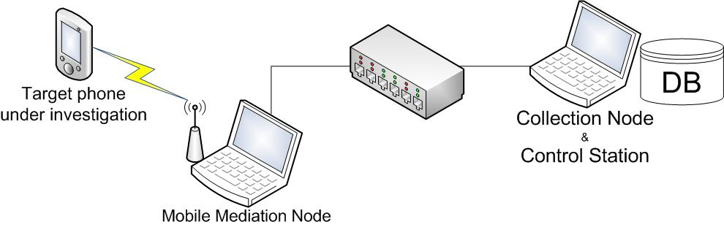
Mobile Demo setup

