Slide 1

Advanced Hybrid image Encryption for Defense and Medical Security
Guide
Dr.J.SIVASANKARI
Assistant professor-II , ECE
Velammal college of Engineering and Technology
Presented by
SURYAPRAKASH K - 913121106109
AJAI V - 913121106006
KISHORE S - 913121106303
Pre-Final Y ear ECE
9131 - Velammal College of Engineering & Technology (Autonomous)

Slide 2

Introduction
We have proposed an efficient and secure method of image encryption. This image encryption method is new , where the plain image is scrambled with respect to pixel position using confusion phase and diffusion phase modifies the intensity of the individual pixel values .

Slide 3
Objective
To generate the key using SHA-3 algorithm for the given image
To design the fibonacci-Lucas transform in order to change the pixel position
To change the individual pixel intensity using tribonacci transform

Slide 4
Literature Survey
S.No. | Title of the paper | Author & Date | Methodology | Findings
1 | An Efficient and Secure Method of Plaintext-Based Image Encryption sing Fibonacci and Tribonacci Transformations | Chinmay maiti, Bibhas chandra dhara, Saiyed umer, Vijayan asari 16 May 2023 | Plaintext based image encryption using Fibonacci and Tribonacci transforms | Proposed the method for Grey scale image encryption
2 | 2D logistic-sine-coupling map for image encryption | Z. Hua, F. Jin, B. Xu, and H. Huang Aug 2018 | a new two-dimensional chaotic map (2D-CCLS)applied in a chaotic image encryption algorithm to scramble, rotate and diffuse the pixels of the image | This algorithm has good performance such as large key space, strong anti-noise attack capability, strong key sensitivity and high security.

Slide 5
Literature Survey
S.No. | Title of the paper | Author & Date | Methodology | Findings
3. | Arnold transform based image scrambling Method | L. Min, L. Ting, H. Yu-Jie 04 may 2020 | Arnold transform is used to change the pixel position of the original image to obtain the initial scrambled image then performs a bitwise exclusive-or operation on each pixel | This algorithm improves the scrambling effect
4 | Image encryption with a new Fibonacci Transform | C. Maiti B. C. Dhara 10 jan 2018 | Fourier transform with the property of fourier series to obtain scrambled image | This method is simple and fast and gives robust performance against different attacks

Slide 6
Literature Survey
S.No | Title of the paper | Author & Date | Methodology | Findings
5 | Image encryption using modified Rubik’s cube algorithm | R. K. Sinha et al 11 july 2019 | The original image is scrambled using two secret keys, which is generated using logistic function and shift register method Then with XOR operator, rows and columns of the scrambled image are again mixed using various means | It is observed that the proposed scheme can resist exhaustive attack, statistical attack and differential attack.

Slide 7
Literature Survey
S.No | Title of the paper | Author & Date | Methodology | Findings
6 | Medical image encryption using fractional discrete cosine transform with chaotic function | S. Kumar, B. Panna, R. K. Jha 9 oct 2009 | XOR is first operated between the original image and logistic map. Then the chaotic image is transformed with Discrete fractional cosine transform two times using different keys successively by rows and by columns. | The transmission of the encrypted image with DFrCT and chaos is faster than with fractional Fourier transform (DFrFT) and chaos

Slide 8
Literature Survey
S.No | Title of the paper | Author & Date | Methodology | Findings
7 | XOR-based progressively secret image sharing | C.-S. Lin C. Chen Y, c. Chen, | The Progressive secret sharing produces a set of shared images in noisy-like form, while Friendly Secret Sharing generates shared images into more-visually-friendly appearance | This proposed method offers a lossless ability in the recovery result of secret image.

Slide 9
Literature Survey
S.No | Title of the paper | Author & Date | Methodology | Findings
8 | Image encryption using permutation generated by modified Regula–Falsi method | A. Paul, S. Kandar, B.C.Dhara 21 jan 2022 | The permutation is defined by the modified Regula-Falsi method and image encryption is achieved by pixel value substitution and iterative addition with the cyclic shift. | As the result of this proposed method, fully noisy images are obtained. It is immune against different attacks

Slide 10
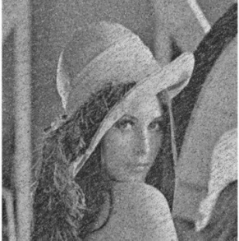
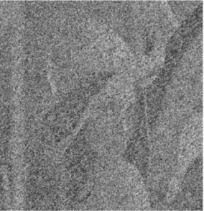

Existing Methodology
INPUT IMAGE
Key generation
SHA-256
Confusion phase
FIBONACCI TRANSFORM
Diffusion phase
TRIBONACCI TRANSFORM
CIPHER IMAGE

Slide 11
Drawbacks of existing methodology
Drawbacks of SHA-256
Low key space ( no of possible keys ) – brute force attack
concerns about the length extension attack
Fixed length upto 256 bits( Block size )
Fixed output size
Not specifically designed for resistance to quantum attacks
Drawbacks of Fibonacci transform
Lack of Robustness - straightforward and predictable structure
simplicity may not provide as much confusion as more complex transformations
Lack of randomness

Slide 12
Proposed Methodology
Plain image
Confusion phase
Key c
Fibonacci-lucas transform
SHA-3
Key generation
KEY
Tribonacci transform
Cipher image
Key d
diffusion phase

Slide 13
Advantage of proposed methodology
Advantages of SHA-3 algorithm
Large key space - variable upto 1024 bits (military applications )
High resistance due to sponge construction
Variable output lengths
Simple padding scheme
Performance - Balanced between security and speed
Advantages of Fibonacci-lucas transform
High randomness
Strong key distribution
Combines Fibonacci and Lucas numbers
adds complexity by incorporating both the Fibonacci and Lucas sequences.

Slide 14
STEP 1 : KEY GENERATION (SHA – 3)
Input: Img the plain image
Output: Keys {key_c, key_d} and key image key_img
Step 1. key_c(1: 128) = 0, key_d(1: 128) = 0
Step 2. key(1:256)= SHA3(Img)
Step 3. For i= 1 to 128
a. key_c(i) = key(i)
b. key_d(i) = key(128 + i)
Step 4. Return {key_c, key_d,}

Slide 15
STEP 2 –CONFUSION PHASE
Step 1. Compute r' and c'
Img_conf(r’, c’) = fib_luc(Img(r, c),key_c)
Step 2. Return Img_conf
Input : Plain image Img , confusion key key_c
Output : Confused image Img_conf

Slide 16
STEP 3 – DIFFUSION PHASE
Input : confused image img_conf , key image key_img , diffusion key key_d
Output : cipher image img_enc
Step 1 : k=mod(key_d , key_img)
Step 2 : img_enc = tri_trans(img_conf,k)
Return img_enc

Slide 17
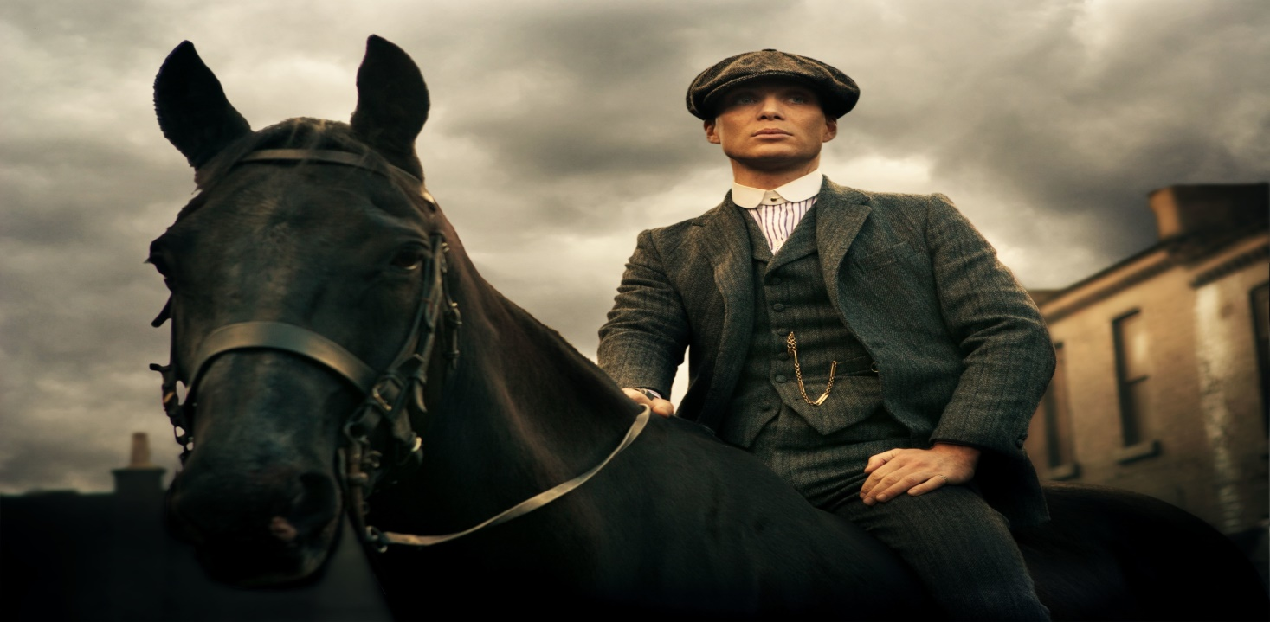
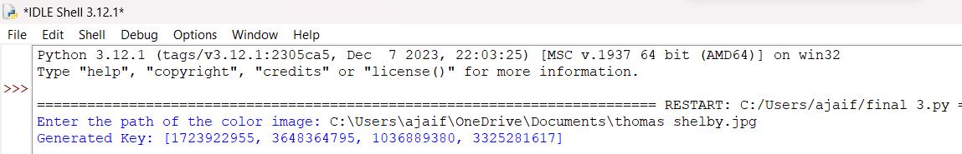
Key Generation
Input image
Key

Slide 18
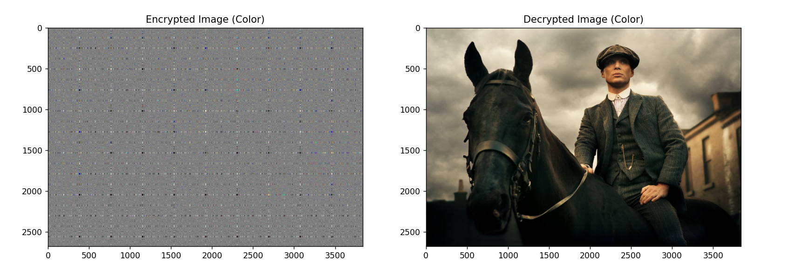
Encrypted and Decrypted image
Flow of Work
Encryption -
Image from user
Image to key generation
Confusion phase – Fibonacci-lucas transform
Diffusion phase - Tribonacci transform
Cipher image ( Encrypted image )
Decryption -
Inverse of encryption

Slide 19
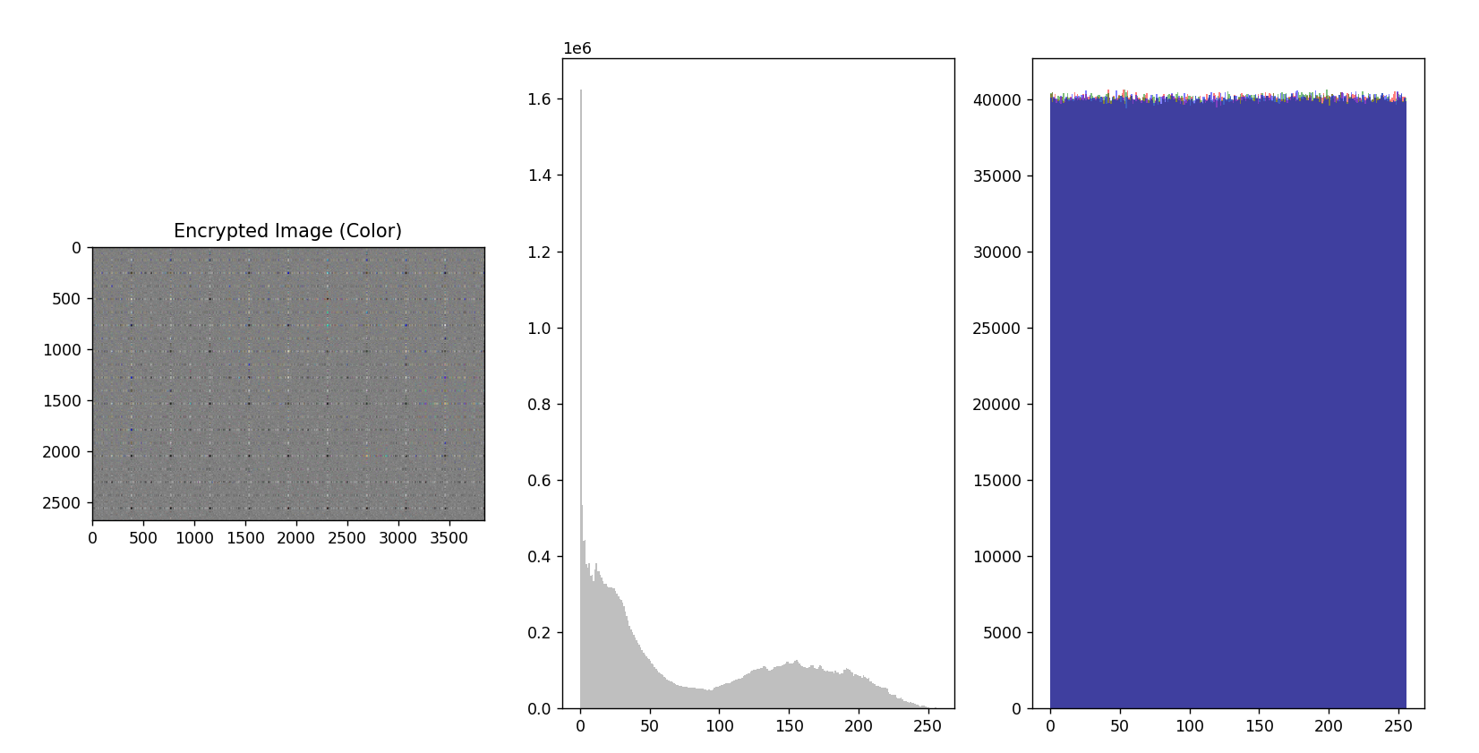
Histogram analysis
histogram analysis involves examining and visualizing the distribution of pixel intensity values in the original and encrypted images
Our proposed methodology showed excellent results for histogram analysis

Slide 20
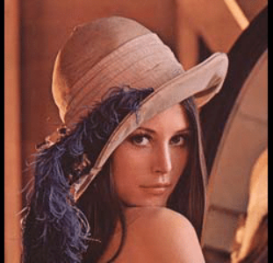
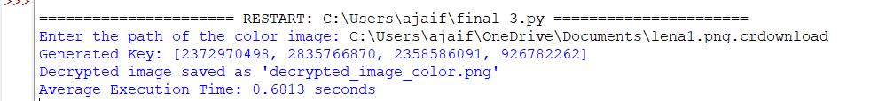
Time analysis
Performed in intel i5 11400H
8 GB ram
python
Lena.bmp
ALGORITHM | AVG TIME ( sec )
Fibonacci-Lucas transformation | 0.68
Arnold | 2.6047
Fibonacci | 2.2097
Poker Shuffle | 0.79689

Slide 21
Action plan
Work / Progress | Month
Literature review | Sep 2023
Implementation of work | 70 % of work – Feb 2024
Final report submission | March 2024
Results and Journal Publication | April – 2024

Slide 22
References
[1] Z. Hua, F. Jin, B. Xu, and H. Huang 2D Logistic-Modulated-Sine-Coupling-Logistic Chaotic Map for Image Encryption January 2019 PP(99):1-1 IEEE access
[2] C. Maiti ,B. C. Dhara Conference: 2018 Fifth International Conference on Emerging Applications of Information Technology (EAIT) 10 jan 2018
[3] R. K. Sinha et al ‘Advances in Computational Intelligence (pp.69-78)’ 11 jul 2019
[4] S. Kumar, B. Panna, R. K. Jha ‘Medical image encryption using fractional discrete cosine transform with chaotic function’international journal of information security 09 oct 2009
[5] C.-S. Lin C. Chen Y, c. Chen, ‘XOR-based progressively secret image sharing ’ IEEE Access (pp.66-76) 11 oct 2019
[6] A. Paul, S. Kandar, B.C.Dhara ‘Image encryption using permutation generated by modified Regula–Falsi method ’ IEEE transactions (pp-76-87) 21 jan 2022

