Slide 1
SECURE DATA HIDING IN IMAGES USING STEGANOGRAPHY
CAPSTONE PROJECT
Presented By:
Student Name : AJAI KUMAR M
College Name & Department : VIT UNIVERSITY & MCA

Slide 2
OUTLINE
Problem Statement
Technology used
Wow factor
End users
Result
Conclusion
Git-hub Link
Future scope

Slide 3
Problem Statement
The project "Secure Data Hiding in Images Using Steganography" focuses on embedding sensitive
information within images to ensure confidentiality. The goal is to develop a method that allows secure
transmission of hidden data without noticeable changes to the image. It should use encryption techniques
to enhance security and prevent unauthorized access. The system must ensure minimal distortion while
maintaining the image's visual integrity. This approach is useful for secure communication, digital watermarking
and covert data transfer.

Slide 4
Technology used
Library – cv2 library platforms – Python Idle (3.13 version)

Slide 5
Wow factors
I have created separate files for both encryption and decryption

Slide 6
End users
Those who are interested in the cybersecurity side can use this project for encrypt the secret data.

Slide 7
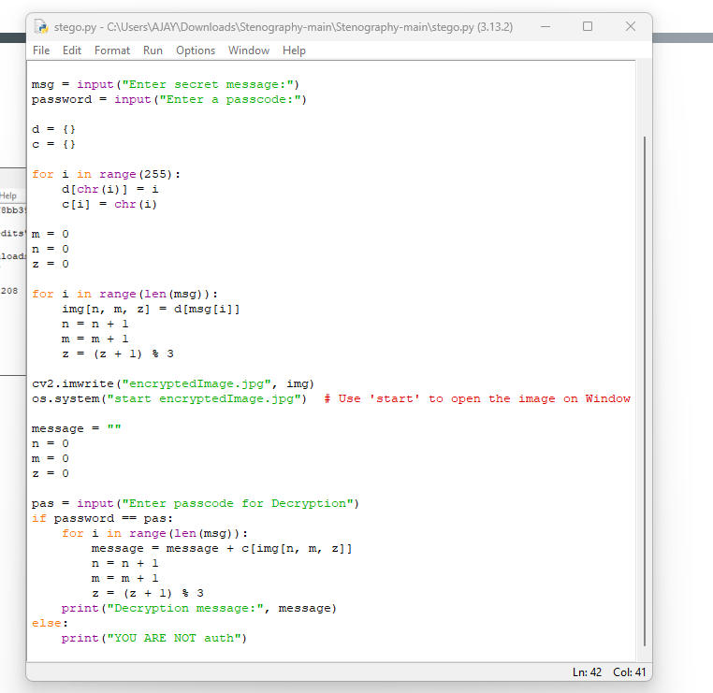
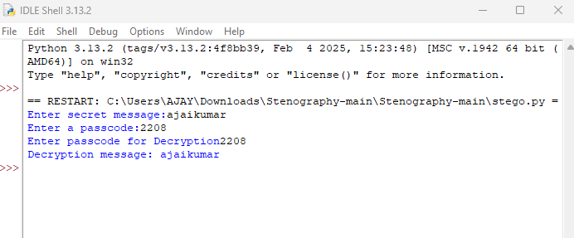
Results

Slide 8
Conclusion
Secure Data Hiding in Images Using Steganography provides an effective method for concealing sensitive
information within digital images. By leveraging advanced encoding techniques, the system ensures secure
communication while maintaining the visual integrity of the image.
The incorporation of encryption further enhances data security, preventing
unauthorized access or detection. This approach is highly useful in various fields, including confidential
communication, digital forensics,and watermarking. Overall, the proposed solution
demonstrates a reliable and efficient way to protect sensitive data from interception or tampering.

Slide 9
GitHub Link
https://github.com/Ajai2208/aicte-Steganography.git

Slide 10
Future scope(optional)
Advanced Encryption Integration – Combining steganography with stronger encryption algorithms
(e.g., AES, RSA) to enhance security and prevent unauthorized access.
AI-Based Steganalysis Detection – Developing machine learning models to detect and
prevent malicious use of steganography while ensuring secure communication.
Increased Capacity and Efficiency – Improving embedding techniques to store larger
amounts of data in images without compromising quality.

Slide 11
THANK YOU

