Slide 1
Hybrid Office Seat Booking System
Project USP
Project USP
Rule-first booking engine (not UI-only validation)
Prevents conflicts using DB constraints + transaction locking
Dynamic floating capacity from released designated seats
Corporate, production-style UI with clear policy feedback
80 Employees
50 Seats
2 Batches
10 Squads
Corporate Internal Tool Demo

Slide 2
Architecture and Flow
Seat Booking System
How it works
Frontend
React
Frontend (React + Tailwind) captures user actions.
Backend validates weekly rotation and booking eligibility.
PostgreSQL enforces one-seat-per-user/day and seat conflict prevention.
Release action converts seat to temporary floating capacity.
APIs return policy context, not only raw seat lists.
Backend
Node/Express
Database
PostgreSQL
Corporate Internal Tool Demo

Slide 3
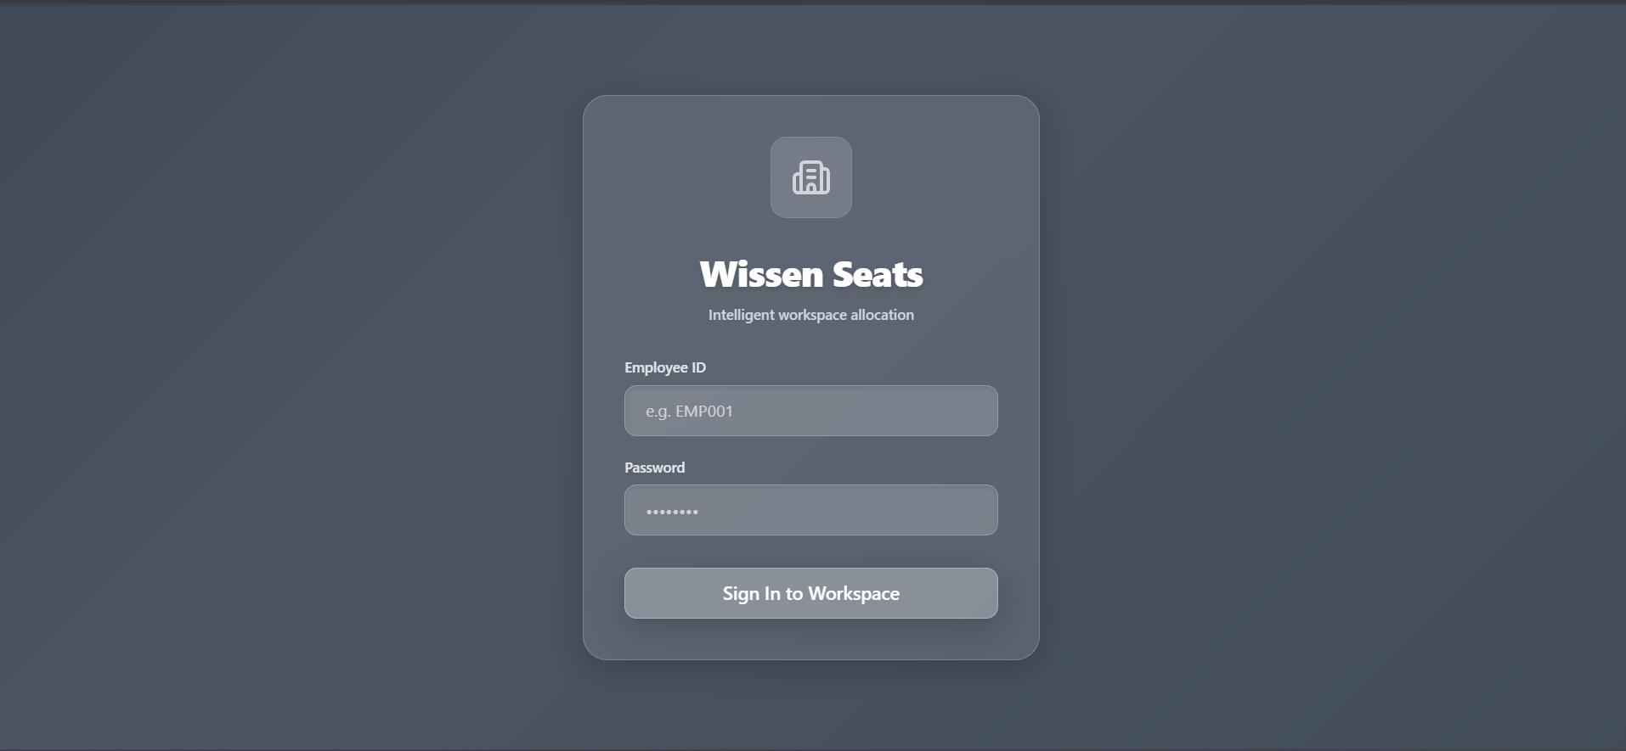
Screen 1: Secure Login
Seat Booking System
What this screen demonstrates
Simple employee authentication flow.
JWT-based backend login API.
Clean, internal-tool visual style.
Fast access to protected booking features.
Foundation for role-based access (Admin/Employee).
Corporate Internal Tool Demo

Slide 4
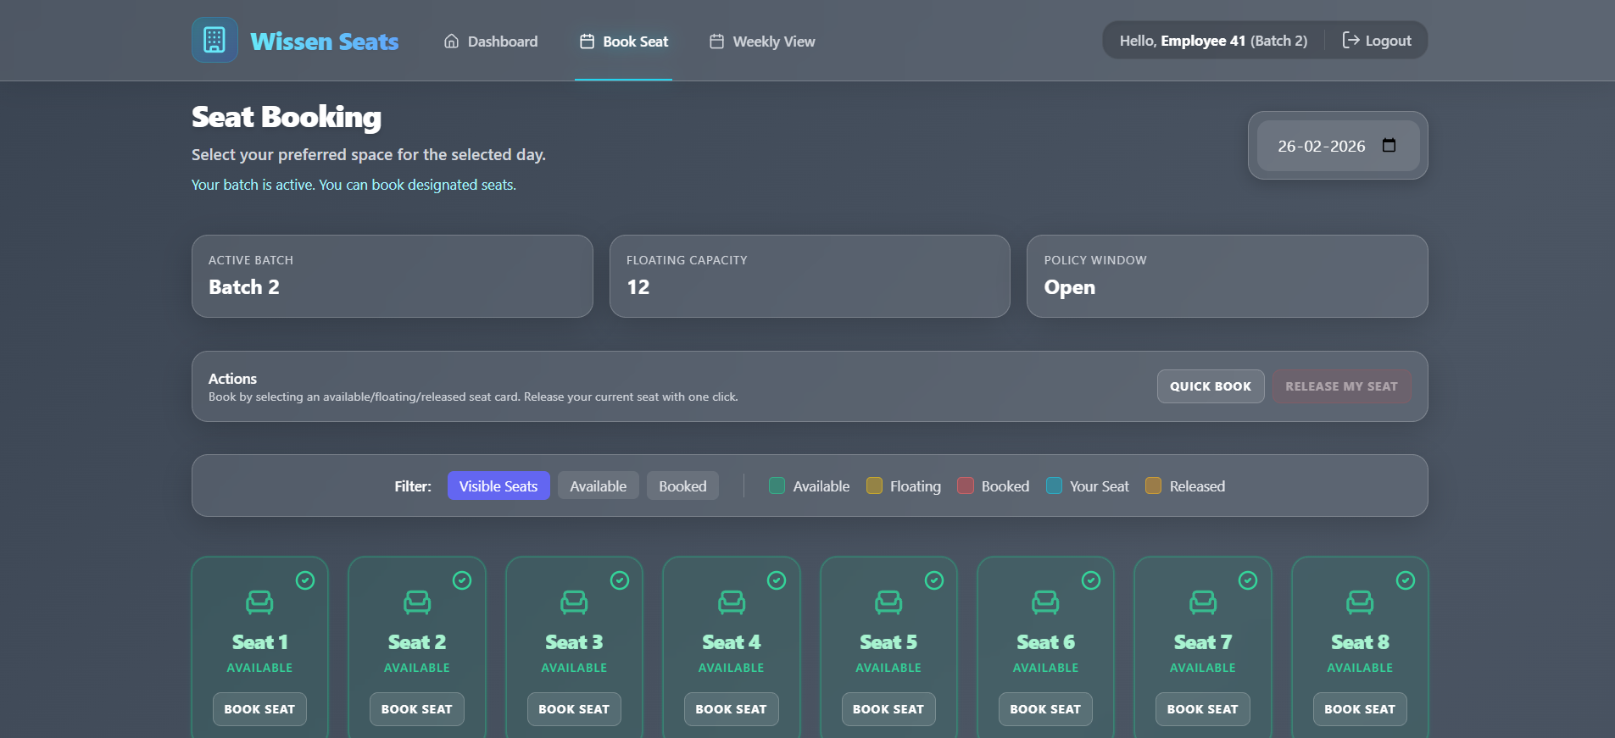
Screen 2: Dashboard Intelligence
Seat Booking System
Why it matters
Shows active batch and current rotation context.
Displays seat and floating capacity indicators.
Highlights actionable policy summary for users.
Includes quick booking/release navigation.
Provides real-time operational clarity.
Corporate Internal Tool Demo

Slide 5
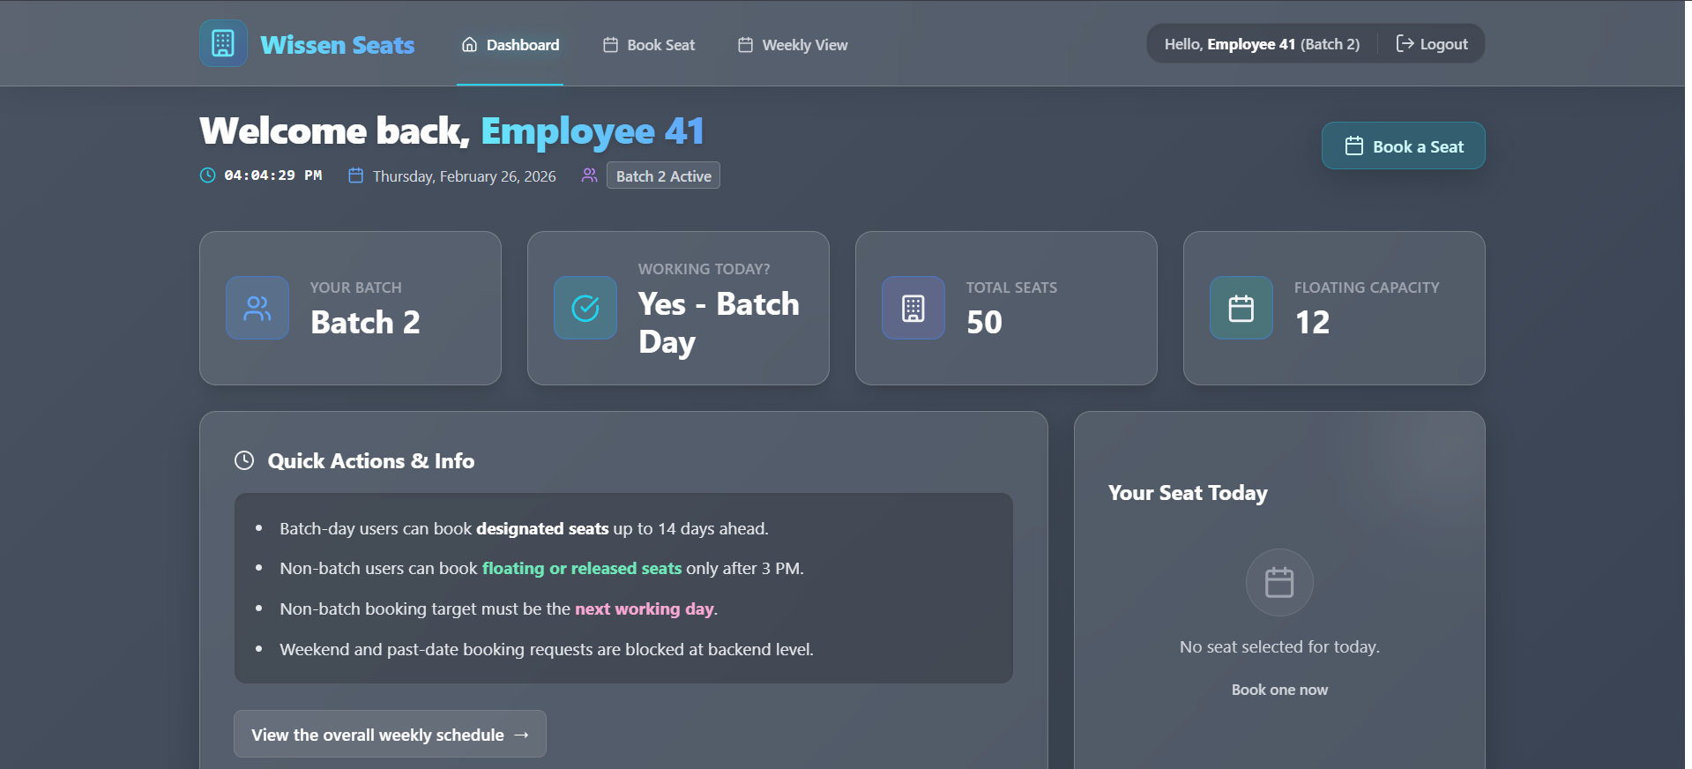
Screen 3: Rule-Based Seat Booking
Seat Booking System
Key capabilities
Seat statuses: available, floating, booked, your seat, released.
Policy window awareness (batch-day vs non-batch-day).
One-click quick book and release options.
Backend-driven seat visibility filtering.
Invalid actions blocked with clear user feedback.
Corporate Internal Tool Demo

Slide 6
Outcome and Next Steps
Seat Booking System
Delivered
Thank You
Questions?
Complete frontend + backend integration.
All critical booking rules enforced server-side.
Transaction-safe booking and release workflow.
Reusable architecture ready for scale.
Seat Booking System | Demo Complete

