Slide 1
Veritas Bank Project
Analyzing Customer Churn and Retention Patterns
Data Analytics Internship Project

Slide 2
Project Overview
Client: Veritas Bank (UK, Germany, France)
Objective: Analyze customer churn drivers and retention strategies
Tools: SQL Server, Power BI, Excel
Focus: Risk segmentation, behavior analysis, and dashboard insights

Slide 3
Objectives
Identify key drivers of customer churn
Segment customers based on risk levels
Visualize insights through dynamic dashboards
Provide data-driven recommendations for retention

Slide 4
Data Sources
Dim_Customer: Demographics (Country, Gender, Age)
Fact_Account: Financial metrics (CreditScore, Balance, Products, Tenure)
Data Volume: ~10,000 records across multiple regions

Slide 5
Data Cleaning & Preparation
Handled missing values and outliers
Ensured referential integrity (CustomerId joins)
Derived calculated columns (e.g., RiskSegment, BalanceSegment)
Created optimized SQL views for Power BI

Slide 6
Churn Segmentation Logic
RiskSegment view created based on account behaviors:
- Very High Risk: Low balance, inactive, 1 product
- High Risk: Moderate balance, inactive
- Moderate to Very Low Risk: Based on balance and product mix
Improved stakeholder targeting by risk category

Slide 7
Key Metrics & KPIs
Churn Rate (%)
Customer Lifetime Value (CLTV)
Average Tenure
Balance Segmentation (Very Low to Very High)
Active vs Inactive Member Analysis

Slide 8
Power BI Dashboard Walkthrough
Interactive filters (Country, Gender, RiskSegment)
Churn trends and drill-through analysis
Balance segmentation visuals
Customer profile insights for decision-making

Slide 9
Insights & Recommendations
High churn risk in customers with low balance and inactivity
Targeted re-engagement for moderate-risk customers
Enhance product offerings for long-tenure customers
Use segmentation for personalized communication

Slide 10
Business Impact & Next Steps
Enhanced visibility into customer churn dynamics
Supports data-driven decision making
Next Steps: Integrate more channels, track campaign ROI, automate churn prediction

Slide 11
Key SQL Views Explained
vw_ChurnByDemographics – Groups customers by age and gender to analyze churn.
vw_ChurnByCreditScore – Buckets credit scores from Poor to Excellent.
vw_CustomerRiskSegments – Tags customers as High, Medium, or Low risk.
vw_EnhancedChurnSegmentation – Adds deeper risk: Very High to Very Low.
vw_ChurnByCountryAgeGroup – Shows churn by country and age group.
vw_CreditCardImpact – Compares churn by card ownership.
vw_HighValueCustomers – Identifies loyal, high-value clients.

Slide 12
Dashboard Visuals Simplified
Customer Dashboard – Demographics and balance/credit segments.
Churn Dashboard – Risk profiles and churn patterns by age/country.
KPI Cards – Quick view of totals, risk counts, churn rate.
Charts – Who’s leaving, from where, and in what risk group.

Slide 13
Appendices

Slide 14
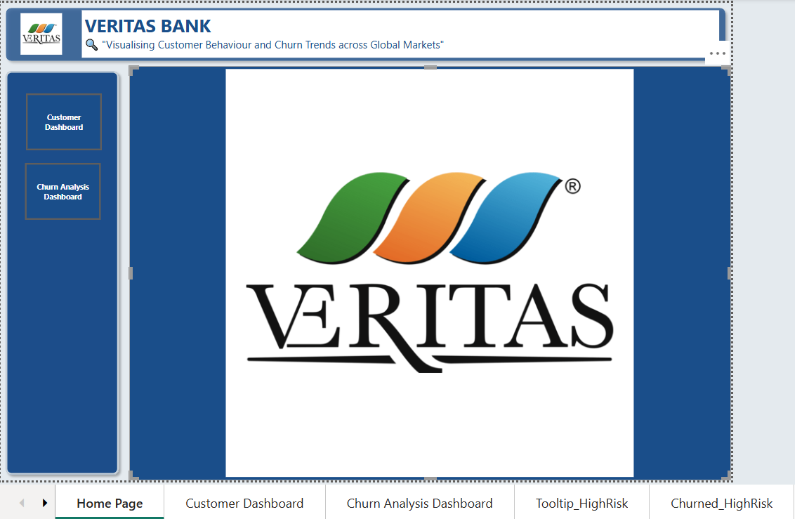

Slide 15
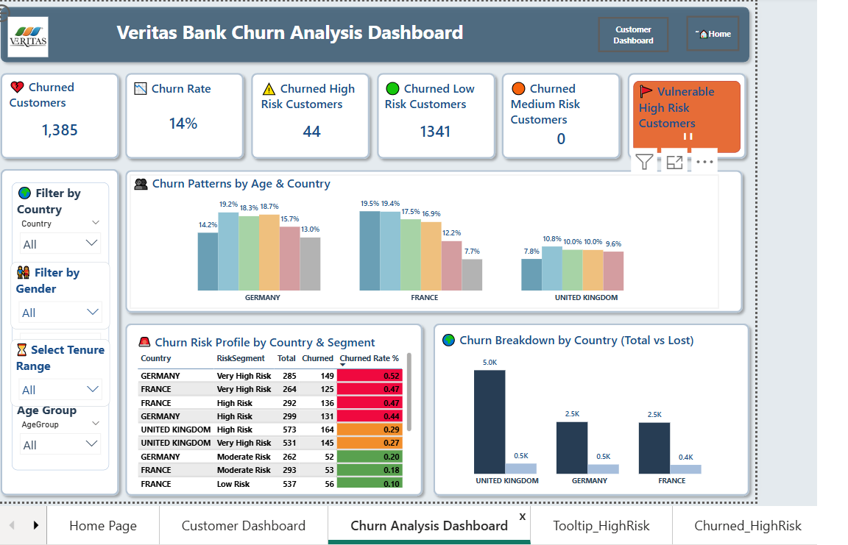

Slide 16
