Slide 1


Athletes who go beyond
By Jarlin Almanzar

Slide 2
Position: Athletes have the better GPA than non-athletes
OBJ: Prove why athletes have a higher GPA than non-athletes
Note: Athlete is defined as someone with athletic ability > 5
Use either Z-test or permutation test
Source provided by Rutgers Data 101 course
SRC: https://sakai.rutgers.edu/access/content/attachment/0c55f23a-8b8f-4f96-9135-a2c2b230ea01/Assignments/e4ad4fb5-4ced-4ae0-b9af-c1ffcfd35b69/Athlete_GPA_Final.csv
For the Data I added a new Column which shows who’s an athlete and a non-athlete .
The mean GPA for all schools is: 1.881568
Athlete_GPA_Final$Status<-NA
> Athlete_GPA_Final$Status<-ifelse(Athlete_GPA_Final$Athletic_Ability>5, "Athlete", "Non-Athlete")

Slide 3
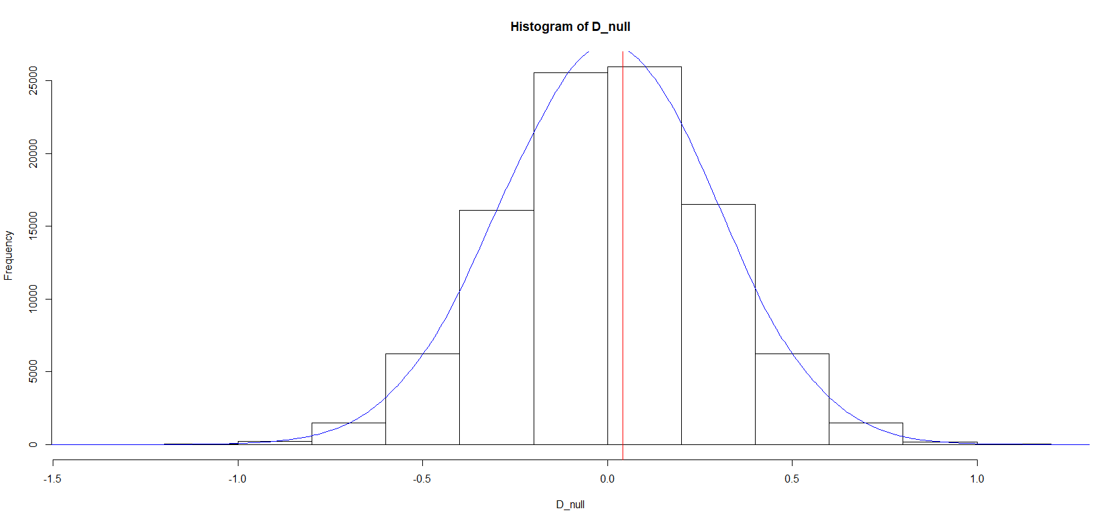
Permutation Test
Based on the Permutation test we did below we get .44705 by removing the colleges that have barely to no athletes.
As such passed of that value we can say that’s there is very weak evidence against Athlete having higher GPA than non-Athletes.
Since .45 =>.1, weak evidence against the H0
AGF.stat<-subset(Athlete_GPA_Final, School!="Michigan)
> AGFF.stat<-subset(AGF.stat, School!="Penn State")
> View(NonAt.GPA)
> View(AGFF.stat)
> View(AGFF.stat)
> PermutationTestSecond::Permutation(AGFF.stat, "Status", "GPA", 100000, "Athlete", "Non-Athlete")
[1] 0.44705

Slide 4
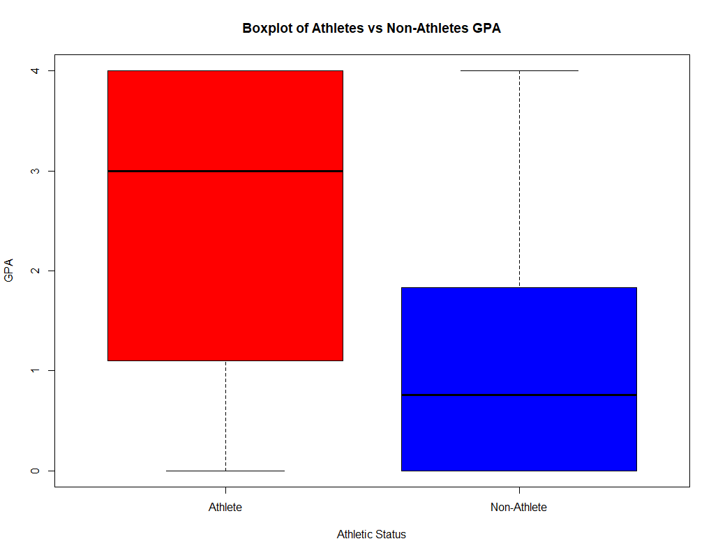
Boxplot of Athletes vs Non-Athletes GPA
As we can see here there is generally a higher median and lower-quartile in the Athletes GPA.
It shows that the general amount of Athletes have a better GPA than Non-Athletes.
boxplot(Athlete_GPA_Final$GPA~Athlete_GPA_Final$Status, xlab='Athletic Status', ylab='GPA', main='Boxplot of Athletes vs Non-Athletes GPA', col = c("red","blue"))

Slide 5
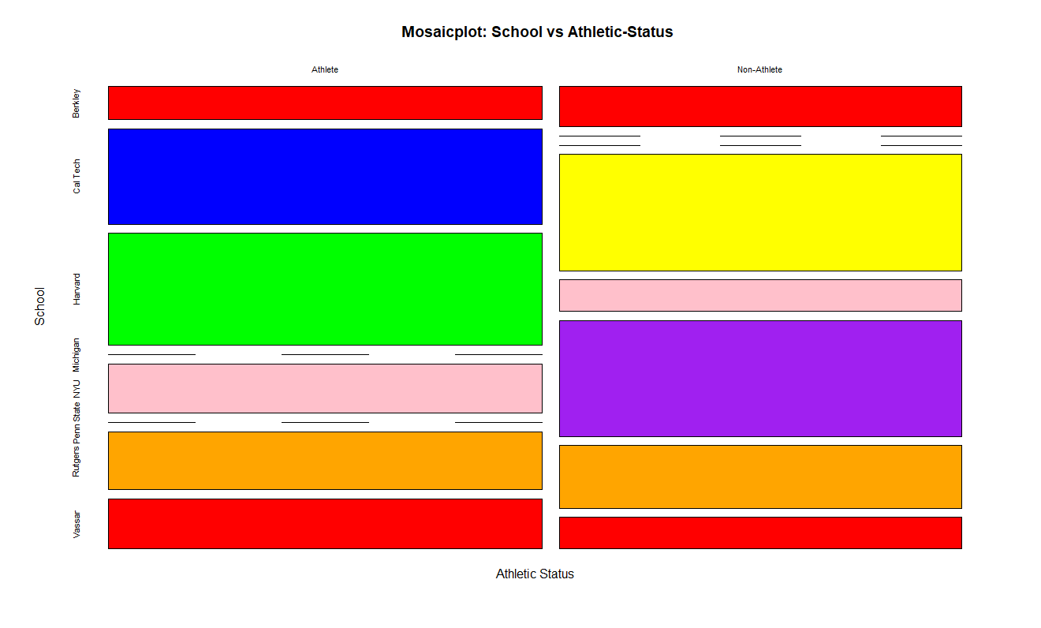
Colleges vs Athletic-Status
Colleges that are more difficult to get into generally have more athletes than non-athletes.
For example, Harvard here generally has more Athletes than other school while being a school who has an acceptance rate: 5.4% (2016, src:google)
Showing that athletes excel at their education
totals=table(Athlete_GPA_Final$Status, Athlete_GPA_Final$School)
mosaicplot(totals, ylab='School', xlab='Athletic Status', main=" Mosaicplot: School vs Athletic-Status", col= c("red","blue","green","yellow", "pink", "purple", "orange"))

Slide 6
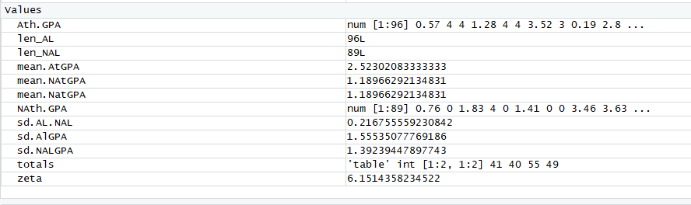
Conclusion
Athletes generally have a higher GPA than non-athletes as they are to their sports and to be on the team you have to maintain a high GPA
Athletes are generally accepted more in prestigious colleges than Non-athletes, places that require higher GPA and merits than other common colleges
Eliminate Schools who don’t really any to no athletes and you have a wider gap between the GPA of Athletes and Non-Athletes
> At.GPA<-subset(Athlete_GPA_Final, Athletic_Ability>5)
NonAt.GPA<-subset(Athlete_GPA_Final, Athletic_Ability<=5)
Ath.GPA<-At.GPA$GPA >
NAth.GPA<-NonAt.GPA$GPA
> mean.AtGPA<-mean(Ath.GPA)
> mean.NAtGPA<-mean(NAth.GPA)
> sd.AlGPA<-sd(AtGPA)
> sd.AlGPA<-sd(AtGPA
> sd.AlGPA<-sd(Ath.GPA)
> sd.NALGPA<-sd(NAth.GPA)
> len_AL<-length(Ath.GPA)
> len_NAL<-length(NAth.GPA)
> sd.AL.NAL<-sqrt(sd.AlGPA^2/len_AL + sd.NALGPA^2/len_NAL)
> zeta<-(mean.AtGPA - mean.NAtGPA)/sd.AL.NAL
> zeta [1] 6.151436

