Slide 1


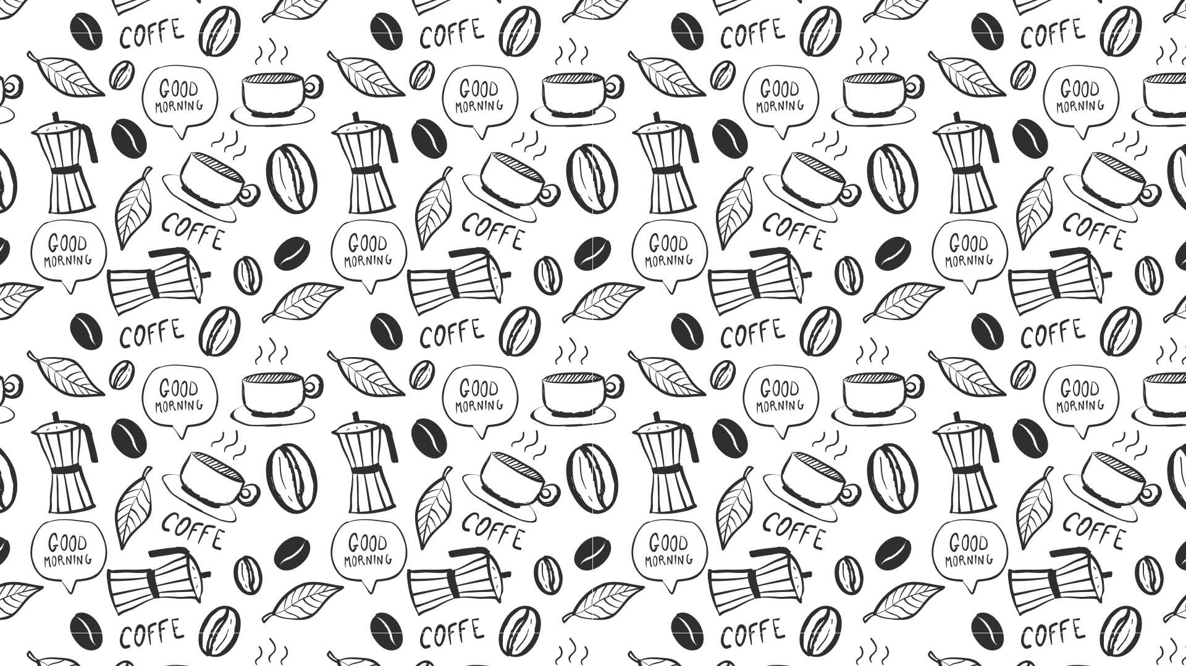



Data Puzzle: What sells Together?
By Jarlin Almanzar
INVESTOR OPPORTUNITY

Slide 2
About the Data
The data contains transactions based on what customers purchased and are represented by 1 bought vs 0 did not buy
Objective:
Analyze which parts of the data go together, as in do people buy 1 item with another most of the time.
We will run permutation tests to see if there’s a significant association between items.
The data is provided by Rutgers Data 101 Class:
URL:https://sakai.rutgers.edu/access/content/attachment/0c55f23a-8b8f-4f96-9135-a2c2b230ea01/Assignments/57ede549-8441-47fd-851f-2ee351ccec7f/WALMART1.csv

Slide 3
A Start for Data
Where to start:
So for my first set of data I simply did a table command in RStudios, using SODA as my main variable.
The table provides my an easy truth table which tells me when both are bought, and as we can see there’s certain product bought with soda than others.
These two products are Steak and Cookies, products who are both above 2500 while the rest are below are closer to 2400.
Based on this I will take a permutation test seeing if its significant by comparing the highest(Cookies) to the lowest(Fish).
> table(WALMART1$SODA, WALMART1$STEAK) 0 1 0 2415 2344 1 2419 2503 > table(WALMART1$SODA, WALMART1$FISH) 0 1 0 2315 2444 1 2522 2400 > table(WALMART1$SODA, WALMART1$COFFEE) 0 1 0 2405 2354 1 2471 2451 > table(WALMART1$SODA, WALMART1$TEA) 0 1 0 2398 2361 1 2498 2424 > table(WALMART1$SODA, WALMART1$SALT) 0 1 0 2420 2339 1 2505 2417 > table(WALMART1$SODA, WALMART1$COOKIES) 0 1 0 2419 2340 1 2380 2542

Slide 4
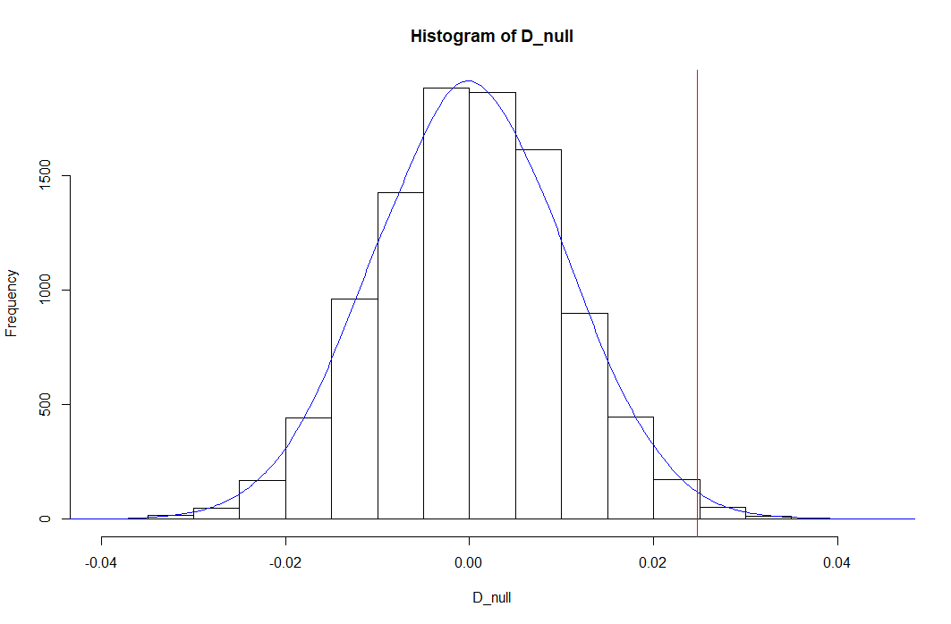
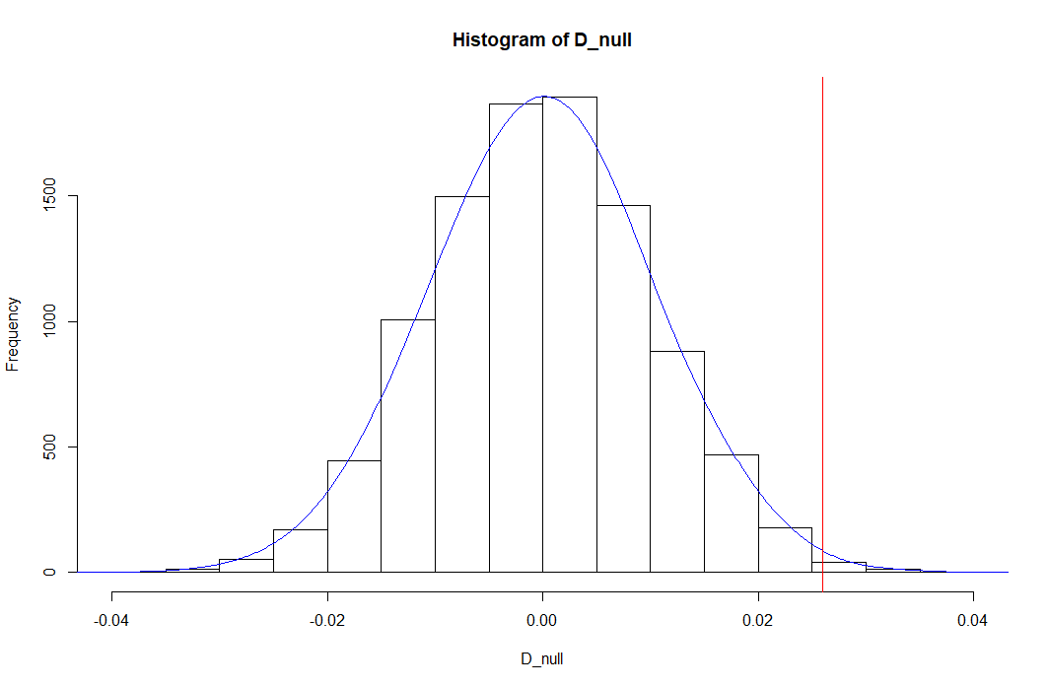
Permutation Tests: Is it significant?
After running the permutation test 10000 times we get the following:
For Soda with Cookies:
.0077
For Soda with Fish:
.0037
Both are under .05 which indicates that the test is significant.
PermutationTestSecond::Permutation(WALMART1, "SODA", "COOKIES",10000,"1", "0")
[1] 0.0077
> PermutationTestSecond::Permutation(WALMART1, "SODA", "FISH",10000,"1", "0") [1] 0.0037

Slide 5
The Bigger Picture
Things that don’t blend together:
For this part of the data, I used tables again to using Coffee as my main variable where I try to items bought together.
For this one, I assumed that salt would be bought the less with coffee. As coffee goes together with sugar more.
It also shows that the most bought is Cookies and soda, showing that this can possibly be used for party or buying drinks in general.
As such I will compare these two with a permutation test.
> table(WALMART1$COFFEE, WALMART1$TEA) 0 1 0 2493 2383 1 2403 2402 > table(WALMART1$COFFEE, WALMART1$SODA) 0 1 0 2405 2471 1 2354 2451 > table(WALMART1$COFFEE, WALMART1$STEAK) 0 1 0 2438 2438 1 2396 2409 > table(WALMART1$COFFEE, WALMART1$FISH) 0 1 0 2434 2442 1 2403 2402 > table(WALMART1$COFFEE, WALMART1$COOKIES) 0 1 0 2421 2455 1 2378 2427 > table(WALMART1$COFFEE, WALMART1$SALT) 0 1 0 2502 2374 1 2423 2382 >

Slide 6
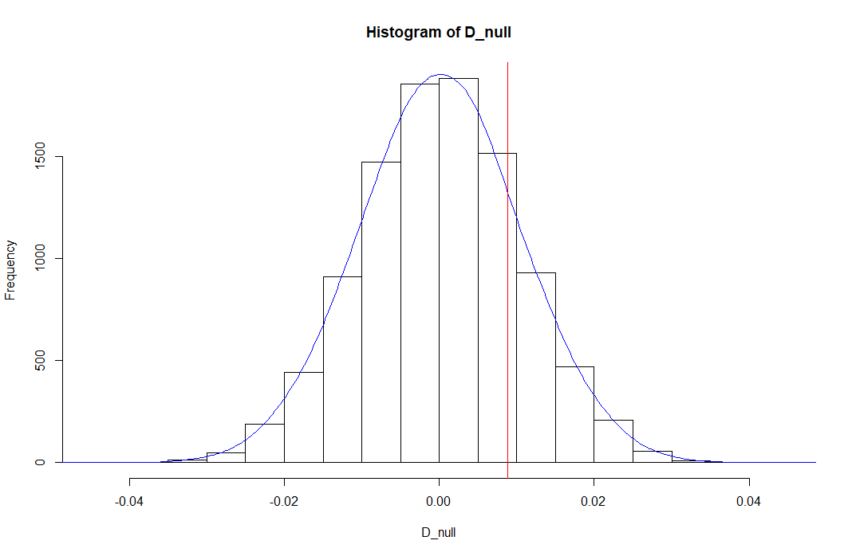
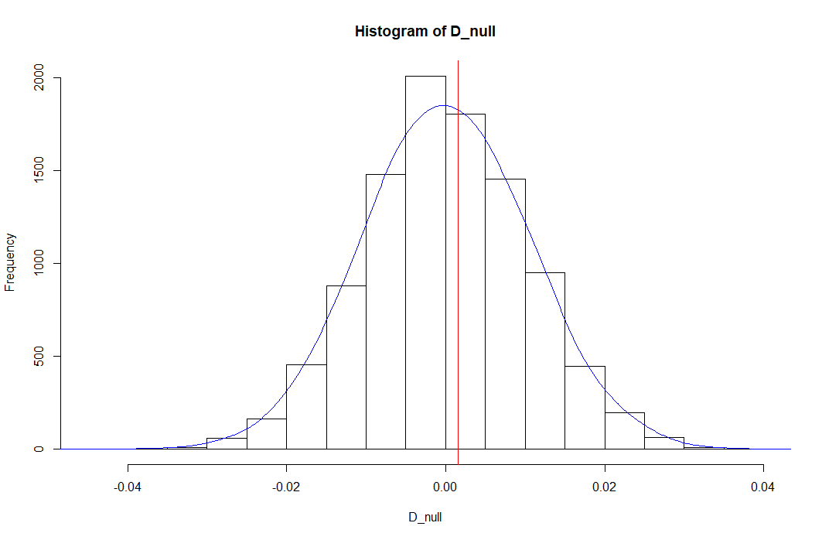
Permutation test: Against each other
So for my permutation test I chose the one of the highest selling along side Coffee(cookies) and the lowest selling to test(Salt).
For the permutation tests we get:
Coffee and Salt:
.187
Coffee and Cookies:
.4297
Both values are above .05 which indicates that weak evidence against the null hypothesis. It also shows that the test is not significant.
PermutationTestSecond::Permutation(WALMART1, "COFFEE", "SALT",10000,"0", "1")
[1] 0.187
PermutationTestSecond::Permutation(WALMART1, "COFFEE", "COOKIES",10000,"0", "1")
[1] 0.4297

Slide 7
Conclusion
Foods that needs each other?
In common sense when it comes to buying stuff, you usually buy something that goes along with it. For example if you buy food you usually buy sauce with it. A common example is pancakes with syrup or steak with soda for a cookout. For this data you can assume the type of food that goes together so the data item I selected for my plots were based on my assumptions. As such I chose soda and assumed that people bought soda more with Cookies(party) and steak(cookout/dinner)
Why get this with that?
Buying certain food makes it so you don’t need to buy other foods. For example for someone who will buy coffee why would they buy salt? As such a item signifies that someone would likely buy an item related to that so instead of salt for coffee it would be sugar.
All in All
The permutation tests shows us that some data can be significant and some not but it doesn’t really prove the that the some items are bought together as much. As many of the sales are in range about 200. As nothing really goes above about 2600 and below 2300. As such a lot of purchases being together is likely by chance while a few are not.

