Slide 1

Video Game Sales
BY: Jarlin Almanzar
Notes:
To change the image on this slide, select the picture and delete it. Then click the Pictures icon in the placeholder to insert your own image.

Slide 2
The Video game industry its rapid growth
Video games were created less than a century ago(1947) and have grown to become an industry bigger than even the film industry.
Which individuals are making the biggest sales, and what system has made huge sales?
Data obtained from Kaggle https://www.kaggle.com/gregorut/videogamesales/data

Slide 3
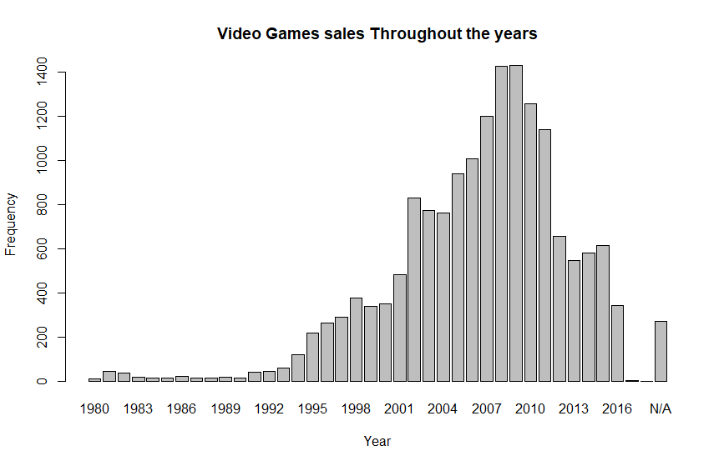
Game Sales History (as of 2016)
barplot(table(vgsales$Year), ylab='Frequency', xlab='Year', main='Video Games sales Throughout the years')
Video Game sales from
1980 - 2016
barplot(table(vgsales$Year), ylab='Frequency’, xlab=‘Year’ main='Video Games sales Throughout the years')

Slide 4
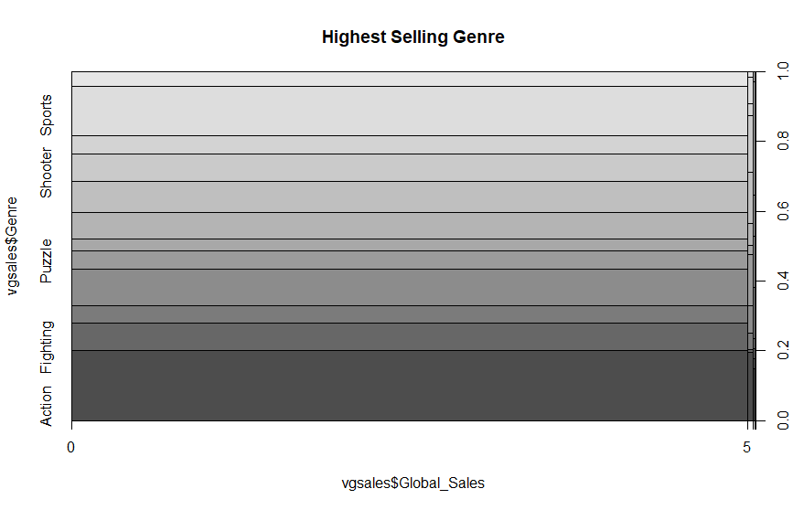
Best Selling Genre
When it comes to selling Games, Some genres sell much more
plot(vgsales$Genre~vgsales$Global_Sales, main="Highest Selling Genre")

Slide 5
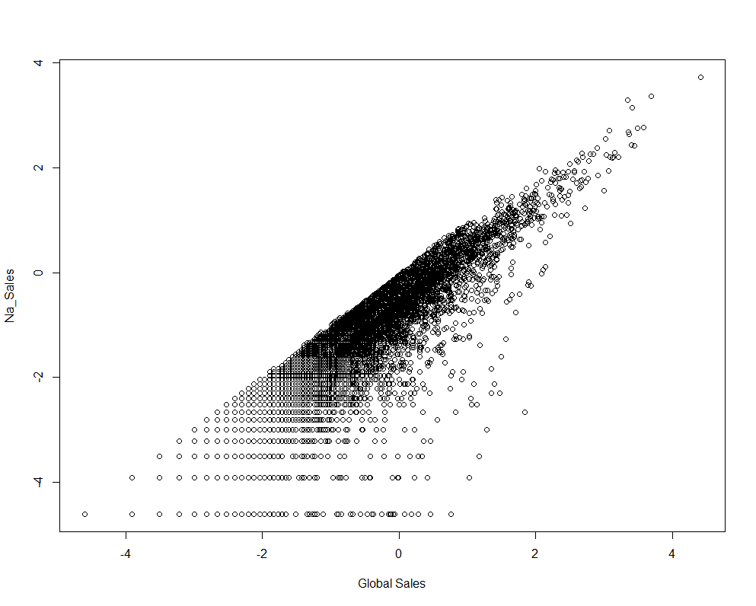
Na’s impact on sales
NA sales compare to global Sales
plot(log(vgsales$Global_Sales), log(vgsales$NA_Sales), xlab='Global Sales', ylab='Na_Sales')

Slide 6
Conclusion
Video game sales are not as big as they were back in the (wii, ps3, and 360 era).
North America Buys the most amount of games even though their population is less than the EU’s
Best game publisher is Nintendo and the best selling Genre is Action

