Slide 1
Prediction Challenge 1
By Jarlin Almanzar

Slide 2
About our Prediction
About: Predict the grades in the testing file and add it to GRADE attribute with predicted grades.
For this program I have multiple files to use:
Testing, Training, and submission example
I will use training to figure out a good approximation to use for my testing method.
Can’t use Rpart
Data provided by Rutgers Data 101 class.
The code used for prediction is code provided by the professors example

Slide 3
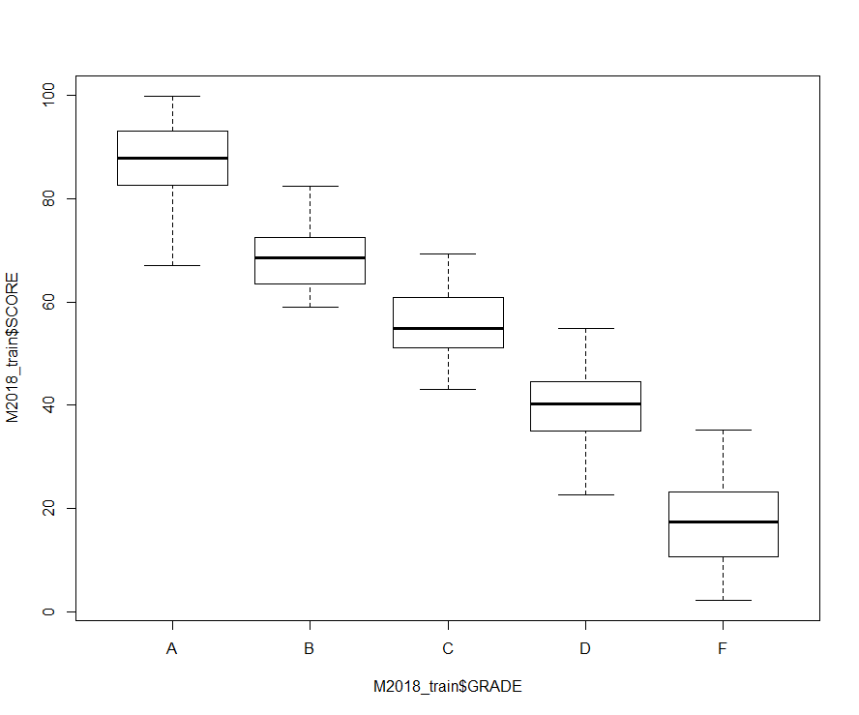
Training Data
I decided to make a starting point to figure out a good range for my dataset. By starting for grades in general and than making a subset of data.
Based of this data we can see a general range of where the grades are.
Such as F being around 30 and below, D around 30 to 48, C around 42 to 58, B around 62 to 75, and A around 80 and above.
However these ranges seem to broad. I will try a different plot to see how it will look like.
plot(M2018_train$SCORE~M2018_train$GRADE)

Slide 4
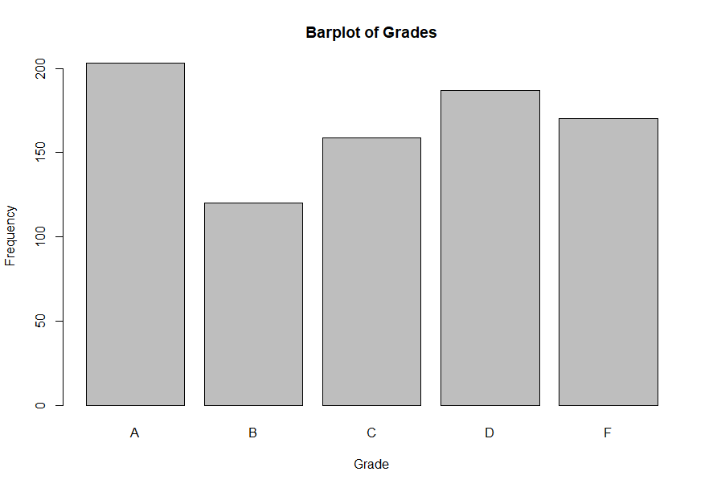
Training Data pt.2
So looking our Bar-plot we see the frequency of each grades.
The most common are A’s, next is D, following C, F , and B
I notice that B is the lowest frequency amongst all the grades. So I am assuming that it has the least standard deviation from it scores because it is the one with smallest frequency.
barplot(table(M2018_train$GRADE), ylab="Frequency", xlab="Grade", main="Barplot of Grades")

Slide 5
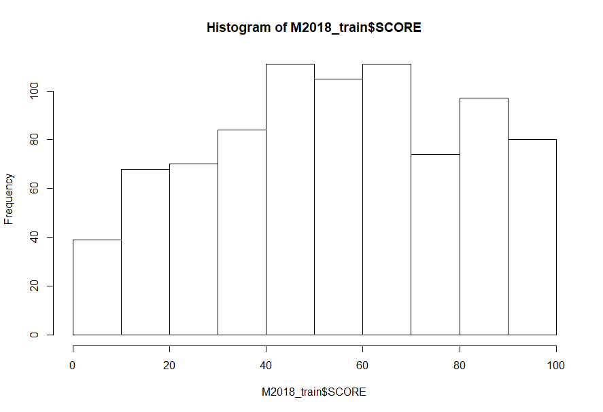
Training Data pt.3
So from our previous, we can see that B has the smallest frequency and as such I'm assuming the grades are really close to each other compare to the other grades.
We can also see from the plot that the outliers and general grades for B are really close to each other compare to the other Grades.
From our data the lowest B score is 59.01 and the highest B grade is 82.37
I created a subset of our B data and was able to figure where the general value of B is located.
Around the 40+ to 70-
With this I Decided to start applying values around this and found some interesting numbers.
sub <-subset(M2018_train, GRADE=="B")
View(sub)
hist(M2018_train)
> hist(M2018_train$SCORE)

Slide 6
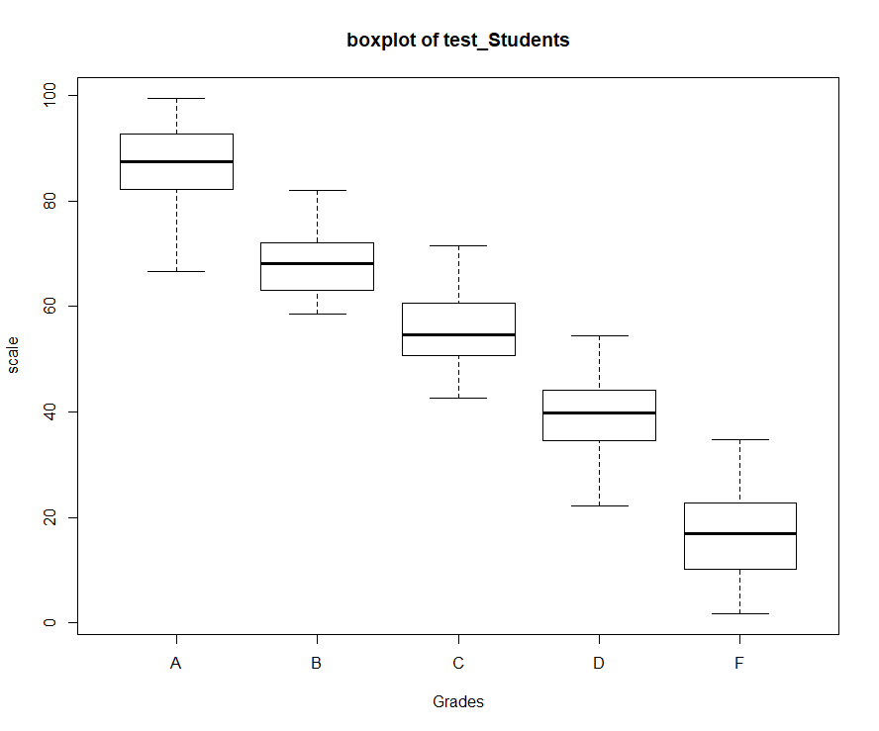
Testing Prediction
A B C D F
203 119 160 187 170
> summary(test)
SCORE GRADE DOZES_OFF TEXTING_IN_CLASS PARTICIPATION
Min. : 1.78 A:203 always :284 always:298 Min. :0.000
1st Qu.:33.64 B:119 never :264 never :284 1st Qu.:0.130
Median :53.47 C:160 sometimes:291 rarely:257 Median :0.270
Mean :53.51 D:187 Mean :0.404
3rd Qu.:73.94 F:170 3rd Qu.:0.690
Max. :99.44 Max. :1.080
> boxplot(test$SCORE~test$GRADE, main="boxplot of test_Students", xlab="Grades", ylab="scale")
> myprediction<-test
> decision <- rep('F',nrow(myprediction))
> decision[myprediction$SCORE>30] <- 'D'
> decision[myprediction$SCORE>52] <- 'C'
> decision[myprediction$SCORE>59] <- 'B'
> decision[myprediction$SCORE>73] <- 'A'
> myprediction$GRADE <-decision
> test$Projection <-decision
> error <- mean(test$GRADE!= myprediction$GRADE)
> error
[1] 0.1942789
After testing out various things in the training data set
I was able to see common patterns in the data. For example many students who ranged from B in the histogram had a general score of 60-75.
With that I Set my A above 75.
C as 50 or 20 away from C.
And D 20 away from C.
From there I started testing points a couple of points away from my assumption to try to get the smallest error.

Slide 7
Conclusion
After checking out our data, I Based of my adjustment mostly of B scores. From the B score assumption, I was able to achieve a low error of .1942789 or around 20%.
This was the smallest I can after moving the numbers away by a couple of digits
The scores are likely to be accurate based off what we are applying for correction.

